Slide 1


Slide 2
Why python?
Statistical analysis
Complex data transformations
ex. hashing, grouping
Data visualization
Bioinformatics-specific libraries
ex. NCBI entrez, Biopython
V e r s a t i l e
Machine learning & AI
File parsing & manipulation
Extract summary stats
Build GUIs or web apps

Slide 3
Outline
Data types
Data structures
Indexing
Reading and writing files
Iterators
Pandas
Installing python

Slide 4
Glossary
Term | Meaning | Example
Variable | Name that stores a value | species = "E. coli”
Iterator | Code that lets you go through items one at a time | for gene in ["lacZ", "recA", "rpoB"]: print(gene) Output: lacZ recA rpoB
Function | Reusable block of code that performs a specific task | len() ⟹ gives the length of whatever’s in the parenthesis

Slide 5
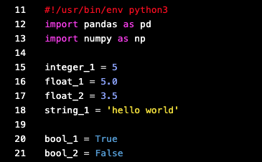
Data types
Integers
Whole numbers
Floats
Numbers with decimals
Strings
Sequence of characters
Bool
Conditional statement

Slide 6
Data structures
Lists
Ordered list of data
Can contain numbers, characters, or variables
Dictionaries
Consists of key:value pairs
Can retrieve value based on key
Can’t have duplicate keys
Lst = [1, 2, 3, “ABC”, 5.4, 1]
d = {“cat”: “mouse”, “lion”: ”zebra”}
Sets
Unordered collection of data
No duplicates
Tuples
Immutable sequnce of data
S = (1, 2, 3, “ABC”, 5.4)
Tup = (“dog”, “cat”, ”bird”)

Slide 7
Indexing
Everything is 0-indexed in python
List = [ 1, 2, 3, 4.0 ]
Index:
0
1
2
3

Slide 8
Reading and writing files
Advice
Briefly inspect file manually before you start to parse it
Note the number of fields if working with CSV or TSV files
Note any repeating characters (e.g. a > in a FASTA header)

Slide 9
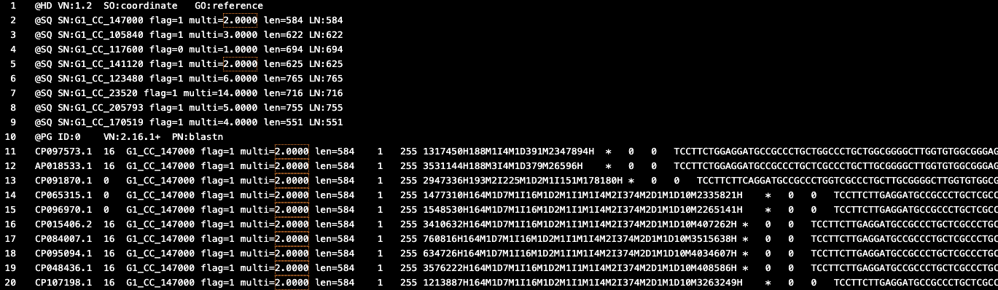
Reading and writing files
SAM file format
9 header lines
…
140 tab-separated lines containing biological data

Slide 10
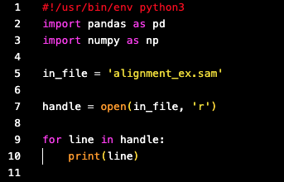
Reading and writing files
Step 1. Create a variable that stores the input file path
Step 2. Create a variable that stores the file handle
Step 3. Open the input file with the built-in function open()
Step 4. Iterate over the contents of the file to parse the data

Slide 11
Reading and writing files
Step 1. Create a variable that stores the input file path
Step 2. Create a variable that stores the file handle
Step 3. Open the input file with the built-in function open()
A file handle is a way to “hold onto” an open file so you can read from it or write to it. It doesn’t contain the contents of the file—it’s just a way to access and control the file.

Slide 12
Reading and writing files
The open() function takes 2 arguments:
Input file path
Whether you want to read or write to the file.
‘r’ means you want to read the file (input file)
‘w’ means you want to write the file (output file)
Step 1. Create a variable that stores the input file path
Step 2. Create a variable that stores the file handle
Step 3. Open the input file with the built-in function open()
Step 4. Iterate over the contents of the file to parse the data

Slide 13
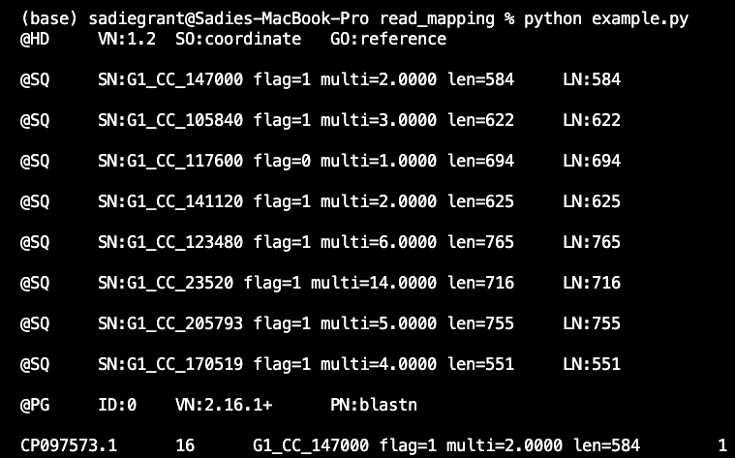
Reading and writing files
Output
Step 1. Create a variable that stores the input file path
Step 3. Open the input file with the built-in function open()
Step 2. Create a variable that stores the file handle
Step 4. Iterate over the contents of the file to parse the data

Slide 14
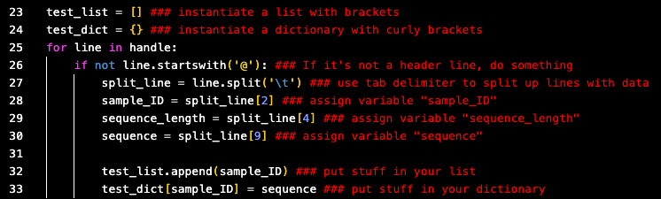
Iterators

Slide 15
Iterators

Slide 16
Iterators
Conditional statement

Slide 17
Iterators
Parse file:
split_line[2]
split_line[4]
split_line[9]
Index: 0
1
2
3
4
5
6
7
8
9

Slide 18
Iterators
Parse file:
Add to list or dictionary:

Slide 19
Pandas
Good for data frame manipulation
For parsing/manipulating files that have columns and rows
Excel but if we gave it cocaine

Slide 20
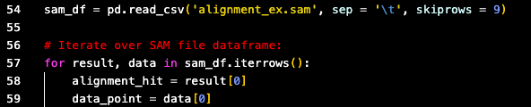
Pandas
Specify delimiter if not a comma
Indicate number of header lines to skip
Read file in as a data frame

Slide 21
Pandas

Slide 22
Installing python

Slide 23
VS Code
Integrated Development Environment (IDE): app that combines terminal, file system explorer, and python file editor
Download

Slide 24
Virtual environments
Advantages:
Don’t fuck up your computer
Manage versions of python & packages (e.g., pandas)
Version of python will affect everything
Some softwares require python2 and others python3.420

Slide 25
Virtual environments
$python -m venv my_venv
Name of virtual environment
Python is already installed on your computer if you have a Linux operating system (OS)

Slide 26
Virtual environments
$python -m venv my_venv
Name of virtual environment
Activate environment:
$source my_venv/activate
Now you’re in it and you can install your desired version of python

Slide 27
Installing python
$sudo apt update
$sudo apt install python3.10
Replace this with desired version

