Slide 1
SunONE Application Server
Brownbag by Mourtazo Chadyev
June 24, 2003

Slide 2
Agenda
Product Overview
Architecture
Installation Overview
Administering SunONE Application Server
WebApp Deployment
Product Demo

Slide 3
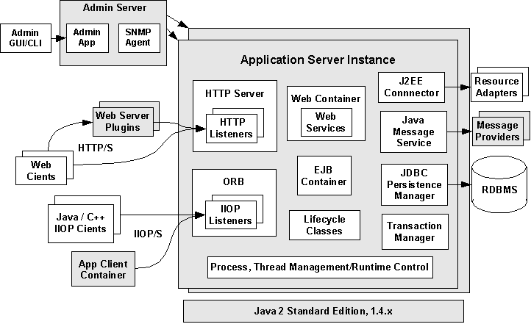
Architecture

Slide 4
Installation
Trial installation includes:
  Sun ONE Application Server 7 Core Server and Utilities
  Sun ONE Message Queue 3.0.1
  Getting Started Guide
  Sample Applications
  Java[tm] 2 Software Development Kit, Standard Edition 1.4.0_02
  PointBase Database Server and Type 4 JDBC[tm] Driver
  Sun ONE Studio 4, Enterprise Edition for Java (trial license)

Slide 5
Installation (continued)
Supported Platforms:
    Sun Solaris, Windows
    GUI Installation option or command line

Slide 6
Installation Directory Structure - Solaris
  /opt/SUNWappserver7 - Contains static portion of the installation image. All utilities, executables and libraries that make up the application
  /etc/opt/SUNWappserver7 - Contains installation wide configuration information such as licenses and the master list of administrative domains configured for this installation.
  /var/opt/SUNWappserver7/domains - administrative domains are created. As administrative domains are created, they can be placed in any location on the system. This area acts only as the default location in which domains are created.

Slide 7
Installation Directory Structure-Windows
c:\Sun\AppServer7 - Windows installation example.
<home_dir>/sun/appserver7 - Evaluation installation on Solaris without the use of Solaris packages.

Slide 8
Administering App Server
Starting the server
  Runs as a service on Windows
  Command line start in UNIX
  Command line:
  start-domain
  Stop-domain
  start-instance
  Stop-instance

Slide 9
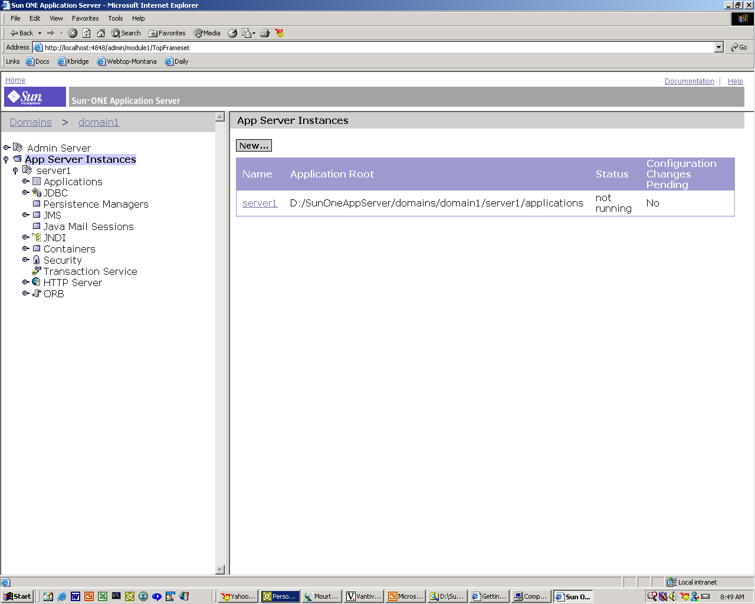
Administering App Server (cont)

Slide 10
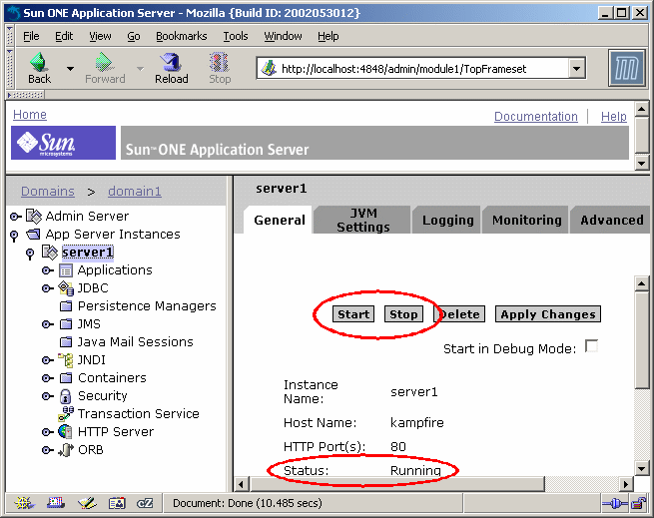
Administering App Server (cont)

Slide 11
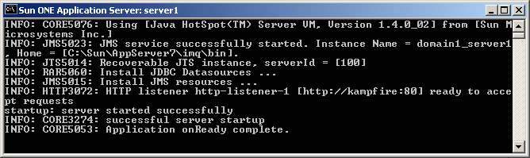
Administering App Server

Slide 12
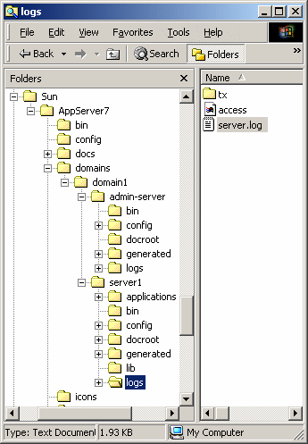
Administering App Server (cont)

Slide 13
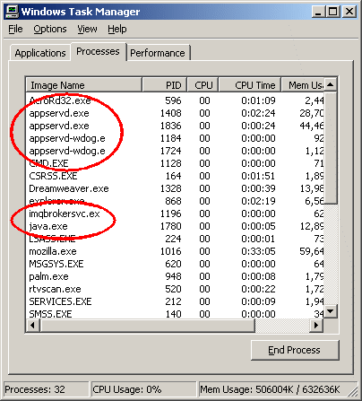
Administering App Server (cont)

Slide 14
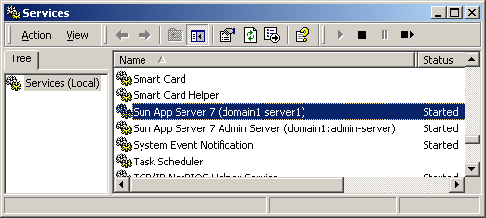
Administering Sun App Server

Slide 15
Administrative Domains
Enables you to define multiple, completely separate application server runtime configurations that reuse the same installation image. Each administrative domain is represented by an administrative server which in turn controls one or more application server instances. The configuration of an administrative domain can reside anywhere on the machine.

Slide 16
Application Server Watchdog
This process - appservd-wdog, are native language processes monitor the application server daemon processes. In case of a daemon failure, the companion watchdog restarts the failed application server daemon process. Each application server daemon has a companion watchdog process.

Slide 17
App Server Processes
Application Server Daemon
  The Application Server Daemon process, appservd, forms the core of the application server runtime. It houses the embedded HTTP Server, ORB, J2EE[tm] Containers and supporting subsystems such as the Transaction Manager and Persistence Managers. Each appservd process houses a Java[tm] Virtual Machine (JVM[tm]).
  In each administrative domain, there is an appservd process that houses the administrative server for the domain. This process is referred to as the Administrative Server Instance. The administrative server controls and manages a number of additional appservd processes that represent individual application server instances.

Slide 18
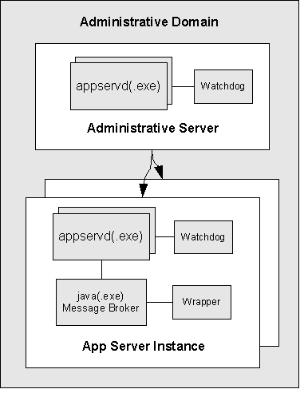
App Server process (cont)

Slide 19
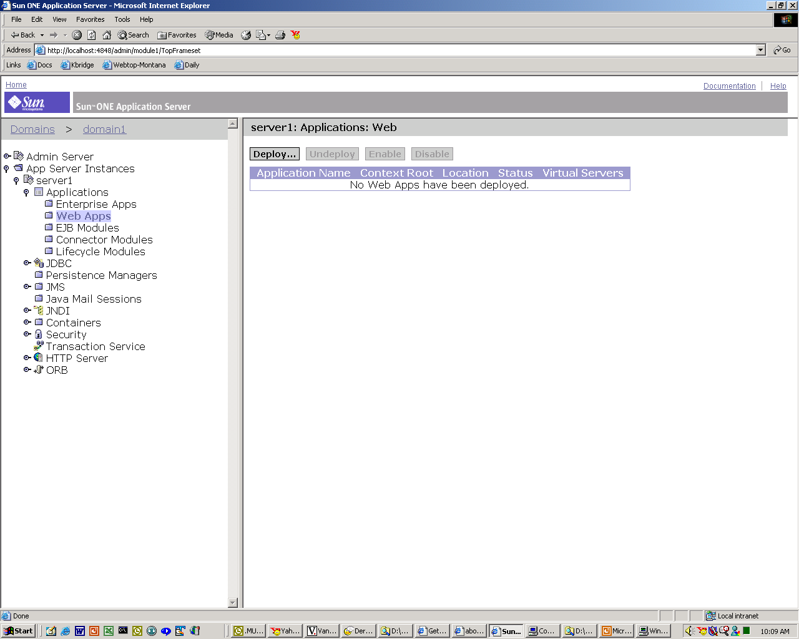
Deployment

Slide 20
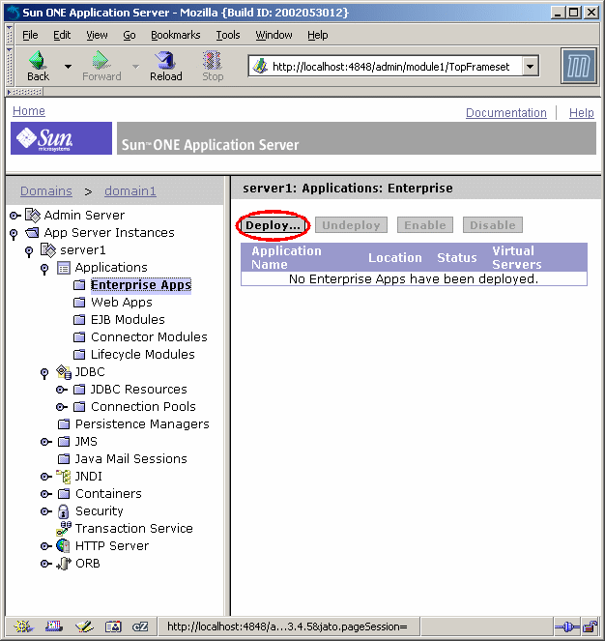
Deployment (cont)

Slide 21
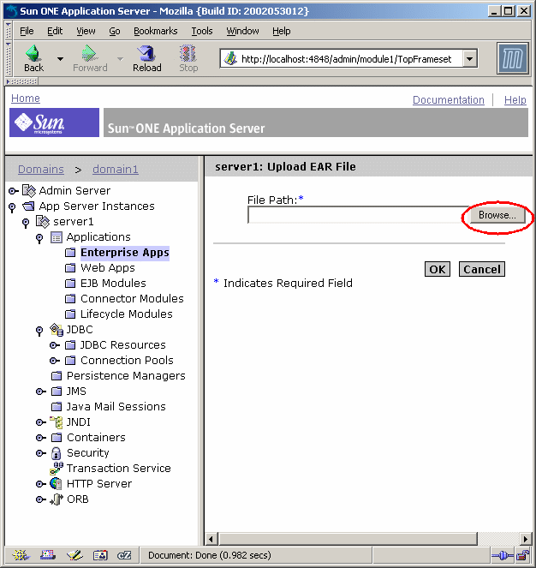
Deployment (cont)

Slide 22
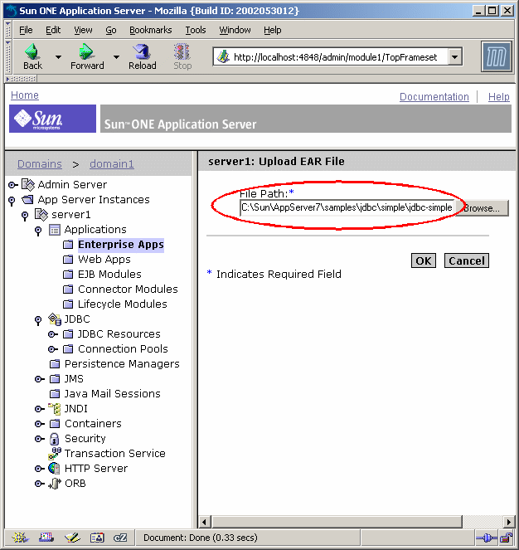
Deployment (cont)
Q &A

Slide 23
Demo Deployment and Monitor
Start SunONE App Server demo

Slide 24
Q & A
Questions
Discussion

