Slide 1
Authentication
Brown Bag
By Bob Philipp

Slide 2
Types of Authentication
Unix Microsoft
Local Local
Domain Domain
LDAP LDAP
NIS Active Directory
NIS+
Trusted

Slide 3
What does it do?
What does it get?
All of the authentication methods give you user authentication tied to a password
However some methods will give you more information than others
We will be examining each method type

Slide 4
User Name and Passwords
Remember that Unix operating system is case sensitive
Microsoft operating system is not for user name, but is for password

Slide 5
Authentication and Unix

Slide 6
Unix Passwords
Passwords must be constructed to meet the following require-
ments:
o Each password must have PASSLENGTH characters, where
PASSLENGTH is defined in /etc/default/passwd and is
set to 6. Only the first eight characters are signifi-
cant.
o Each password must contain at least two alphabetic
characters and at least one numeric or special charac-
ter. In this case, "alphabetic" refers to all upper or
lower case letters.
o Each password must differ from the user's login name
and any reverse or circular shift of that login name.
For comparison purposes, an upper case letter and its
corresponding lower case letter are equivalent.
o New passwords must differ from the old by at least
three characters. For comparison purposes, an upper
case letter and its corresponding lower case letter
are equivalent.

Slide 7
Unix Authentication
First we need to know what method the Unix system is using.
/etc/nsswitch.conf

Slide 8
/etc/nsswitch.conf
# ls -al nsswitch.*
-rw-r--r-- 1 root sys 1283 Jun 26 2002 nsswitch.conf
-rw-r--r-- 1 root sys 1298 Feb 15 2002 nsswitch.dns
-rw-r--r-- 1 root sys 780 Feb 15 2002 nsswitch.files
-rw-r--r-- 1 root sys 1506 Feb 15 2002 nsswitch.ldap
-rw-r--r-- 1 root sys 1697 Feb 15 2002 nsswitch.nis
-rw-r--r-- 1 root sys 1697 Feb 15 2002 nsswitch.nisplus

Slide 9
Examples of nsswitch.conf
/etc/nsswitch.files
# the following two lines obviate the "+" entry in /etc/passwd and /etc/group.
passwd: files
group: files
/etc/nsswitch.nis
# the following two lines obviate the "+" entry in /etc/passwd and /etc/group.
passwd: files nis
group: files nis
/etc/nsswitch.ldap
# the following two lines obviate the "+" entry in /etc/passwd and /etc/group.
passwd: files ldap
group: files ldap

Slide 10
Whats next after nsswitch?
PAM
Pluggable Authentication Module

Slide 11
PAM
After the authentication method is select in nsswitch.conf
PAM makes the system calls to run the selected method.
NAME
pam_unix - authentication, account, session, and password
management PAM modules for UNIX
DESCRIPTION
The UNIX service module for PAM,
/usr/lib/security/pam_unix.so.1, provides functionality for
all four PAM modules: authentication, account management,
session management and password management.

Slide 12
PAM and Domain Authentication
We support Unix to Domain Authentication
But only after it is setup
As you saw in the pervious slide
PAM did not support this
So a PAM is loaded and compiled for the purpose of domain authentication.
The source for this comes from a company called Samba

Slide 13
Unix Local Authentication
Local Unix authentication is broken into two files /etc/passwd and /etc/shadow for Solaris
Theses files are directly associated.
If account information is added for a user on line 25 of /etc/password file, then the corresponding information must be on line 25 of the /etc/shadow file.
Trusted HP-UX splits the matching entry for /etc/passwd into individual entries listed alphabetically in /tcb/files/auth/
AIX uses the /etc/security/passwd file

Slide 14
Why have two files?
There used to be only one file - /etc/passwd
For security the file was broken into multiple files
The /etc/passwd has world read permissions
Even through the password was shown in encrypted format, it was moved to a file that has root permissions only.
Other attributes were moved to this file as well.

Slide 15
How do you edit the file?
Do not recommend the direct editing of these files
Each vendor has management interfaces
Sun – admintool
HP – sam
IBM – smit

Slide 16
/etc/passwd
Example of user entry:
bobp:x:90994:10::/export/akira1/bobp:/bin/sh
user:password:uid:gid:message field:home directory:shell
You can see the x set in the password field
This shows the the password is not set here.
In older versions of software you would see the encrypted password set here.
Non-trusted HP-UX will show the encrypted password here

Slide 17
What is not set in the password file?
password
A 13-character encrypted password for the user, a
lock string to indicate that the login is not
accessible, or no string, which shows that there
is no password for the login.
lastchg
The number of days between January 1, 1970, and
the date that the password was last modified.
min The minimum number of days required between pass-
word changes.
max The maximum number of days the password is valid.
warn The number of days before password expires that
the user is warned.
inactive
The number of days of inactivity allowed for that
user.
expire
An absolute date specifying when the login may no
longer be used.

Slide 18
/etc/shadow
We will look at how Solaris is configured as an example
Example of user
bobp:HX6XSUVtfHVrI:12020::::120::
user:password:lastchg:min:max:warn: inactive:expire:flag
Here you can see the encrypted password
lastchg
The number of days between January 1, 1970, and
the date that the password was last modified.

Slide 19
dm_ check_password
Location $DOCUMENTUM/dba
-rwsr-s--- 1 root dmadmins 11076 Nov 11 09:29 dm_check_password
The owner of this file is root
The group is dmadmins
This command must be run as root
The set uid bit is set for the group execution
What does this mean?
Anyone in the group may run the command as root.

Slide 20
Dm_check_password
What does it check?
# define MAX_PROCESS_RETURN_CODE 255
DM_EXT_APP_SUCCESS 0
DM_EXT_APP_NOT_IMPLEMENTED (MAX_PROCESS_RETURN_CODE - 1)
DM_EXT_APP_OS_ERROR (MAX_PROCESS_RETURN_CODE - 2)
DM_ASSUME_USER_SYSTEM_ERROR (MAX_PROCESS_RETURN_CODE - 3)
DM_ASSUME_USER_TIMEOUT_EXPIRED(MAX_PROCESS_RETURN_CODE5)
DM_CHGPASS_PASSWORD_CRITERIA (MAX_PROCESS_RETURN_CODE - 4)
DM_CHKPASS_NO_RIGHT (MAX_PROCESS_RETURN_CODE - 5)
DM_CHKPASS_ACCOUNT_DROPPED (MAX_PROCESS_RETURN_CODE - 6)
DM_CHKPASS_ACCOUNT_EXPIRED (MAX_PROCESS_RETURN_CODE - 7)
DM_CHKPASS_PASSWORD_EXPIRED (MAX_PROCESS_RETURN_CODE - 8)
DM_CHKPASS_PASSWORD_STALE (MAX_PROCESS_RETURN_CODE - 9)
DM_CHKPASS_BAD_LOGIN (MAX_PROCESS_RETURN_CODE - 10) DM_CHKPASS_ACCOUNT_LOCKED (MAX_PROCESS_RETURN_CODE - 11)

Slide 21
dm_check_password
Source Code
Comes with server
Location
$DM_HOME/install/external_apps/checkpass

Slide 22
Trusted Logins on Unix
If you log on to the server as the install owner
Then you are a Trusted User
You will be able to run Documentum programs on the server without a password
IAPI, IDQL and agent exec

Slide 23
Authentication and Microsoft

Slide 24
Local verses Domain Authentication
Microsoft uses a sid to identify user
It does not allow you choose your sid
So local user bob on one system will have a different sid on another local system
Where a domain user will have the same sid within the domain

Slide 25
User is NOT Case Sensitive
You are allowed to login in as user in lower case or with capitalization
You can login as bob or BOB
Docbase is case sensitive
Password is case sensitive

Slide 26
user_auth_case
The user_auth_case is set in the server.ini for Docbases on Microsoft Only!
Example:
user _auth_case = lower
The user_auth_case key indicates the case (upper, lower, or unspecified) to which the server should convert the client’s user name before authenticating the user.
Valid settings are:
upper
lower
NULL
The default is NULL, meaning the name is authenticated using the case in which it was entered by the user.

Slide 27
user_auth_target
The user_auth_target is set in the server.ini for Docbases on Microsoft Only!
Domain name is set here
Example
user _auth_target = CORPORATE
The user_auth_target key identifies the domain that the server uses to
authenticate the client’s user name and password.
The default is the domain in which the server resides.

Slide 28
dm_check_password
Is not used by default
Must set it to be able to use it

Slide 29
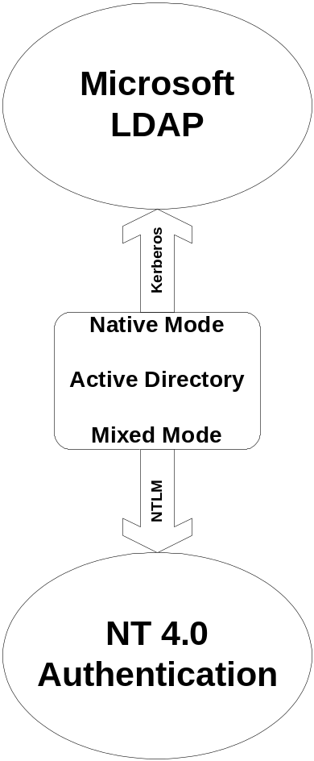
Active Directory
What do we support?
Mixed Mode – yes
Native Mode – 4.2.6J
LDAP – 5.1

Slide 30
Docbase User Authentication
Specifies how to authenticate a given Docbase user's user_domain_name and password. Valid values are:
Blank
LDAP
unix only
domain only
unix first
domain first
*

Slide 31
No Domain Required Mode
In no-domain required mode, users are not required to enter a domain name when they connect to the Docbase. In this mode, a user’s OS name must be unique among the user_os_name values in the Docbase.
How the server authenticates a user depends on what value is found in the user’s user_domain_name attribute. The attribute can contain an asterisk (*), a blank, or a domain name:
If user_domain_name contains an asterisk or blank, eContent Server authenticates the user using his or her OS name and the domain specified in the connection request. If no domain is specified in the connection request, the server uses the domain defined in the user_auth_target parameter in the server.ini file.

Slide 32
User Authentication
If user_domain_name contains a domain name, the user must specify that domain when establishing a connection to the Docbase. The only
exceptions are trusted logons and ticketed logins.

Slide 33
Trusted Login
Trusted logons occur when the client is running on the same machine as the server, the client user is the installation owner, and the installation owner’s domain is the same as that defined in user_auth_target

Slide 34
Trusted Login
When the installation owner is installing eContent Server or using methods that depend on connecting with trusted login, the list of domains that can be used now includes the domain of the running server process.

Slide 35
NT Unified Login
Also known as Windows Login and Silent Login
When you select the Use Window Login box
The client software will edit the registry with domain name and user account information.
HKEY_CURRENT_USER
SOFTWARE
DOCUMENTUM
COMMON
UNIFIED LOGIN

Slide 36
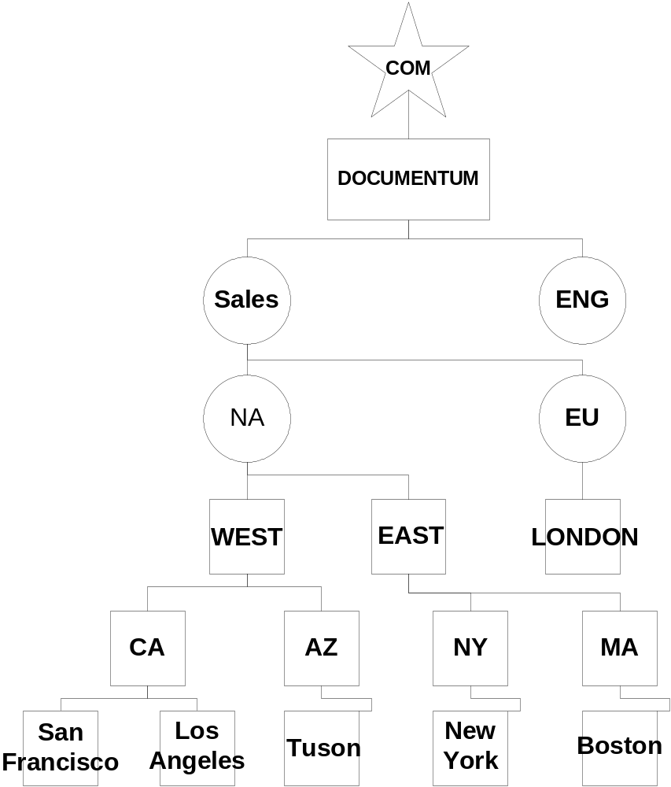
LDAP
One LDAP config object
Want to auth user in the group west
LDAP Config Object on the person search base
Group=West
OU=NA
OU=SALES
DC=DOCUMENTUM
DC=COM
GROUP=WEST,OU=NA,OU=SALES,DC=DOCUMENTUM,DC=COM

Slide 37
Trouble shooting

Slide 38
Keep it simple
Understand the problem
Single user or all users.
Local or Remote
Caps Lock?

Slide 39
Can you login?
Take Documentum out of the picture
Can you log into the system as the user?
Can you login from another system?

Slide 40
Tracing user authentication
From the server start with
-otrace_authentication
Or from API
API>apply,c,NULL,SET_OPTION,S,trace_authentication,VALUE,B,T
Trace dm_check_password
./dm_check_password –tracing –p <pdc> -m only

Slide 41
Test
If I delete the dm_check_password
on a NT server using domain authentication
What will happen?

Slide 42
Support notes
SN 16985 What are the different Authentications methods used by Documentum?
SN 17781 Can I use a domain user to install eCS and start my eCS service ?
SN 18725 Can Content Server 5.1 and 4.2.6 authenticate against NT domains running Active Directory?
SN 16883 Basic information about LDAP
SN 16901 In what ways can I control login via Desktop Client in an NT environment?
SN 16592 What are the things I need to know when integrating dm_check_password with pam_smb module ?
SN14958 How can I trace who is logging in to a Docbase?
SN 11515 How do we authenticate the LDAP user login
SN 9496 How do I trace NT domain login problems?

