Slide 1
Documentum Compliance Manager (DCM) 6.6
Overview
Tony Qiu
Nov 19,2010
Notes:
[Click for next]

Slide 2
Agenda
What is DCM (short review)?
Documentum Compliance Manager (DCM) Value Proposition
Things you should know!
Notes:
[Click for next]
Title
Month Year

Slide 3



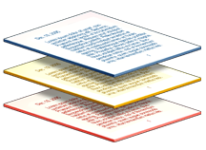










Features and Benefits
DCM - Features
Controlled lifecycle – automatically attached to document
Real-time overlays and watermarking
Change management
Automated review and approval with eSignatures
Adheres to requirements in 21 CFR Part 11
Information
Lifecycle
Create
Review
Approve
DCM – Benefits
Quickly determine when, why and who has interacted with content
Enforce signatures and proper approvals
Ensure content authenticity and retention
Easily respond to regulatory agencies and auditors
Publish
Retire
Retain
Dispose
Notes:
The primary tool set used by DCM to apply control to content is the controlled lifecycle. DCM extends standard lifecycle functionality provided by the Documentum platform to provide document and regulatory controls including template assignment, signatories, e-signatures, and workflows by content type. These lifecycle extensions as the lifecycles themselves are highly configurable and may involve many states or only a few. DCM is the only application within the Documentum platform to immediately apply a lifecycle to controlled content upon creation. This lifecycle then governs what can happen to the content at each stage of its evolution from initial creation until final disposition.
Controlled lifecycle management is a set of policies that are applied at every stage of a document’s life. Lifecycles are flexible, so you can have as many stages as needed to map to business processes.
How does that apply to compliance? Well, when content is promoted or demoted between stages - for example the stages an SOP goes through during it’s review and approval cycle - other activities can occur, such as changing security settings, changing access control privileges, moving files to a new location such as a portal site, changing file formats (such as automatically generating secure PDFs), and so on. Organizations set up business rules to determine what changes when.
[Click for next]
Lifecycle management is a powerful feature, EMC’s Compliance Manager product helps companies enforce compliance throughout business processes and allows organizations to quickly respond to any regulatory inquiries.
[Click for next]

Slide 4

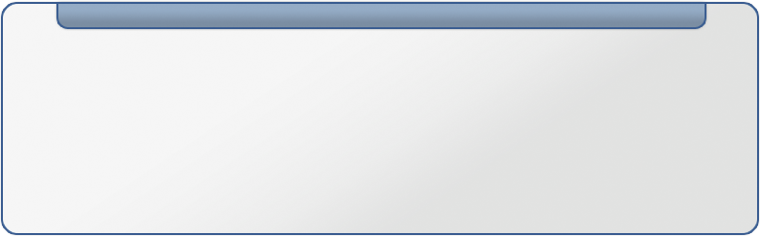


DCM Components and Complementary Products
Documentum Compliance Manager (DCM)
Controlled Lifecycle
Enforcement
Base Webtop Capabilities
Controlled
Relationship
Electronic
Signatures
Audited Notifications
Real-time Watermarking
& Overlays
Change Management
Enhanced Auditing
ADTS (or DTS)
Trusted Content Services
Print Control Services
Retention Policy Services
PDF Renditioning
Advanced
PDF Capabilities
Digital Shredding
Encryption
Controlled Copies
Secured
Print
Activities
Policy based retention and disposition
Legal Holds
No longer required for esign
Notes:
Documentum Compliance Manager is well integrated with the Documentum Platform and is a pure extension of WebTop. As such, any improvements to WebTop are also improvements to DCM. DCM includes the capabilities in the gray box such as (selected examples):
Controlled lifecycle management to enforce an organization’s business rules for document review, approval and distribution [Click in appropriate box only]
All capabilities found in WebTop including modal dialogues for better navigation, extended search capabilities, and configurable presets [Click in appropriate box only]
Electronic signatures – to control document signoff and enforce justification of signoff, to help streamline approvals [Click in appropriate box only]
Notifications and tracking – which notifies consumers of changes to ensure approved content is in use.
Real-time watermarking and Overlays – prints effective dates and states on documents in real-time so that workers understand the status of a document. [Click in appropriate box only]
The platform components most often used in association with DCM are: [Click in little blue box]
Transformation Services
Trusted Content Services
Print Control Services and
Retention Policy Services
ADTS or Advanced Document Transformation Services, or DTS, Document Transformation Services, automate the conversion of standard desktop document formats into web-ready formats such as PDF and HTML, and stores the renditions in a Documentum repository alongside the original. ADTS provides additional PDF rendering for multi-page TIFF, AutoCAD 2002, Microsoft® Visio, and Project. Documentum Advanced Document Transformation Services also provides additional format and metadata extraction support—a necessity for content authors who use advanced features such as template styles, hyperlinks, and URLs in their source documents and wish to preserve these features in their PDF documents. Either ADTS or DTS is required with DCM because DCM works with PDF documents.
Retention Policy Services (RPS) for managing content retention. With the exception of DTS each are optional but highly useful options for many customer requirements.
Trusted Content Services (TCS) is no longer required for e-signatures [Click],
Print Control Services (PCS) provides the ability to manage controlled copies of approved content. [Click] , it will only be available later in 2008
[Click in blue box]

Slide 5
DCM 6.6 High-Level Themes
    Simplified architecture / easier deployment
  Totally native code: Watermarking, Overlays, e-Signatures
Integration and alignment with Documentum platform
  Certification with Branch Office Caching (BOCS), Retention Policy Services (RPS), and Collaboration Services (CS)
  Single-sever deployment
Initial entry into SOA
Notes:
[Click for next]

Slide 6
Things you should know!
DCM 6.5/6.6 no longer uses PDFaqua. Hence no more license keys!
DCM 6.5/6.6 no longer requires TCS
All DCM custom object types and their attributes remain the same as DCM5.3Sp4.
DCM 6.5/6.6 uses open source components
  iText version 2.0.2 – An open source PDF API library
  http://www.lowagie.com/iText/
  Bouncy Castle Release1.36 – An open source cryptography API library
  http://www.bouncycastle.org/
DCM6.5/6.6 uses EMC Documentum Electronic Signature solution instead of 3rd party software. This requires customers who used TCS or Liquent PDFSign at DCM5.3x to finish all signoffs before upgrade to DCM6.5.
DCM6.5/6.6 uses EMC Documentum watermark solution instead of 3rd parth software. This requires customers who had Liquent PDFAqua overlay templates at DCM5.3x to covert those existing templates to PSS overlay templates.
Notes:
[Click for each next bullet]

Slide 7
Things you should know!
DCM 6.5 provides integration of PDF Stamping Service watermark with PDF Annotation Service. This integration allows end users of DCM to see watermark when annotate the PDF rendition.
Use Java instead of dmbasic for lifecycle implementation
We are running a Rapid Success Program
“Do No Harm” mechanism
At DCM we have application-level control of SysObject. An application-level control is independent of repository security. For detailed descriptions of how application-level control works please refer to Content Server Fundamentals at “What application-level control of SysObject is” section.
Using application-level control means users must use DCM to access Controlled Documents.
Customer can use any other EMC Documentum applications to access non-Controlled Documents stored within a DCM repository (Notwithstanding, there may be validation issues with other applications sharing a DCM repository).
Notes:
[Click for each next bullet]

Slide 8
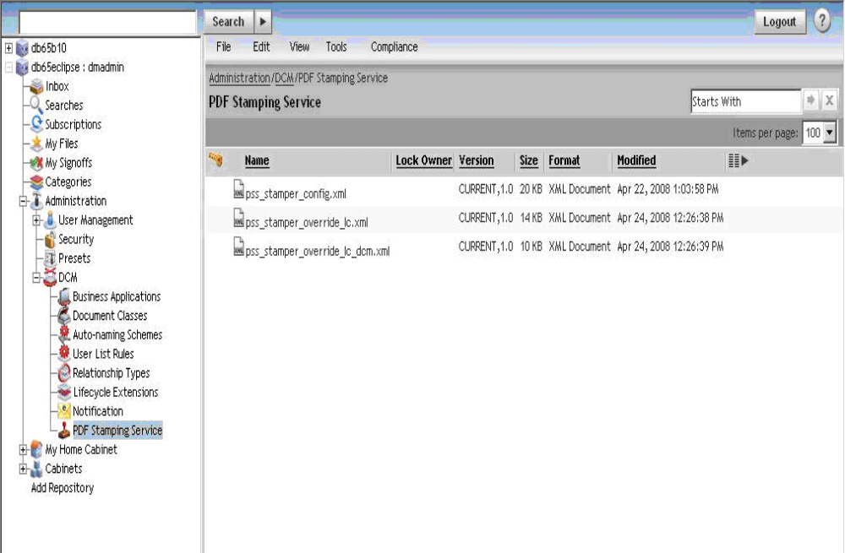
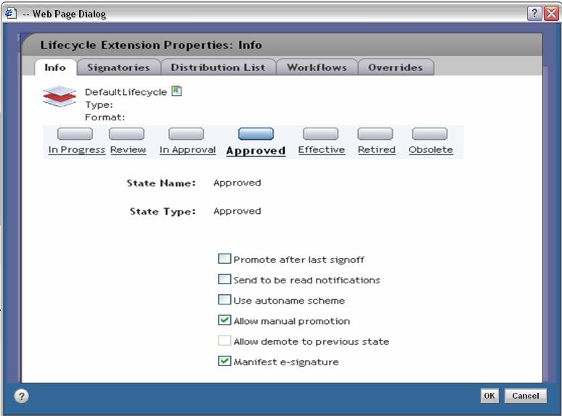
Controlled Life Cycle
PDF Stamping Service
Notes:
Title
Month Year
This screenshot shows the lifecycle states for this type of document, such as in progress, in approval, approved and effective. An effective document is one that has been approved, signed, and is currently in use and available to the general user population for view purposes. DCM’s lifecycle capabilities include:
attaching a lifecycle to a document automatically upon creation or import, to facilitate controlled review and approval
enforcing specified lifecycle states.
preventing a document from being deleted in certain states
scheduling automatic review, of an approved and in use (effective) document
making approved documents in use (effective) upon a certain date
Moving an existing version of a document to the retired state when a new version is made effective
Retiring a document upon a certain date
Clean up (delete) of all in progress or draft versions of a document upon approval of a document version
[Click in the center of the page to return to slide 6]

Slide 9
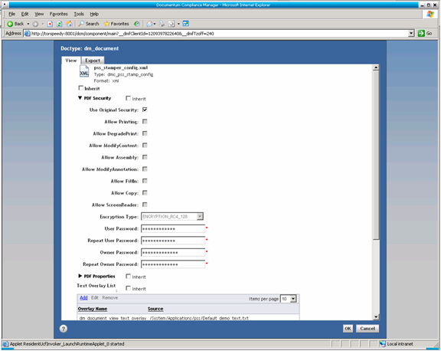
Controlled Life Cycle
Notes:
Title
Month Year
This screenshot shows the first page of the configuration of PDF Stamping Services for managing the controls provided over the PDF during view.
[Click in the center of the page to return to slide 6]

Slide 10
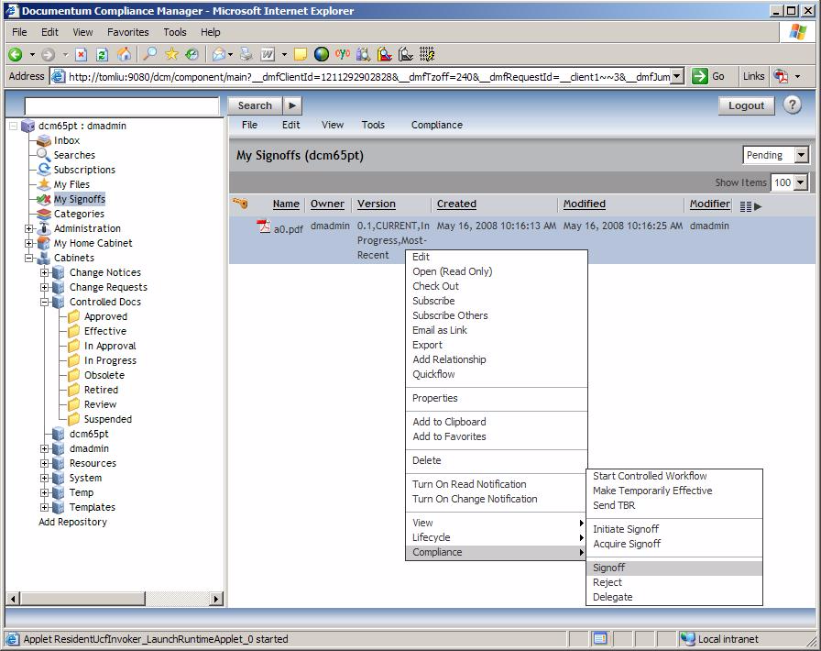

E-Signature
Signoff
Notes:
Initiate signoff
Sign-offs can be configured in any state of the lifecycle and the compliance interface allows you to track what has been signed off and by whom as well as what is pending.
[Click]
Title
Month Year

Slide 11
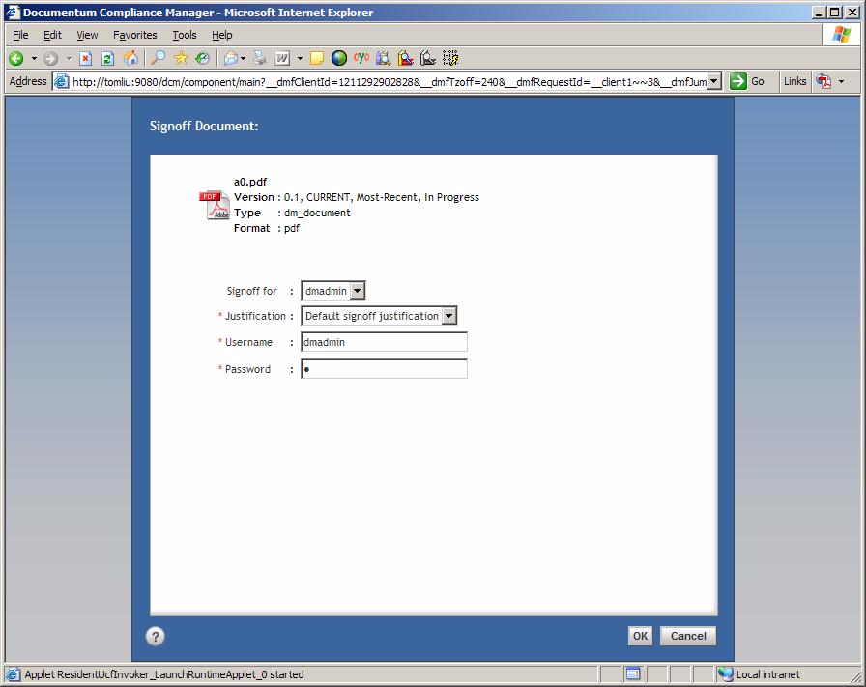
E-Signature
Notes:
This screen shot shows information that a signatory is required to supply, as per the dictate of 21 CFR part 11.
[Click]
Title
Month Year

Slide 12
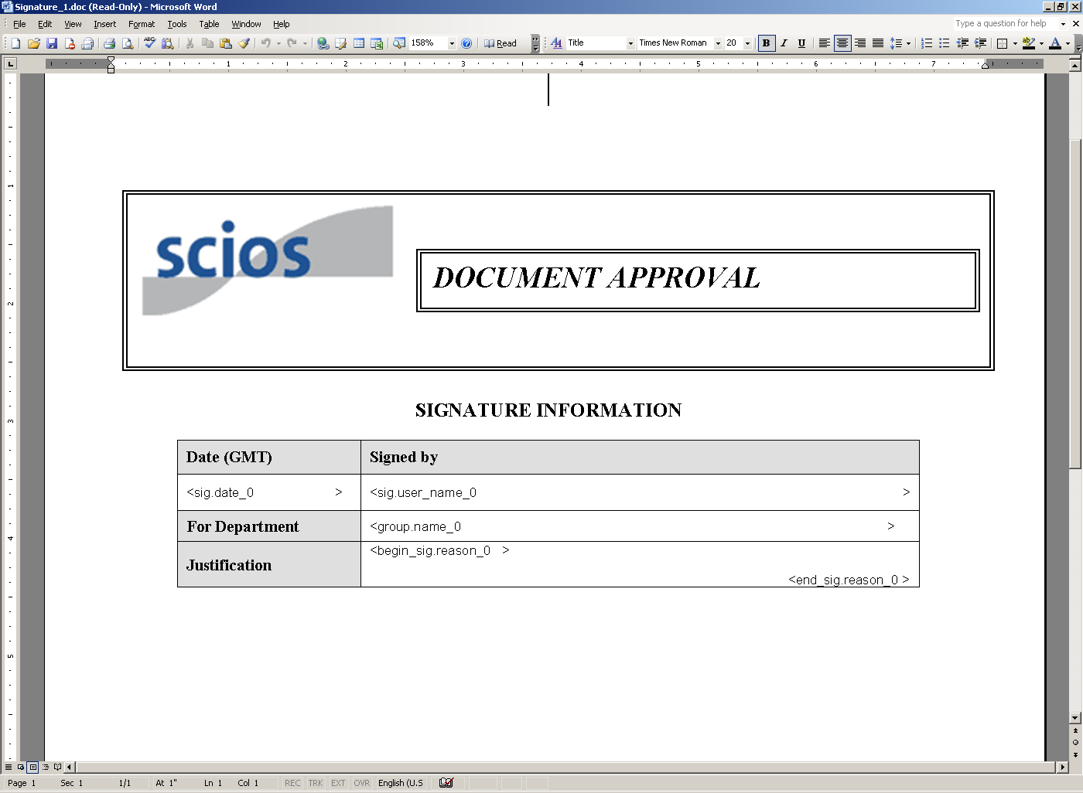
E-Signature Manifestation
06/17/2008
dmadmin
Regulatory Affairs
Default signoff justification
Notes:
Title
Month Year
This screen shot shows signoff page – or eSignature manifestation. This page show all the information provided during signoff for each signatory. The page can be configured to be at the beginning or the end of the document.
[Click in the center of the page to return to slide 6]

Slide 13
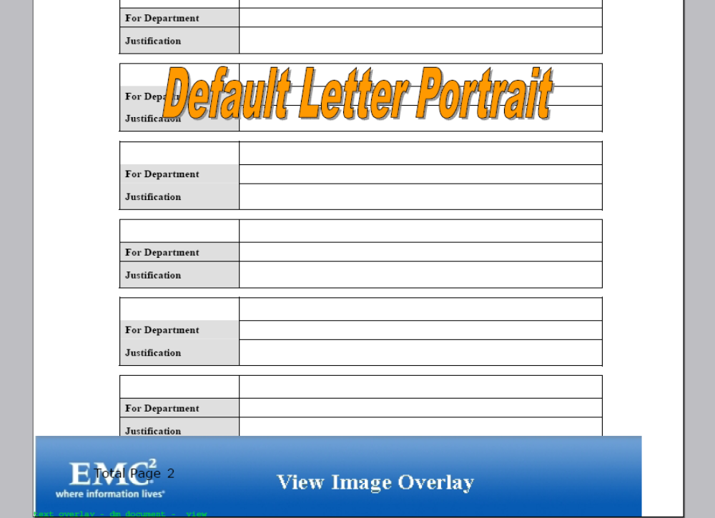
Overlay/Watermarking
Notes:
This screen shot shows the overlays or watermarks that can be configured in the new PDF Stamping Services functionality within DCM. One can configure headers and footers, use block letters for overlays such as that in ‘Default Letter Portrait’, and there is also the capability to use an image such as that within the blue bar at the bottom.
[Click in the center of the page to return to slide 6]

