Slide 1
Print Control Services Knowledge Transfer
Tony Qiu

Slide 2
What is the Print Control Services (PCS)?
PCS manages the print process for controlled documents. With PCS, you can audit printing, restrict printing to authorized recipients, and record this information.
PCS provides two major functionalities: Print and Recall
Print
Associate a unique number to the print.
Generate a watermarked PDF for print by using PDF Stamping Services (PSS).
Convert the watermarked PDF to a PostScript by using Documentum Transformation Services (DTS).
Send a request of printing the PostScript file to a selected printer by using Java Print Services (JPS).
Create an audit trail to record the printing request.

Slide 3
What is the Print Control Services (PCS)? - Continued
Send a “To Be Read” (TBR) on selected prints of given document to print recipient’s inbox.
Generate an audit trail to record the recall request.
Recipient destroys the paper copy and confirms the recall request TBR.
Generate an audit trail to record the recall confirmation.

Slide 4
What is the Print Control Services (PCS)? - Continued
PCS server supports both standalone and cluster deployment

Slide 5
Architecture
PCS Knowledge Transfer

Slide 6
Agenda
How does PCS Print work?
How does PCS Recall work?
What technologies are used?

Slide 7
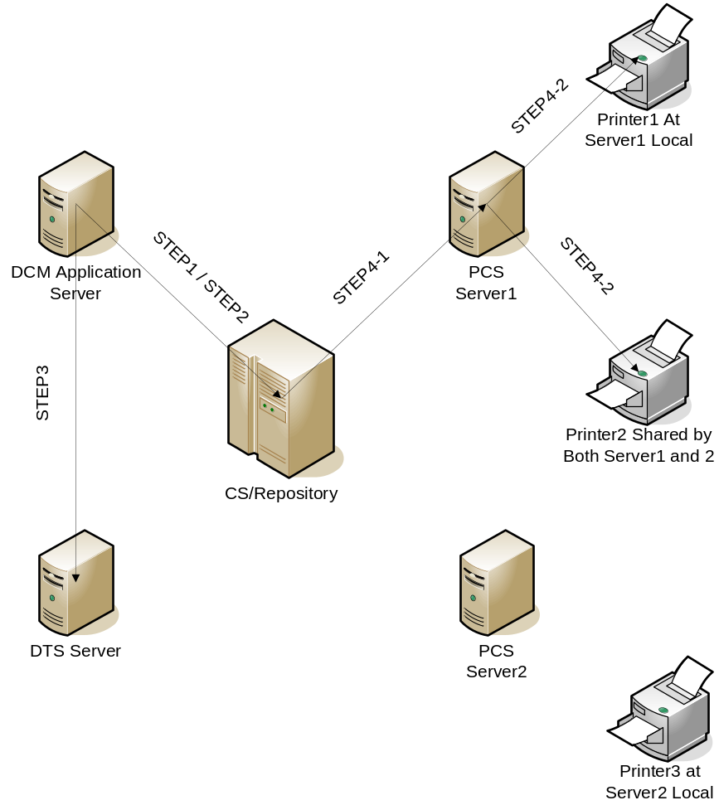
How does PCS Print work?
Step1: DCM AS retrieves a list of preconfigured printing_server_uri from dmc_pss_print_config object named as “pcs_default_root.xml” to let print requestor select one Recipient Site (PCS Server) for print.
Step2: DCM AS retrieves a list of Recipients. Each Recipient has a list of configured Printers and Reasons. Requestor selects a Recipient; a Printer and a Reason for print.
Step3: DCM AS generates a watermarked PDF for selected document. If given object does not have a PDF rendition the request will be rejected. DCM AS uses watermarked PDF as the primary rendition to create a new dmc_pss_print_copy object. The Printer and Reason information are saved at the corresponding attributes of this new dmc_pss_print_copy object. DCM AS then sends a request to DTS for a PostScript rendition and changes the "print_status" attribute of the dmc_pss_print_copy object to “PsRequested”.
Step4-1: PCS print job running in content server keeps polling on dmc_pss_print_copy objects that have “print_status” as “PsRequested” to check their PostScript rendition. When the PostScript rendition is available, this job calls print() method at Printing Server. In case PostScript rendition can not be generated; or Printing Server is not available, PCS print job records every attempt by increasing “print_attempts”. If “print_attempts” reached a number defined by “pcs.print.attempts.max” within pss.properties, a notification will be sent to Requestor’s inbox and “print_attempts” is reset to 0. “print_status” of dmc_pss_print_copy is changed to “PrintRequestFailed” in such cases to support recall on failed print requests.
Step4-2: print() in PCS web service method uses JDK/JPS to send the printing request to selected printer and generates an “pss_print_requested” audit trail for this print.
Notes:
What the customer needs to know
What partners need to know
What EMC sales engineers and consultants need to know
What is the architecture of the Product Group (e.g. Platform Server, Platform Client, Collaboration)?
How does the product/feature fit with the overall CMA architecture?
What is the specific product/feature architecture?

Slide 8
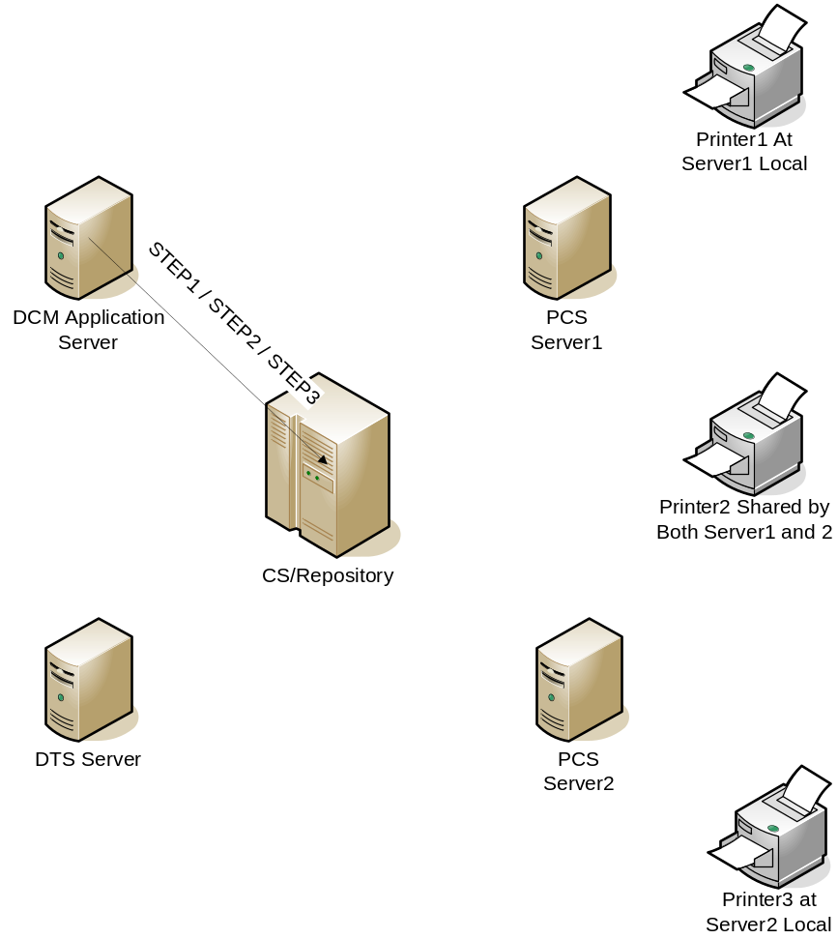
How does PCS Recall work?
Step1: DCM AS retrieves a list of copies for given document so that print requestor can select one or multiple prints to recall. The list includes all succeed prints by querying “pss_print_requested” audit trails; the list includes failed prints by querying dmc_pss_print_copy objects which have “print_status” as “PrintRequestFailed”; the list excludes prints which have been recalled.
Step2: DCM AS requests recall on one or multiple prints by sending TBR to print recipient’s inbox for confirmation and generates “pss_recall_requested’ audit trail(s). It also marks the “print_status” of corresponding dmc_pss_print_copy objects to “RecallRequested”.
Step3: Print recipient confirms TBR from user inbox. “pss_recalled” audit trail is generated for this recall confirmation.
Notes:
What the customer needs to know
What partners need to know
What EMC sales engineers and consultants need to know
What is the architecture of the Product Group (e.g. Platform Server, Platform Client, Collaboration)?
How does the product/feature fit with the overall CMA architecture?
What is the specific product/feature architecture?

Slide 9
What technologies are used?
JDK Java Print Service APIs are used to print PostScript on physical printers
Documentum Transformation Services(DTS) is required for PCS print
DTS uses Adobe PDF printer to convert a PDF to a PostScript

Slide 10
Installation
PCS Knowledge Transfer

Slide 11
How long will it take?
PCS installation includes: (Estimates are for a basic without customizations and installation done by an experienced PCS developer assuming DCM is already installed)
- DTS (if has not been installed) setup by provided installer – 30 minutes
- PCS dar installation by using Composer – 15 minutes
- PCS Server installation using provided installer – 5 minutes
Notes:
Keyboard time
Machine time

Slide 12
Configuration
PCS Knowledge Transfer

Slide 13
Agenda
How do I configure DTS for PCS?
How do I verify PCS Server connection after PCS Server install?
How do I configure PCS Server for repository connection?
How do I configure Recipient Sites?
How do I change a PCS configuration xml?
How do I configure watermark for print?
How do I configure print requestors?
How do I configure PCS jobs?
Supported Acrobat Form fields in PCS

Slide 14
How do I configure DTS for PCS?
Follow DTS Installation Guide to install DTS
Enable PDF to PostScript(PS) transformation. Details are included within DTS Administration Guide
To verify PDF to PS transformation, at DTS machine set “Default PostScript Printer” as the default printer; right click a watermarked PDF then select “print” from the menu. Make sure a PostScript file is created at C:\DISTASST.PS after print
Increase the timeout configuration of DTS for transformation at <CTS installation folder>\config\defaultapp\defaultapp.xml
BACKGROUND_PRINTING_WAIT_INTERVAL from 10 to 30 - 100
Disable the automatically update of Acrobat. Install Adobe version 9 or above in DTS machine

Slide 15
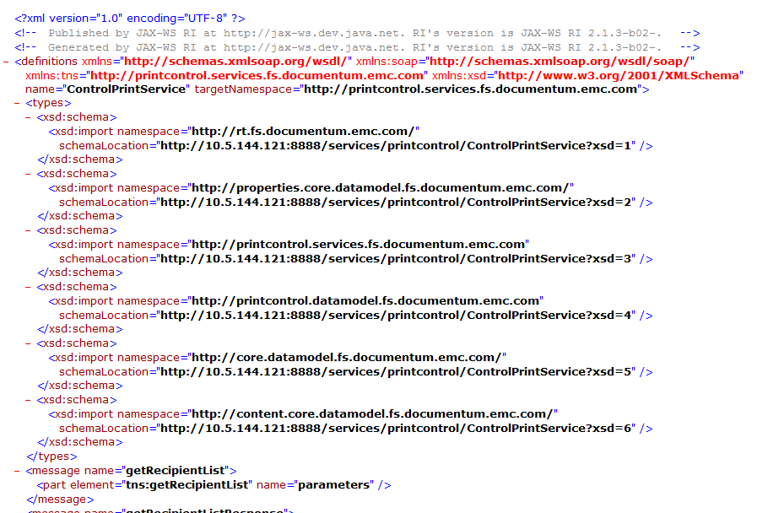
How do I verify PCS Server connection after PCS Server install?
Connect to http://<PCS server machine name>:8888/services/printcontrol/ControlPrintService?wsdl
An xml page returns with description of ControlPrintServices

Slide 16
How do I configure PCS Server for repository connection?
Modify <PCS server installation folder>\jboss4.3.0\server\
DctmServer_pcs\deploy\dfs.ear\APP-INF\classes\dfc.properties
  dfc.data.checkout_dir=${dfc.data.user_dir}/checkout
  dfc.data.dir=C:/Documentum/jboss4.3.0/server/DctmServer_PCS/data/PCS
  dfc.data.export_dir=${dfc.data.user_dir}/export
  dfc.data.user_dir=${dfc.data.dir}
  dfc.exception.include_decoration=false
  dfc.exception.include_id=false
  dfc.globalregistry.password=k+o7acaLITk=
  dfc.globalregistry.repository=tor_mrjazz
  dfc.globalregistry.username=dm_bof_registry
  dfc.search.ecis.enable=false
  dfc.search.ecis.host=
  dfc.search.ecis.port=
  dfc.tokenstorage.dir=${dfc.data.user_dir}/apptoken
  dfc.tokenstorage.enable=false
  dfc.docbroker.host[0]=pletsdocbroker
  dfc.docbroker.port[0]=1489

Slide 17
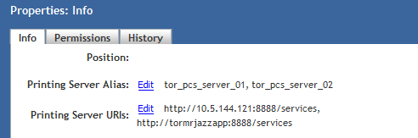
How do I configure Recipient Sites?
Configure the properties of pcs_default_root.xml object which locates in /System/Applications/pss/ from DA or DCM
Provide user-friendly name of PCS Server(also known as Recipient Site) at ”Printing Server Alias” property
Provide URI of PCS Server at ”Printing Server URIs” property
Format of ”Printing Server URIs” is http://<PCS Server name>:<port#>/services
Both properties above are repeating attributes to support multiple Recipient Sites

Slide 18
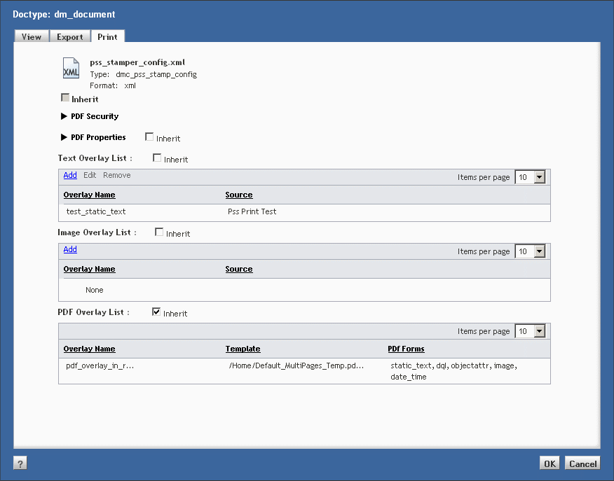
How do I configure watermark for print?
User PDF Stamping Services configuration to configure watermark for print

Slide 19
How do I configure print requestors?
Print requestors must have repository user accounts
Print requestors must be member of “print coordinator” role
Use Documentum Administrator or DCM to configure repository user account and role assignment for print requestors

Slide 20
How do I configure PCS jobs?
PcsAsyncPrintJob must be active
PcsAsyncPrintJob runs every 10 minutes by default
PcsCleanPCopiesJob is inactive by default. If you would like to cleanup PCS copy objects, please activate this job
PcsCleanPCopiesJob runs every week by default when it is active.
Use DA to modify the job period and active status.

Slide 21
Supported Acrobat Form fields in PCS
In addition to the acrobat form fields supported by PSS, there are 3 fields specific to PCS are supported
• PcNo__SfFx: to populate the copy number
• PrCp__SfFx: to populate the recipient user name
• PrEa__SfFx: to populate the reason for printing

Slide 22
Troubleshooting
PCS Knowledge Transfer

Slide 23
Agenda
What is the troubleshooting checklist?
What log files are generated?
Issues faced by customer

Slide 24
What log files are generated?
Application Server logs: To get the DCM/PSS/PCS Application Server side logs
Java Method Server Logs: To get the logs of PCS methods
Pcs logs: To get the PCS server side logs for printing
PSS logs: To get the logs for PSS (watermarking).
PSS has 4 logging levels: DEBUG, INFO, WARN and ERROR.
- DEBUG level messages are used to log the entering and exiting of PSS methods. In PssTrace methodEnter() and methodExit() use DEBUG level.
- INFO level messages are used to log extra information during a method call. In PssTrace infoLog() method uses INFO level.
- WARN level messages are used to log class name, total jvm memory used, total free jvm (in bytes) and the message itself. In PssTrace meterRead() method uses WARN level.
- ERROR level messages are used to log exceptions. In PssTrace exceptionLog() method uses ERROR level.
Notes:
Description
How to enable trace
Format
Location
Sample log file

Slide 25
Issues faced by customer
Issue: Print menu is not enabled in DCM UI
Cause: The document may not be in Effective state or the logged in user may not be in Print Coordinator role
Solution: Try printing an Effective document. Assign the user to Print Coordinator role

Slide 26
Issues faced by customer - Continued
Issue: Recipient Site is not having any values in drop down
Cause: Printing Server URIs and Printing Server Alias not set for pcs_default_root.xml
Solution: Set values for Printing Server URIs and Printing Server Alias

Slide 27
Issues faced by customer - Continued
Issue: Print is invoked from DCM UI. Even after few minutes, it is not printed
Cause: Print Job is a scheduled job which will run in its frequency (by default 10 mins).
Solution: Wait for the job to run and then check for the print out

Slide 28
Issues faced by customer - Continued
Issue: Print is invoked from DCM UI. Print job failed with the below error in job report
“com.emc.documentum.fs.services.printcontrol.ControlPrintServiceException: Error1005: Selected printer <printer name> is not in the available printer list on Print Server machine”
Cause: Printer name as available in the PCS machine is not matching with that in pcs_default_root.xml .
Solution: Modify pcs_default_root.xml with the correct name of the printer
Cause: postscript printer driver may not be installed properly in the printer .
Solution: Configure postscript printer driver in the printer properly
Cause: Printer may be installed after pcs is installed.
Solution: Restart PCS service

Slide 29
Issues faced by customer - Continued
Issue: Print is invoked from DCM UI. Print job failed with the below error in job report
com.emc.documentum.fs.rt.ServiceInvocationException: Service "com.emc.documentum.fs.services.printcontrol.ControlPrintService" is not available at url:”
Cause: PCS may not be running.
Solution: To check this try to access the url http://<machine name>:8888/services/printcontrol/ControlPrintService?wsdl in content server machine and check whether It displays an xml page with description of ControlPrintSerives. Start PCS Server
Cause: Printing Server URI may be specified wrongly in the properties of pcs_default_root.xml
Solution: Edit the Printing Server URIs and Provide the correct PCS URL, http://<machine name>:8888/services

Slide 30
Issues faced by customer - Continued
Issue: Print is invoked from DCM UI. Ps rendition is not created. But ps rendition is getting created normally for pdf renditions through WT or DCM
Cause: Adobe installed in DTS machine may not be latest
Solution: Adobe version of 8 or above to be installed in DTS machine as watermarking needs newer versions of adobe reader

Slide 31
Issues faced by customer - Continued
Issue: We have set various configurations in printer connected in PCS machine but when printing a document using PCS, these configurations are not applied
Cause: ps rendition created will not have all these configurations incorporated
Solution: Setup all the needed configurations in Default Postscript printer in DTS machine so that when ps rendition is created, these configurations will be incorporated in the rendition itself.

