Slide 1
PDF Stamping Service (PSS) eSignature KT on D6.6
Tony Qiu
November 19,2010

Slide 2
What is PSS (PDF Stamping Service) eSignature?
PSS eSignature is a replacement for eSignature done by Liquent PDF Sign / TCS in 5.3.x
PSS uses iText which is an open source Java library that allows you to generate eSignature pages while signing off controlled documents
In PSS with iText as PDF library, Acrobat Form is used for dynamic value population
Acrobat Professional 8 or above is needed to create PDF forms

Slide 3
Architecture
PSS eSignature Knowledge Transfer

Slide 4
Agenda
How does PSS eSignature work?

Slide 5
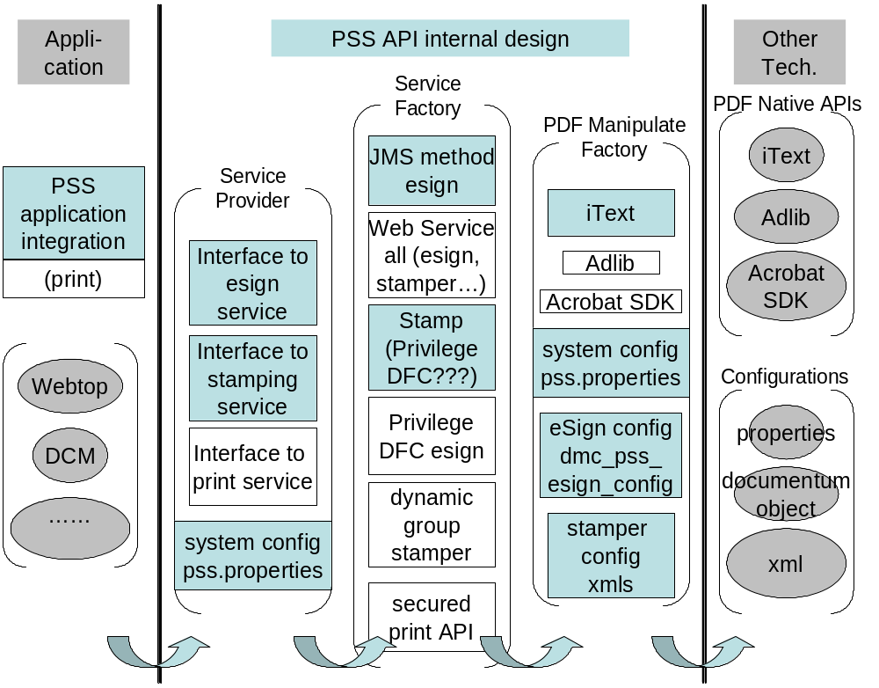
How does PSS eSignature work?

Slide 6
Installation
PSS eSignature Knowledge Transfer

Slide 7
How long will it take?
PSS eSignature is a part of DCM installation and so no separate deployment in application server
- PssEsign dar installation by using Composer
Notes:
Keyboard time
Machine time

Slide 8
Configuration
PSS eSignature Knowledge Transfer

Slide 9
Agenda
How do I configure pss.properties for eSignature?
How do I create eSignature template?
How do I configure eSignature template’s properties?
Supported Acrobat Form fields in PSS eSignature

Slide 10

How do I configure pss.properties for eSignature?
PSS uses Java properties file called pss.properties to store the PSS system configuration.
It is packed in $DCM\WEB-INF\lib\pssproperties.jar

Slide 11
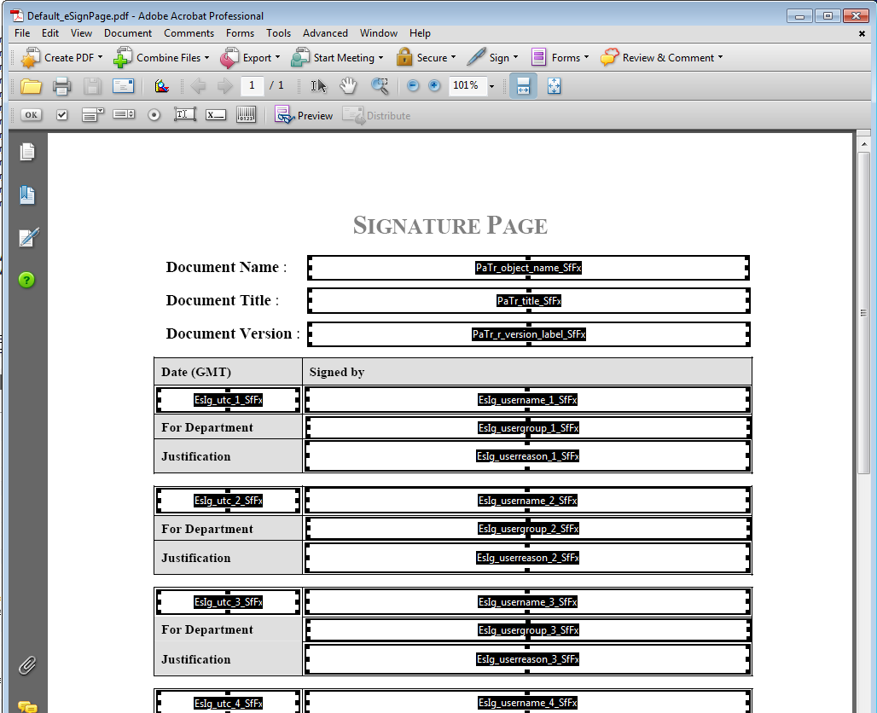
How do I create esignature template?
In Acrobat Professional (use Acrobat8.0 for example), either click on the Text Form icon or go to Tools -> Form Tools -> Forms Toolbar
click “Edit layout” button,eSignature template shows as following:

Slide 12
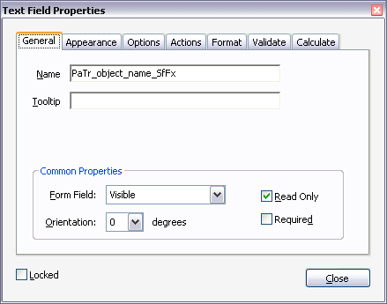
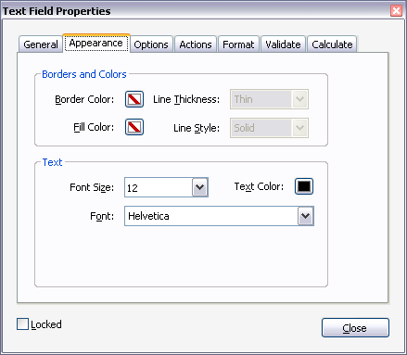
How do I create esignature template? - Continued
Double click on newly added Text Form Field to edit

Slide 13
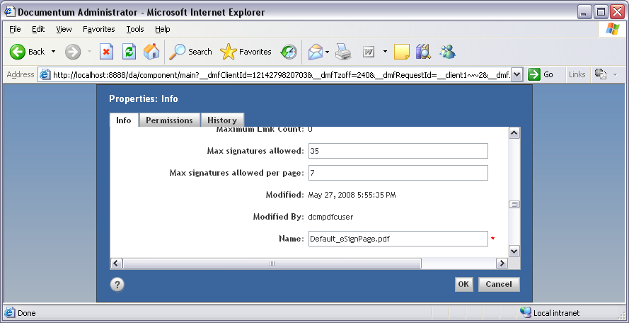
How do I setup electronic signature template attributes?
The way to setup electronic signature template attributes is almost the same as setup the template for Trust Content Server(TCS)
Use DA / Webtop / DCM to setup the attributes
Customer can create their own dmc_pss_esign_config instances; The Default Sample template is under Cabinets/System/Applications/pss
Notes:
[Click]

Slide 14
How do I configure eSignature template’s properties?
PSS uses Documentum dmc_pss_esign_config objects for eSign configuration
append_to_body : True/False – Prepend/Append eSiganture page
document_type: supported object types
max_signatures: Total maximum signatures allowed.
max_signatures_per_page: Maximum signatures in one page
pdf_version: Specify a PDF version for signed PDF. “1.5”; “1.6” and “1.7” are supported string values for this attribute. If any other string value is configured PSS keeps the PDF version of signed PDF as the same as the original PDF.
simple_date_format: Specify a Java SimpleDateFormat pattern for the time information populated at the signature page.
runtime_ids: Signing Object Id at runtime. PSS uses this attribute to prevent more than one user signing the same document concurrently
enable_compression: True/False – Compress or not compress eSigned PDF. Please note you can only enable compression if you select PDF 1.5 or higher as the version of signed PDF. The earlier versions of PDF disallow full compression

Slide 15
Supported Acrobat Form fields in PSS
In addition to the form fields supported by PSS, the below are also supported.
EsIg_: An eSiganture field used at eSignature template. In DCM6.5, the following eSignature fields are supported:
EsIg_date_x_SfFx: eSign date of the local time.
EsIg_utc_x_SfFx: eSign date of the UTC (Universal Time Coordinated) time.
EsIg_number_x_SfFx: eSignature number.
EsIg_username_x_SfFx: username of the signatory.
EsIg_userid_x_SfFx: user ID of the signatory.
EsIg_userreason_x_SfFx: eSignature justification.
EsIg_usergroup_x_SfFx: group name of the signatory when the signatory is a user group.
EsIg_asgroup_x_SfFx: group name that signatory selected to eSign as a group.
Note: The “x” above is the number of eSignature field defined in the template. It starts from 1 and must be consecutive for the rest fields.

Slide 16
Demonstration
PSS eSignature Knowledge Transfer

Slide 17
eSignature
DEMO
Initiate Signoff and acquire Signoff manually, it will trigger dcm_signoff event, and PSS will add esignature page to CD
create workflow to initiate signoff request, as soon as performer signoff, dcm_signoff event will be sent, and PSS will add esignature to CD.

Slide 18
Troubleshooting
PSS eSignature Knowledge Transfer

Slide 19
Agenda
PSS Tracing
Issues faced by customer

Slide 20
PSS Tracing
PSS has 4 logging levels: DEBUG, INFO, WARN and ERROR.
DEBUG level messages are used to log the entering and exiting of PSS methods. In PssTrace methodEnter() and methodExit() use DEBUG level.
INFO level messages are used to log extra information during a method call. In PssTrace infoLog() method uses INFO level.
WARN level messages are used to log class name, total jvm memory used, total free jvm (in bytes) and the message itself. In PssTrace meterRead() method uses WARN level.
ERROR level messages are used to log exceptions. In PssTrace exceptionLog() method uses ERROR level.
Notes:
Description
How to enable trace
Format
Location
Sample log file

Slide 21
PSS Tracing - Continued
To enable PSS trace, Modify the log4j.properties to append to the following:
# ------------ PSS log4j configuration-----------------
#DO NOT ALTER THESE COMMENTS OR MOVE THIS CONFIGURATION OUTSIDE OF THIS SECTION
#Set the level to DEBUG if you want to log all messages
log4j.appender.PSSAppender.threshold=DEBUG
log4j.category.pss=DEBUG,PSSAppender
log4j.appender.PSSAppender=org.apache.log4j.DailyRollingFileAppender
log4j.appender.PSSAppender.File=C:/Documentum/logs/pss1.log
log4j.appender.PSSAppender.Append=true
log4j.appender.PSSAppender.layout=org.apache.log4j.PatternLayout
log4j.appender.PSSAppender.layout.ConversionPattern=%d{HH:mm:ss,SSS} %5p [%10t] %c{1} %5x %m%n
log4j.appender.PSSAppender.DatePattern=’.’yyyywwdd

Slide 22
Issues faced by customer
Issue: Unable to get an eSignature page generated
Cause: dmi_registry for signoff events may not be configured properly or more than 1 entry may be available for signoff event
Solution: Set a_esignature_required value as true and remove the extra dmi_registry entries for signoff event
DQLL tips:
  DQL> SELECT r_object_id,user_name,registered_id,event,a_esignature_required,sign_audit,is_audittrail FROM dmi_registry where event in ('dcm_signoff','dcm_reject')

Slide 23
Issues faced by customer - Continued
Issue: Hash code mismatch throws up
Cause: Simultaneous signoff by more than a user on the same document
Solution: Document has to be signed off in sequence.

Slide 24
Issues faced by customer - Continued
Issue: In 5.3.x DCM, if eSignature fails, what to do?
Solution: In 5.3.x, eSignature is supported by TCS / PDFSign. So contact content server / Liquent for failures.
Per 6.5 latest, eSignaure is handled by iText Opensource

