Slide 1
PDF Stamping Services KT
Tony Qiu
November 19,2010

Slide 2
What is PDF Stamping Services (PSS)?
Pdf watermark solution for DCM which was supported by Liquent PDF Aqua in 5.3.x
PSS uses iText which is an open source Java library that allows you to generate PDF files on the fly
In PSS with iText as PDF library, Acrobat Form is used for dynamic value population
Acrobat Professional 8 or above is needed to create PDF forms
Watermarking is supported in View, Export and Print actions

Slide 3
Architecture
PSS Knowledge Transfer

Slide 4
Agenda
How does PSS work?

Slide 5
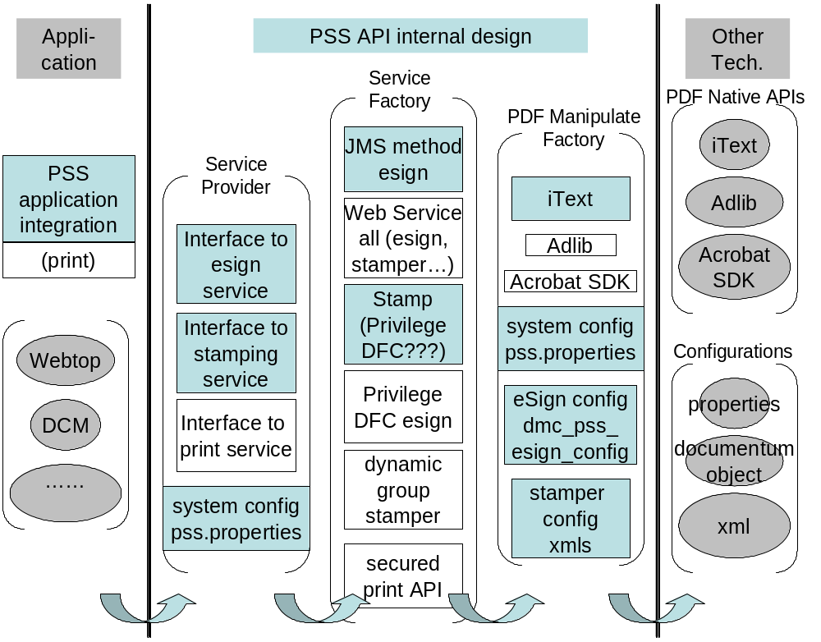
How does PSS work?

Slide 6
Installation
PSS Knowledge Transfer

Slide 7
What need to be installed for PSS
PSS is a part of DCM installation and so no separate deployment in application server
- PssStamp dar installation by using Composer
Notes:
Keyboard time
Machine time

Slide 8
Configuration
PSS Knowledge Transfer

Slide 9
Agenda
How do I configure pss.properties for watermarking?
How do I create Acrobat Form for watermarking?
Supported Acrobat Form fields in PSS

Slide 10

How do I configure pss.properties for watermarking?
PSS uses Java properties file called pss.properties to store the PSS system configuration.
pss.properties is packed on pssproperties.jar of dcm.war, if you want to modify pss.properties, you need to extract it from pssproperties.jar and re-packed it again.

Slide 11
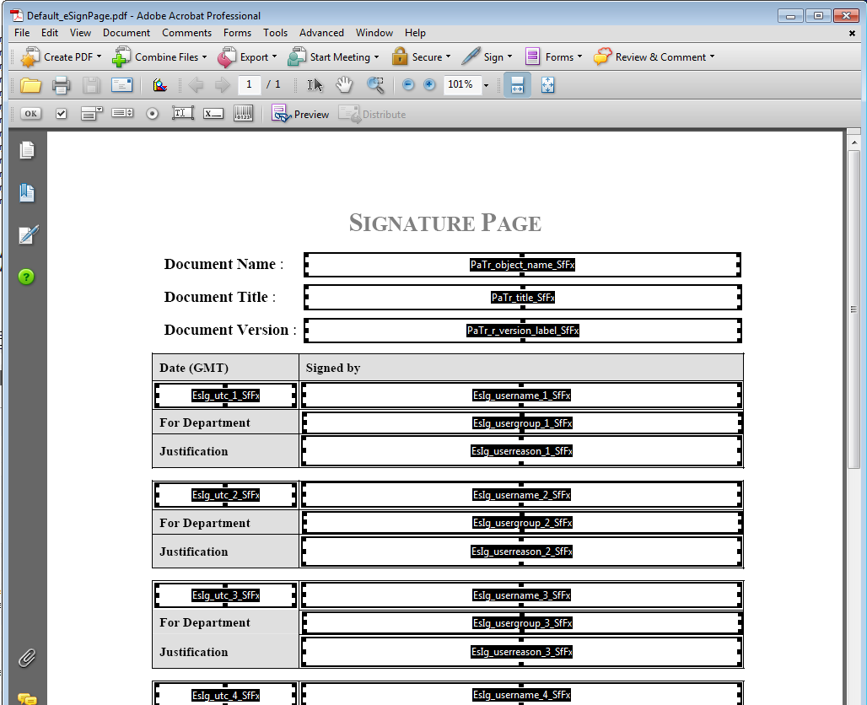
How do I create esignature template?
In Acrobat Professional (use Acrobat8.0 for example), either click on the Text Form icon or go to Tools -> Form Tools -> Forms Toolbar
click “Edit layout” button, eSignature template shows as following:

Slide 12
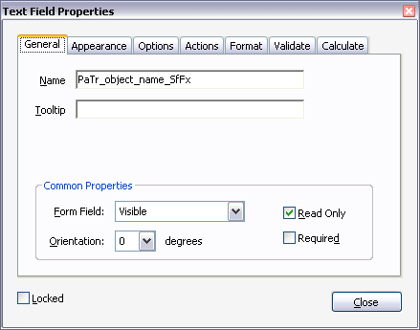
How do I create Acrobat Form for watermarking? - Continued
Double click on new added Text Form Field to edit

Slide 13
Supported Acrobat Form fields in PSS
All Acrobat Form Fields’ name must use one of supported prefixes and the supported suffix.
only accept suffix as “_SfFx”.
support the prefix as “PrFx_” for Text; Image and DateTime Fields. also support the following pre-defined prefixes for Text field in order to populate various values in the Text fields.
PaTr_: To populate the value of given Documentum object attribute. Values of repeating attributes are “;” delimited. As an example, text field with name as “PaTr_object_name_SfFx” is populated by using the object name of given object.
PlOc_: To populate the repository location of given object.
PuSr_: To populate the user name who requests for watermark/overlay.
PSS watermark supports page number and total page number displayed as a watermark on each
page. These new reserved fields are static fields of the text overlay:
• PcPn__SfFx, which displays the current page number
• PtPn__SfFx, which displays the total number of pages
To use these new fields:
1. Create a new text overlay in PSS
2. When prompted for the value of the field, choose static
3. The static value includes either PcPn__SfFx, or PtPn__SfFx, or both.
For example, Page PcPn__SfFx of PtPn__SfFx
displays as a watermark of Page 1 of 10

Slide 14
How do I setup overlay attributes when configuring watermark?
3 types of watermark template for overlay/underlay:
  PDF,
  Text, and
  Image.
3 types of acrobat form for PDF template:
  Text,
  Image, and
  DateTime
2 hierarchy types:
  DCTM object type, and
  DCM BA/DC.
  Custom configuration can be implemented to support additional requirements
Notes:
[Click next bullet]
[Click]

Slide 15
Customization of PSS
PSS Knowledge Transfer

Slide 16
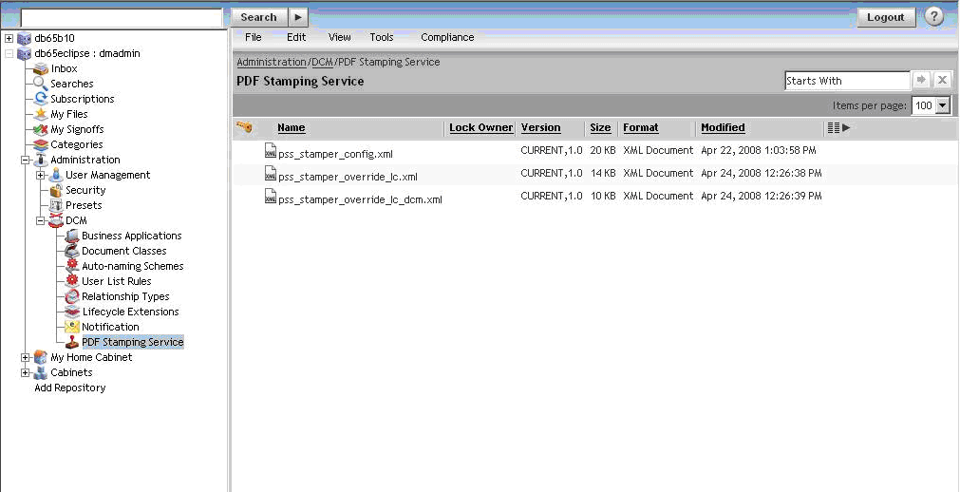
PDF Stamping Services (PSS)
Notes:
[Click]

Slide 17
customization configuration interface for watermark.
In case customers need to support different type of hierarchy; or need to have exceptions by using one of supported hierarchies, customers can implement the customization interface to support various requirements.
  public interface IPssOverridePlugin{
  String getConfigFileName(IDfSysObject object) throws PssException; }
  The interface has a public method getConfigFileName() which returns a configuration file. Customer can implement this method to return different configurations for different business scenarios.
Notes:
[Click on check mark to return to slide 6]

Slide 18
Customization of PSS Configuration (1)
Create all the required PSS configurations with whatever stamping details customer need
Check the sample file provided (psscustom.jar) to create the xml file similar to lifecycle_config.xml to define all the filter conditions and the stamping configuration that needs to be used for each condition
Create the customized class similar to LifecycleOverridePlugin to include the logic of selection of the stamping configuration based on the conditions specified in xml file
Jar the class file and the xml file similar to psscustom.jar and place it in WEB-INF/lib folder of the DCM application.
In PSS UI, for pss_stamper_config.xml, specify the customized class name in the override tab , entry new class to Plug-in name and plug-in implementation

Slide 19
Customization of PSS Configuration (2)
the simplest example for Customization
  package com.emc.documentum.pss.custom.impl;
  import com.documentum.fc.client.IDfSysObject;
  import com.emc.documentum.pss.common.config.api.IPssOverridePlugin;
  import com.emc.documentum.pss.common.exception.PssException;
  public class PssSamplePluginLC implements IPssOverridePlugin
  {
  public String getConfigFileName(IDfSysObject object) throws PssException
  {
  return "pss_stamper_override_lc.xml";
  }
  }

Slide 20
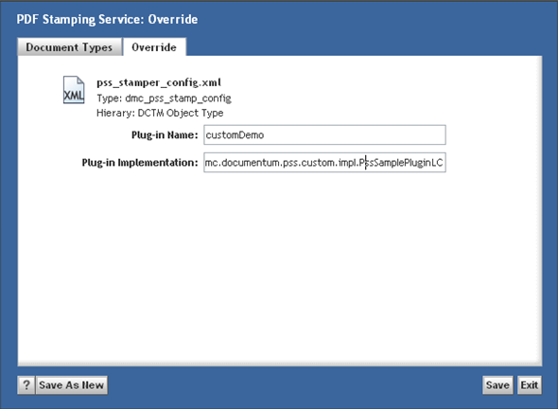
Customization of PSS Configuration (3)

Slide 21
DEMOSTRATION
PSS Knowledge Transfer

Slide 22
PSS Demo
DEMO

Slide 23
Troubleshooting
PSS Knowledge Transfer

Slide 24
Agenda
PSS Tracing
Issues faced by customer

Slide 25
PSS Tracing
PSS has 4 logging levels: DEBUG, INFO, WARN and ERROR.
DEBUG level messages are used to log the entering and exiting of PSS methods. In PssTrace methodEnter() and methodExit() use DEBUG level.
INFO level messages are used to log extra information during a method call. In PssTrace infoLog() method uses INFO level.
WARN level messages are used to log class name, total jvm memory used, total free jvm (in bytes) and the message itself. In PssTrace meterRead() method uses WARN level.
ERROR level messages are used to log exceptions. In PssTrace exceptionLog() method uses ERROR level.
Notes:
Description
How to enable trace
Format
Location
Sample log file

Slide 26
PSS Tracing - Continued
To enable PSS trace, Modify the log4j.properties to append to the following:
# ------------ PSS log4j configuration-----------------
#DO NOT ALTER THESE COMMENTS OR MOVE THIS CONFIGURATION OUTSIDE OF THIS SECTION
#Set the level to DEBUG if you want to log all messages
log4j.appender.PSSAppender.threshold=DEBUG
log4j.category.pss=DEBUG,PSSAppender
log4j.appender.PSSAppender=org.apache.log4j.DailyRollingFileAppender
log4j.appender.PSSAppender.File=C:/Documentum/logs/pss1.log
log4j.appender.PSSAppender.Append=true
log4j.appender.PSSAppender.layout=org.apache.log4j.PatternLayout
log4j.appender.PSSAppender.layout.ConversionPattern=%d{HH:mm:ss,SSS} %5p [%10t] %c{1} %5x %m%n
log4j.appender.PSSAppender.DatePattern=’.’yyyywwdd

Slide 27
Issues faced by customer
Issue: Print button is enabled for control documents while viewing. How to disable it?
Cause: Pdf Security may not be set in PSS configuration
Solution: Use Pdf Security to disable Print button for View action
Cause: Owner and user password may be set as same in Pdf Security
Solution: Set Owner and user password differently

Slide 28
Issues faced by customer - Continued
Issue: In a multi page document, the template page is not properly selected and applied
Cause: There may be minor variations in page size of the document.
Solution: Change in pss match algorithm in pss.properties.

Slide 29
Issues faced by customer - Continued
Issue: How to override PSS for customer specific use cases?
Solution: Utilize the override tab to specify the customizations done by customer for PSS

Slide 30
Limitations
PSS Knowledge Transfer

Slide 31
Limitations
Cannot disable overlays for specific pages / signature pages in a controlled document
PSS supports only the default fonts provided by iText (Helvetica, Courier).
It is not possible to configure PSS to leave some pdf form fields from pdf template as form fields after the overlay is applied

