Slide 1
Content Transformation Services 5.3
Knowledge Transfer
April 2005
Davinder Jhattu
Sheeba Padmanabhan
Kham Chang

Slide 2
Agenda
Terminology Used
Product Overview for 5.3
How the CTS products work
What is New in 5.3
CTS 5.3 Admin client
Installation & Setup
Troubleshooting
Question & Answer
Content Transformation Services Knowledge Transfer

Slide 3
Terminology Used
CTS – Content Transformation Services is a framework for Documentum server-side products that provide transformations and analysis for content. CTS products:
  DTS - Document Transformation Services (Formerly CRS, Auto-Render Pro)
  ADTS - Advanced Document Transformation Services
  MTS - Media Transformation Services (Formerly Media Services)
  AVTS – Audio Video Transformation Services
  MITS – Medical Imaging Transformation Services
Content Transformation Services Knowledge Transfer

Slide 4
Agenda
Terminology Used
Product Overview for 5.3
How the CTS products work
What is New in 5.3
CTS 5.3 Admin client
Installation & Setup
Troubleshooting
Question & Answer
Content Transformation Services Knowledge Transfer

Slide 5
CTS Overview
Content Transformation Services is a suite of Documentum server side products that provide transformations and analysis for all content.
The home for all server side transformations.
Content Transformation Services Knowledge Transfer

Slide 6
CTS Overview
5 CTS Products !
Highlights:
Each Product provides different transformation and analysis features for different content formats
Products can be deployed individually or all at once
All products utilize a common framework
Fully extensible through Software Development Kit (SDK) and invoked through common API
Software Development Kit
Document Transformation Services (DTS)
Advanced Document Transformation Services (ADTS)
Audio/Video Transformation Services (AVTS)
Common Architecture
Media Transformation Services (MTS)
Medical Imaging Transformation Services (MITS)
Content Transformation Services Knowledge Transfer

Slide 7
CTS Overview
Document Transformation Services
Replaces CRS (aka Auto-Render Pro)
Document based Transformations
Auto-transform on import
Advanced Document Transformation Services
Additional format support (MS Project,
Visio, AutoCAD, Multi-page TIFF)
Creates bookmarks and preserves links
Transformation UI in WDK
applications
Active storyboard (DAM only)
Software Development Kit
Document Transformation Services (DTS)
Advanced Document Transformation Services (ADTS)
Common Architecture
Content Transformation Services Knowledge Transfer

Slide 8
CTS Overview
Media Transformation Services
Rich media transformations and analysis
Thumbnail delivery
PowerPoint assembly
Read and write metadata
Audio/ Video Transformation Services
Audio/Video Formats, Animations
Medical Imaging Transformation Services
Medical Imaging – DICOM support
Software Development Kit
Audio/Video Transformation Services (AVTS)
Common Architecture
Media Transformation Services (MTS)
Medical Imaging Transformation Services (MITS)
Content Transformation Services Knowledge Transfer

Slide 9
Agenda
Terminology Used
Product Overview for 5.3
How the CTS products work
What is New in 5.3
CTS 5.3 Admin client
Installation & Setup
Troubleshooting
Question & Answer
Content Transformation Services Knowledge Transfer

Slide 10
Where CTS Fits
DAM
Web
Publisher
DA
CTS Admin
Agent
CTS API
CTS API
Streaming
Server
Thumbnail
Server
CS
Common Architecture
Java Method
Server
DTS
ADTS
MTS
AVTS
Streaming
File
Store
Thumbnail
File
Store
DB
File
Store
MITS
Content Transformation Services Knowledge Transfer

Slide 11
CTS Architecture
Common Architecture
DFC
Queue Poll
Content
Server
Thread Pool
Task
Task
Task
Plug-In API
Thumbnail Server
File Store
AAES MP
Altercast
MP
IMG
MP
MP X
Supporting Plug-in Libraries
Content Transformation Services Knowledge Transfer

Slide 12
Architecture Enhancements
Architectural unification
The CRS functionality is ported to the existing, proven architecture of Media Services (MS)
The advantages of a unified architecture are:
  Better stability and robustness using a proven architecture
  Runs as unattended Windows Service
  Support for parameterized processing and job options
  Create new renditions automatically at import time
  Script for Batch transformation requests
  Common SDK for extending functionality through custom plug-ins
  Common code-base for Documentum engineering to maintain and upgrade
  Ability to install DTS and MTS on the same machine
Content Transformation Services Knowledge Transfer

Slide 13
Agenda
Terminology Used
Product Overview for 5.3
How the CTS products work
What is New in 5.3
CTS 5.3 Admin client
Installation & Setup
Troubleshooting
Question & Answer
Content Transformation Services Knowledge Transfer

Slide 14
Functionality Overview – What’s new in 5.3
Multiple Configurations on Single Process
CTS Supports the ability to process multiple repositories with a single CTS instance, as well as having multiple CTS instances service the same repository.
Multiple queue and Multiple repository handling
CTS processes two job queue items, the default dm_mediaserver queue and the legacy queue items, those are created by client applications using dm_autorender_win31 queue.
XML Application to support Profiles
MediaProfile XML App is enhanced to support dm_media_profile creation directly on import, reducing the maintanance on CTS. So on an import / checkin of an atomic profile (NOT for a chain or sequence profile), the CTS service is not necessary to be restarted.
Content Transformation Services Knowledge Transfer

Slide 15
What’s new in 5.3 Contd…
Transformation Versioning
A Flag is set to Automatically Re-apply transformation when source is versioned. When content is versioned all flagged transformations that existed for the previous version are automatically generated for the new version.
New CTS Windows Service
CTS uses a new executable CTS.exe, instead of the third party product ‘sRunner’ to enable CTS to run as a windows service.
Ticketed Login
CTS uses the client’s user session, instead of the super-user to perform the transformations.
Content Transformation Services Knowledge Transfer

Slide 16
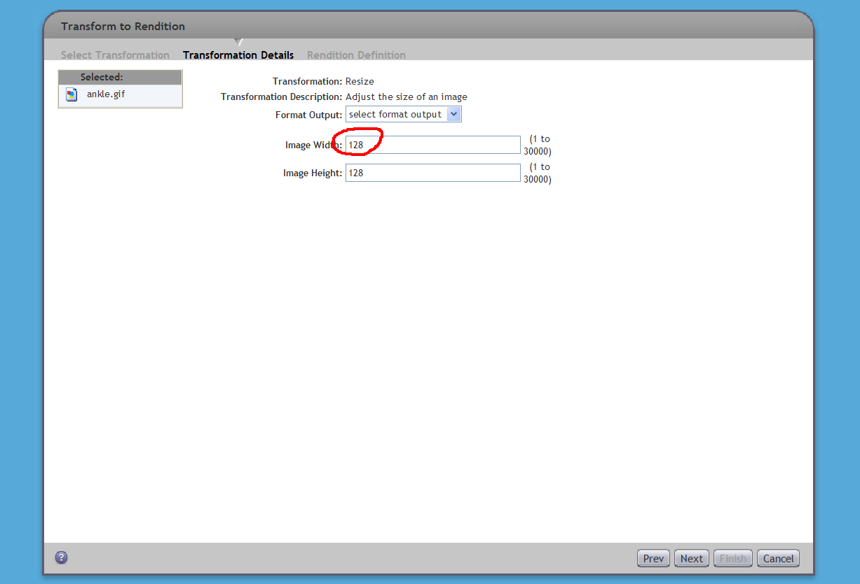
What’s new in 5.3 Contd…
XML transformation profiles improvements
DQL in profiles for default values
<Parameter name="doc_token_width" label="Image Width" controltype="range" datatype="integer" dql="select content_attr_value from dmr_content_r where content_attr_name='Width'">
</Parameter>
Content Transformation Services Knowledge Transfer

Slide 17
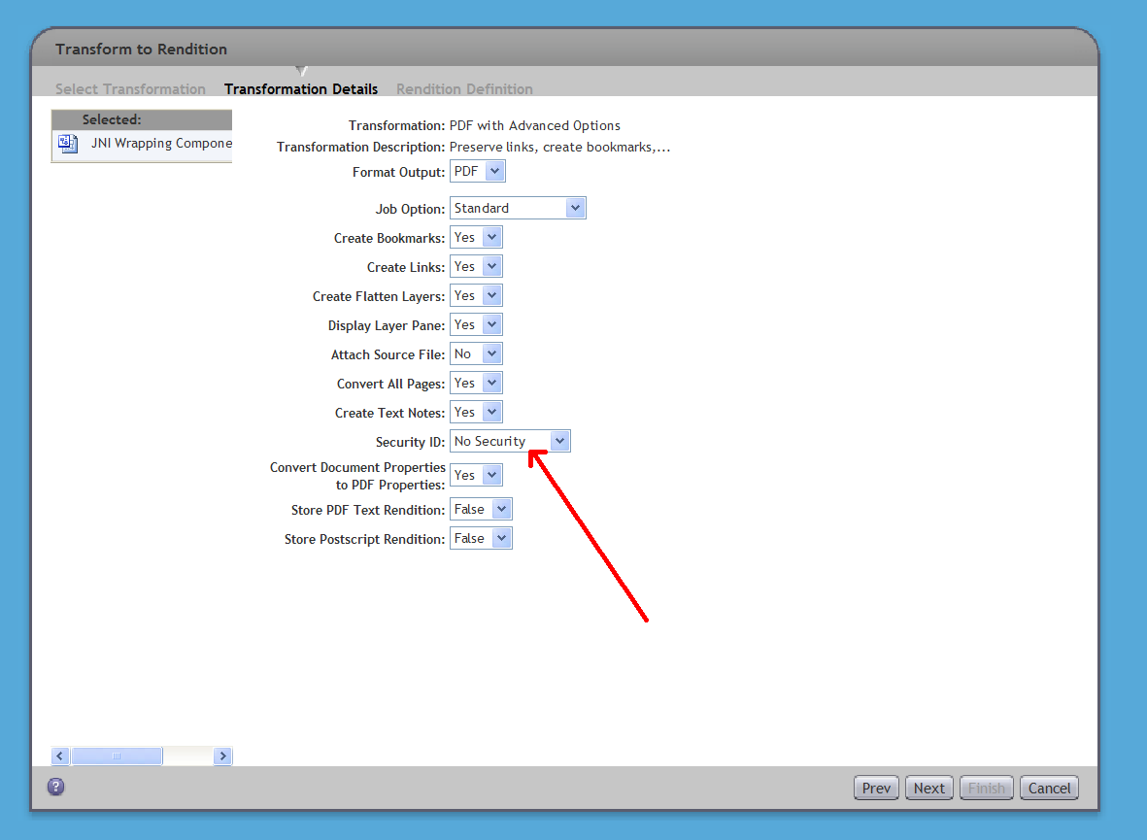
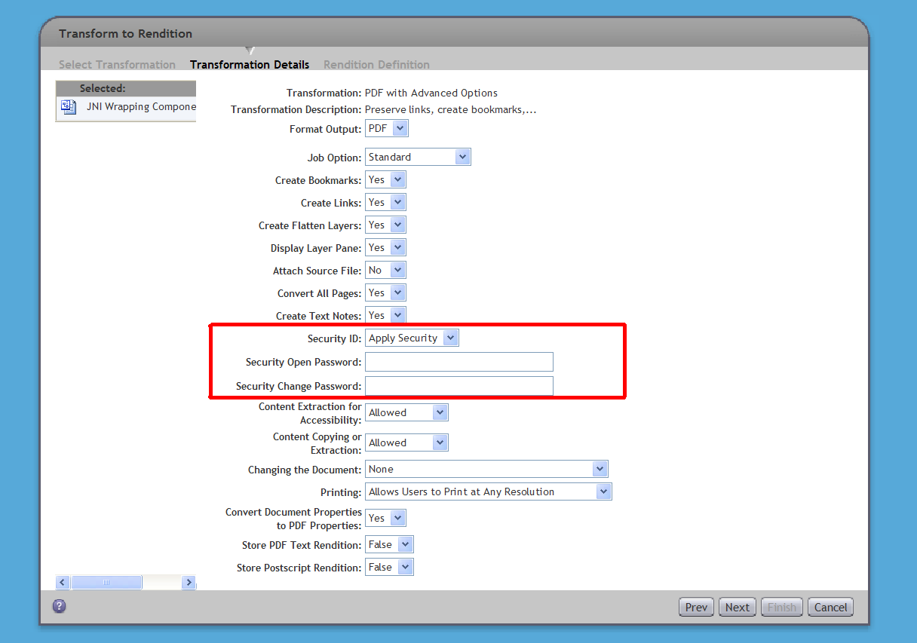
DTD changes Contd…
Conditional parameters (the displaying of parameters can be dependent on the value of other parameters)
<Parameter name="doc_token_securityID" label="Security ID" description="Enables the application of Acrobat Standard Security to a generated PDF file" controltype="list" datatype="string">
<ValueList>
<Value label="No Security">0</Value>
<Value label="Apply Security">1</Value>
</ValueList>
</Parameter>
<Parameter name="doc_token_secOpass" label="Security Open Password" description="Password required to open a PDF file" default=" " controltype="text" datatype="string">
<Value label="Security Open Password"/>
<depends-on-param param-name="doc_token_securityID" action="hide">
<Value label="No Security">0</Value>
</depends-on-param>
</Parameter>
Content Transformation Services Knowledge Transfer

Slide 18
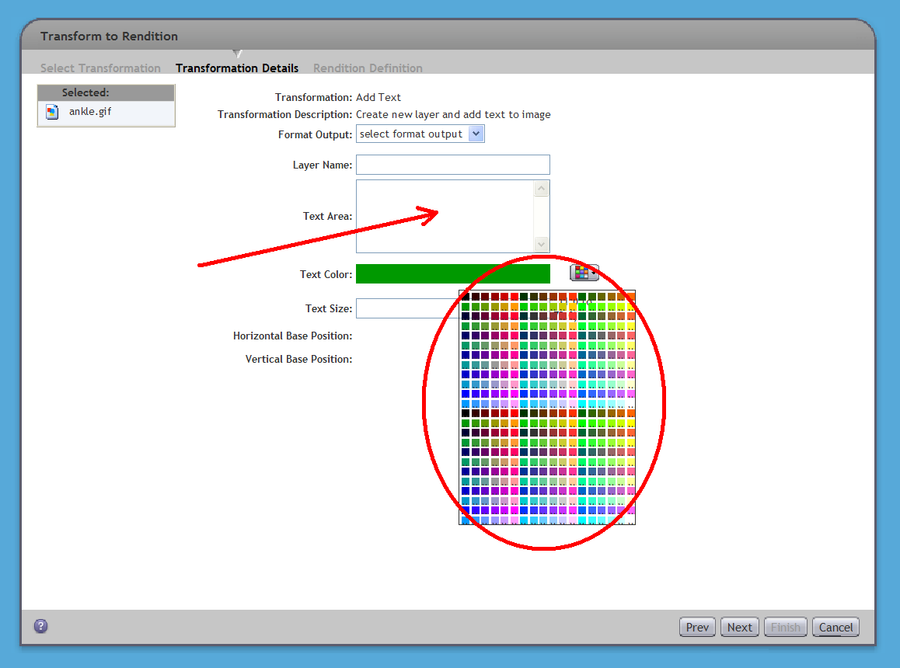
DTD Changes COntd…
New Control Types
(list | range | text | text-block | color-picker | object | listbox)
Text Block Control Type
Color-picker Control Type
Object Control Type
Content Transformation Services Knowledge Transfer

Slide 19
What’s new in 5.3 Contd…
Persistent Instance Capabilities
A new cts_instance_info object is created in the repository, as part of CTS configuration. This instance stores the information regarding the CTS, like product information, plug-ins information, versions, agent_url etc.
Multi-Language Support
A single instance can support multiple languages simultaneously. Previously a single instance of Media Services supported only one language at a time.
Default Preview Settings
CTS has the ability to set the default preview for objects in 5.3 on import or transform request. The register profile is modified to enable this configuration. By default, jpeg_lres rendition is set for default preview for all the formats except for video format, for which a streamable Quicktime format is set as default preview.
<InnerProfile path="/System/Media Server/System Profiles/autoGenProxy" waitOnCompletion="false" useTargetFormat="true">
<InnerTokenMapping LocalProfileToken="jpeg_lres" InnerProfileToken="default_proxy_format" Literal="true"/>
</InnerProfile>
Content Transformation Services Knowledge Transfer

Slide 20
What’s new in 5.3 Contd…
CTS Transformation API
  - CTS Transformation API allows WDK based applications (or any custom client) to create and submit transformation requests based on ProfileSubmission dtd.
  The same API is used by CTS products for reading the request
  - CTS Transformation API is deployed through DTS/MTS installations.
  Supports backward compatibility from Media Services 5.2.5
Content Transformation Services Knowledge Transfer

Slide 21
CTS Transformation API Contd…
CTS products are exposed in Documentum clients
  All clients - DTS (not exposed in transformation wizard)
  All clients - ADTS
  DAM, Web Publisher - MTS
  DAM, Web Publisher - AVTS
  DAM, Web Publisher - MITS
Bulk transformation capabilities supported for all clients
Content Transformation Services Knowledge Transfer

Slide 22
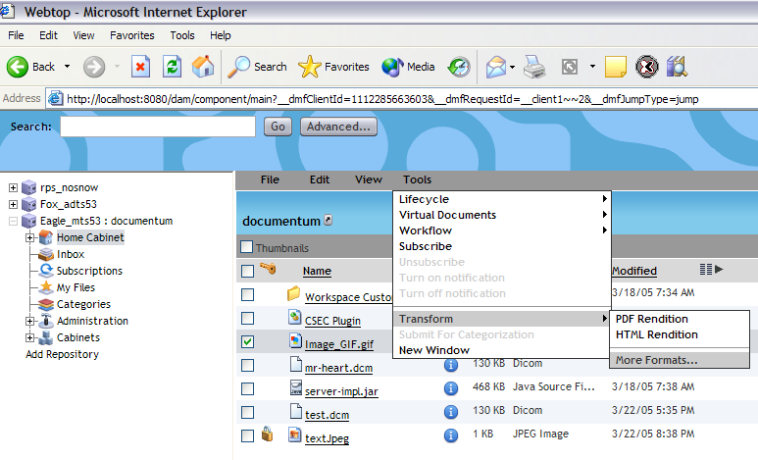
CTS Transformation API Contd…
If Repository is enabled for transformation, it can be launched by selecting one or more objects in classic view and selecting from Tool menu Transform->More Formats… submenu
Content Transformation Services Knowledge Transfer

Slide 23
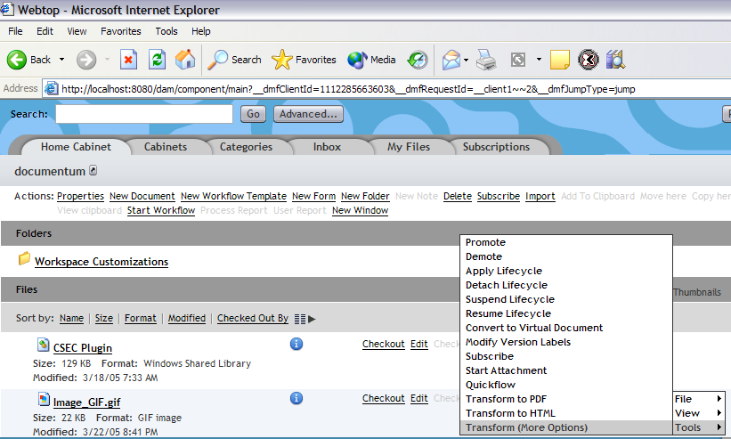
CTS Transformation API Contd…
CTS
Launching transformation from streamline view
Content Transformation Services Knowledge Transfer

Slide 24
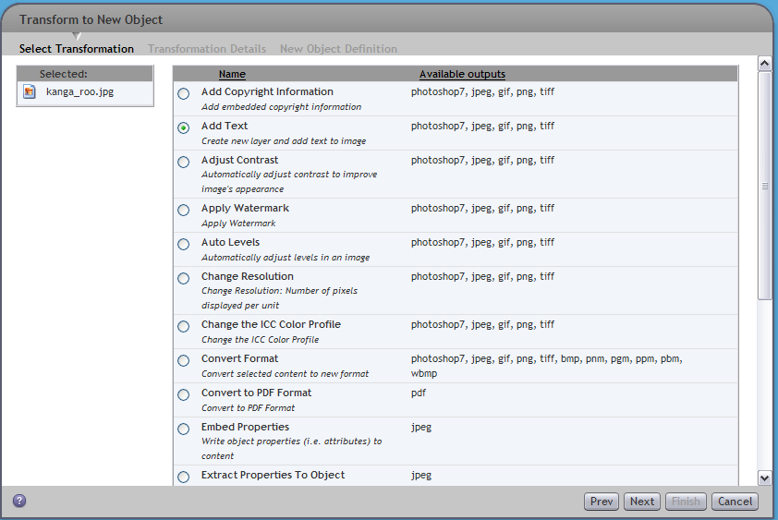
CTS Transformation API Contd…
This panel is common for both type of transformation
Content Transformation Services Knowledge Transfer

Slide 25

MTS – Media Transformation Services
Transforms Images, PPT and PDF formats
IRW, EPS, PDF Plug-ins are replaced with new plug-ins
IMG Plug-in is added for image processing
PDFStorybard Plug-in is added for PDF thumbnail and storyboard process
New Profiles are added like watermark, changeResolution, changeColorMode, addTextBlocks etc
MTS
Adobe Altercast
IMG
New
PDFStoryboard
New
Windows OS
XMP
Power Point
Content Transformation Services Knowledge Transfer

Slide 26
New Plug-ins in MTS
IMG Media Plug-in
Based on JAI (Java Advanced Image) library
Supported Formats
Input Formats | Output Formats
Bitmap (MS windows)* GIF (graphics interchange format) FPX (FlashPIX) JPEG PNG (portable network graphics) PNM (PBM, PGM, PPM) WBMP (wireless bitmap; bi-level) | Bitmap (MS windows)* JPEG PNG (portable network graphics) PNM (PBM, PGM, PPM) WBMP (wireless bitmap; bi-level)
Content Transformation Services Knowledge Transfer

Slide 27
New Plug-ins in MTS
PDF Storyboard Plug-in
Creates thumbnails and storyboards for PDF Formats
Input Formats | Output Formats
PDF | JPEG
Content Transformation Services Knowledge Transfer

Slide 28
DTS Document Transformation Services
DTS 5.3
Document Transformation Services replaces Content Rendition Services/Auto-Render Pro
DTS continues to handle basic rendering of common document formats to PDF and HTML
Beyond the name change, there are important architectural changes that yield significant advantages
DTS
WORD
EXCEL
POWERPOINT
WORDPERFECT
DISTILLER
ACROBAT
CUSTOM OLE PLUGIN
Content Transformation Services Knowledge Transfer

Slide 29
ADTS – Advanced Document Transformation Services
ADTS 5.3
Add-on to DTS
Support for active bookmarks and hyperlinks in PDF output
Additional format support (e.g. Visio, MS Project, AutoCAD, multi-page TIFF)
Transformation User Interface
Document thumbnails and storyboards
ADTS
Adobe Element Server
New
PDFStoryboard
New
XMP
Content Transformation Services Knowledge Transfer
Notes:
ADTS
DTS is a prerequisite for ADTS
Bookmarks and Hyperlink Support
ADTS can be configured to automatically leverage the styles and bookmarks contained in MS Office documents and create bookmarks within the PDF output. It will automatically convert all URL text to clickable links and embedded URLs within a document, including internal cross-references (e.g. table of contents) within the document.
Transformation User Interface
All WDK clients will expose the transformation user interface if ADTS has been installed for that Repository. The interface allows users to manually request available transformations and supply parameters. The available transformations are completely configurable by an Administrator using XML files contained in the Repository.
Features of the Transformation UI:
Transform to new object
Flag to Automatically Re-apply transformation when source is versioned
Parameterize individual jobs
Bulk Transformation
Document thumbnails and storyboards
ADTS can (configurable) create thumbnails and storyboards for all supported document types for ease of previewing. Note that only the Digital Asset Manager web client displays storyboards.

Slide 30
AVTS , MITS …
AVTS
Some profiles are moved from Profile folder to System Profile folder
MWS plug-in is taken out.
To change a system profile to user profile
MITS
Dicom Plug-in in 5.2.5, is renamed to
MITS ( Medical Imaging Transformation Services)
<MediaEnabled category="AVTS"/>
<MediaEnabled category="System"/>
<MediaEnabled category="AVTS"/>
<MediaEnabled category=“Public"/>
Content Transformation Services Knowledge Transfer

Slide 31
Agenda
Terminology Used
Product Overview for 5.3
How the CTS products work
What is New in 5.3
CTS 5.3 Admin client
Installation & Setup
Troubleshooting
Question & Answer
Content Transformation Services Knowledge Transfer

Slide 32
Introduction
CTS Administration Client allows for a convenient way to make changes to any CTS install.
Provides a simple interface for administrators to make changes without knowledge of the XML configuration files.
Allows for viewing of CTS logs from the CTS server machine.
Gives administrators control over the CTS server.
Content Transformation Services Knowledge Transfer

Slide 33
Functionality Overview
New Functionality
  List installed CTS instances
  Start/Stop/Refresh a CTS Instance
  View CTS Instance Details
  Change CTS Instance User and Password
  Change CTS Instance Configuration
  View CTS Instance log files
Content Transformation Services Knowledge Transfer

Slide 34
Functionality: List Installed CTS Instances
CTS admin. functionality can be accessed by selecting the administration node, and then Content Transformation Services.
Once a CTS instance has been selected, various actions can be performed using that instance.
These are made available from
  menu:tools/Content Transformation Services
Content Transformation Services Knowledge Transfer

Slide 35
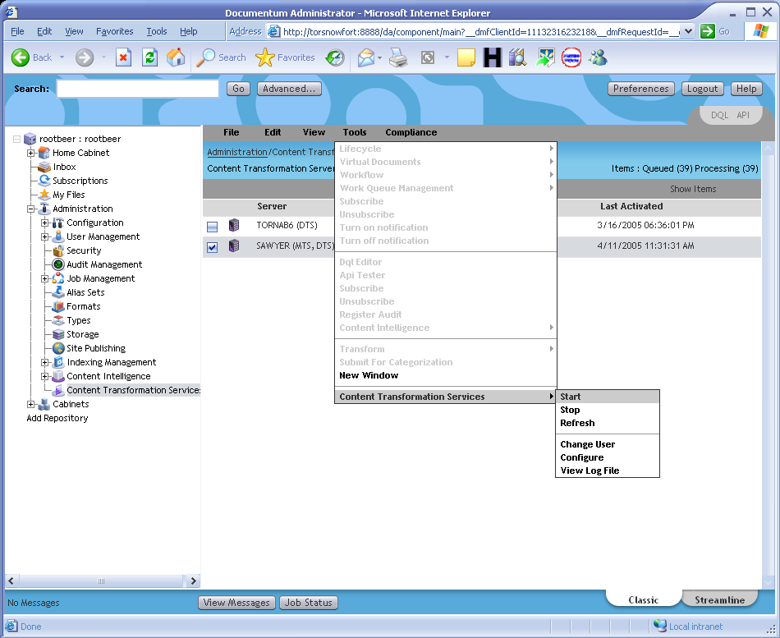
Functionality: CTS Instance menu (screen)
Content Transformation Services Knowledge Transfer

Slide 36
Functionality: Start/Stop/Refresh
Once a CTS instance has been selected the user has the option to:
  Start
  Stop
  Refresh Configuration
Refreshing the configuration after changes will prompt the user.
User information, and Logging level will not be refreshed using this feature.
NOTE: These functions operate on the CTS process, and not the individual plug-ins.
Content Transformation Services Knowledge Transfer

Slide 37
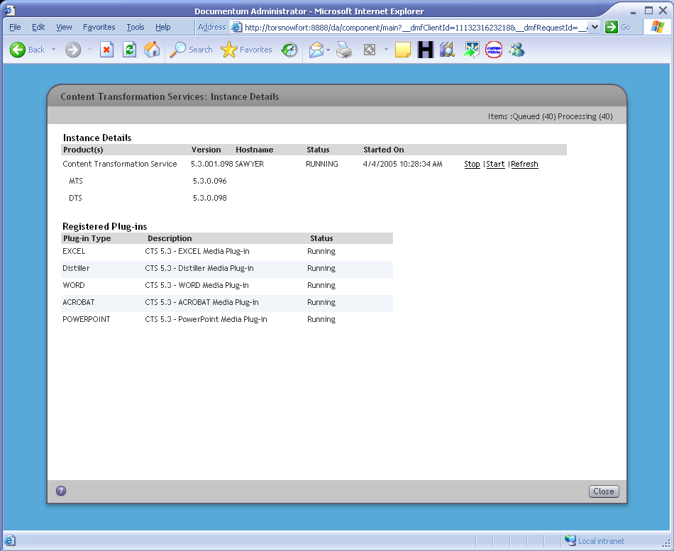
Functionality: View Instance details
Selecting the (i) icon on the listing page will display the instance details.
The user also has the same options to manage the process as per the menus. (start/stop/refresh)
Content Transformation Services Knowledge Transfer

Slide 38
Functionality: Change Configuration & User
Updates the configuration files for the selected Instance. Fields updated are as follows:
  Polling Interval (How often should CTS retrieve queue items)
  Logging Level (Log4J logging level for CTS)
  Operator (Notification User)
  Send Notification (Send notifications to the operator?)
  Max Queue Items to Sign Off
  Max Queue Item Age
Changing of the user and password which CTS uses to initialize itself.
Content Transformation Services Knowledge Transfer

Slide 39
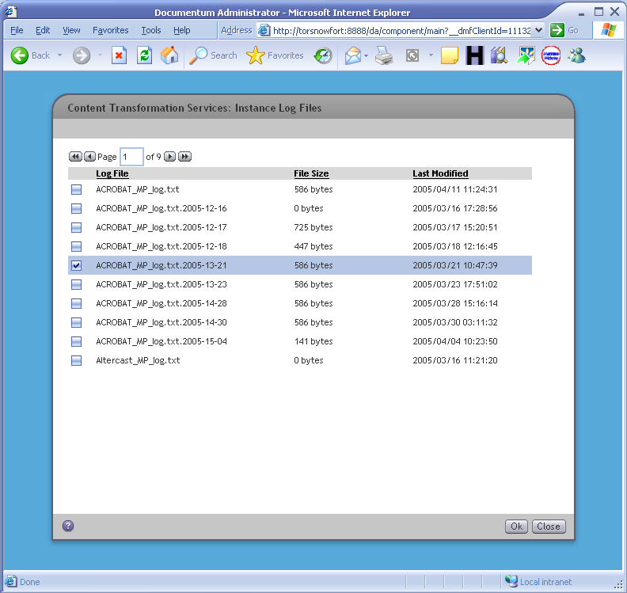
Functionality: View CTS instance log files
Allows for viewing of log files from the CTS server.
Check the file to view and select the “ok” button. The log file will be opened on the client side with the default viewing application for that file type.
Content Transformation Services Knowledge Transfer

Slide 40
In-depth Architecture: Breakdown
Server related calls are routed to the CTS Admin. Agent(2) on the CTS machine.
A Java Server Method(1) on the CS (CTSAdmin) is called with the action, and also the instance id (cts_intance_info) of the CTS Instance.
DA
2
CTS Admin
Agent
Common Architecture
DTS
1
ADTS
CS
Java Method
Server
MTS
AVTS
MITS
Content Transformation Services Knowledge Transfer

Slide 41
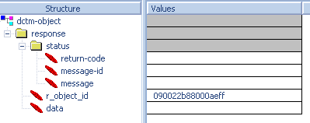
In-depth Architecture: Transactions
Responses from the agent are in XML format.
Responses such as the CTS instance process state are returned as the “message” portion of the XML. More complex items such as the log listing is stored in the <data> element and is processed accordingly.
Log files to be viewed are stored in the docbase, and the objectid is returned in the response indicating which document to present to the user.
Content Transformation Services Knowledge Transfer

Slide 42
Agenda
Terminology Used
Product Overview for 5.3
How the CTS products work
What is New in 5.3
CTS 5.3 Admin client
Installation & Setup
Troubleshooting
Question & Answer
Content Transformation Services Knowledge Transfer

Slide 43
Installation and Setup
Host Requirements
Windows 2003 Server (32 bit version)*, Windows 2000 Server SP4
Requires Documentum Foundation Classes (DFC) 5.3, will be installed by CTS if not already installed.
Requires Documentum Content Server 5.2.5, 5.2.5 SPx, 5.3
Content Transformation Services Knowledge Transfer

Slide 44
Installation & Setup Sequence
Installation Sequence
MTS and DTS can be installed one after another
AVTS, MITS can only be installed after MTS
ADTS can only be installed after DTS
MTS
DTS
AVTS
MITS
ADTS
Content Transformation Services Knowledge Transfer

Slide 45
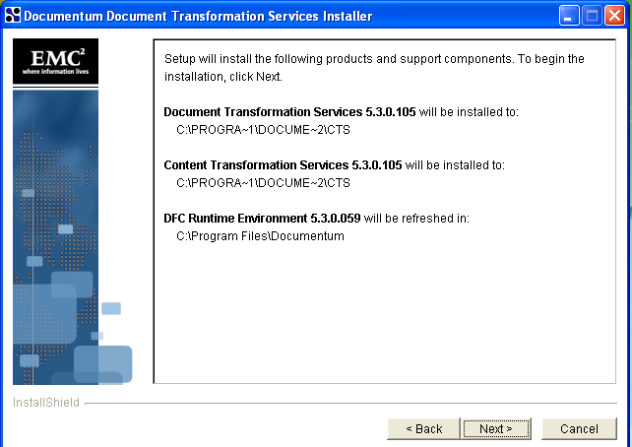
DTS Installation and Setup
Installing and Conguring Document Transformation Server is a 2 step process
Step 1: Run the DTS installer, which will deploy CTS framework and DTS code and install DFC
Content Transformation Services Knowledge Transfer

Slide 46
DTS Installation and Setup
  Step 2: After running the installer, the user must configure a DTS instance with Configurator :
  Start->Programs->Documentum->DTS Instance Add or Remove
  - User will be queried for connection info.
  - Configuration info (profiles) will be deployed for each
  repository instance to the folder
  <DCTM_HOME>/CTS/docbases/<docbaseName>/
  - Configurator will install MediaProfile and
  CTSTransformRequest XML applications into
  the repository
  - Start CTS Windows services
Content Transformation Services Knowledge Transfer

Slide 47
ADTS Installation and Setup
Installing and Conguring ADTS is a 2 step process
Step 1: Run the ADTS installer, which will deploy ADTS plugin jars code and profile, install Adobe Acrobat Element server.
Step 2: Run the ADTS configurator, which will imports profiles, and also updates certain profiles that are involved in providing ADTS functionality.
Content Transformation Services Knowledge Transfer

Slide 48

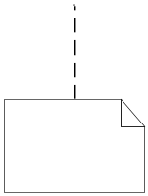
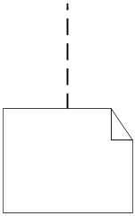
ADTS Installation and Setup
document_to_pdf profile migration when adding ADTS:
1. Check out document_to_pdf dm_media_profile
….
<CommandFilePath mptype="WORD">
/System/Media Server/Command Line Files/document_to_pdf.xml
</CommandFilePath>
……
3. Check-in the modified document_to_pdf profile to the repository, with the modifed entry for AAES command line file and formats.
transform
2. Execute the document_to_pdf.xslt script on the document_to_pdf profile through the Xalan transformation library
<CommandFilePath mptype="AAES">
/System/Media Server/Command Line Files/defaultJobOptionsForAES.xml
</CommandFilePath>
<CommandFilePath mptype="WORD">
/System/Media Server/Command Line Files/document_to_pdf.xml
</CommandFilePath>
….
<xsl:template match="Transcodings“>
<xsl:copy> <xsl:copy-of select="@*"/>
<xsl:apply-templates/> </xsl:copy>
….
Content Transformation Services Knowledge Transfer

Slide 49
MITS, AVTS, MITS Installation
Installing and Conguring MTS, AVTS, or MITS is a 2 step process
Step 1: Run the particular product installer, which will deploy that products code and profile, and install any required product
Step 2: Run the configurator, which will imports profiles, and also updates certain profiles that are involved in providing functionality for a particular product.
Content Transformation Services Knowledge Transfer

Slide 50
CTS DA Client Installation & Setup
Installation
  The CTS Admin Agent is installed with either MTS or DTS.
  A port is assigned to the agent during install time, and an entry (agent_url) is added to the cts_instance_info object during the installation to indicate where the agent is running.
Content Transformation Services Knowledge Transfer

Slide 51
Agenda
Terminology Used
Product Overview for 5.3
How the CTS products work
What is New in 5.3
CTS 5.3 Admin client
Installation & Setup
Troubleshooting
Question & Answer
Content Transformation Services Knowledge Transfer

Slide 52
Troubleshooting
CTS separate logging by repositories:
Followings are custom-configurations for separate logging in log4j.properties.
#------------------- CTSLog Config --------------------------
com.documentum.separatelogging.enabled=true
com.documentum.separatelogging.docbasesepath=C:\\Program Files\\Documentum\\MediaServer\\docbases
com.documentum.separatelogging.logsubfolder=\\config\\logs\\
# Following repositories are excluded from separate logging.
# Logs for these repositories are written to repository-neutral log files
# excluded repositories names should be separated by comma(,)
com.documentum.separatelogging.excludeddocbases=
#------------------- CTSLog Config --------------------------
Content Transformation Services Knowledge Transfer

Slide 53
Troubleshooting
If the Windows Service for the CTS instance is started, but nothing is being processed, start CTS from a batch file for more verbose error reporting: <DCTM_HOME>/CTS/server_install/CTSService/startCTS.bat
The CTS Service must be restarted if a chain or sequence profile is modified.
Content Transformation Services Knowledge Transfer

Slide 54
Troubleshooting
Uninstalling CTS
Note: Follow the following procedure only if no other Documentum application is installed on the same machine
1) Stop the CTS and CTS Agent Services
  2) Uninstall Content Transformation Services (should work). You do not need to reboot yet.
  3) Uninstall DFC
  4) Reboot
  5) Delete the following folders and all contents:
  C:\Documentum
  C:\Program Files\Documentum
  6) Remove the remaining documentum products from Add/Remove Programs
  7) Open regedit
  8) Navigate to: HKEY_LOCAL_MACHINE\SOFTWARE
  9) Delete the Documentum entry
  10) Reboot the CTS machine to make sure everything is clean
  11) Login to DAM/Webtop/DA as an admin user
  12) Delete the Media Server folder, located in: \System (select all children and all versions when prompted during delete)
  13) Navigate to \System\Applications
  14) Delete the CTSTransformRequest and MediaProfile folder (select "All Objects", "All Versions", "All Descendants" when prompted)
  15) Run the following two DQL statements against the docbase, in this order:
  delete cts_instance_info object
  drop type cts_instance_info
  16) You can now start the installation of DTS/MTS
Content Transformation Services Knowledge Transfer

Slide 55
Troubleshooting
Workarounds (for missing sc.exe utility)
  Problem: Windows 2000 Server does not ship with a utility sc.exe which the agent uses to perform service operations. Status will not be displayed, and Administrators will not be able to manage the CTS service.
  Solution: There is a free download from the Microsoft website which will install the utility onto the machine.
  http://www.microsoft.com/netserver/nts/downloads/recommended/ntkit/default.asp
Content Transformation Services Knowledge Transfer

Slide 56
Troubleshooting: Open Bugs
Open Bugs
  97116
    Stop, Start and Refresh buttons on the CTS: Instance Details screen are displayed incorrectly (xxMSG_STOP_BUTTONxx), when DA is installed on Solaris (windows content server)
Content Transformation Services Knowledge Transfer

Slide 57
Limitations and Restrictions
CTS Admin Agent will fail to respond if the systems does not have temp directory defined (#96405)
  The CTS Admin Agent (which installs Apache Tomcat) needs to have the temp directory. On some machines the temp directory is not defined; the CTS Admin Agent needs this to locate a temporary storage location for it to work with. This is defined in the Environment Variables TEMP or TMP. Tomcat also has a Environment variable which can be used to override this to a different location
Content Transformation Services Knowledge Transfer

Slide 58
Q & A
Are there any questions?
Content Transformation Services Knowledge Transfer

