Slide 1

ZFS
From now to then
Linda Kateley
Nexenta Systems
2012

Slide 2

Trouble With Existing Filesystems
No defense against silent data corruption
    Any defect in disk, controller, cable, driver, or firmware can corrupt data silently; like running a server without ECC memory
Difficult to manage
    Disk labels, partitions, volumes, provisioning, grow/shrink, hand-editing /etc/vfstab...
    Lots of limits: filesystem/volume size, file size, number of files, files per directory, number of snapshots, ...
    Not portable between x86 and SPARC
Performance could be much better
    Linear-time create, fat locks, fixed block size, naïve prefetch, slow random writes, dirty region logging

Slide 3
ZFS Objective
End the suffering
Design an integrated system from scratch
Throw away 20 years of obsolete assumptions

Slide 4



Evolution of Disks and Volumes
File System
File System
File System
Initially, we had simple disks
Abstraction of disks into volumes to meet requirements
Industry grew around HW / SW volume management
Volume Manager
Volume Manager
Volume Manager
Lower 1GB
Upper 1GB
Even 1GB
Odd 1GB
Left 1GB
Right 1GB
Concatenated 2GB
Striped 2GB
Mirrored 1GB

Slide 5
ZFS Design Principles
Start with a new design around today's requirements
Pooled storage
  Eliminate the notion of volumes
  Do for storage what virtual memory did for RAM
End-to-end data (and metadata) integrity
  Historically considered too expensive.
  Now, data is too valuable not to protect
Transactional operation
  Maintain consistent on-disk format
  Reorder transactions for performance gains – big performance win by coalesced I/O

Slide 6
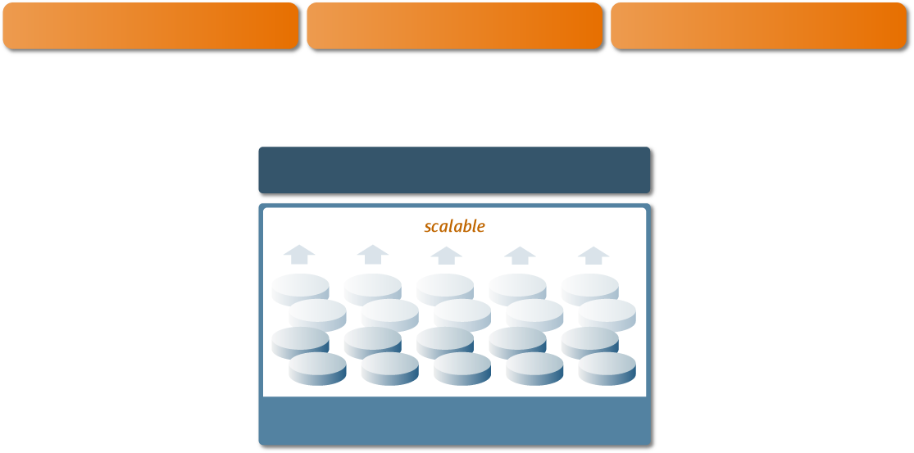

FS/Volume Model vs.
ZFS
Traditional Volumes
1:1 FS to Volume
Grow / shrink by hand
Limited bandwidth
Storage fragmented
ZFS Pooled Storage
No partitions / volumes
Grow / shrink FS automatically
All bandwidth always available
All storage in pool is shared
FS
ZFS
ZFS
ZFS
Volume Manager

Slide 7
ZFS pool fundamentals
ZFS data lives in pools. A system can have multiple pools
ZFS pools can have different storage properties: one more more disks simple, mirrored, or RAID (several styles), optionally with separate cache or “intent log” devices
A ZFS pool is composed of multiple virtual devices (vdevs) that are based on either physical devices (eg: a disk) or groups of logically linked disks (eg: a mirror or RAID group)
Each pool can have multiple ZFS file systems, which may be nested, and can each have separate properties (such as quotas, compression, record size), ownership, be separately snapshoted, cloned, etc.
zpool command manages pools, zfs command manages FS

Slide 8
FS / Volume Model vs. ZFS
ZFS I/O Stack
FS / Volume I/O Stack
ZFS to Data Mgmt Unit
  Object-based transactions
  “Change these objects”
  All or nothing
DMU to Storage Pool
  Transaction group commit
  All or nothing
  Always consistent on disk
  Journal not needed
SP to Disk
  Schedule, aggregate, and issue I/O at will – runs at platter speed
  No resync if power lost
FS to Volume
  Block device interface
  Write blocks, no TX boundary
  Loss of power = loss of consistency
  Workaround: journaling – slow & complex
Volume to Disk
  Block device interface
  Write each block to each disk immediately to sync mirrors
  Loss of power = resync
  Synchronous & slow

Slide 9
DATA
INTEGRITY

Slide 10
ZFS Data Integrity Model
Everything is copy-on-write
Never overwrite live data
On-disk state always valid – no fsck
Everything is transactional
Related changes succeed or fail as a whole
No need for journaling
Everything is checksummed
No silent corruptions
No panics from bad metadata
Enhanced data protection
Mirrored pools, RAID-Z, disk scrubbing

Slide 11

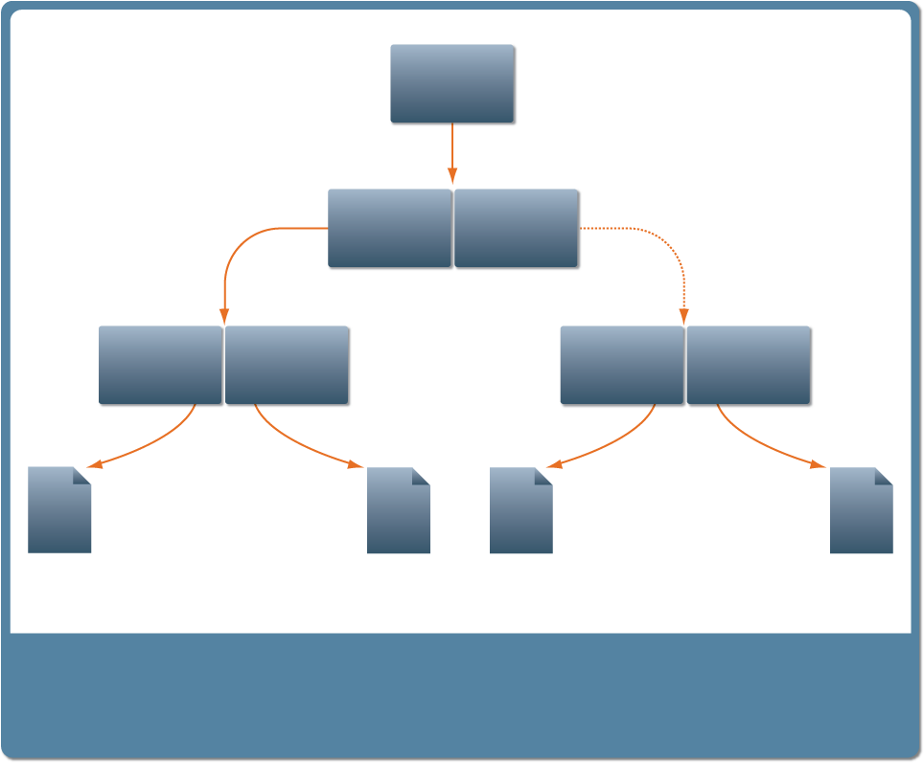
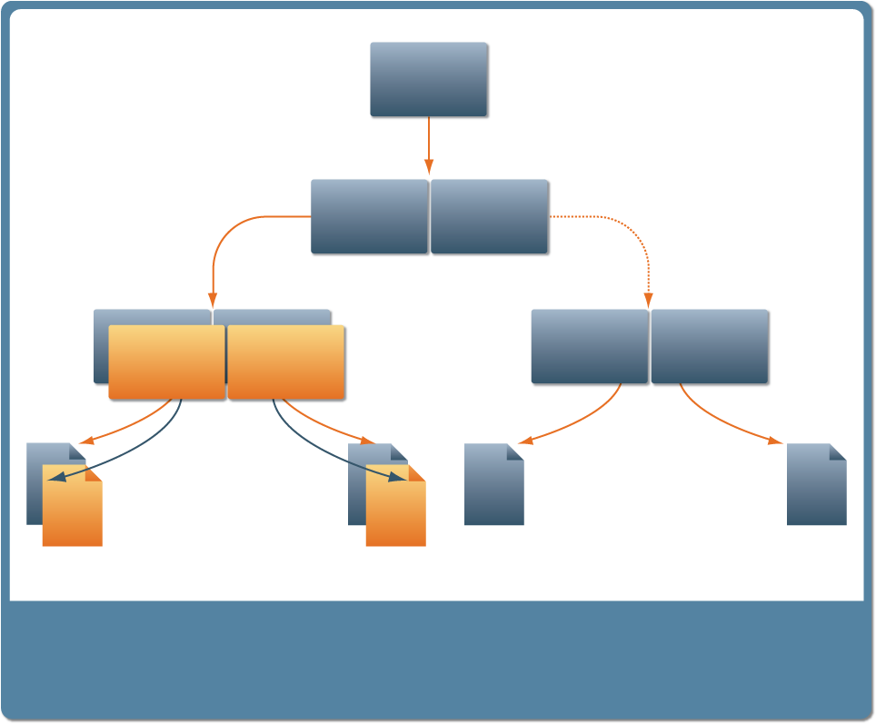

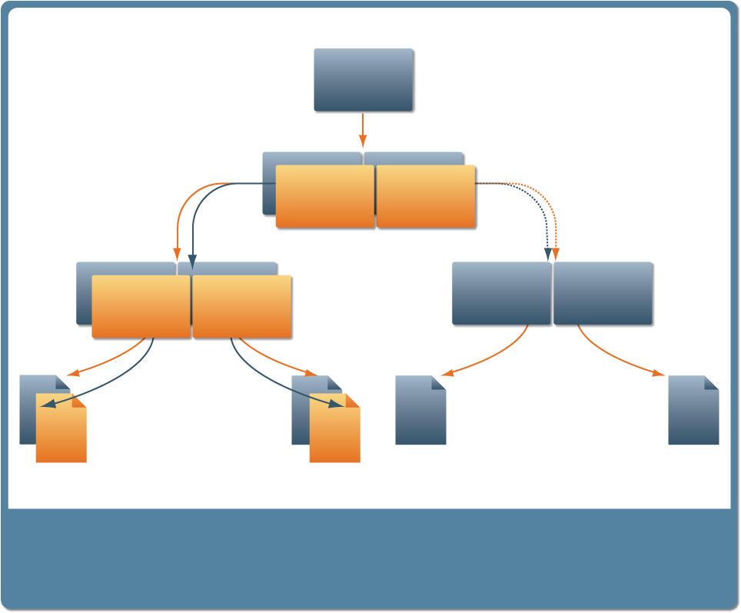
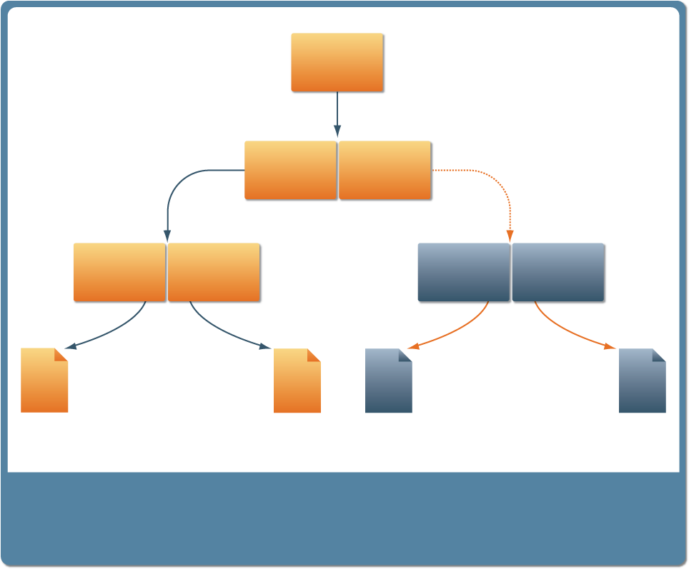
Copy-on-Write and Transactional
Uber-block
Original Data
New Data
Initial block tree
Writes a copy of some changes
Original Pointers
New Uber-block
New Pointers
Copy-on-write of indirect blocks
Rewrites the Uber-block

Slide 12

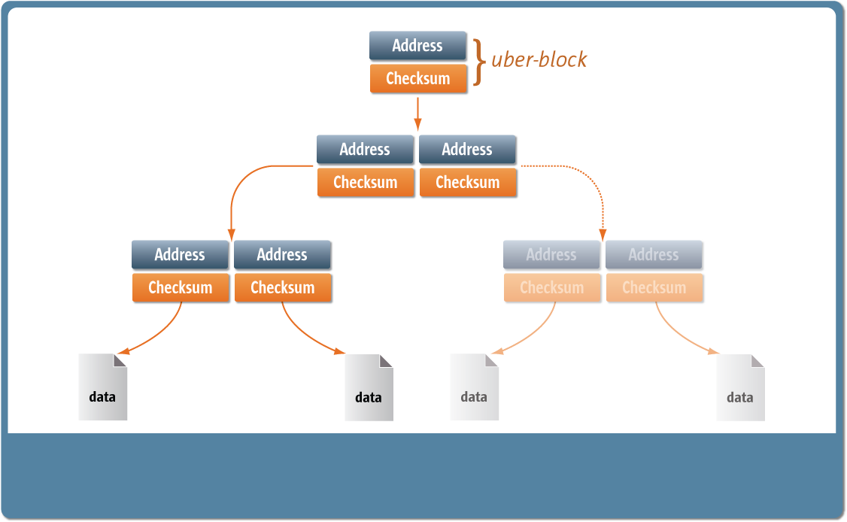
End-to-End Checksums
Checksums are separated from
the data
Entire I/O path is self-validating (uber-block)

Slide 13







Self-Healing Data
ZFS can detect bad data using checksums and “heal”
the data using its mirrored copy.
Application
Application
Application
ZFS Mirror
ZFS Mirror
ZFS Mirror
Detects Bad Data
Gets Good Data from Mirror
“Heals” Bad Copy

Slide 14
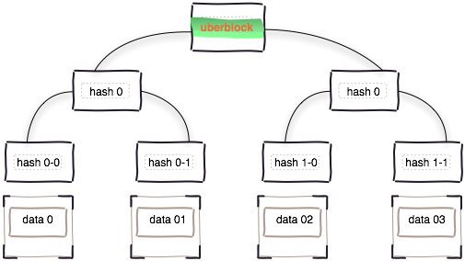

SILENT DATA
CORRUPTION
Study of CERN showed alarming results
- 8.7TB, 1:1500 files corrupted
Provable end to end data integrity
- Checksum and data are isolated
Only rebuild data that is damaged
- No “array” initialization
Ditto blocks
- Just another property

Slide 15
RAID-Z Protection
ZFS provides better than RAID-5 availability
Copy-on-write approach solves historical problems
Striping uses dynamic widths
Each logical block is its own stripe
All writes are full-stripe writes
Eliminates read-modify-write (So it's fast!)
Eliminates RAID-5 “write hole”
No need for NVRAM

Slide 16
RAID-Z
Dynamic stripe width
Variable block size: 512 – 128K
Each logical block is its own stripe
Single, double, or triple parity
All writes are full-stripe writes
Eliminates read-modify-write (it's fast)
Eliminates the RAID-5 write hole
(no need for NVRAM)
Detects and corrects silent data corruption
Checksum-driven combinatorial reconstruction
No special hardware – ZFS loves cheap disks

Slide 17
ZFS Intent Log (ZIL)
Filesystems buffer write requests and sync these to storage periodically to improve performance
Power loss can corrupt filesystems and/or suffer data loss. In ZFS, corruption solved with TXG commits
synchronous semantics for apps requiring data flushed to stable storage by the time a system call returns
Open file with O_DSYNC, or flush buffers with fsync(3c)
The ZIL provides synchronous semantics for ZFS with a replayable log written to disk
High IOPS, small, mostly-write: can direct to separate disk (short stroke disk, SSD, Flash) for dramatic performance improvement with thousands writes/sec

Slide 18

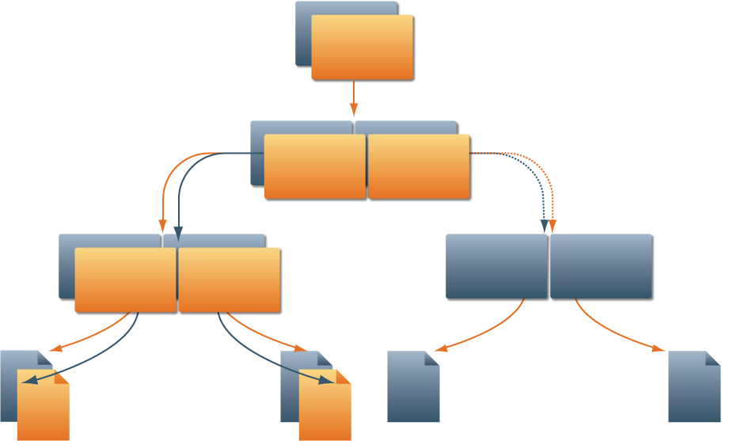

ZFS Snapshots
Provide a read-only point-in-time copy of file system
Copy-on-write makes them essentially “free”
Very space efficient – only changes are tracked/stored
And instantaneous – just doesn't delete the copy
Snapshot Uber-block
New Uber-block
Current Data

Slide 19

ZFS Snapshots
Simple to create and rollback with snapshots
# zfs list -r tank
NAME USED AVAIL REFER MOUNTPOINT
tank 20.0G 46.4G 24.5K /tank
tank/home 20.0G 46.4G 28.5K /export/home
tank/home/ahrens 24.5K 10.0G 24.5K /export/home/ahrens
tank/home/billm 24.5K 46.4G 24.5K /export/home/billm
tank/home/bonwick 24.5K 66.4G 24.5K /export/home/bonwick
# zfs snapshot tank/home/billm@s1
# zfs list -r tank/home/billm
NAME USED AVAIL REFER MOUNTPOINT
tank/home/billm 24.5K 46.4G 24.5K /export/home/billm
tank/home/billm@s1 0 - 24.5K -
# cat /export/home/billm/.zfs/snapshot/s1/foo.c
# zfs rollback tank/home/billm@s1
# zfs destroy tank/home/billm@s1

Slide 20
ZFS Clones
A clone is a writable copy of a snapshot
Created instantly, unlimited number
Perfect for “read-mostly” file systems – source directories, application binaries and configuration, etc.
# zfs list -r tank/home/billm
NAME USED AVAIL REFER MOUNTPOINT
tank/home/billm 24.5K 46.4G 24.5K /export/home/billm
tank/home/billm@s1 0 - 24.5K -
# zfs clone tank/home/billm@s1 tank/newbillm
# zfs list -r tank/home/billm tank/newbillm
NAME USED AVAIL REFER MOUNTPOINT
tank/home/billm 24.5K 46.4G 24.5K /export/home/billm
tank/home/billm@s1 0 - 24.5K -
tank/newbillm 0 46.4G 24.5K /tank/newbillm

Slide 21
ZFS Data Migration
Host-neutral format on-disk
Move data from SPARC to x86 transparently
Data always written in native format, reads reformat data if needed
ZFS pools may be moved from host to host
Or handy for external USB disks
ZFS handles device ids & paths, mount points, etc.
Export pool from original host
source# zpool export tank
Import pool on new host (“zpool import” without operands lists importable pools)
destination# zpool import tank

Slide 22
Open ZFS

Slide 23




ZFS Working Group
Comprised of community developers actively working on ZFS
Collaboration and exchange of new ideas
Collaborate of development efforts
Discussion of issues
Members from all platforms
  illumos, FreeBSD, Linux, and Mac OS
Contributing companies:

Slide 24
ZFS “clones” property
Difficult to quickly find if a snapshot has a clone
  zfs list -o name,origin -r <pool> | grep <snapshot>
  Hard to determine programmatically
New property to quickly identify all clones of a given snapshot
  Property provides a comma-separated list of all filesystems or volumes which are clones of this snapshot
# zfs list -o name,origin,clones -t all -r tank
NAME ORIGIN CLONES
tank - -
tank/fs - -
tank/fs@today - tank/fs-clone1,tank/fs-clone2
tank/fs-clone1 tank/fs@today -
tank/fs-clone2 tank/fs@today -

Slide 25
ZFS “written” Property
Difficult to define how big a snapshot is
  “used” property is the amount of space unique to that snapshot
  Space can be shared by multiple snapshots; “UsedBySnapshots” can be much larger than sum of unique (“used”) space
The “written” property displays the amount of space written to this dataset since the previous snapshot
  A different perspective on how “big” a snapshot is
  Sum of fs & snapshots' “written” = fs's “UsedByDataset”+“UsedBySnapshots”
# zfs list -t all -o name,used,written -r tank
NAME USED WRITTEN
tank 6.26M 32K
tank/fs 6.08M 0
tank/fs@11:00 19K 2.03M
tank/fs@11:05 0 2.02M
tank/fs@11:10 0 0
tank/fs@11:15 0 2.02M

Slide 26
Enhancements to zfs send
Want to estimate how big the stream output by “zfs send” will be
  '-v' option now prints this information
  New '-n' option performs dry-run send
  New '-P' option prints machine-parsable information about the send stream
# zfs send -Rnv tank/fs@11:15
send from @ to tank/fs@11:00 estimated size is 2.02M
send from @11:00 to tank/fs@11:05 estimated size is 2.01M
send from @11:05 to tank/fs@11:10 estimated size is 0
send from @11:10 to tank/fs@11:15 estimated size is 2.01M
total estimated size is 6.05M
# zfs send -RnP tank/fs@11:15
full tank/fs@11:00 2117504
incremental 11:00 tank/fs@11:05 2111360
incremental 11:05 tank/fs@11:10 0
incremental 11:10 tank/fs@11:15 2111872
size 6340736

Slide 27
ZFS Device Selection Algorithm
When ZFS writes data to a pool it will dynamically stripe writes across all its top-level vdevs
  Top-level vdevs may be disks, mirrors, or raidz devices
Data is striped in a round-robin fashion
  Each top-level vdev will attempt to write a predetermined amount of data
  Once a top-level vdev has successfully written its allotment, the next top-level device is chosen
  To handle imbalanced devices a bias is given to top-level vdevs which have more available space
    Emptier devices are allowed to write more data

Slide 28




Writing to Imbalanced Top-level vdevs
Three newly added mirrors
Each top-level vdev must write the same amount of data
Lots of time spent trying to write to original vdevs which are extremely full
Bias towards empty vdevs helps very little
ZFS
ZFS
ZFS
Storage Pool
1
2
3
4
5
Original vdevs > 90% full

Slide 29
Resumable send/recv
If “zfs send ... | zfs receive ...” is interrupted (network outage, machine reboots, etc), we have to re-do the entire “send | receive” from the beginning
We would like to be able to pick up the “zfs send” from where it left off
Need to verify that we still receive the entire stream (ie, we are picking up from the correct place)
Need to verify checksum of stream as we go, rather than all at the end
Don't need to know up-front if the receiver supports resuming
  No special flag, no new stream format for resumable send
(Both sides need new code to actually do the resume)
Approximate syntax:
“zfs receive --get-resume-data pool/fs | zfs send --resume | zfs receive”

Slide 30
Background Destroy
Destroying a filesystem / volume / clone takes a long time
This is inherent – we must locate all the blocks to free
Problem at Delphix: want GUI to remove filesystem right away
  “Solution”: rename FS, delete in separate thread
    This is hacky: everyone needs to know about it
      When checking for clones, must exclude the renamed ones
      When renaming to mark destroyed, must explicitly unshare
Real solution: do background destroy in ZFS
  Dataset goes away in constant time, but space is not reclaimed immediately
  “zfs destroy <snapshot>” already does this (on pool version >= 26)
  “zfs destroy <filesystem | volume | clone>” will do this too
  Remove dataset from namespace and unlink from associated datasets (eg. Clone origin) immediately
  Move root block from dataset to pool's work queue
  Free blocks in background (from spa_sync())

Slide 31
Other New Features
Libzfs
  Cleaning and documenting lib
Testing
  Robust test package
Feature Flags
label for disk including feature of version
    Allows for mapping of mismatched pool versions
    May only import read only

Slide 32
Q&A
linda.kateley@nexenta.com

