Slide 1
Zillow/AirBnB and Noise Complaints

Slide 2
Dataset sources
https://www.kaggle.com/zillow/zecon
https://data.cityofchicago.org/Environment-Sustainable-Development/Noise-Complaints-in-Chicago/6ttz-f3sv/data
http://insideairbnb.com/get-the-data.html

Slide 3
Extract
Original data formats
Zillow | AirBnB | Noise-complaints
CSV | CSV | CSV

Slide 4
Transformations

Slide 5
Zillow ZIP code data transformation
Reduced data frame to applicable columns
Filtered data to last five years
Filtered data to Chicago only ZIP codes
Dropped NaN rows
Grouped by ZIP code and aggregated by mean of house prices

Slide 6
Chicago noise complaint TRANSFORMATION
Reduce data frame to applicable columns
Renamed columns
Add new columns and calculate their values.
Dropped complaints older than 5 years
Get zip code, full address, latitude, and longitude from Google Maps geocoding API.
Group data by zip code and get count of noise complaints for each zip code.
Delete missing data and typos.
Convert zip code field to string.

Slide 7
airBNB DATA TRANSFORMATION
Drop columns not required
Add new columns and calculate their values.
Drop columns no longer required.
Get zip code
Drop columns no longer needed.
Delete missing data and typos.
Group data by zip code and get count of airbnbs in area and average price per night

Slide 8
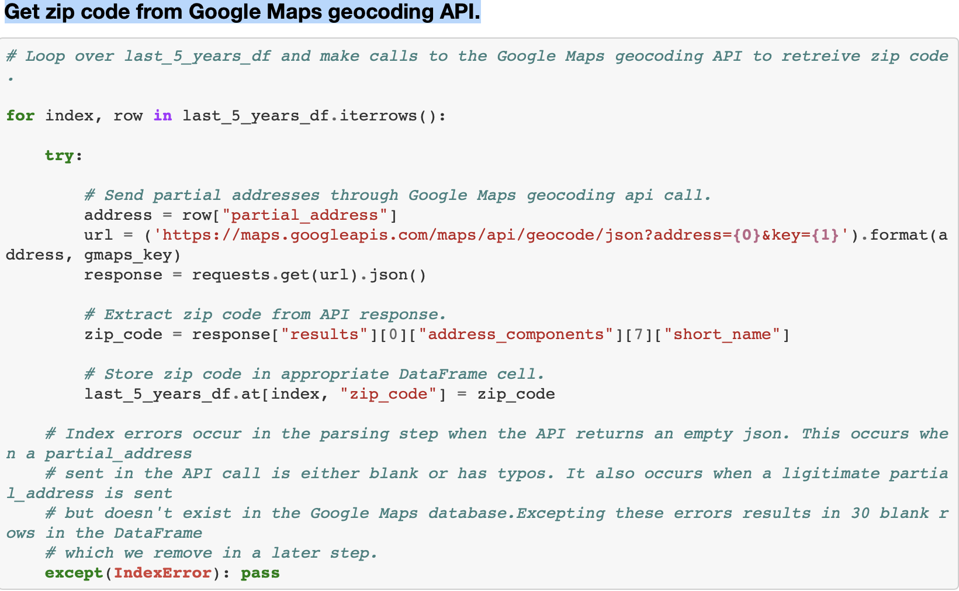
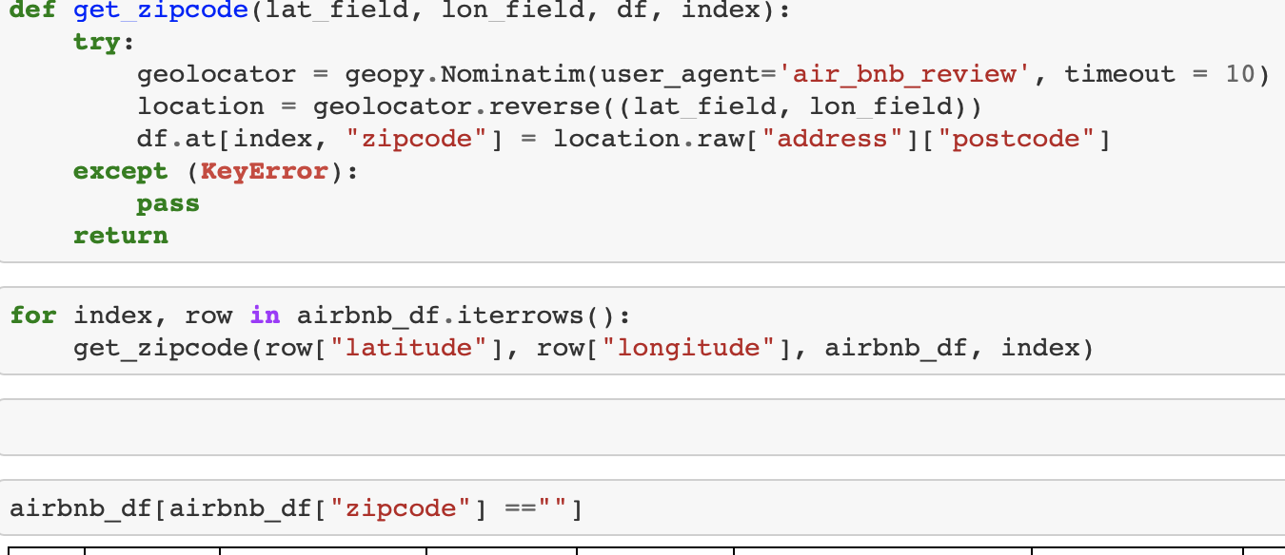
finding ZIP CODES
AirBnB data
Noise complaint data
Using Geopy and Geolocator
Google Maps geocoding API.¶

Slide 9
Load
Zillow data
AirBnB data
Noise Complaint
Postgres

Slide 10
potential QUESTIONS
What is the effect of noise complaints on property value in specific ZIP code?
Do ZIP codes with higher concentrations of AirBnB’s report more noise complaints?
What is the effect of property values in ZIP codes with high concentrations of AirBnB?
What is the effect of noise complaints on property values?

