Slide 1


An Approach to Predictive Policing with Dallas City
Team Members(RAAS):
Ranjan Venkatesh
Alisha Mehta
Ashish Soni
Sagunala Shashikanth

Slide 2
Agenda
Motivation
Data collection
Data Pre-Processing
Exploratory Data Analysis
Training Models
Model Evaluation
Conclusion

Slide 3


Motivation
To assist the law enforcement in making certain helpful predictions based on the heuristics of the past incidents.
Predictive insights help the law enforcement authorities to channel their resources in the most effective way in order to curb potential crimes.

Slide 4
DATA SET
Dallas city crime dataset:
The data used in this project contains
498KObservations
100 Variables

Slide 5
DATA PRE-PROCESSING
Objective : Generate dataframes
1. dallas_incidents,
2. dallas_crime_type &
3. dallas_crime_rate
Dataframe dallas_indcidents must be suitable for Exploratory data analysis.

Slide 6
EDA
Objective : To evaluate the pattern/trend in the dataset that could
1. Answer some basic questions
2. Help in selecting attributes for predictive analysis

Slide 7
EDA
1. What crimes are frequent?

Slide 8
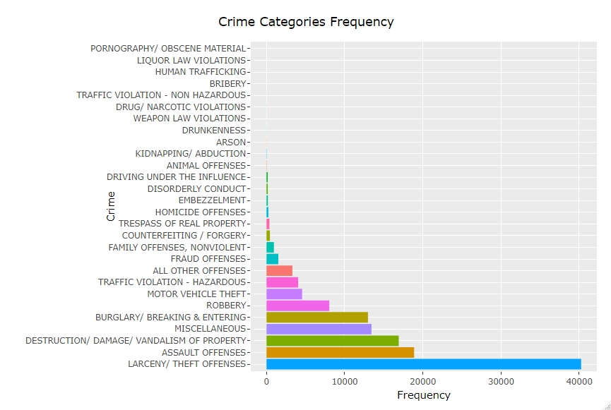
EDA

Slide 9
EDA
2. How victim gender and the time of crime are related and volume of crime for each time slot?

Slide 10
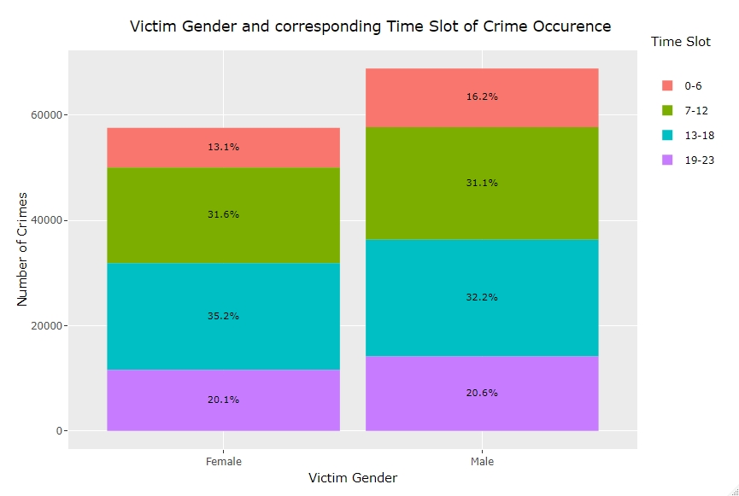
EDA

Slide 11
EDA
3. How crimes relate to the time of day?

Slide 12
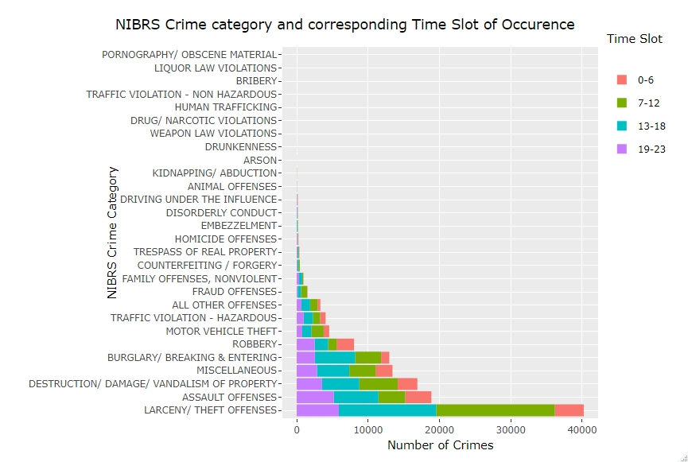
EDA

Slide 13
EDA
4. How crimes are related to days of the week and time slot of occurrence?

Slide 14
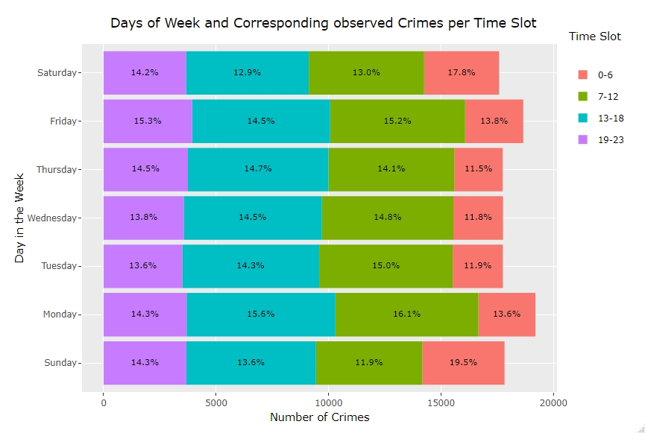
EDA

Slide 15
EDA
5. What age group in adults (over 18) is highly prone to be a victim? changed to What age group in adults (over 16) is highly prone to be a victim?

Slide 16
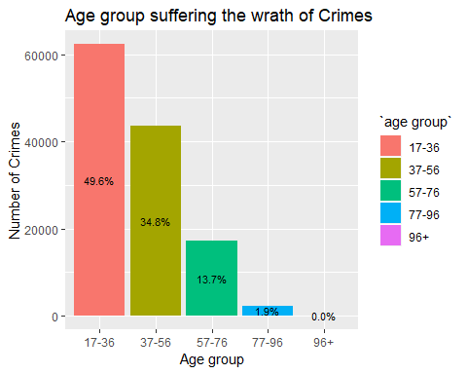
EDA

Slide 17
EDA
6. How crimes are related to time of occurrence and day of the week?

Slide 18
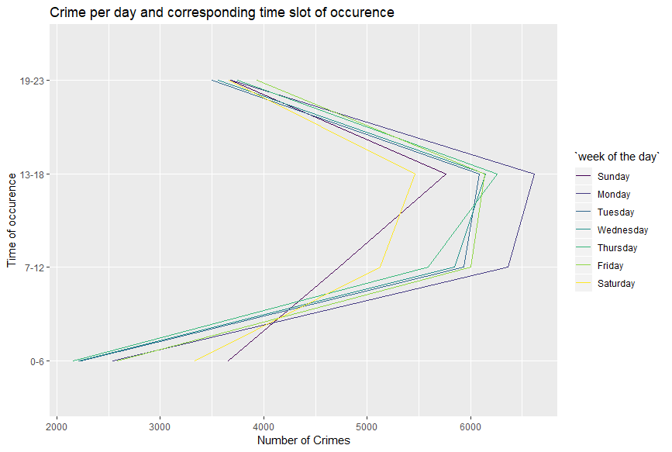
EDA

Slide 19
EDA
7. Heat map for number of crimes committed based on the days of the week and timeslot

Slide 20
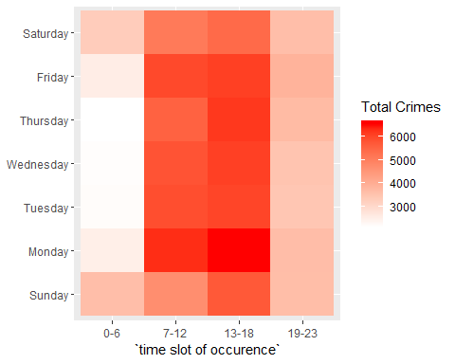
EDA

Slide 21
Feature Selection for Predictive Analysis
Two types of problems were designed for the given dataset :
1. Regression
2. Classification
Objectives :
To evaluate attributes and their correlation
Generate datasets dallas_crime_rate (regression) and dallas_crime_type (classification) suitable to solve the designed problems.
Feature Selection for Regression problem:
Following steps taken to generate dallas_crime_rate dataframe
Grouped by ‘Division’, ‘rounded time’ and ‘week number of the day’ and summarized the frequency of records to new attribute ‘freq’
Reduction of Location Type attribute to 4 categorical values from 73.

Slide 22
Evaluation of Variable Importance
Following attributes were considered(in various combinations) for the evaluation
frequency ~ (ZipCode, LocationType, rounded time, NIBRS Category, time slot of occurrence, week number of day and Division )
Following interpretations can be drawn from the tests
Rejected ZipCode and NIBRS Category in boxplot because of too many outliers.
NIBRS category is ignored because it is not a meaningful variable in describing the response variable.
Time slot of occurrence can be rejected because there weren’t too many differences in mean level of ‘time slot of occurrence’ in comparison to that of ‘rounded time’ from boxplot.
Anova method shows combinations of ‘Division’, ‘rounded time’ and ‘week number of the day’ gave much favourable p-value than that of ‘LocationType’, ‘rounded time’ and ‘week number of day’.

Slide 23
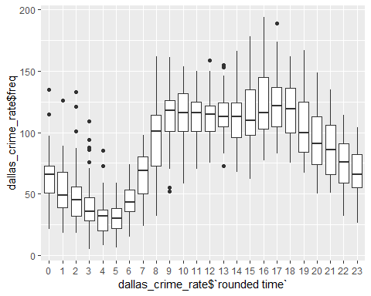
Boxplot Visualisation 1

Slide 24
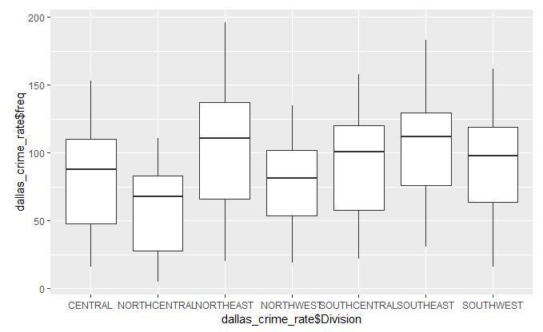
Boxplot Visualisation 2

Slide 25
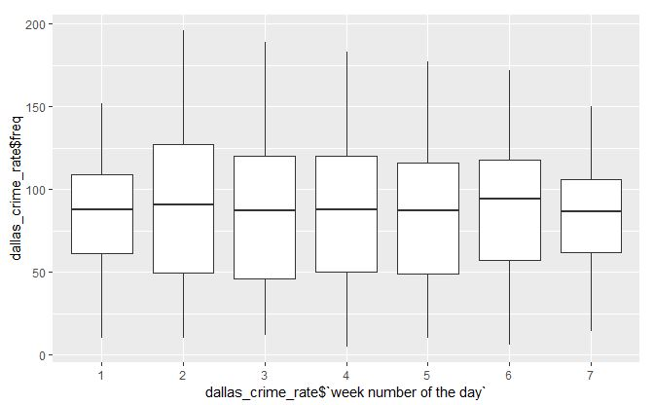
Boxplot Visualisation 3

Slide 26
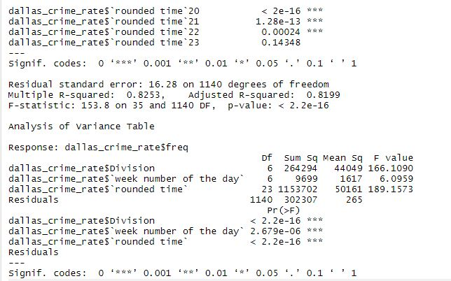
P-value using Anova method

Slide 27
Feature Selection for Classification
Following steps taken to generate dallas_crime_type dataframe
All steps to generate dallas_incidents dataframe
group by ‘Division’, ‘rounded time’ and ‘week number of the day’ and summarize the frequency of records to new attribute ‘freq’
Reduction of Location Type attribute to 4 categorical values from 73
Usage of ‘NIBRS Crime Category’(28 categorical values) instead of ‘Category Type’(903 categorical values) attribute
Further reduction of ‘NIBRS Crime category’ to consist of 8 categorical values in new attribute ‘Category’
Usage of ‘Division’(13 categorical values ) instead of ‘Zip Code’ (122 categorical values)
Cleaning the ‘Division’ attribute - bringing values to consistent format, thus reducing to 8 categorical values

Slide 28
Evaluation of variable importance
Using chi-square test
Null hypothesis : There is no association between 2 variables
Following attributes were considered(in various combinations) for the evaluation
Crime Category ~ (rounded time, time slot of occurrence, week of the day and Division)
Both combinations of (rounded time, week of the day and Division) and (time slot of occurrence, week of the day and Division) passed chi-square test. However, we pick the combination that contains time slot of occurrence as it has only factor levels in comparison to that of 24 in rounded time for building model with better accuracy.
Another reason to reject rounded time is the duration of training the model is higher.
## [1] "p-value is significant - Null Hypothesis rejected"

Slide 29
Model Training
Divide the data into training(75%) and testing(25%)
Parameters auto-tune length set to 10
Resampling method chosen : Cross validation of chunk size 10
Both Classification and Regression models are trained using the
explanatory variables that had highest importance(from our
inferential statistics tools) in predicting the future outcome

Slide 30
Regression Model
Using the explanatory variables week of the day, rounded time and division for predicting the crime frequency generating dummy variables of the dataframe
Using the boxcox transformation for the response variable crime frequency
Using linear regression model and gradient boosting algorithms preprocess the target attribute to scale and center
4. Using RMSE metrics for cross validation evaluation

Slide 31
Classification Model
Using the explanatory variables week of the day, division and time slot of occurrence for predicting Category (crime type)generating dummy variables of the dataframe.
Using the algorithms SVM, Random Forest and Naive Bayes
preprocess the target attribute to scale and center

Slide 32
Model Prediction and Evaluation
Regression Model
Evaluation using Predicted v/s Actual Dataset Plot and RMSE Mean
## [1] "Linear Regression Model Performance :"

Slide 33
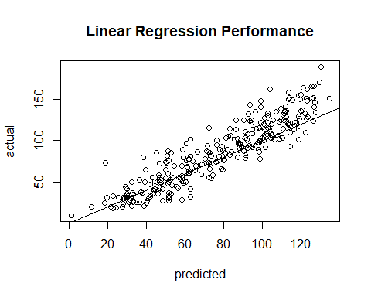
Model Prediction and Evaluation

Slide 34
## ## Call: ## lm(formula = .outcome ~ ., data = dat) ## ## Residuals: ## Min 1Q Median 3Q Max ## -50.812 -9.926 -0.989 8.472 71.306 ## ## Coefficients: ## Estimate Std. Error t value Pr(>|t|) ## (Intercept) 50.42597 3.00045 16.806 < 2e-16 *** ## Division.NORTHCENTRAL -22.25181 1.88047 -11.833 < 2e-16 *** ## Division.NORTHEAST 17.76723 1.88533 9.424 < 2e-16 *** ## Division.NORTHWEST -4.59759 1.89501 -2.426 0.015467 * ## Division.SOUTHCENTRAL 6.54218 1.91714 3.412 0.000674 *** ## Division.SOUTHEAST 21.92837 1.87506 11.695 < 2e-16 *** ## Division.SOUTHWEST 10.37983 1.87304 5.542 4.00e-08 *** ## X.rounded.time.1 -8.23026 3.46094 -2.378 0.017626 * ## X.rounded.time.2 -9.73177 3.43466 -2.833 0.004715 ** ## X.rounded.time.3 -20.70978 3.43752 -6.025 2.52e-09 *** ## X.rounded.time.4 -27.20124 3.41169 -7.973 5.00e-15 *** ## X.rounded.time.5 -29.19081 3.41572 -8.546 < 2e-16 *** ## X.rounded.time.6 -16.81475 3.51533 -4.783 2.03e-06 *** ## X.rounded.time.7 0.70603 3.41633 0.207 0.836321 ## X.rounded.time.8 31.61849 3.48355 9.077 < 2e-16 *** ## X.rounded.time.9 44.39124 3.41618 12.994 < 2e-16 *** ## X.rounded.time.10 46.24839 3.43624 13.459 < 2e-16 *** ## X.rounded.time.11 43.03592 3.34960 12.848 < 2e-16 *** ## X.rounded.time.12 41.97184 3.45949 12.132 < 2e-16 *** ## X.rounded.time.13 44.10388 3.48525 12.654 < 2e-16 *** ## X.rounded.time.14 43.44546 3.54603 12.252 < 2e-16 *** ## X.rounded.time.15 44.23679 3.43479 12.879 < 2e-16 *** ## X.rounded.time.16 52.89052 3.43468 15.399 < 2e-16 *** ## X.rounded.time.17 54.07114 3.43809 15.727 < 2e-16 *** ## X.rounded.time.18 50.74415 3.43756 14.762 < 2e-16 *** ## X.rounded.time.19 37.10975 3.45972 10.726 < 2e-16 *** ## X.rounded.time.20 29.15536 3.36828 8.656 < 2e-16 *** ## X.rounded.time.21 22.11583 3.63378 6.086 1.75e-09 *** ## X.rounded.time.22 10.60347 3.35152 3.164 0.001613 ** ## X.rounded.time.23 4.08000 3.41042 1.196 0.231901 ## X.week.number.of.the.day.2 8.12300 1.88073 4.319 1.75e-05 *** ## X.week.number.of.the.day.3 1.01660 1.90494 0.534 0.593711 ## X.week.number.of.the.day.4 0.31041 1.88586 0.165 0.869299 ## X.week.number.of.the.day.5 0.01004 1.84666 0.005 0.995664 ## X.week.number.of.the.day.6 4.18783 1.88996 2.216 0.026968 * ## X.week.number.of.the.day.7 0.89295 1.87244 0.477 0.633563 ## --- ## Signif. codes: 0 '***' 0.001 '**' 0.01 '*' 0.05 '.' 0.1 ' ' 1 ## ## Residual standard error: 14.85 on 848 degrees of freedom ## Multiple R-squared: 0.8219, Adjusted R-squared: 0.8145 ## F-statistic: 111.8 on 35 and 848 DF, p-value: < 2.2e-16
## [1] "Gradient Boosting Model Performance :"

Slide 35
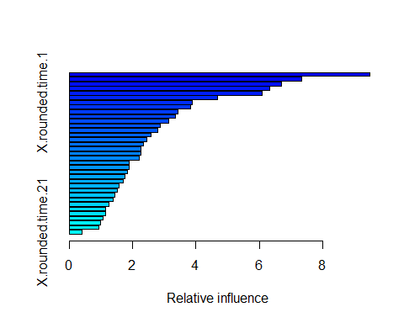
Model Prediction and Evaluation

Slide 36
## var rel.inf ## Division.NORTHCENTRAL Division.NORTHCENTRAL 9.4913640 ## X.rounded.time.4 X.rounded.time.4 7.3222521 ## X.rounded.time.5 X.rounded.time.5 6.6886960 ## X.rounded.time.3 X.rounded.time.3 6.3322463 ## X.rounded.time.2 X.rounded.time.2 6.0997665 ## X.rounded.time.6 X.rounded.time.6 4.6726548 ## X.rounded.time.1 X.rounded.time.1 3.8852850 ## Division.SOUTHEAST Division.SOUTHEAST 3.8398992 ## Division.NORTHEAST Division.NORTHEAST 3.4274015 ## X.rounded.time.16 X.rounded.time.16 3.3586984 ## X.rounded.time.17 X.rounded.time.17 3.1315216 ## X.rounded.time.7 X.rounded.time.7 2.8798024 ## X.rounded.time.8 X.rounded.time.8 2.7895080 ## X.rounded.time.9 X.rounded.time.9 2.5760725 ## X.rounded.time.10 X.rounded.time.10 2.4610236 ## Division.NORTHWEST Division.NORTHWEST 2.3550555 ## X.week.number.of.the.day.2 X.week.number.of.the.day.2 2.2676596 ## X.rounded.time.18 X.rounded.time.18 2.2625262 ## X.rounded.time.23 X.rounded.time.23 2.2214500 ## X.rounded.time.14 X.rounded.time.14 1.9036016 ## X.rounded.time.15 X.rounded.time.15 1.8790498 ## X.rounded.time.11 X.rounded.time.11 1.8362913 ## X.rounded.time.22 X.rounded.time.22 1.7467296 ## X.rounded.time.13 X.rounded.time.13 1.6983624 ## X.rounded.time.12 X.rounded.time.12 1.5656168 ## X.rounded.time.19 X.rounded.time.19 1.5075069 ## Division.SOUTHWEST Division.SOUTHWEST 1.4442209 ## X.week.number.of.the.day.5 X.week.number.of.the.day.5 1.3997390 ## X.week.number.of.the.day.7 X.week.number.of.the.day.7 1.2532407 ## X.week.number.of.the.day.6 X.week.number.of.the.day.6 1.1524012 ## X.rounded.time.20 X.rounded.time.20 1.1478323 ## X.week.number.of.the.day.3 X.week.number.of.the.day.3 1.0778230 ## X.week.number.of.the.day.4 X.week.number.of.the.day.4 0.9871318 ## Division.SOUTHCENTRAL Division.SOUTHCENTRAL 0.9253060 ## X.rounded.time.21 X.rounded.time.21 0.4122637
## [1] "Comparison on performance : "
## ## Call: ## summary.resamples(object = res) ## ## Models: lm, gbm ## Number of resamples: 30 ## ## MAE ## Min. 1st Qu. Median Mean 3rd Qu. Max. NA's ## lm 10.427546 11.06372 11.52853 11.68077 12.37765 13.18812 0 ## gbm 8.815698 9.89768 10.66670 10.62323 11.29992 13.04242 0 ## ## RMSE ## Min. 1st Qu. Median Mean 3rd Qu. Max. NA's ## lm 13.11263 14.39692 15.02485 15.13331 15.83411 18.00960 0 ## gbm 11.59596 13.04679 13.34855 13.73745 14.29213 17.85638 0 ## ## Rsquared ## Min. 1st Qu. Median Mean 3rd Qu. Max. NA's ## lm 0.7401943 0.7873036 0.8085967 0.8084995 0.8273587 0.8622241 0 ## gbm 0.7342509 0.8239029 0.8503263 0.8428384 0.8691883 0.8935508 0
6.2 Classification Model
Evaluation using Confusion Matrix
## [1] "SVM Model Performance :"
## Confusion Matrix and Statistics ## ## Reference ## Prediction ALL OTHER OFFENSES ## ALL OTHER OFFENSES 239 ## ASSAULT OFFENSES 0 ## BURGLARY/ BREAKING & ENTERING 0 ## DESTRUCTION/ DAMAGE/ VANDALISM OF PROPERTY 0 ## DRUNKENNESS/TRESPASSING/NUISANCE 0 ## FRAUD OFFENSES 0 ## LARCENY/ THEFT OFFENSES 0 ## TRAFFIC VIOLATION 0 ## Reference ## Prediction ASSAULT OFFENSES ## ALL OTHER OFFENSES 0 ## ASSAULT OFFENSES 150 ## BURGLARY/ BREAKING & ENTERING 0 ## DESTRUCTION/ DAMAGE/ VANDALISM OF PROPERTY 0 ## DRUNKENNESS/TRESPASSING/NUISANCE 0 ## FRAUD OFFENSES 0 ## LARCENY/ THEFT OFFENSES 0 ## TRAFFIC VIOLATION 0 ## Reference ## Prediction BURGLARY/ BREAKING & ENTERING ## ALL OTHER OFFENSES 0 ## ASSAULT OFFENSES 0 ## BURGLARY/ BREAKING & ENTERING 1800 ## DESTRUCTION/ DAMAGE/ VANDALISM OF PROPERTY 0 ## DRUNKENNESS/TRESPASSING/NUISANCE 0 ## FRAUD OFFENSES 0 ## LARCENY/ THEFT OFFENSES 0 ## TRAFFIC VIOLATION 0 ## Reference ## Prediction DESTRUCTION/ DAMAGE/ VANDALISM OF PROPERTY ## ALL OTHER OFFENSES 0 ## ASSAULT OFFENSES 0 ## BURGLARY/ BREAKING & ENTERING 0 ## DESTRUCTION/ DAMAGE/ VANDALISM OF PROPERTY 4233 ## DRUNKENNESS/TRESPASSING/NUISANCE 0 ## FRAUD OFFENSES 0 ## LARCENY/ THEFT OFFENSES 0 ## TRAFFIC VIOLATION 0 ## Reference ## Prediction DRUNKENNESS/TRESPASSING/NUISANCE ## ALL OTHER OFFENSES 0 ## ASSAULT OFFENSES 0 ## BURGLARY/ BREAKING & ENTERING 0 ## DESTRUCTION/ DAMAGE/ VANDALISM OF PROPERTY 0 ## DRUNKENNESS/TRESPASSING/NUISANCE 137 ## FRAUD OFFENSES 0 ## LARCENY/ THEFT OFFENSES 0 ## TRAFFIC VIOLATION 0 ## Reference ## Prediction FRAUD OFFENSES ## ALL OTHER OFFENSES 0 ## ASSAULT OFFENSES 0 ## BURGLARY/ BREAKING & ENTERING 0 ## DESTRUCTION/ DAMAGE/ VANDALISM OF PROPERTY 0 ## DRUNKENNESS/TRESPASSING/NUISANCE 0 ## FRAUD OFFENSES 153 ## LARCENY/ THEFT OFFENSES 0 ## TRAFFIC VIOLATION 0 ## Reference ## Prediction LARCENY/ THEFT OFFENSES ## ALL OTHER OFFENSES 0 ## ASSAULT OFFENSES 0 ## BURGLARY/ BREAKING & ENTERING 0 ## DESTRUCTION/ DAMAGE/ VANDALISM OF PROPERTY 0 ## DRUNKENNESS/TRESPASSING/NUISANCE 0 ## FRAUD OFFENSES 0 ## LARCENY/ THEFT OFFENSES 1138 ## TRAFFIC VIOLATION 0 ## Reference ## Prediction TRAFFIC VIOLATION ## ALL OTHER OFFENSES 0 ## ASSAULT OFFENSES 0 ## BURGLARY/ BREAKING & ENTERING 0 ## DESTRUCTION/ DAMAGE/ VANDALISM OF PROPERTY 0 ## DRUNKENNESS/TRESPASSING/NUISANCE 0 ## FRAUD OFFENSES 0 ## LARCENY/ THEFT OFFENSES 0 ## TRAFFIC VIOLATION 1052 ## ## Overall Statistics ## ## Accuracy : 1 ## 95% CI : (0.9996, 1) ## No Information Rate : 0.4755 ## P-Value [Acc > NIR] : < 2.2e-16 ## ## Kappa : 1 ## Mcnemar's Test P-Value : NA ## ## Statistics by Class: ## ## Class: ALL OTHER OFFENSES Class: ASSAULT OFFENSES ## Sensitivity 1.00000 1.00000 ## Specificity 1.00000 1.00000 ## Pos Pred Value 1.00000 1.00000 ## Neg Pred Value 1.00000 1.00000 ## Prevalence 0.02685 0.01685 ## Detection Rate 0.02685 0.01685 ## Detection Prevalence 0.02685 0.01685 ## Balanced Accuracy 1.00000 1.00000 ## Class: BURGLARY/ BREAKING & ENTERING ## Sensitivity 1.0000 ## Specificity 1.0000 ## Pos Pred Value 1.0000 ## Neg Pred Value 1.0000 ## Prevalence 0.2022 ## Detection Rate 0.2022 ## Detection Prevalence 0.2022 ## Balanced Accuracy 1.0000 ## Class: DESTRUCTION/ DAMAGE/ VANDALISM OF PROPERTY ## Sensitivity 1.0000 ## Specificity 1.0000 ## Pos Pred Value 1.0000 ## Neg Pred Value 1.0000 ## Prevalence 0.4755 ## Detection Rate 0.4755 ## Detection Prevalence 0.4755 ## Balanced Accuracy 1.0000 ## Class: DRUNKENNESS/TRESPASSING/NUISANCE ## Sensitivity 1.00000 ## Specificity 1.00000 ## Pos Pred Value 1.00000 ## Neg Pred Value 1.00000 ## Prevalence 0.01539 ## Detection Rate 0.01539 ## Detection Prevalence 0.01539 ## Balanced Accuracy 1.00000 ## Class: FRAUD OFFENSES Class: LARCENY/ THEFT OFFENSES ## Sensitivity 1.00000 1.0000 ## Specificity 1.00000 1.0000 ## Pos Pred Value 1.00000 1.0000 ## Neg Pred Value 1.00000 1.0000 ## Prevalence 0.01719 0.1278 ## Detection Rate 0.01719 0.1278 ## Detection Prevalence 0.01719 0.1278 ## Balanced Accuracy 1.00000 1.0000 ## Class: TRAFFIC VIOLATION ## Sensitivity 1.0000 ## Specificity 1.0000 ## Pos Pred Value 1.0000 ## Neg Pred Value 1.0000 ## Prevalence 0.1182 ## Detection Rate 0.1182 ## Detection Prevalence 0.1182 ## Balanced Accuracy 1.0000
## [1] "Random Forest Model Performance :"
## Confusion Matrix and Statistics ## ## Reference ## Prediction ALL OTHER OFFENSES ## ALL OTHER OFFENSES 239 ## ASSAULT OFFENSES 0 ## BURGLARY/ BREAKING & ENTERING 0 ## DESTRUCTION/ DAMAGE/ VANDALISM OF PROPERTY 0 ## DRUNKENNESS/TRESPASSING/NUISANCE 0 ## FRAUD OFFENSES 0 ## LARCENY/ THEFT OFFENSES 0 ## TRAFFIC VIOLATION 0 ## Reference ## Prediction ASSAULT OFFENSES ## ALL OTHER OFFENSES 0 ## ASSAULT OFFENSES 150 ## BURGLARY/ BREAKING & ENTERING 0 ## DESTRUCTION/ DAMAGE/ VANDALISM OF PROPERTY 0 ## DRUNKENNESS/TRESPASSING/NUISANCE 0 ## FRAUD OFFENSES 0 ## LARCENY/ THEFT OFFENSES 0 ## TRAFFIC VIOLATION 0 ## Reference ## Prediction BURGLARY/ BREAKING & ENTERING ## ALL OTHER OFFENSES 0 ## ASSAULT OFFENSES 0 ## BURGLARY/ BREAKING & ENTERING 1800 ## DESTRUCTION/ DAMAGE/ VANDALISM OF PROPERTY 0 ## DRUNKENNESS/TRESPASSING/NUISANCE 0 ## FRAUD OFFENSES 0 ## LARCENY/ THEFT OFFENSES 0 ## TRAFFIC VIOLATION 0 ## Reference ## Prediction DESTRUCTION/ DAMAGE/ VANDALISM OF PROPERTY ## ALL OTHER OFFENSES 0 ## ASSAULT OFFENSES 0 ## BURGLARY/ BREAKING & ENTERING 0 ## DESTRUCTION/ DAMAGE/ VANDALISM OF PROPERTY 4233 ## DRUNKENNESS/TRESPASSING/NUISANCE 0 ## FRAUD OFFENSES 0 ## LARCENY/ THEFT OFFENSES 0 ## TRAFFIC VIOLATION 0 ## Reference ## Prediction DRUNKENNESS/TRESPASSING/NUISANCE ## ALL OTHER OFFENSES 0 ## ASSAULT OFFENSES 1 ## BURGLARY/ BREAKING & ENTERING 0 ## DESTRUCTION/ DAMAGE/ VANDALISM OF PROPERTY 0 ## DRUNKENNESS/TRESPASSING/NUISANCE 136 ## FRAUD OFFENSES 0 ## LARCENY/ THEFT OFFENSES 0 ## TRAFFIC VIOLATION 0 ## Reference ## Prediction FRAUD OFFENSES ## ALL OTHER OFFENSES 0 ## ASSAULT OFFENSES 0 ## BURGLARY/ BREAKING & ENTERING 0 ## DESTRUCTION/ DAMAGE/ VANDALISM OF PROPERTY 0 ## DRUNKENNESS/TRESPASSING/NUISANCE 0 ## FRAUD OFFENSES 153 ## LARCENY/ THEFT OFFENSES 0 ## TRAFFIC VIOLATION 0 ## Reference ## Prediction LARCENY/ THEFT OFFENSES ## ALL OTHER OFFENSES 0 ## ASSAULT OFFENSES 0 ## BURGLARY/ BREAKING & ENTERING 0 ## DESTRUCTION/ DAMAGE/ VANDALISM OF PROPERTY 0 ## DRUNKENNESS/TRESPASSING/NUISANCE 0 ## FRAUD OFFENSES 0 ## LARCENY/ THEFT OFFENSES 1138 ## TRAFFIC VIOLATION 0 ## Reference ## Prediction TRAFFIC VIOLATION ## ALL OTHER OFFENSES 0 ## ASSAULT OFFENSES 0 ## BURGLARY/ BREAKING & ENTERING 0 ## DESTRUCTION/ DAMAGE/ VANDALISM OF PROPERTY 0 ## DRUNKENNESS/TRESPASSING/NUISANCE 0 ## FRAUD OFFENSES 0 ## LARCENY/ THEFT OFFENSES 0 ## TRAFFIC VIOLATION 1052 ## ## Overall Statistics ## ## Accuracy : 0.9999 ## 95% CI : (0.9994, 1) ## No Information Rate : 0.4755 ## P-Value [Acc > NIR] : < 2.2e-16 ## ## Kappa : 0.9998 ## Mcnemar's Test P-Value : NA ## ## Statistics by Class: ## ## Class: ALL OTHER OFFENSES Class: ASSAULT OFFENSES ## Sensitivity 1.00000 1.00000 ## Specificity 1.00000 0.99989 ## Pos Pred Value 1.00000 0.99338 ## Neg Pred Value 1.00000 1.00000 ## Prevalence 0.02685 0.01685 ## Detection Rate 0.02685 0.01685 ## Detection Prevalence 0.02685 0.01696 ## Balanced Accuracy 1.00000 0.99994 ## Class: BURGLARY/ BREAKING & ENTERING ## Sensitivity 1.0000 ## Specificity 1.0000 ## Pos Pred Value 1.0000 ## Neg Pred Value 1.0000 ## Prevalence 0.2022 ## Detection Rate 0.2022 ## Detection Prevalence 0.2022 ## Balanced Accuracy 1.0000 ## Class: DESTRUCTION/ DAMAGE/ VANDALISM OF PROPERTY ## Sensitivity 1.0000 ## Specificity 1.0000 ## Pos Pred Value 1.0000 ## Neg Pred Value 1.0000 ## Prevalence 0.4755 ## Detection Rate 0.4755 ## Detection Prevalence 0.4755 ## Balanced Accuracy 1.0000 ## Class: DRUNKENNESS/TRESPASSING/NUISANCE ## Sensitivity 0.99270 ## Specificity 1.00000 ## Pos Pred Value 1.00000 ## Neg Pred Value 0.99989 ## Prevalence 0.01539 ## Detection Rate 0.01528 ## Detection Prevalence 0.01528 ## Balanced Accuracy 0.99635 ## Class: FRAUD OFFENSES Class: LARCENY/ THEFT OFFENSES ## Sensitivity 1.00000 1.0000 ## Specificity 1.00000 1.0000 ## Pos Pred Value 1.00000 1.0000 ## Neg Pred Value 1.00000 1.0000 ## Prevalence 0.01719 0.1278 ## Detection Rate 0.01719 0.1278 ## Detection Prevalence 0.01719 0.1278 ## Balanced Accuracy 1.00000 1.0000 ## Class: TRAFFIC VIOLATION ## Sensitivity 1.0000 ## Specificity 1.0000 ## Pos Pred Value 1.0000 ## Neg Pred Value 1.0000 ## Prevalence 0.1182 ## Detection Rate 0.1182 ## Detection Prevalence 0.1182 ## Balanced Accuracy 1.0000
## [1] "Naive Bayes Performance :"
## Confusion Matrix and Statistics ## ## Reference ## Prediction ALL OTHER OFFENSES ## ALL OTHER OFFENSES 0 ## ASSAULT OFFENSES 0 ## BURGLARY/ BREAKING & ENTERING 0 ## DESTRUCTION/ DAMAGE/ VANDALISM OF PROPERTY 239 ## DRUNKENNESS/TRESPASSING/NUISANCE 0 ## FRAUD OFFENSES 0 ## LARCENY/ THEFT OFFENSES 0 ## TRAFFIC VIOLATION 0 ## Reference ## Prediction ASSAULT OFFENSES ## ALL OTHER OFFENSES 0 ## ASSAULT OFFENSES 0 ## BURGLARY/ BREAKING & ENTERING 0 ## DESTRUCTION/ DAMAGE/ VANDALISM OF PROPERTY 150 ## DRUNKENNESS/TRESPASSING/NUISANCE 0 ## FRAUD OFFENSES 0 ## LARCENY/ THEFT OFFENSES 0 ## TRAFFIC VIOLATION 0 ## Reference ## Prediction BURGLARY/ BREAKING & ENTERING ## ALL OTHER OFFENSES 0 ## ASSAULT OFFENSES 0 ## BURGLARY/ BREAKING & ENTERING 1800 ## DESTRUCTION/ DAMAGE/ VANDALISM OF PROPERTY 0 ## DRUNKENNESS/TRESPASSING/NUISANCE 0 ## FRAUD OFFENSES 0 ## LARCENY/ THEFT OFFENSES 0 ## TRAFFIC VIOLATION 0 ## Reference ## Prediction DESTRUCTION/ DAMAGE/ VANDALISM OF PROPERTY ## ALL OTHER OFFENSES 0 ## ASSAULT OFFENSES 0 ## BURGLARY/ BREAKING & ENTERING 0 ## DESTRUCTION/ DAMAGE/ VANDALISM OF PROPERTY 4233 ## DRUNKENNESS/TRESPASSING/NUISANCE 0 ## FRAUD OFFENSES 0 ## LARCENY/ THEFT OFFENSES 0 ## TRAFFIC VIOLATION 0 ## Reference ## Prediction DRUNKENNESS/TRESPASSING/NUISANCE ## ALL OTHER OFFENSES 0 ## ASSAULT OFFENSES 0 ## BURGLARY/ BREAKING & ENTERING 0 ## DESTRUCTION/ DAMAGE/ VANDALISM OF PROPERTY 137 ## DRUNKENNESS/TRESPASSING/NUISANCE 0 ## FRAUD OFFENSES 0 ## LARCENY/ THEFT OFFENSES 0 ## TRAFFIC VIOLATION 0 ## Reference ## Prediction FRAUD OFFENSES ## ALL OTHER OFFENSES 0 ## ASSAULT OFFENSES 0 ## BURGLARY/ BREAKING & ENTERING 0 ## DESTRUCTION/ DAMAGE/ VANDALISM OF PROPERTY 153 ## DRUNKENNESS/TRESPASSING/NUISANCE 0 ## FRAUD OFFENSES 0 ## LARCENY/ THEFT OFFENSES 0 ## TRAFFIC VIOLATION 0 ## Reference ## Prediction LARCENY/ THEFT OFFENSES ## ALL OTHER OFFENSES 0 ## ASSAULT OFFENSES 0 ## BURGLARY/ BREAKING & ENTERING 0 ## DESTRUCTION/ DAMAGE/ VANDALISM OF PROPERTY 1138 ## DRUNKENNESS/TRESPASSING/NUISANCE 0 ## FRAUD OFFENSES 0 ## LARCENY/ THEFT OFFENSES 0 ## TRAFFIC VIOLATION 0 ## Reference ## Prediction TRAFFIC VIOLATION ## ALL OTHER OFFENSES 0 ## ASSAULT OFFENSES 0 ## BURGLARY/ BREAKING & ENTERING 0 ## DESTRUCTION/ DAMAGE/ VANDALISM OF PROPERTY 1052 ## DRUNKENNESS/TRESPASSING/NUISANCE 0 ## FRAUD OFFENSES 0 ## LARCENY/ THEFT OFFENSES 0 ## TRAFFIC VIOLATION 0 ## ## Overall Statistics ## ## Accuracy : 0.6777 ## 95% CI : (0.6679, 0.6874) ## No Information Rate : 0.4755 ## P-Value [Acc > NIR] : < 2.2e-16 ## ## Kappa : 0.4441 ## Mcnemar's Test P-Value : NA ## ## Statistics by Class: ## ## Class: ALL OTHER OFFENSES Class: ASSAULT OFFENSES ## Sensitivity 0.00000 0.00000 ## Specificity 1.00000 1.00000 ## Pos Pred Value NaN NaN ## Neg Pred Value 0.97315 0.98315 ## Prevalence 0.02685 0.01685 ## Detection Rate 0.00000 0.00000 ## Detection Prevalence 0.00000 0.00000 ## Balanced Accuracy 0.50000 0.50000 ## Class: BURGLARY/ BREAKING & ENTERING ## Sensitivity 1.0000 ## Specificity 1.0000 ## Pos Pred Value 1.0000 ## Neg Pred Value 1.0000 ## Prevalence 0.2022 ## Detection Rate 0.2022 ## Detection Prevalence 0.2022 ## Balanced Accuracy 1.0000 ## Class: DESTRUCTION/ DAMAGE/ VANDALISM OF PROPERTY ## Sensitivity 1.0000 ## Specificity 0.3855 ## Pos Pred Value 0.5960 ## Neg Pred Value 1.0000 ## Prevalence 0.4755 ## Detection Rate 0.4755 ## Detection Prevalence 0.7978 ## Balanced Accuracy 0.6928 ## Class: DRUNKENNESS/TRESPASSING/NUISANCE ## Sensitivity 0.00000 ## Specificity 1.00000 ## Pos Pred Value NaN ## Neg Pred Value 0.98461 ## Prevalence 0.01539 ## Detection Rate 0.00000 ## Detection Prevalence 0.00000 ## Balanced Accuracy 0.50000 ## Class: FRAUD OFFENSES Class: LARCENY/ THEFT OFFENSES ## Sensitivity 0.00000 0.0000 ## Specificity 1.00000 1.0000 ## Pos Pred Value NaN NaN ## Neg Pred Value 0.98281 0.8722 ## Prevalence 0.01719 0.1278 ## Detection Rate 0.00000 0.0000 ## Detection Prevalence 0.00000 0.0000 ## Balanced Accuracy 0.50000 0.5000 ## Class: TRAFFIC VIOLATION ## Sensitivity 0.0000 ## Specificity 1.0000 ## Pos Pred Value NaN ## Neg Pred Value 0.8818 ## Prevalence 0.1182 ## Detection Rate 0.0000 ## Detection Prevalence 0.0000 ## Balanced Accuracy 0.5000

Slide 37
Conclusion
Interpretations
Regression Model Evaluation – RMSE Mean : 14(gbm) > 17(lm) – Rsquared : 0.85(lm) > 0.82(gbm)
Classification Model Evaluation – Accuracy : 100%(SVM) > 99.98% (RF) > 68%(Naive Bayes)
Scope for Future Improvement
Predicted values in regression fit well with the actual values as per the plotted graphs of actual vs. predicted.
Accuracy is high for SVM,RF - High overfitting possible (or over-simplified model), Accuracy is moderate for Naive Bayes method
Better feature engineering and complex selection of explanatory attributes must be addressed

Slide 38
SCREENCAST & WEBSITE
https://www.youtube.com/watch?v=hRQZnXqdxao&feature=youtu.be
https://sites.google.com/view/datascienceraas/home?authuser=0

Slide 39


