Slide 1
Dallas_pp
RAAS

Slide 2
1. Data Reading
Objective : Read CSV file from data source
dallas<-read_csv('https://www.dropbox.com/s/lsr9m5vb70lnkqi/Police_Incidents.csv?dl=1') dallas%<>%select(`Service Number ID`,`Type Location`,`Division`,`Sector`,`Council District`,`Call Received Date Time`,`Victim Gender`,`Victim Age at Offense`,`Offense Status`,`NIBRS Crime Category`,`Zip Code`,`Hate Crime Description`) #as_tibble(dallas) #summary(dallas)

Slide 3
2. Data Pre-processing
Objective : Generate dataframes dallas_incidents,dallas_crime_type and dallas_crime_rate. Dataframe dallas_indcidents must be suitable for Exploratory data analysis.

Slide 4
3. Exploratory Data Analysis
Objective : To evaluate the pattern/trend in the dataset that could 1. Answer some basic questions 2. Help in selecting attributes for predictive analysis
3.1 What crimes are frequent?

Slide 5
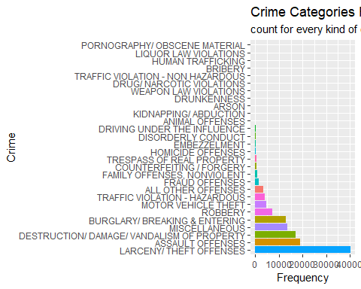

Slide 6
3.2 How victim gender and the time of crime are related and volume of crime for each time slot.

Slide 7
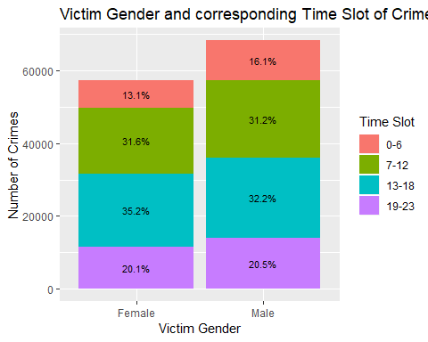

Slide 8
3.3 How crimes relate to the time of day

Slide 9
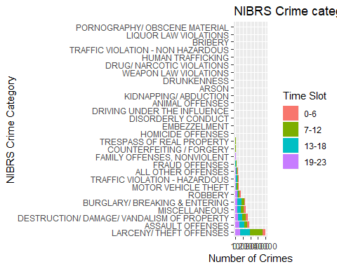

Slide 10
3.4 How crimes are related to days of the week and time slot of occurence

Slide 11
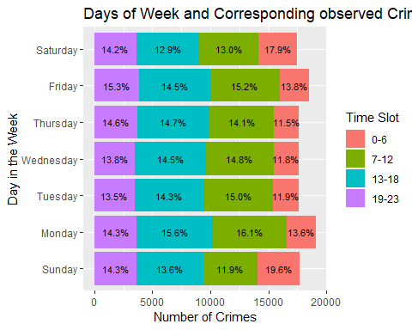

Slide 12
3.5 What percentage of crimes are “Hate crimes”?
Not feasible

Slide 13
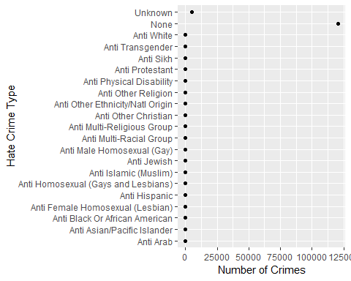

Slide 14
3.6 What age group in adults (over 18) is highly prone to be a victim? changed to What age group in adults (over 16) is highly prone to be a victim?

Slide 15
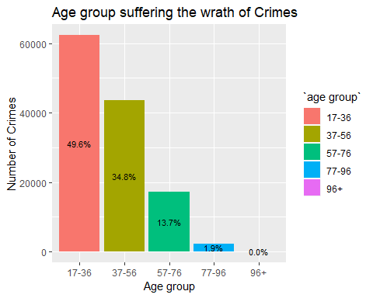

Slide 16
3.7 How crime rate varies in the week

Slide 17
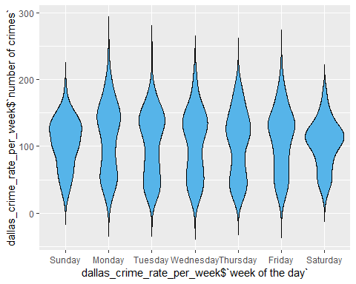

Slide 18
3.8 Heatmap

Slide 19
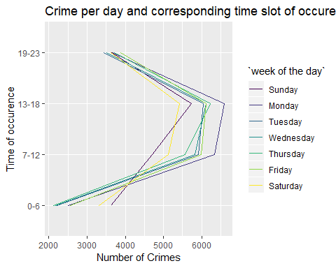

Slide 20
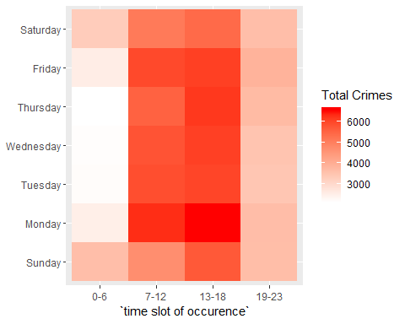

Slide 21
4. Feature Selection for Predictive Analysis
Two types of problems were designed for the given dataset : 1. Regression, 2. Classification
Objectives :
Evaluate attributes and their correlation
Generate datasets dallas_crime_rate(regression) and dallas_crime_type(classification) suitable to solve the designed problems
4.1 Feature Selection for Regression problem
4.1.1 Following chunk performs the generation of dataframe dallas_crime_rate
4.1.1.1 Following steps taken to generate dallas_crime_rate dataframe
All steps to generate dallas_incidents dataframe
group by ‘Division’, ‘rounded time’ and ‘week number of the day’ and summarize the frequency of records to new attribute ‘freq’
4.1.1.2 Following steps were completed done during preliminary features selection phase :
Reduction of Location Type attribute to 4 categorical values from 73
4.1.2 Following chunk performs evaluation of variable importance using boxplot visualizations and anova method
4.1.2.1 Following attributes were considered(in various combinations) for the evaluation
frequency ~ (ZipCode, LocationType, rounded time, NIBRS Category, time slot of occurence, week number of day and Division )
4.1.2.2 Following interpretations can be drawn from the tests
There were too many outliers for ZipCode and NIBRS Category in boxplot - hence can be rejected
Another reason for ignoring NIBRS category completely is - it is not a meaningful variable in describing the response variable
There were not too many differences in mean level of ‘time slot of occurence’ in comparison to that of ‘rounded time’ from boxplot - hence time slot of occurence can be rejected
Anova method shows combinations of ‘Division’, ‘rounded time’ and ‘week number of the day’ gave much favourable p-value (less than 0.05) than that of ‘LocationType’, ‘rounded time’ and ‘week number of day’. Thus we select the combination that has relatively lower p-value.
Please note : following chunk consists only those variables that were finally selected.
## ## Call: ## lm(formula = dallas_crime_rate$freq ~ dallas_crime_rate$Division + ## dallas_crime_rate$`week number of the day` + dallas_crime_rate$`rounded time`, ## data = dallas_crime_rate) ## ## Residuals: ## Min 1Q Median 3Q Max ## -53.446 -10.496 -1.353 9.147 89.866 ## ## Coefficients: ## Estimate Std. Error t value ## (Intercept) 56.33759 2.84874 19.776 ## dallas_crime_rate$DivisionNORTHCENTRAL -24.15476 1.77650 -13.597 ## dallas_crime_rate$DivisionNORTHEAST 19.86310 1.77650 11.181 ## dallas_crime_rate$DivisionNORTHWEST -4.21429 1.77650 -2.372 ## dallas_crime_rate$DivisionSOUTHCENTRAL 8.79167 1.77650 4.949 ## dallas_crime_rate$DivisionSOUTHEAST 22.73214 1.77650 12.796 ## dallas_crime_rate$DivisionSOUTHWEST 10.48810 1.77650 5.904 ## dallas_crime_rate$`week number of the day`2 7.02381 1.77650 3.954 ## dallas_crime_rate$`week number of the day`3 -0.43452 1.77650 -0.245 ## dallas_crime_rate$`week number of the day`4 0.25595 1.77650 0.144 ## dallas_crime_rate$`week number of the day`5 0.08929 1.77650 0.050 ## dallas_crime_rate$`week number of the day`6 5.06548 1.77650 2.851 ## dallas_crime_rate$`week number of the day`7 -0.86905 1.77650 -0.489 ## dallas_crime_rate$`rounded time`1 -8.83673 3.28944 -2.686 ## dallas_crime_rate$`rounded time`2 -13.20408 3.28944 -4.014 ## dallas_crime_rate$`rounded time`3 -21.91837 3.28944 -6.663 ## dallas_crime_rate$`rounded time`4 -30.89796 3.28944 -9.393 ## dallas_crime_rate$`rounded time`5 -31.87755 3.28944 -9.691 ## dallas_crime_rate$`rounded time`6 -20.20408 3.28944 -6.142 ## dallas_crime_rate$`rounded time`7 1.14286 3.28944 0.347 ## dallas_crime_rate$`rounded time`8 34.24490 3.28944 10.411 ## dallas_crime_rate$`rounded time`9 49.69388 3.28944 15.107 ## dallas_crime_rate$`rounded time`10 52.61224 3.28944 15.994 ## dallas_crime_rate$`rounded time`11 50.26531 3.28944 15.281 ## dallas_crime_rate$`rounded time`12 49.10204 3.28944 14.927 ## dallas_crime_rate$`rounded time`13 51.14286 3.28944 15.548 ## dallas_crime_rate$`rounded time`14 49.40816 3.28944 15.020 ## dallas_crime_rate$`rounded time`15 51.44898 3.28944 15.641 ## dallas_crime_rate$`rounded time`16 60.73469 3.28944 18.464 ## dallas_crime_rate$`rounded time`17 60.22449 3.28944 18.308 ## dallas_crime_rate$`rounded time`18 55.24490 3.28944 16.795 ## dallas_crime_rate$`rounded time`19 43.42857 3.28944 13.202 ## dallas_crime_rate$`rounded time`20 31.71429 3.28944 9.641 ## dallas_crime_rate$`rounded time`21 24.00000 3.28944 7.296 ## dallas_crime_rate$`rounded time`22 11.73469 3.28944 3.567 ## dallas_crime_rate$`rounded time`23 4.81633 3.28944 1.464 ## Pr(>|t|) ## (Intercept) < 2e-16 *** ## dallas_crime_rate$DivisionNORTHCENTRAL < 2e-16 *** ## dallas_crime_rate$DivisionNORTHEAST < 2e-16 *** ## dallas_crime_rate$DivisionNORTHWEST 0.017846 * ## dallas_crime_rate$DivisionSOUTHCENTRAL 8.59e-07 *** ## dallas_crime_rate$DivisionSOUTHEAST < 2e-16 *** ## dallas_crime_rate$DivisionSOUTHWEST 4.68e-09 *** ## dallas_crime_rate$`week number of the day`2 8.17e-05 *** ## dallas_crime_rate$`week number of the day`3 0.806814 ## dallas_crime_rate$`week number of the day`4 0.885465 ## dallas_crime_rate$`week number of the day`5 0.959925 ## dallas_crime_rate$`week number of the day`6 0.004432 ** ## dallas_crime_rate$`week number of the day`7 0.624801 ## dallas_crime_rate$`rounded time`1 0.007328 ** ## dallas_crime_rate$`rounded time`2 6.36e-05 *** ## dallas_crime_rate$`rounded time`3 4.16e-11 *** ## dallas_crime_rate$`rounded time`4 < 2e-16 *** ## dallas_crime_rate$`rounded time`5 < 2e-16 *** ## dallas_crime_rate$`rounded time`6 1.12e-09 *** ## dallas_crime_rate$`rounded time`7 0.728331 ## dallas_crime_rate$`rounded time`8 < 2e-16 *** ## dallas_crime_rate$`rounded time`9 < 2e-16 *** ## dallas_crime_rate$`rounded time`10 < 2e-16 *** ## dallas_crime_rate$`rounded time`11 < 2e-16 *** ## dallas_crime_rate$`rounded time`12 < 2e-16 *** ## dallas_crime_rate$`rounded time`13 < 2e-16 *** ## dallas_crime_rate$`rounded time`14 < 2e-16 *** ## dallas_crime_rate$`rounded time`15 < 2e-16 *** ## dallas_crime_rate$`rounded time`16 < 2e-16 *** ## dallas_crime_rate$`rounded time`17 < 2e-16 *** ## dallas_crime_rate$`rounded time`18 < 2e-16 *** ## dallas_crime_rate$`rounded time`19 < 2e-16 *** ## dallas_crime_rate$`rounded time`20 < 2e-16 *** ## dallas_crime_rate$`rounded time`21 5.54e-13 *** ## dallas_crime_rate$`rounded time`22 0.000376 *** ## dallas_crime_rate$`rounded time`23 0.143421 ## --- ## Signif. codes: 0 '***' 0.001 '**' 0.01 '*' 0.05 '.' 0.1 ' ' 1 ## ## Residual standard error: 16.28 on 1140 degrees of freedom ## Multiple R-squared: 0.8239, Adjusted R-squared: 0.8185 ## F-statistic: 152.4 on 35 and 1140 DF, p-value: < 2.2e-16
## Analysis of Variance Table ## ## Response: dallas_crime_rate$freq ## Df Sum Sq Mean Sq F value ## dallas_crime_rate$Division 6 258623 43104 162.5940 ## dallas_crime_rate$`week number of the day` 6 9796 1633 6.1588 ## dallas_crime_rate$`rounded time` 23 1145235 49793 187.8261 ## Residuals 1140 302215 265 ## Pr(>F) ## dallas_crime_rate$Division < 2.2e-16 *** ## dallas_crime_rate$`week number of the day` 2.274e-06 *** ## dallas_crime_rate$`rounded time` < 2.2e-16 *** ## Residuals ## --- ## Signif. codes: 0 '***' 0.001 '**' 0.01 '*' 0.05 '.' 0.1 ' ' 1
## # A tibble: 1,176 x 4 ## Division `rounded time` `week number of the day` freq ## <fct> <fct> <fct> <int> ## 1 CENTRAL 0 1 68 ## 2 CENTRAL 0 2 51 ## 3 CENTRAL 0 3 30 ## 4 CENTRAL 0 4 44 ## 5 CENTRAL 0 5 41 ## 6 CENTRAL 0 6 70 ## 7 CENTRAL 0 7 78 ## 8 CENTRAL 1 1 88 ## 9 CENTRAL 1 2 42 ## 10 CENTRAL 1 3 36 ## # ... with 1,166 more rows

Slide 22
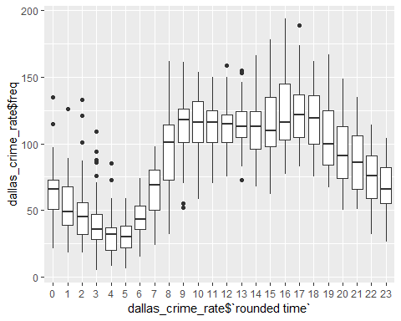

Slide 23
4.2 Feature Selection for Classification problem
4.2.1 Following chunk performs the generation of dataframe dallas_crime_type
4.2.1.1 Following steps taken to generate dallas_crime_type dataframe
All steps to generate dallas_incidents dataframe
group by ‘Division’, ‘rounded time’ and ‘week number of the day’ and summarize the frequency of records to new attribute ‘freq’
4.2.1.2 Following steps were completed done during preliminary features selection phase :
Reduction of Location Type attribute to 4 categorical values from 73
Usage of ‘NIBRS Crime Category’(28 categorical values) instead of ‘Category Type’(903 categorical values) attribute
Further reduction of ‘NIBRS Crime category’ to consist 8 categorical values in new attribute ‘Category’
Usage of ‘Division’(13 categorical values ) instead of ‘Zip Code’ (122 categorical values)
Cleaning the ‘Division’ attribute - bringing values to consistent format, thus reducing to 8 categorical values
4.2.2 Following chunk performs evaluation of variable importance using chi-square test
Null hypothesis : There is no association between 2 variables
4.2.2.1 Following attributes were considered(in various combinations) for the evaluation
Crime Category ~ (rounded time, time slot of occurence, week of the day and Division)
4.2.2.2 Following interpretations can be drawn from the tests
both combinations of (rounded time, week of the day and Division) and (time slot of occurence, week of the day and Division) passes chi-square test. However, we pick the combination that contains time slot of occurence as it has only factor levels in comparison to that of 24 in rounded time for building model with better accuracy.
Another reason to reject rounded time is the duration of traning the model is higher.
## [1] "p-value is significant - Null Hypothesis rejected"
Note for the following chunks: Training Code has been commented to prevent longer run time. Please uncomment before use or use trained weights saved under “trained weights” directory.

Slide 24
5. Model Training
Both classification and regression models are trained using the explanatory variables that had highest importance(from our inferential statistics tools) in predicting the future outcome
Divide the data into training(75%) and testing(25%)
Parameters auto-tune length set to 10
Resampling method chosen : Cross validation of chunk size 10
5.1 Regression Model
Using the explanatory variables week of the day, rounded time and division for predicting the crime frequency
generating dummy variables of the dataframe
Using the boxcox transformation for the response variable crime frequency
Using linear regression model and gradient boosting algorithms.
preprocess the target attribute to scale and center
Using RMSE metrics for cross validation evaluation
5.2 Classification Model
Using the explanatory variables week of the day,division and time slot of occurence for predicting Category (crime type)
generating dummy variables of the dataframe
Using the algorithms SVM,Random Forest and Naive Bayes.
preprocess the target attribute to scale and center

Slide 25
6 Model Prediction and Evaluation
6.1 Regression Model
Evaluation using Predicted v/s Actual Dataset Plot and RMSE Mean
## [1] "Linear Regression Model Performance :"

Slide 26
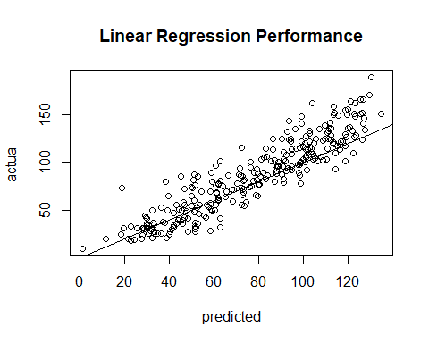

Slide 27
## ## Call: ## lm(formula = .outcome ~ ., data = dat) ## ## Residuals: ## Min 1Q Median 3Q Max ## -50.812 -9.926 -0.989 8.472 71.306 ## ## Coefficients: ## Estimate Std. Error t value Pr(>|t|) ## (Intercept) 50.42597 3.00045 16.806 < 2e-16 *** ## Division.NORTHCENTRAL -22.25181 1.88047 -11.833 < 2e-16 *** ## Division.NORTHEAST 17.76723 1.88533 9.424 < 2e-16 *** ## Division.NORTHWEST -4.59759 1.89501 -2.426 0.015467 * ## Division.SOUTHCENTRAL 6.54218 1.91714 3.412 0.000674 *** ## Division.SOUTHEAST 21.92837 1.87506 11.695 < 2e-16 *** ## Division.SOUTHWEST 10.37983 1.87304 5.542 4.00e-08 *** ## X.rounded.time.1 -8.23026 3.46094 -2.378 0.017626 * ## X.rounded.time.2 -9.73177 3.43466 -2.833 0.004715 ** ## X.rounded.time.3 -20.70978 3.43752 -6.025 2.52e-09 *** ## X.rounded.time.4 -27.20124 3.41169 -7.973 5.00e-15 *** ## X.rounded.time.5 -29.19081 3.41572 -8.546 < 2e-16 *** ## X.rounded.time.6 -16.81475 3.51533 -4.783 2.03e-06 *** ## X.rounded.time.7 0.70603 3.41633 0.207 0.836321 ## X.rounded.time.8 31.61849 3.48355 9.077 < 2e-16 *** ## X.rounded.time.9 44.39124 3.41618 12.994 < 2e-16 *** ## X.rounded.time.10 46.24839 3.43624 13.459 < 2e-16 *** ## X.rounded.time.11 43.03592 3.34960 12.848 < 2e-16 *** ## X.rounded.time.12 41.97184 3.45949 12.132 < 2e-16 *** ## X.rounded.time.13 44.10388 3.48525 12.654 < 2e-16 *** ## X.rounded.time.14 43.44546 3.54603 12.252 < 2e-16 *** ## X.rounded.time.15 44.23679 3.43479 12.879 < 2e-16 *** ## X.rounded.time.16 52.89052 3.43468 15.399 < 2e-16 *** ## X.rounded.time.17 54.07114 3.43809 15.727 < 2e-16 *** ## X.rounded.time.18 50.74415 3.43756 14.762 < 2e-16 *** ## X.rounded.time.19 37.10975 3.45972 10.726 < 2e-16 *** ## X.rounded.time.20 29.15536 3.36828 8.656 < 2e-16 *** ## X.rounded.time.21 22.11583 3.63378 6.086 1.75e-09 *** ## X.rounded.time.22 10.60347 3.35152 3.164 0.001613 ** ## X.rounded.time.23 4.08000 3.41042 1.196 0.231901 ## X.week.number.of.the.day.2 8.12300 1.88073 4.319 1.75e-05 *** ## X.week.number.of.the.day.3 1.01660 1.90494 0.534 0.593711 ## X.week.number.of.the.day.4 0.31041 1.88586 0.165 0.869299 ## X.week.number.of.the.day.5 0.01004 1.84666 0.005 0.995664 ## X.week.number.of.the.day.6 4.18783 1.88996 2.216 0.026968 * ## X.week.number.of.the.day.7 0.89295 1.87244 0.477 0.633563 ## --- ## Signif. codes: 0 '***' 0.001 '**' 0.01 '*' 0.05 '.' 0.1 ' ' 1 ## ## Residual standard error: 14.85 on 848 degrees of freedom ## Multiple R-squared: 0.8219, Adjusted R-squared: 0.8145 ## F-statistic: 111.8 on 35 and 848 DF, p-value: < 2.2e-16
## [1] "Gradient Boosting Model Performance :"

Slide 28
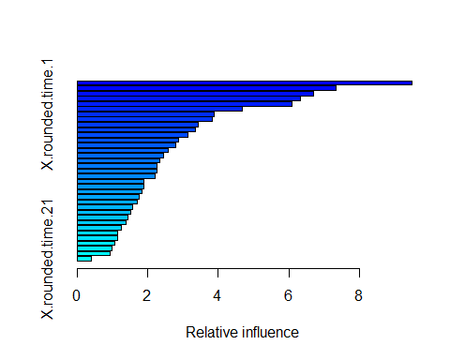

Slide 29
## var rel.inf ## Division.NORTHCENTRAL Division.NORTHCENTRAL 9.4913640 ## X.rounded.time.4 X.rounded.time.4 7.3222521 ## X.rounded.time.5 X.rounded.time.5 6.6886960 ## X.rounded.time.3 X.rounded.time.3 6.3322463 ## X.rounded.time.2 X.rounded.time.2 6.0997665 ## X.rounded.time.6 X.rounded.time.6 4.6726548 ## X.rounded.time.1 X.rounded.time.1 3.8852850 ## Division.SOUTHEAST Division.SOUTHEAST 3.8398992 ## Division.NORTHEAST Division.NORTHEAST 3.4274015 ## X.rounded.time.16 X.rounded.time.16 3.3586984 ## X.rounded.time.17 X.rounded.time.17 3.1315216 ## X.rounded.time.7 X.rounded.time.7 2.8798024 ## X.rounded.time.8 X.rounded.time.8 2.7895080 ## X.rounded.time.9 X.rounded.time.9 2.5760725 ## X.rounded.time.10 X.rounded.time.10 2.4610236 ## Division.NORTHWEST Division.NORTHWEST 2.3550555 ## X.week.number.of.the.day.2 X.week.number.of.the.day.2 2.2676596 ## X.rounded.time.18 X.rounded.time.18 2.2625262 ## X.rounded.time.23 X.rounded.time.23 2.2214500 ## X.rounded.time.14 X.rounded.time.14 1.9036016 ## X.rounded.time.15 X.rounded.time.15 1.8790498 ## X.rounded.time.11 X.rounded.time.11 1.8362913 ## X.rounded.time.22 X.rounded.time.22 1.7467296 ## X.rounded.time.13 X.rounded.time.13 1.6983624 ## X.rounded.time.12 X.rounded.time.12 1.5656168 ## X.rounded.time.19 X.rounded.time.19 1.5075069 ## Division.SOUTHWEST Division.SOUTHWEST 1.4442209 ## X.week.number.of.the.day.5 X.week.number.of.the.day.5 1.3997390 ## X.week.number.of.the.day.7 X.week.number.of.the.day.7 1.2532407 ## X.week.number.of.the.day.6 X.week.number.of.the.day.6 1.1524012 ## X.rounded.time.20 X.rounded.time.20 1.1478323 ## X.week.number.of.the.day.3 X.week.number.of.the.day.3 1.0778230 ## X.week.number.of.the.day.4 X.week.number.of.the.day.4 0.9871318 ## Division.SOUTHCENTRAL Division.SOUTHCENTRAL 0.9253060 ## X.rounded.time.21 X.rounded.time.21 0.4122637
## [1] "Comparison on performance : "
## ## Call: ## summary.resamples(object = res) ## ## Models: lm, gbm ## Number of resamples: 30 ## ## MAE ## Min. 1st Qu. Median Mean 3rd Qu. Max. NA's ## lm 10.427546 11.06372 11.52853 11.68077 12.37765 13.18812 0 ## gbm 8.815698 9.89768 10.66670 10.62323 11.29992 13.04242 0 ## ## RMSE ## Min. 1st Qu. Median Mean 3rd Qu. Max. NA's ## lm 13.11263 14.39692 15.02485 15.13331 15.83411 18.00960 0 ## gbm 11.59596 13.04679 13.34855 13.73745 14.29213 17.85638 0 ## ## Rsquared ## Min. 1st Qu. Median Mean 3rd Qu. Max. NA's ## lm 0.7401943 0.7873036 0.8085967 0.8084995 0.8273587 0.8622241 0 ## gbm 0.7342509 0.8239029 0.8503263 0.8428384 0.8691883 0.8935508 0
6.2 Classification Model
Evaluation using Confusion Matrix
## [1] "SVM Model Performance :"
## Confusion Matrix and Statistics ## ## Reference ## Prediction ALL OTHER OFFENSES ## ALL OTHER OFFENSES 239 ## ASSAULT OFFENSES 0 ## BURGLARY/ BREAKING & ENTERING 0 ## DESTRUCTION/ DAMAGE/ VANDALISM OF PROPERTY 0 ## DRUNKENNESS/TRESPASSING/NUISANCE 0 ## FRAUD OFFENSES 0 ## LARCENY/ THEFT OFFENSES 0 ## TRAFFIC VIOLATION 0 ## Reference ## Prediction ASSAULT OFFENSES ## ALL OTHER OFFENSES 0 ## ASSAULT OFFENSES 150 ## BURGLARY/ BREAKING & ENTERING 0 ## DESTRUCTION/ DAMAGE/ VANDALISM OF PROPERTY 0 ## DRUNKENNESS/TRESPASSING/NUISANCE 0 ## FRAUD OFFENSES 0 ## LARCENY/ THEFT OFFENSES 0 ## TRAFFIC VIOLATION 0 ## Reference ## Prediction BURGLARY/ BREAKING & ENTERING ## ALL OTHER OFFENSES 0 ## ASSAULT OFFENSES 0 ## BURGLARY/ BREAKING & ENTERING 1800 ## DESTRUCTION/ DAMAGE/ VANDALISM OF PROPERTY 0 ## DRUNKENNESS/TRESPASSING/NUISANCE 0 ## FRAUD OFFENSES 0 ## LARCENY/ THEFT OFFENSES 0 ## TRAFFIC VIOLATION 0 ## Reference ## Prediction DESTRUCTION/ DAMAGE/ VANDALISM OF PROPERTY ## ALL OTHER OFFENSES 0 ## ASSAULT OFFENSES 0 ## BURGLARY/ BREAKING & ENTERING 0 ## DESTRUCTION/ DAMAGE/ VANDALISM OF PROPERTY 4233 ## DRUNKENNESS/TRESPASSING/NUISANCE 0 ## FRAUD OFFENSES 0 ## LARCENY/ THEFT OFFENSES 0 ## TRAFFIC VIOLATION 0 ## Reference ## Prediction DRUNKENNESS/TRESPASSING/NUISANCE ## ALL OTHER OFFENSES 0 ## ASSAULT OFFENSES 0 ## BURGLARY/ BREAKING & ENTERING 0 ## DESTRUCTION/ DAMAGE/ VANDALISM OF PROPERTY 0 ## DRUNKENNESS/TRESPASSING/NUISANCE 137 ## FRAUD OFFENSES 0 ## LARCENY/ THEFT OFFENSES 0 ## TRAFFIC VIOLATION 0 ## Reference ## Prediction FRAUD OFFENSES ## ALL OTHER OFFENSES 0 ## ASSAULT OFFENSES 0 ## BURGLARY/ BREAKING & ENTERING 0 ## DESTRUCTION/ DAMAGE/ VANDALISM OF PROPERTY 0 ## DRUNKENNESS/TRESPASSING/NUISANCE 0 ## FRAUD OFFENSES 153 ## LARCENY/ THEFT OFFENSES 0 ## TRAFFIC VIOLATION 0 ## Reference ## Prediction LARCENY/ THEFT OFFENSES ## ALL OTHER OFFENSES 0 ## ASSAULT OFFENSES 0 ## BURGLARY/ BREAKING & ENTERING 0 ## DESTRUCTION/ DAMAGE/ VANDALISM OF PROPERTY 0 ## DRUNKENNESS/TRESPASSING/NUISANCE 0 ## FRAUD OFFENSES 0 ## LARCENY/ THEFT OFFENSES 1138 ## TRAFFIC VIOLATION 0 ## Reference ## Prediction TRAFFIC VIOLATION ## ALL OTHER OFFENSES 0 ## ASSAULT OFFENSES 0 ## BURGLARY/ BREAKING & ENTERING 0 ## DESTRUCTION/ DAMAGE/ VANDALISM OF PROPERTY 0 ## DRUNKENNESS/TRESPASSING/NUISANCE 0 ## FRAUD OFFENSES 0 ## LARCENY/ THEFT OFFENSES 0 ## TRAFFIC VIOLATION 1052 ## ## Overall Statistics ## ## Accuracy : 1 ## 95% CI : (0.9996, 1) ## No Information Rate : 0.4755 ## P-Value [Acc > NIR] : < 2.2e-16 ## ## Kappa : 1 ## Mcnemar's Test P-Value : NA ## ## Statistics by Class: ## ## Class: ALL OTHER OFFENSES Class: ASSAULT OFFENSES ## Sensitivity 1.00000 1.00000 ## Specificity 1.00000 1.00000 ## Pos Pred Value 1.00000 1.00000 ## Neg Pred Value 1.00000 1.00000 ## Prevalence 0.02685 0.01685 ## Detection Rate 0.02685 0.01685 ## Detection Prevalence 0.02685 0.01685 ## Balanced Accuracy 1.00000 1.00000 ## Class: BURGLARY/ BREAKING & ENTERING ## Sensitivity 1.0000 ## Specificity 1.0000 ## Pos Pred Value 1.0000 ## Neg Pred Value 1.0000 ## Prevalence 0.2022 ## Detection Rate 0.2022 ## Detection Prevalence 0.2022 ## Balanced Accuracy 1.0000 ## Class: DESTRUCTION/ DAMAGE/ VANDALISM OF PROPERTY ## Sensitivity 1.0000 ## Specificity 1.0000 ## Pos Pred Value 1.0000 ## Neg Pred Value 1.0000 ## Prevalence 0.4755 ## Detection Rate 0.4755 ## Detection Prevalence 0.4755 ## Balanced Accuracy 1.0000 ## Class: DRUNKENNESS/TRESPASSING/NUISANCE ## Sensitivity 1.00000 ## Specificity 1.00000 ## Pos Pred Value 1.00000 ## Neg Pred Value 1.00000 ## Prevalence 0.01539 ## Detection Rate 0.01539 ## Detection Prevalence 0.01539 ## Balanced Accuracy 1.00000 ## Class: FRAUD OFFENSES Class: LARCENY/ THEFT OFFENSES ## Sensitivity 1.00000 1.0000 ## Specificity 1.00000 1.0000 ## Pos Pred Value 1.00000 1.0000 ## Neg Pred Value 1.00000 1.0000 ## Prevalence 0.01719 0.1278 ## Detection Rate 0.01719 0.1278 ## Detection Prevalence 0.01719 0.1278 ## Balanced Accuracy 1.00000 1.0000 ## Class: TRAFFIC VIOLATION ## Sensitivity 1.0000 ## Specificity 1.0000 ## Pos Pred Value 1.0000 ## Neg Pred Value 1.0000 ## Prevalence 0.1182 ## Detection Rate 0.1182 ## Detection Prevalence 0.1182 ## Balanced Accuracy 1.0000
## [1] "Random Forest Model Performance :"
## Confusion Matrix and Statistics ## ## Reference ## Prediction ALL OTHER OFFENSES ## ALL OTHER OFFENSES 239 ## ASSAULT OFFENSES 0 ## BURGLARY/ BREAKING & ENTERING 0 ## DESTRUCTION/ DAMAGE/ VANDALISM OF PROPERTY 0 ## DRUNKENNESS/TRESPASSING/NUISANCE 0 ## FRAUD OFFENSES 0 ## LARCENY/ THEFT OFFENSES 0 ## TRAFFIC VIOLATION 0 ## Reference ## Prediction ASSAULT OFFENSES ## ALL OTHER OFFENSES 0 ## ASSAULT OFFENSES 150 ## BURGLARY/ BREAKING & ENTERING 0 ## DESTRUCTION/ DAMAGE/ VANDALISM OF PROPERTY 0 ## DRUNKENNESS/TRESPASSING/NUISANCE 0 ## FRAUD OFFENSES 0 ## LARCENY/ THEFT OFFENSES 0 ## TRAFFIC VIOLATION 0 ## Reference ## Prediction BURGLARY/ BREAKING & ENTERING ## ALL OTHER OFFENSES 0 ## ASSAULT OFFENSES 0 ## BURGLARY/ BREAKING & ENTERING 1800 ## DESTRUCTION/ DAMAGE/ VANDALISM OF PROPERTY 0 ## DRUNKENNESS/TRESPASSING/NUISANCE 0 ## FRAUD OFFENSES 0 ## LARCENY/ THEFT OFFENSES 0 ## TRAFFIC VIOLATION 0 ## Reference ## Prediction DESTRUCTION/ DAMAGE/ VANDALISM OF PROPERTY ## ALL OTHER OFFENSES 0 ## ASSAULT OFFENSES 0 ## BURGLARY/ BREAKING & ENTERING 0 ## DESTRUCTION/ DAMAGE/ VANDALISM OF PROPERTY 4233 ## DRUNKENNESS/TRESPASSING/NUISANCE 0 ## FRAUD OFFENSES 0 ## LARCENY/ THEFT OFFENSES 0 ## TRAFFIC VIOLATION 0 ## Reference ## Prediction DRUNKENNESS/TRESPASSING/NUISANCE ## ALL OTHER OFFENSES 0 ## ASSAULT OFFENSES 1 ## BURGLARY/ BREAKING & ENTERING 0 ## DESTRUCTION/ DAMAGE/ VANDALISM OF PROPERTY 0 ## DRUNKENNESS/TRESPASSING/NUISANCE 136 ## FRAUD OFFENSES 0 ## LARCENY/ THEFT OFFENSES 0 ## TRAFFIC VIOLATION 0 ## Reference ## Prediction FRAUD OFFENSES ## ALL OTHER OFFENSES 0 ## ASSAULT OFFENSES 0 ## BURGLARY/ BREAKING & ENTERING 0 ## DESTRUCTION/ DAMAGE/ VANDALISM OF PROPERTY 0 ## DRUNKENNESS/TRESPASSING/NUISANCE 0 ## FRAUD OFFENSES 153 ## LARCENY/ THEFT OFFENSES 0 ## TRAFFIC VIOLATION 0 ## Reference ## Prediction LARCENY/ THEFT OFFENSES ## ALL OTHER OFFENSES 0 ## ASSAULT OFFENSES 0 ## BURGLARY/ BREAKING & ENTERING 0 ## DESTRUCTION/ DAMAGE/ VANDALISM OF PROPERTY 0 ## DRUNKENNESS/TRESPASSING/NUISANCE 0 ## FRAUD OFFENSES 0 ## LARCENY/ THEFT OFFENSES 1138 ## TRAFFIC VIOLATION 0 ## Reference ## Prediction TRAFFIC VIOLATION ## ALL OTHER OFFENSES 0 ## ASSAULT OFFENSES 0 ## BURGLARY/ BREAKING & ENTERING 0 ## DESTRUCTION/ DAMAGE/ VANDALISM OF PROPERTY 0 ## DRUNKENNESS/TRESPASSING/NUISANCE 0 ## FRAUD OFFENSES 0 ## LARCENY/ THEFT OFFENSES 0 ## TRAFFIC VIOLATION 1052 ## ## Overall Statistics ## ## Accuracy : 0.9999 ## 95% CI : (0.9994, 1) ## No Information Rate : 0.4755 ## P-Value [Acc > NIR] : < 2.2e-16 ## ## Kappa : 0.9998 ## Mcnemar's Test P-Value : NA ## ## Statistics by Class: ## ## Class: ALL OTHER OFFENSES Class: ASSAULT OFFENSES ## Sensitivity 1.00000 1.00000 ## Specificity 1.00000 0.99989 ## Pos Pred Value 1.00000 0.99338 ## Neg Pred Value 1.00000 1.00000 ## Prevalence 0.02685 0.01685 ## Detection Rate 0.02685 0.01685 ## Detection Prevalence 0.02685 0.01696 ## Balanced Accuracy 1.00000 0.99994 ## Class: BURGLARY/ BREAKING & ENTERING ## Sensitivity 1.0000 ## Specificity 1.0000 ## Pos Pred Value 1.0000 ## Neg Pred Value 1.0000 ## Prevalence 0.2022 ## Detection Rate 0.2022 ## Detection Prevalence 0.2022 ## Balanced Accuracy 1.0000 ## Class: DESTRUCTION/ DAMAGE/ VANDALISM OF PROPERTY ## Sensitivity 1.0000 ## Specificity 1.0000 ## Pos Pred Value 1.0000 ## Neg Pred Value 1.0000 ## Prevalence 0.4755 ## Detection Rate 0.4755 ## Detection Prevalence 0.4755 ## Balanced Accuracy 1.0000 ## Class: DRUNKENNESS/TRESPASSING/NUISANCE ## Sensitivity 0.99270 ## Specificity 1.00000 ## Pos Pred Value 1.00000 ## Neg Pred Value 0.99989 ## Prevalence 0.01539 ## Detection Rate 0.01528 ## Detection Prevalence 0.01528 ## Balanced Accuracy 0.99635 ## Class: FRAUD OFFENSES Class: LARCENY/ THEFT OFFENSES ## Sensitivity 1.00000 1.0000 ## Specificity 1.00000 1.0000 ## Pos Pred Value 1.00000 1.0000 ## Neg Pred Value 1.00000 1.0000 ## Prevalence 0.01719 0.1278 ## Detection Rate 0.01719 0.1278 ## Detection Prevalence 0.01719 0.1278 ## Balanced Accuracy 1.00000 1.0000 ## Class: TRAFFIC VIOLATION ## Sensitivity 1.0000 ## Specificity 1.0000 ## Pos Pred Value 1.0000 ## Neg Pred Value 1.0000 ## Prevalence 0.1182 ## Detection Rate 0.1182 ## Detection Prevalence 0.1182 ## Balanced Accuracy 1.0000
## [1] "Naive Bayes Performance :"
## Confusion Matrix and Statistics ## ## Reference ## Prediction ALL OTHER OFFENSES ## ALL OTHER OFFENSES 0 ## ASSAULT OFFENSES 0 ## BURGLARY/ BREAKING & ENTERING 0 ## DESTRUCTION/ DAMAGE/ VANDALISM OF PROPERTY 239 ## DRUNKENNESS/TRESPASSING/NUISANCE 0 ## FRAUD OFFENSES 0 ## LARCENY/ THEFT OFFENSES 0 ## TRAFFIC VIOLATION 0 ## Reference ## Prediction ASSAULT OFFENSES ## ALL OTHER OFFENSES 0 ## ASSAULT OFFENSES 0 ## BURGLARY/ BREAKING & ENTERING 0 ## DESTRUCTION/ DAMAGE/ VANDALISM OF PROPERTY 150 ## DRUNKENNESS/TRESPASSING/NUISANCE 0 ## FRAUD OFFENSES 0 ## LARCENY/ THEFT OFFENSES 0 ## TRAFFIC VIOLATION 0 ## Reference ## Prediction BURGLARY/ BREAKING & ENTERING ## ALL OTHER OFFENSES 0 ## ASSAULT OFFENSES 0 ## BURGLARY/ BREAKING & ENTERING 1800 ## DESTRUCTION/ DAMAGE/ VANDALISM OF PROPERTY 0 ## DRUNKENNESS/TRESPASSING/NUISANCE 0 ## FRAUD OFFENSES 0 ## LARCENY/ THEFT OFFENSES 0 ## TRAFFIC VIOLATION 0 ## Reference ## Prediction DESTRUCTION/ DAMAGE/ VANDALISM OF PROPERTY ## ALL OTHER OFFENSES 0 ## ASSAULT OFFENSES 0 ## BURGLARY/ BREAKING & ENTERING 0 ## DESTRUCTION/ DAMAGE/ VANDALISM OF PROPERTY 4233 ## DRUNKENNESS/TRESPASSING/NUISANCE 0 ## FRAUD OFFENSES 0 ## LARCENY/ THEFT OFFENSES 0 ## TRAFFIC VIOLATION 0 ## Reference ## Prediction DRUNKENNESS/TRESPASSING/NUISANCE ## ALL OTHER OFFENSES 0 ## ASSAULT OFFENSES 0 ## BURGLARY/ BREAKING & ENTERING 0 ## DESTRUCTION/ DAMAGE/ VANDALISM OF PROPERTY 137 ## DRUNKENNESS/TRESPASSING/NUISANCE 0 ## FRAUD OFFENSES 0 ## LARCENY/ THEFT OFFENSES 0 ## TRAFFIC VIOLATION 0 ## Reference ## Prediction FRAUD OFFENSES ## ALL OTHER OFFENSES 0 ## ASSAULT OFFENSES 0 ## BURGLARY/ BREAKING & ENTERING 0 ## DESTRUCTION/ DAMAGE/ VANDALISM OF PROPERTY 153 ## DRUNKENNESS/TRESPASSING/NUISANCE 0 ## FRAUD OFFENSES 0 ## LARCENY/ THEFT OFFENSES 0 ## TRAFFIC VIOLATION 0 ## Reference ## Prediction LARCENY/ THEFT OFFENSES ## ALL OTHER OFFENSES 0 ## ASSAULT OFFENSES 0 ## BURGLARY/ BREAKING & ENTERING 0 ## DESTRUCTION/ DAMAGE/ VANDALISM OF PROPERTY 1138 ## DRUNKENNESS/TRESPASSING/NUISANCE 0 ## FRAUD OFFENSES 0 ## LARCENY/ THEFT OFFENSES 0 ## TRAFFIC VIOLATION 0 ## Reference ## Prediction TRAFFIC VIOLATION ## ALL OTHER OFFENSES 0 ## ASSAULT OFFENSES 0 ## BURGLARY/ BREAKING & ENTERING 0 ## DESTRUCTION/ DAMAGE/ VANDALISM OF PROPERTY 1052 ## DRUNKENNESS/TRESPASSING/NUISANCE 0 ## FRAUD OFFENSES 0 ## LARCENY/ THEFT OFFENSES 0 ## TRAFFIC VIOLATION 0 ## ## Overall Statistics ## ## Accuracy : 0.6777 ## 95% CI : (0.6679, 0.6874) ## No Information Rate : 0.4755 ## P-Value [Acc > NIR] : < 2.2e-16 ## ## Kappa : 0.4441 ## Mcnemar's Test P-Value : NA ## ## Statistics by Class: ## ## Class: ALL OTHER OFFENSES Class: ASSAULT OFFENSES ## Sensitivity 0.00000 0.00000 ## Specificity 1.00000 1.00000 ## Pos Pred Value NaN NaN ## Neg Pred Value 0.97315 0.98315 ## Prevalence 0.02685 0.01685 ## Detection Rate 0.00000 0.00000 ## Detection Prevalence 0.00000 0.00000 ## Balanced Accuracy 0.50000 0.50000 ## Class: BURGLARY/ BREAKING & ENTERING ## Sensitivity 1.0000 ## Specificity 1.0000 ## Pos Pred Value 1.0000 ## Neg Pred Value 1.0000 ## Prevalence 0.2022 ## Detection Rate 0.2022 ## Detection Prevalence 0.2022 ## Balanced Accuracy 1.0000 ## Class: DESTRUCTION/ DAMAGE/ VANDALISM OF PROPERTY ## Sensitivity 1.0000 ## Specificity 0.3855 ## Pos Pred Value 0.5960 ## Neg Pred Value 1.0000 ## Prevalence 0.4755 ## Detection Rate 0.4755 ## Detection Prevalence 0.7978 ## Balanced Accuracy 0.6928 ## Class: DRUNKENNESS/TRESPASSING/NUISANCE ## Sensitivity 0.00000 ## Specificity 1.00000 ## Pos Pred Value NaN ## Neg Pred Value 0.98461 ## Prevalence 0.01539 ## Detection Rate 0.00000 ## Detection Prevalence 0.00000 ## Balanced Accuracy 0.50000 ## Class: FRAUD OFFENSES Class: LARCENY/ THEFT OFFENSES ## Sensitivity 0.00000 0.0000 ## Specificity 1.00000 1.0000 ## Pos Pred Value NaN NaN ## Neg Pred Value 0.98281 0.8722 ## Prevalence 0.01719 0.1278 ## Detection Rate 0.00000 0.0000 ## Detection Prevalence 0.00000 0.0000 ## Balanced Accuracy 0.50000 0.5000 ## Class: TRAFFIC VIOLATION ## Sensitivity 0.0000 ## Specificity 1.0000 ## Pos Pred Value NaN ## Neg Pred Value 0.8818 ## Prevalence 0.1182 ## Detection Rate 0.0000 ## Detection Prevalence 0.0000 ## Balanced Accuracy 0.5000

Slide 30
7 Interpretations and Scope for Future Improvement
7.1 Interpretations
Regression Model Evaluation – RMSE Mean : 14(gbm) > 17(lm) – Rsquared : 0.85(lm) > 0.82(gbm)
Classification Model Evaluation – Accuracy : 100%(SVM) > 99.98% (RF) > 68%(Naive Bayes)
7.2 Scope for Future Improvement
Predicted values in regression fit well with the actual values as per the plotted graphs of actual vs predicted.
Accuracy is high for SVM,RF - High overfitting possible (or over-simplified model), Accuracy is moderate for Naive Bayes method
Better feature engineering and complex selection of explanatory attributes must be addressed

