Slide 1
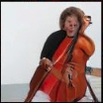
Midterm Presentation SoundGAN
Students: Sagy Gersh, Yahav Vinokur
Supervisor: Tamar Rott-Shaham, Idan Kligvasser
Semester: Winter, 2020-2021
Date: 17/01/21
Is it a cello?
Or is it a human?

Slide 2
Outline
Project Goal
Literature survey
Chosen solution
Current results
Future work
Notes:
Outline
This slide should contain an outline (list of headings) of the presentation
Maximum 5-6 bullets

Slide 3
Project Goal
Create an estimated image of a given sound source.
Can we extract enough visual features from sound?
Will technology allow us to create well understood pictures?
Show that manipulating the sound source affect the output image in a sensible way.
For example, raising volume might enlarge objects in image.
Notes:
Project Goal
Describe the goal of the project
What is the problem you face?
What you want to achieve?
Can we extract enough visual features from a given sound source, so we can estimate it’s visual appearance? –too long sentence
Will current technology allow us to create good quality pictures, and manipulate their features space with our vector?

Slide 4
Background
The task had been accomplished on the constricted area of faces.
Several attempts of more broad areas had been made with low or no success.
Using older nets and methods
Notes:
Background
A general description of background
The environment and context
Motivation (why is it an interesting problem?)

Slide 5
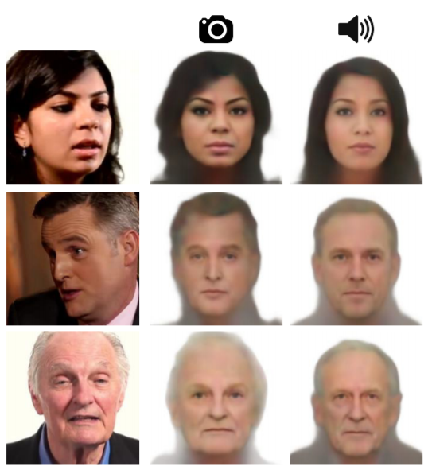
Literature Survey
Sound2Face
Restricted area
Limited feature space (easy to cover the whole space)
Good results with image encoder
Notes:
Literature Survey
Describe existing solutions to the problem that you have found in the literature survey
For each solution, give a general overview, some details, pros and cons (quality, complexity, cost, …)

Slide 6
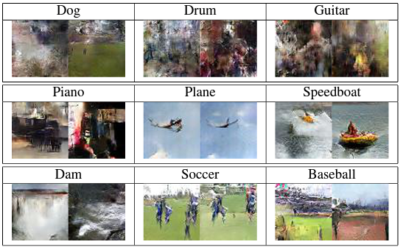
Literature Survey
Towards Audio to Scene Image Synthesis using Generative Adversarial Network
Broad area
Wide feature space
Mediocre results with GAN

Slide 7
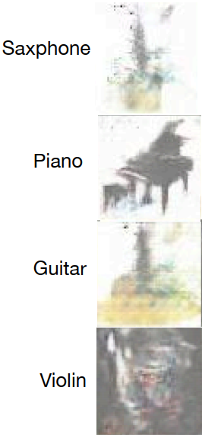
Literature Survey
Deep Cross-Modal Audio-Visual Generation
Semi-broad area
Wide feature space
Bad results with GAN

Slide 8
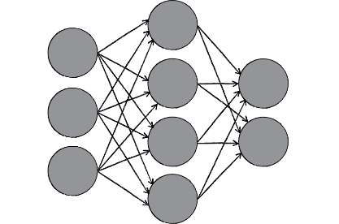
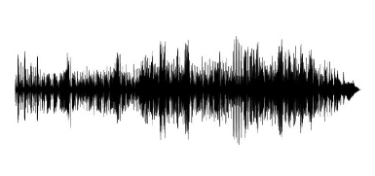
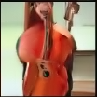
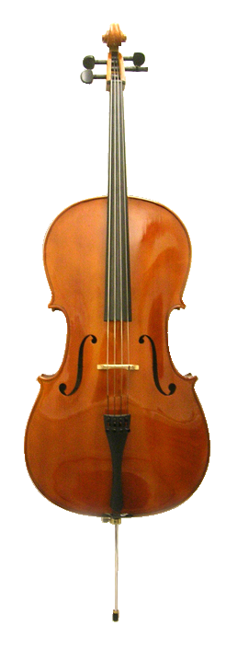
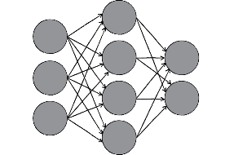
Chosen solution
Feature-Vector transition net
Generated Image
PANNs-Sound Classifier
BigGAN – image genarator
Sound-Object pairs
BigGAN Class
VGG
Feature
vector
VGG
Feature
vector
LOSS compute
VGG – image classifier
VGG – image classifier

Slide 9
Sound classifier
Based on PANN
New, state of the art audio classification net
Fine-tuned to our database
Very high accuracy
Sound Classifier

Slide 10
Results
PANNs – State of the art sound classification
Previous methods used soundNet - acc. On ESC-50: 74.2%
Our method uses PANNs - acc. On ESC-50: 94.7%
Fine tuned to our database – 97.5%

Slide 11
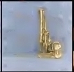

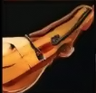
Results
BigGAN – best image generator available
In compare to former attempt – very good starting point!
Former methods
Our BigGAN’s results
“S2I”
“Audio to Scene”
saxophone
horn
violin

Slide 12
Work So Far
Literature Survey
Finding the best solution for each block
Modifying architectures to our needs
Fine tuning sound classifier
Connecting sound classifier to BigGAN
Notes:
Work So Far
Your work stages in the project so far

Slide 13
Future Work
Implementing Feature-Vector transition net
Optimizing training (If necessary)
Maybe train all system together instead
Adding VGG loss mechanism
Finding best LOSS function
Improving results
Fine tune BigGAN
Extracting human layers from BigGAN
Notes:
Future Work
Suggested direction to continue your work

Slide 14
References
Q. Kong, Y. Cao, T. Iqbal, Y. Wang, W. Wang, and M. D. Plumbley, “Panns: Large-scale pretrained audio neural networks for audio pattern recognition,” arXiv preprint arXiv:1912.10211, 2019.
Chia-Hung Wan, Shun-Po Chuang, and Hung-yi Lee. Towards audio to scene image synthesis using generative adversarial network. In IEEE International Conference on Acoustics, Speech and Signal Processing, ICASSP 2019, Brighton, United Kingdom, May 12-17, 2019, pages 496–500, 2019
Brock, A., Donahue, J., and Simonyan, K. Large scale gan training for high fidelity natural image synthesis. arXiv preprint arXiv:1809.11096, 2018
T.-H. Oh, T. Dekel, C. Kim, I. Mosseri, W. T. Freeman, M. Rubinstein, and W. Matusik. Speech2face: Learning the face behind a voice. In CVPR, 2019
Lele Chen, Sudhanshu Srivastava, Zhiyao Duan, and Chenliang Xu. Deep cross-modal audio-visual generation. arXiv preprint arXiv:1704.08292, 2017.
Notes:
References
Only the most important references should be mentioned here, in IEEE format
Here are some examples:

