Slide 1
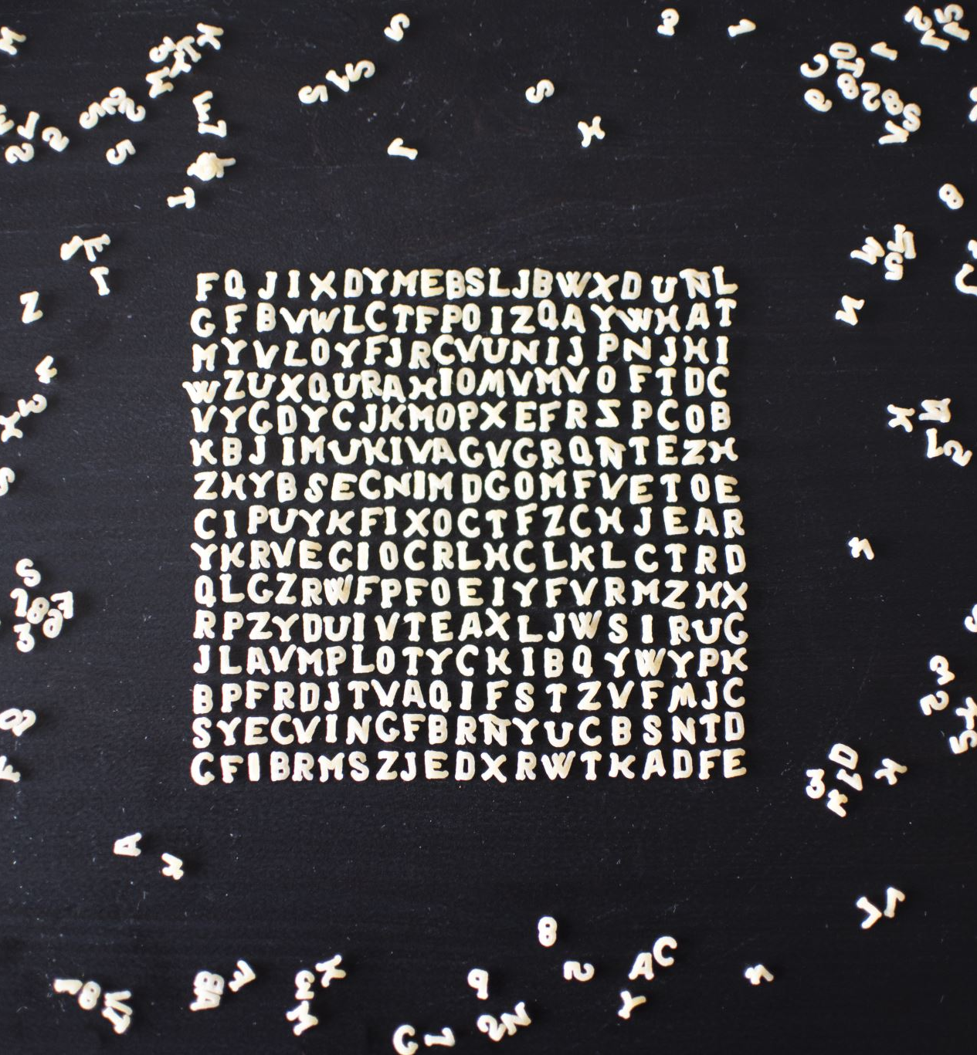
Text Summarization using Python
Jisun Lee (U37416487)
CS 688 Project

Slide 2

The Process Of Project
Choose 10 TED Talks and download the transcripts into text file
Use different types of summarization techniques (NLTK, Gensim, and SpaCy)
Read the 10 talks text files and analysis the files
Present the most frequently used terms and summary

Slide 3
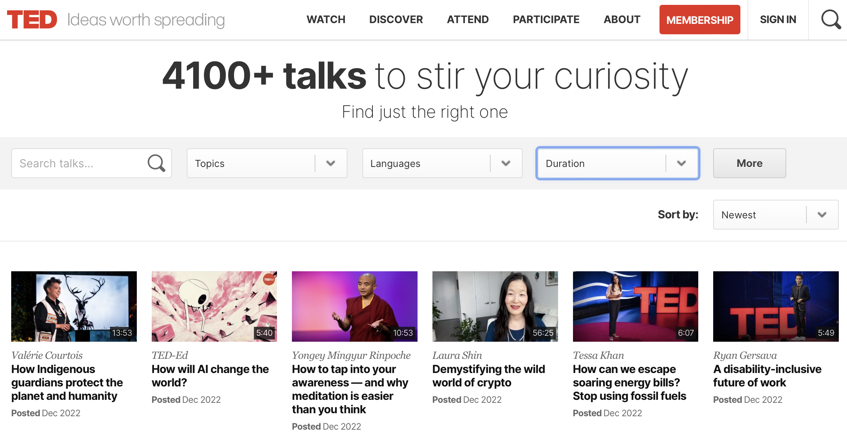
Collect The Data
Website:
https://www.ted.com/talks
Collect the data with Duration of the talk
Durations:
0-6 minutes
6-12 minutes
12-18 minutes
Copy and Paste the Transcripts into text file

Slide 4
Python Summarization Tools
NLTK
leading platform for building Python programs to work with human language data.
Pre-processing capabilities such as identify stopwords, remove punctuation, etc.
Cannot identify if a word is a verb, adjective, or noun
Gensim
Python library for topic modelling, document indexing and similarity retrieval with large corpora.
Represents documents as semantic vectors
Provides automatic text summarization
spaCy
free and open-source library for Natural Language Processing (NLP) in Python with a lot of in-built capabilities.
Can identify if a word is a verb, adjective, or noun
In text summarization, spaCy performs better than Gensim.

Slide 5
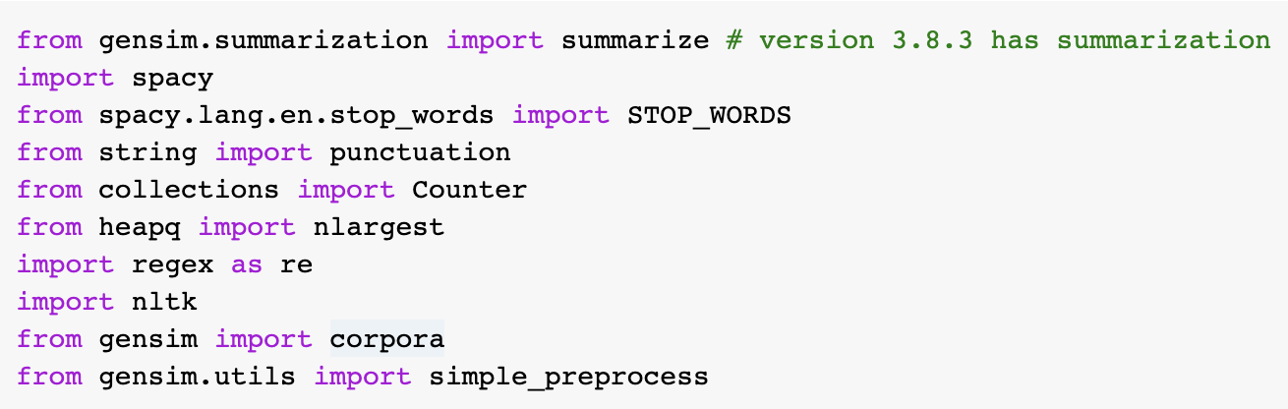

Packages Setting

Slide 6
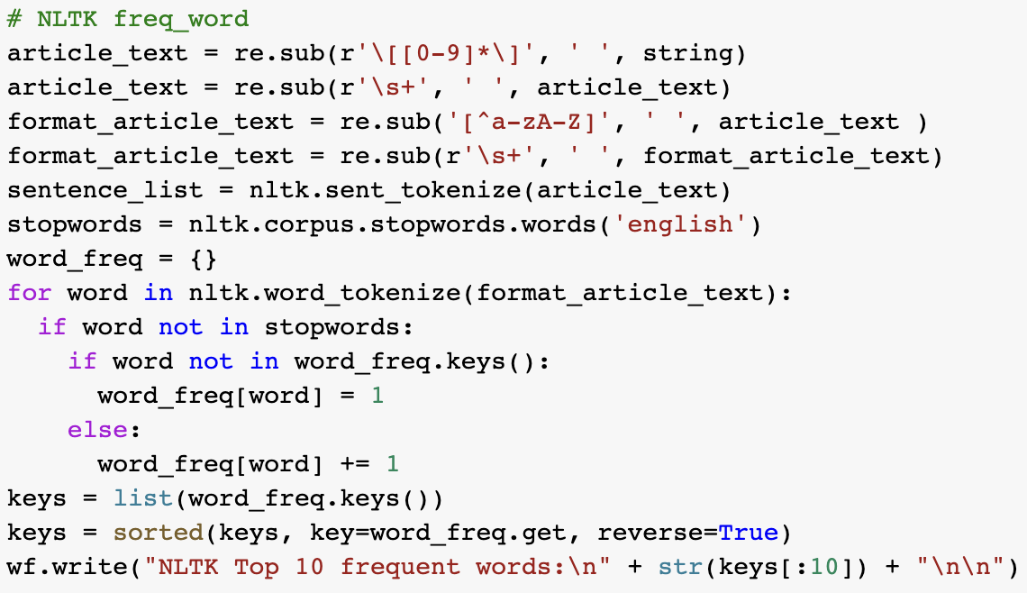
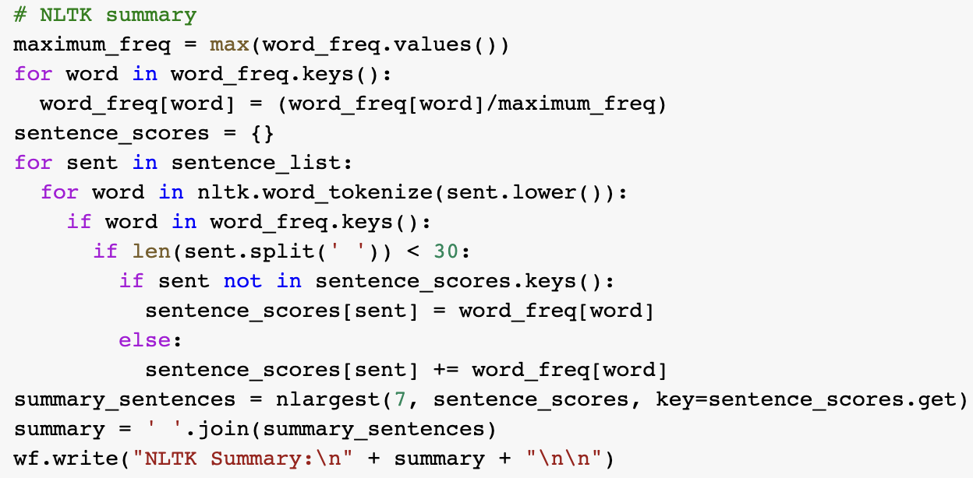
NLTK Code
Frequent Words
Summarization

Slide 7
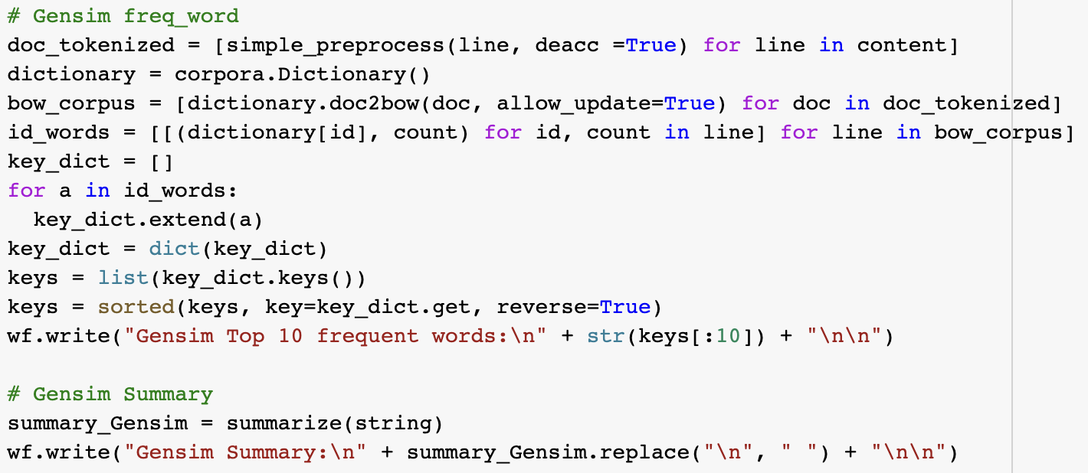
Gensim Code
Frequent Words & Summarization

Slide 8
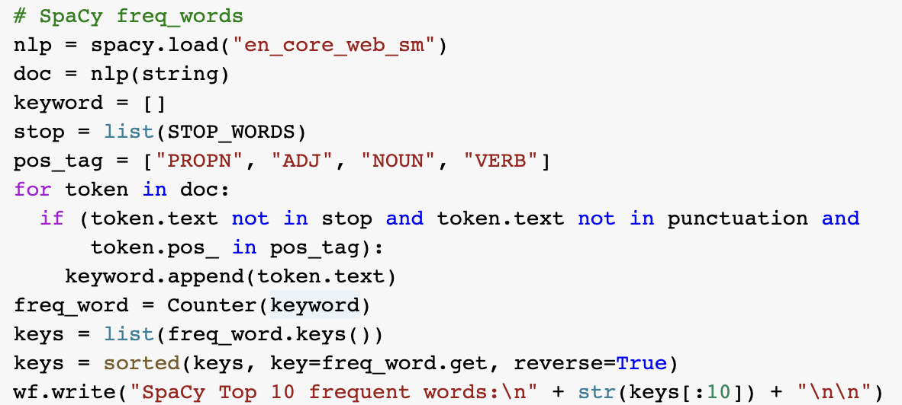
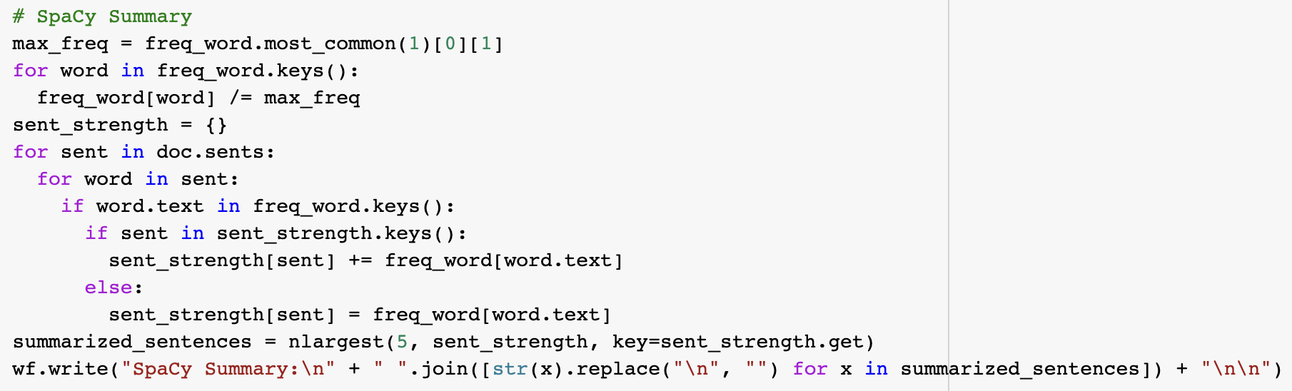
spaCy Code
Frequent Words
Summarization

Slide 9
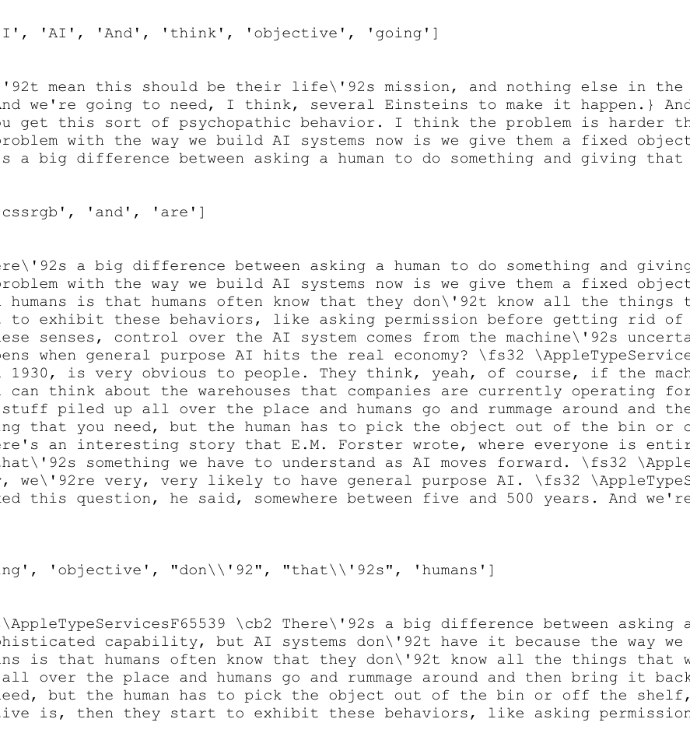
Result of Talk1
Top 10 Frequent Words
NLTK - ['fs', 'AppleTypeServices', 'cb', 'AppleTypeServicesF', 'I', 'AI', 'And', 'think', 'objective', 'going']
Gensim - ['don', 'know', 'blue', 'green', 'red', 'should', 'he', 'cssrgb', 'and', 'are']
spaCy - ['\\AppleTypeServices', '\\cb1', 'AI', 'think', 't', 'going', 'objective', "don\\'92", "that\\'92s", 'humans']

Slide 10
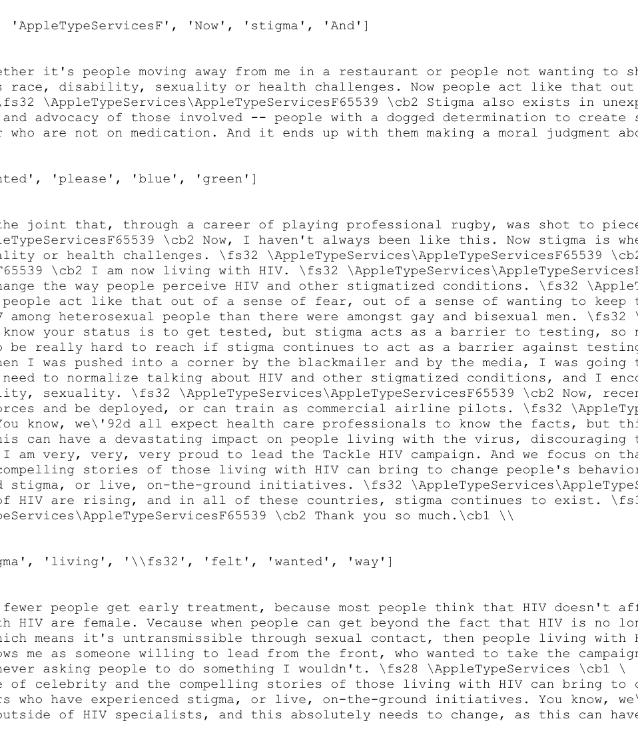
Result of Talk5
Top 10 Frequent Words
NLTK - ['I', 'fs', 'AppleTypeServices', 'cb', 'HIV', 'people', 'AppleTypeServicesF', 'Now', 'stigma', 'And’]
Gensim - ['on', 'afraid', 'me', 'through', 'was', 'people', 'wanted', 'please', 'blue', 'green’]
spaCy - ['HIV', 'people', '\\AppleTypeServices', '\\cb1', 'stigma', 'living', '\\fs32', 'felt', 'wanted', 'way']

Slide 11
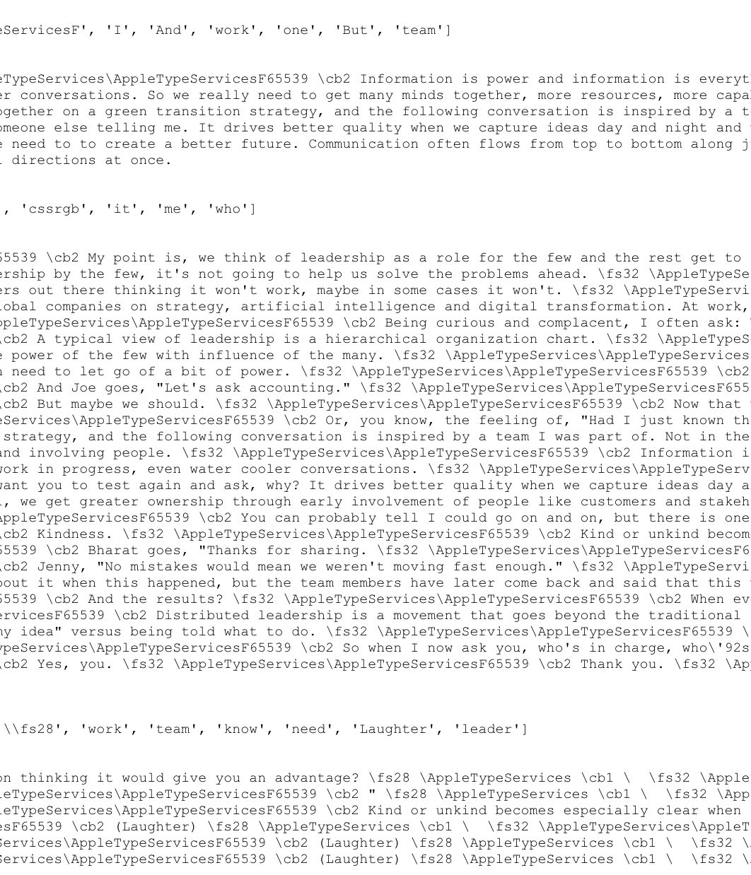
Result of Talk10
Top 10 Frequent Words
NLTK - ['fs', 'AppleTypeServices', 'cb', 'AppleTypeServicesF', 'I', 'And', 'work', 'one', 'But', 'team']
Gensim - ['blue', 'red', 'and', 'we', 'on', 'results', 'cssrgb', 'it', 'me', 'who']
spaCy - [['\\AppleTypeServices', '\\cb1', '\\fs32', '\\fs28', 'work', 'team', 'know', 'need', 'Laughter', 'leader']

Slide 12
Conclusion
Compared NLTK with other tools, it divides more sentences, but the length of the sentence is short.
Although Gensim is the shortest code, it has the longest summary and wordy.
spaCy can reassemble the article and make new sentence. Comparing with Gensim, spaCy has more detail.

Slide 13
Reference
https://www.nltk.org
https://pypi.org/project/gensim/
https://realpython.com/natural-language-processing-spacy-python/

