Slide 1
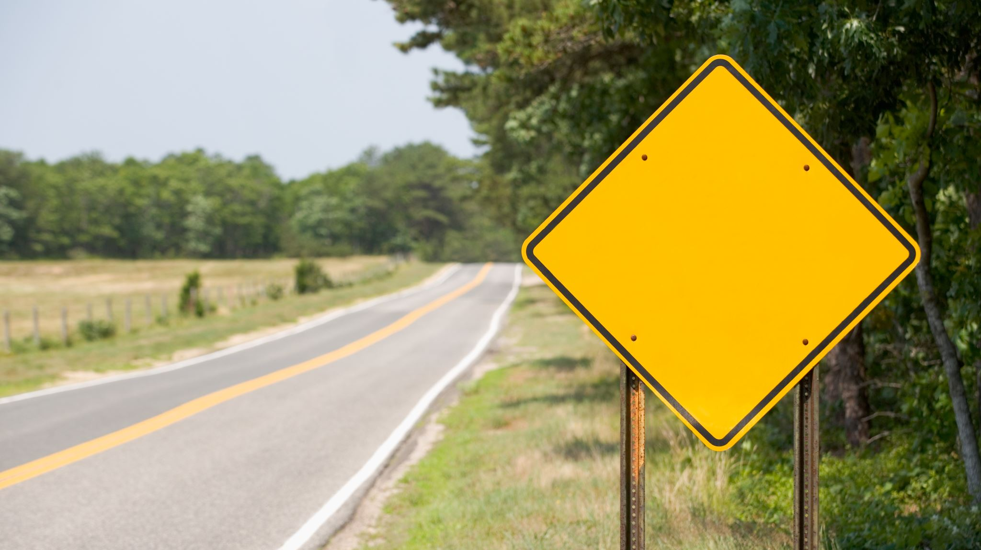
Traffic Sign Recognition
Jisun Lee (U37416487)
CS 767 Project

Slide 2
About Project
In this project, I will create a deep neural network model capable of categorizing traffic signs in an image. I can read and comprehend traffic signs using the model, which is a critical duty for all autonomous cars. The dataset contains almost 50,000 images of various traffic signals. It is further subdivided into 43 distinct classes. The dataset is highly varied; some classes contain many photos, while others have few images. The dataset is around 300 MB in size. The dataset has a train folder with photos for each class and a test folder with images for evaluating our model.

Slide 3
Description of Project
In short, the Conv2d layer is used to filter the picture and identify similarity, the Max Pool is used to extract the important data, and the Flatten Layer is used to convert a 2-dimensional vector into a 1-dimensional vector as a preparation for the linked layer that follows. Finally, the Output Layer uses the SoftMax function, which may offer the class of an input picture.

Slide 4
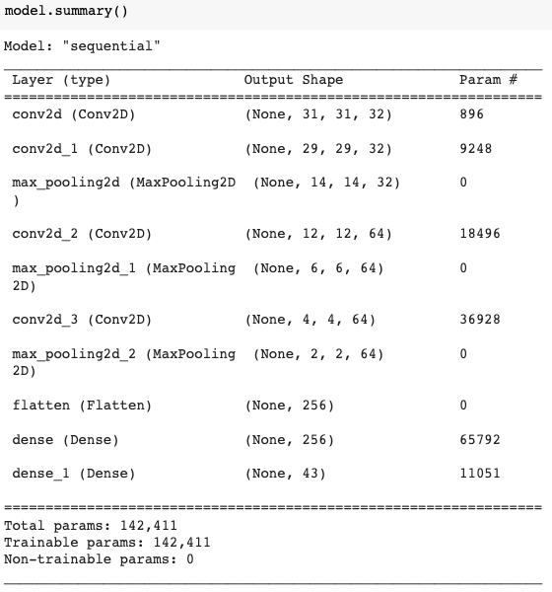
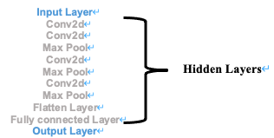
Output of Model CNN Implementation

Slide 5
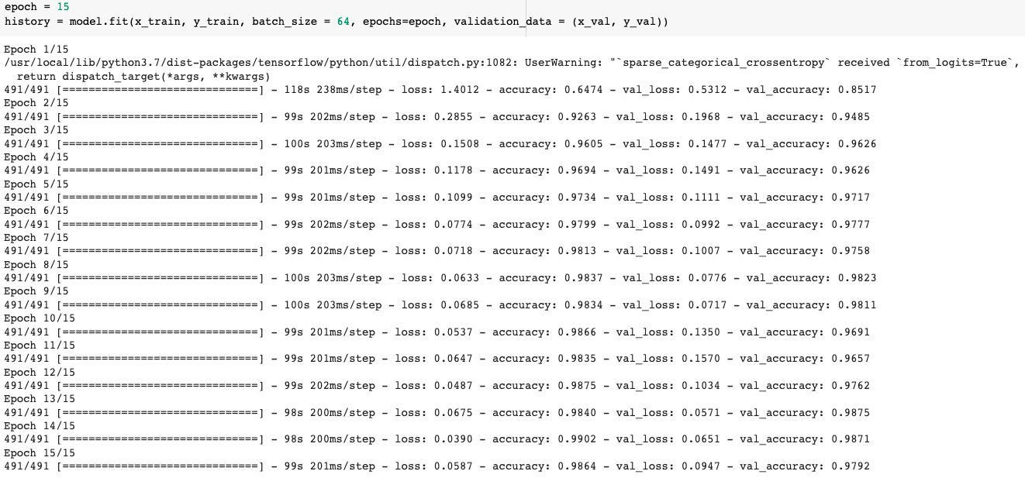
Output of Model

Slide 6
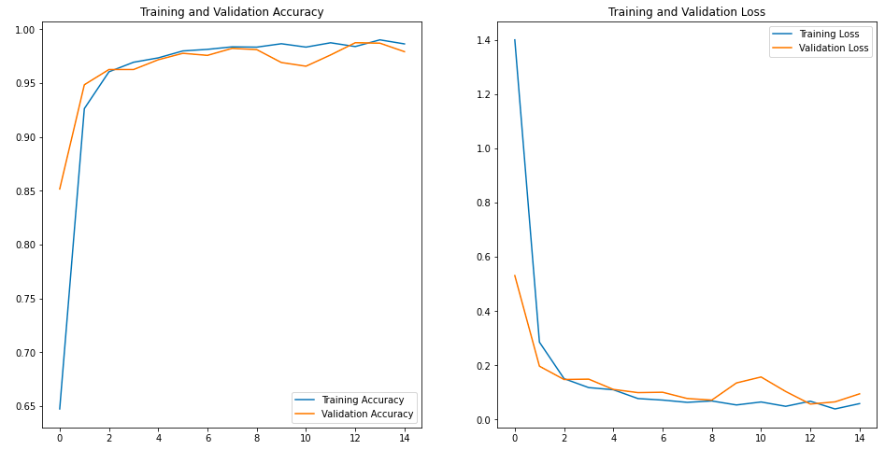
Outcome 98% on Validation data 94% on Testing data

Slide 7
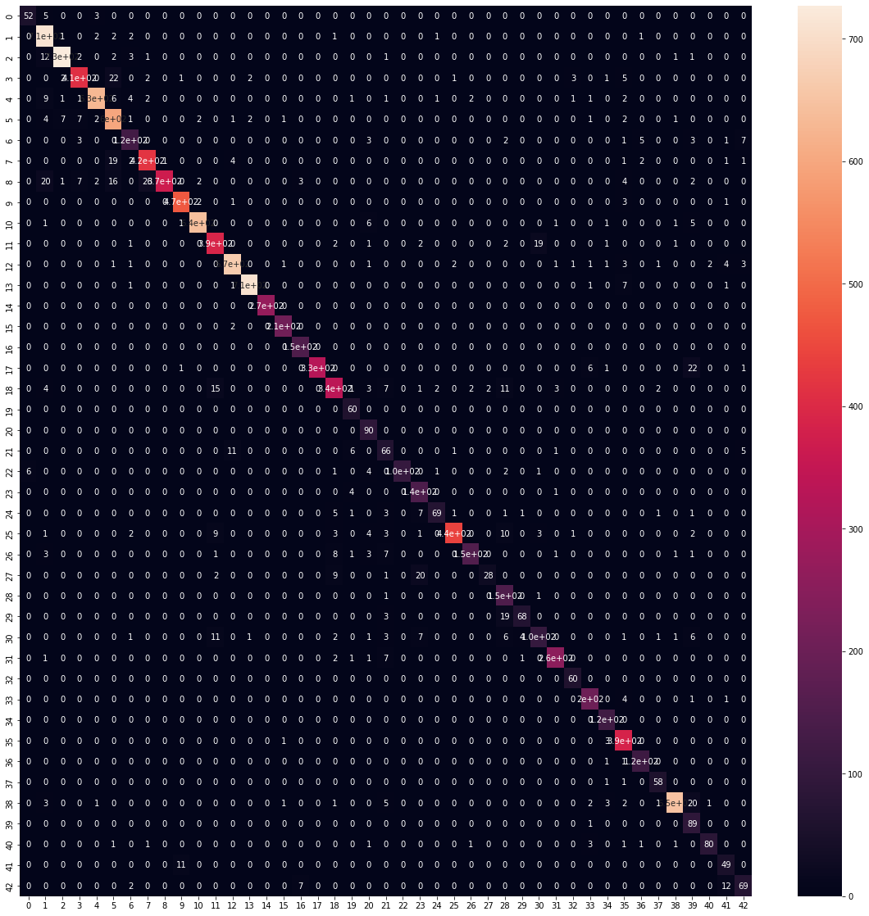
Confusion Matrix

Slide 8
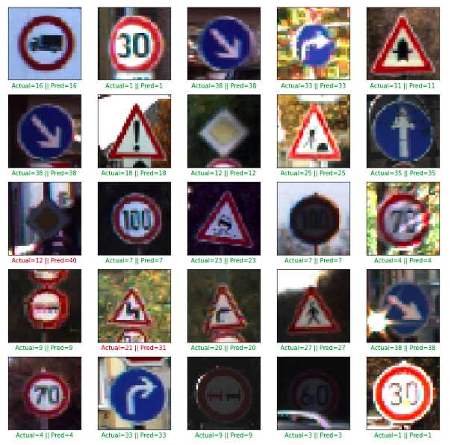
What I learned Although having high percentage of outcome, there are still some error when I compare the predicted results by entering the test data.

Slide 9

Thank you!

