Slide 1

IOT-BASED CLASSROOM DOOR LOCK SYSTEM
TEAM
DIPTI RAJ SAH (21CSB0F34)
ANUBHAV AGRAWAL (21CSB0F36)
ARJUN KHARE (21CSB0F21)
Guided By - Shiva Darshan SL

Slide 2

PROJECT OVERVIEW
SECURITY RISK
Accessing classrooms without proper authorization can result in multiple problems regarding security.
Traditional lock and key mechanisms are not secure as they lack authentication, anyone with the key can unlock the door whether authorized or not.
SOLUTION
A smart door lock system utilizing the ESP32 is controlled via Blynk, logs data on ThingSpeak, and displays real-time status on an LCD screen, making it secure and automated. It sends instant SMS notifications to administrators.

Slide 3
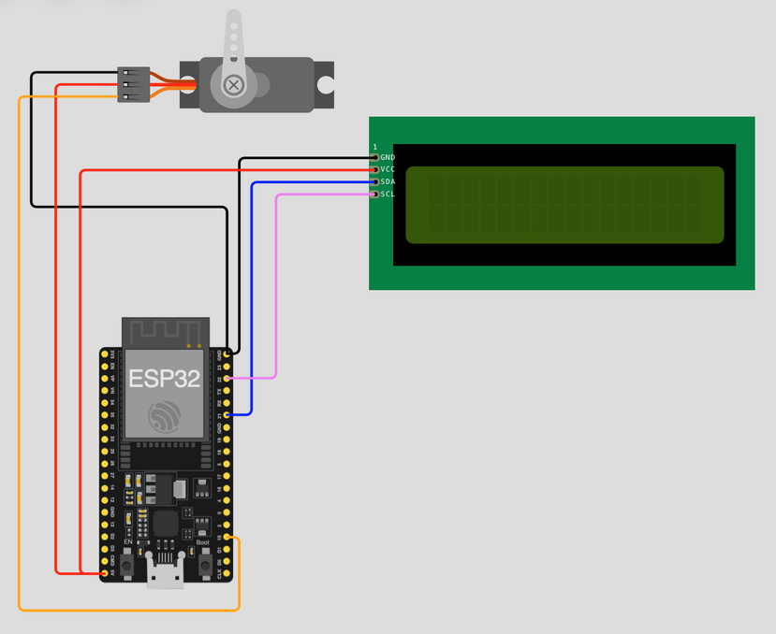
LAYOUT
Key Components
ESP32: Connects to WiFi and controls the lock.
Servo Motor: Controls door locking/unlocking.
Blynk App: Allows remote access authentication.
ThingSpeak: Logs access attempts and lock status.
LCD Display: Shows door status.
Twilio SMS Alerts: Sends real-time SMS notifications to the administrator in case door status changes.
SERVO MOTOR
LCD DISPLAY
ESP32

Slide 4
WORKFLOW
User enters a password in the Blynk App.
ESP32 verifies the password:
If correct → Unlocks the door, logs event on ThingSpeak, updates LCD.
If incorrect → Displays "Wrong Password", logs incorrect attempt on ThingSpeak.
ESP32 continuously monitors and updates the lock status.
ESP32 triggers an SMS alert to the administrator using Twilio, containing details like timestamp and status.
ThingSpeak provides real-time data on access logs, incorrect attempts, and lock status.

Slide 5
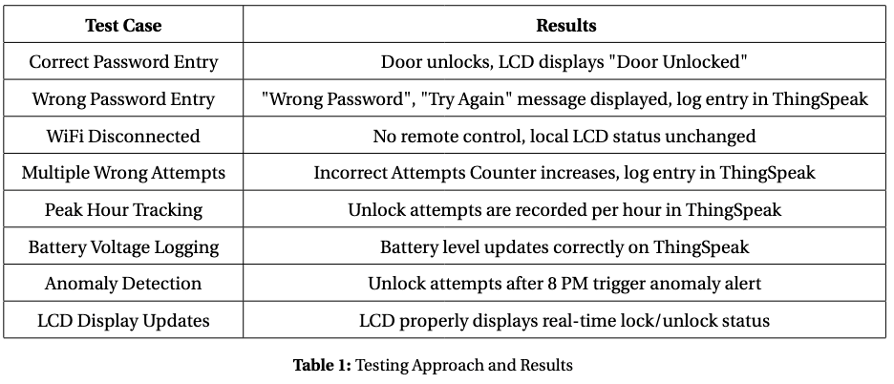
RESULT

Slide 6
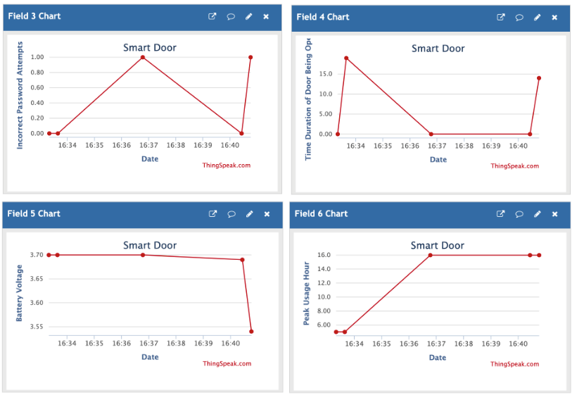
RESULT

Slide 7
CONCLUSION
The IoT-based classroom door lock system effectively enhances security by integrating authentication, remote monitoring, and automation.
The Blynk app enables seamless access control, while ThingSpeak ensures real-time tracking. The system remains secure even in cases of human oversight, with SMS alerts sent to the administrator using Twilio.
Thus, we can conclude that the system is in a working state of monitoring the smart classroom door lock based on Iot device and we are able to develop the prototype for the same using the discussed technologies and methodologies that we followed in the classroom.

Slide 8
THANK YOU

