Slide 1
Lidar 3D Object Detection with Voxelnet / PointNet

Slide 2
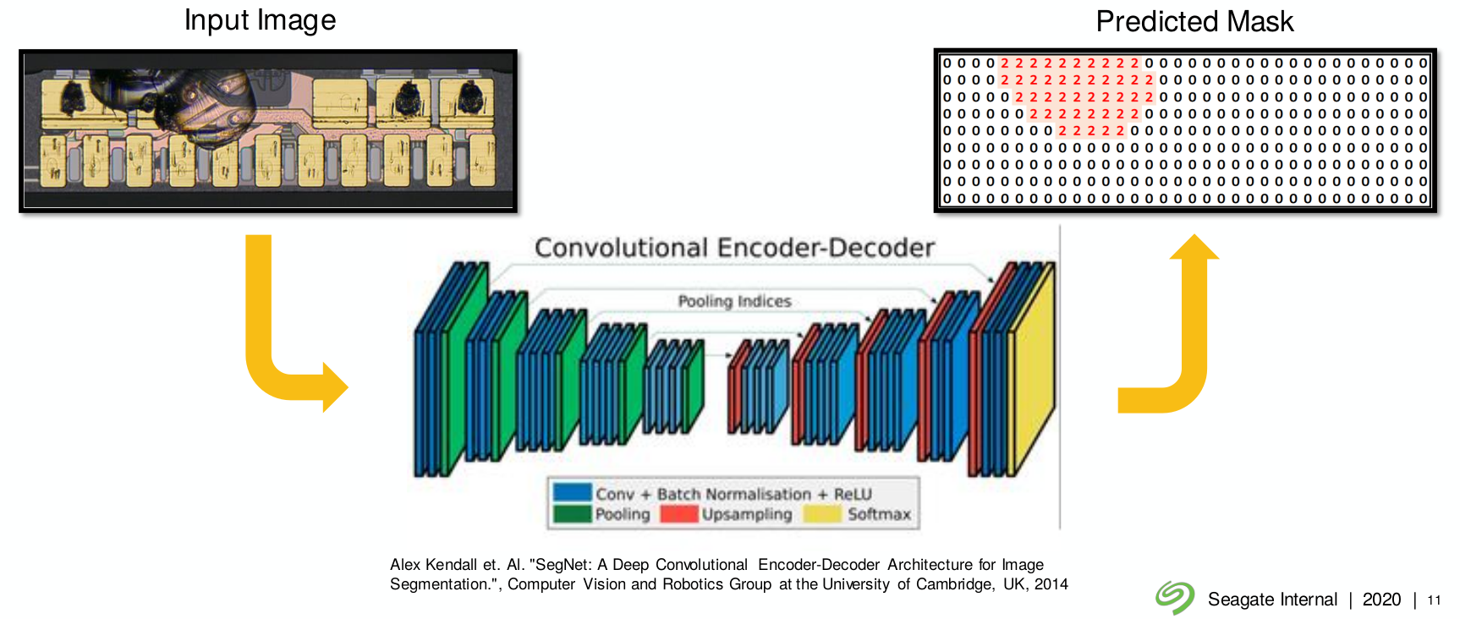
Supervised Autoencoder

Slide 3
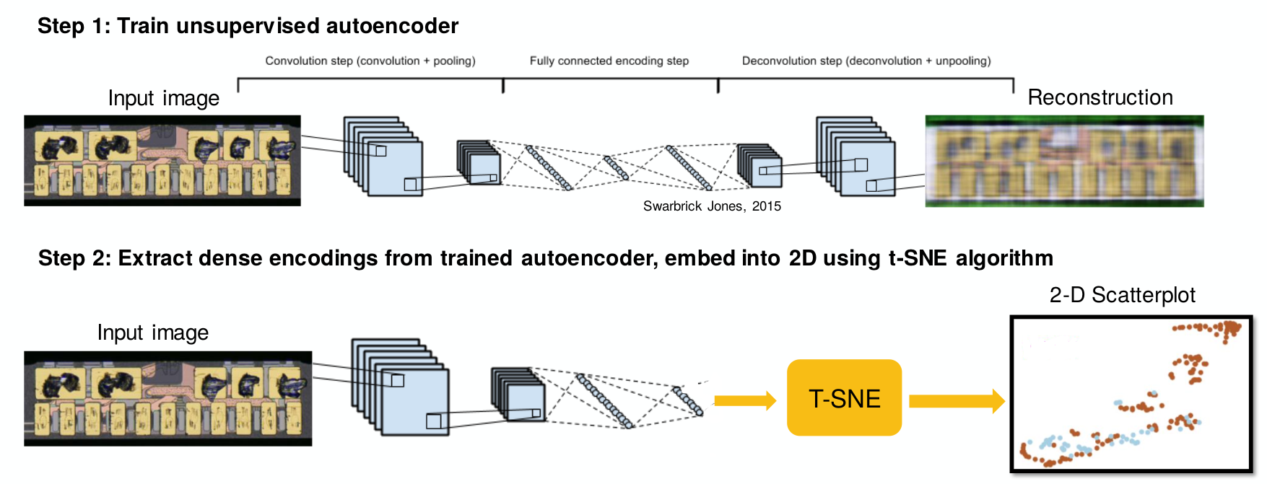
Unsupervised Autoencoder
Achieved an accuracy of 95% in segregating defect disk drive images, and improving the model with semi-supervised learning

Slide 4
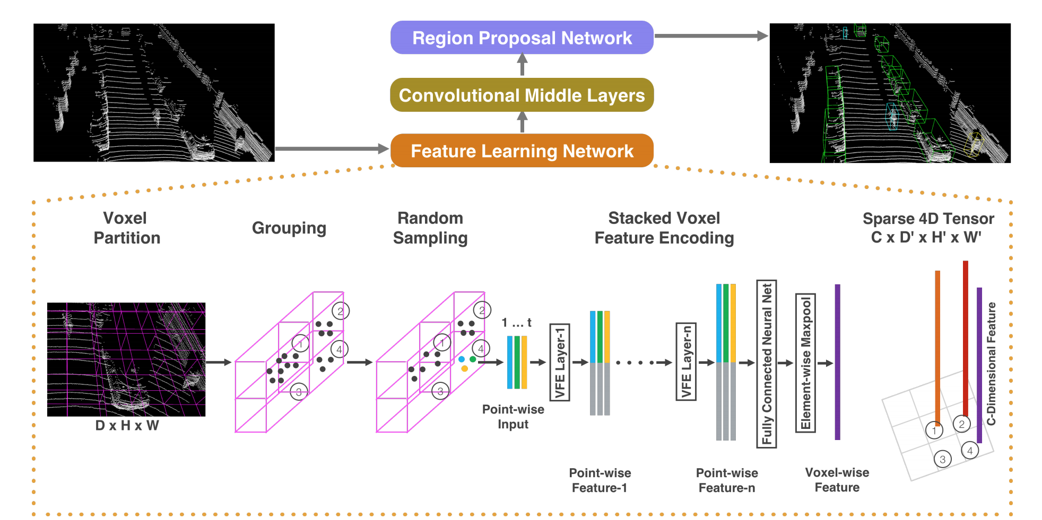
VoxelNet

Slide 5
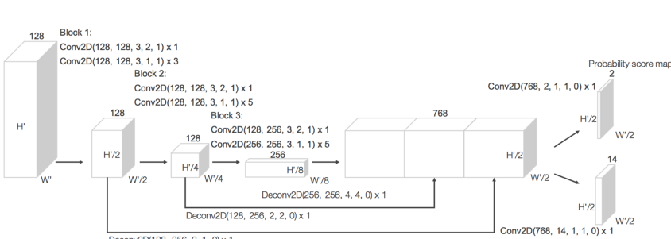
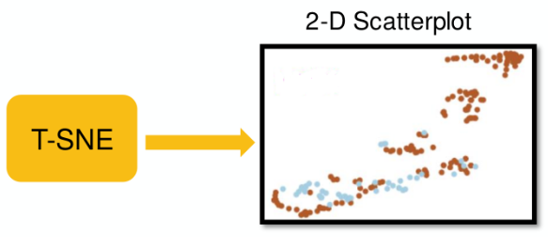
Region Proposal Network in VoxelNet
From the T-SNE plot few datapoints can
be selected and Labeled those

Slide 6
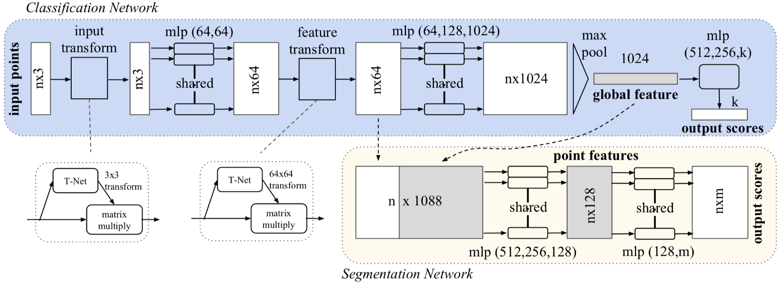
PointNet
From the T-SNE plot few datapoints can
be selected and Labeled those

Slide 7
PointNet invariant to input permutations: PointNet implements the symmetric function with max pooling in the Global Feature step.
Transformation invariance of Pointnet with T-Net: Similar to the localization net in STs, the T-Net brings rotational invariance to PointNet.

