Slide 1








Data-Driven Cyberphysical Systems
Univ of Texas at Austin
Univ of California at Berkeley
Rensselaer Polytechnic Institute
Northeastern Univ
California Inst of Technology
Topcu
Fish
Dillig
Caramanis
Sangiovanni-Vincentelli
Sznaier
Mishra
Yue
URL: DataDrivenCPS.org. Contact: utopcu@utexas.edu. Award numbers: 1646522, 1645648, 1646121, 1645832, 1645964.
Data-Driven CPS

Slide 2






The central question
How can we, in a data-rich world, design and operate CPS differently?
Why?
Increasingly difficult and costly to develop complex, adaptable yet provably trustworthy CPS
Vision
Data-driven methods complementing model-based design and respecting the “laws” and needs of CPS
modeling
data
field and test data
legacy models
libraries
humans’ insights
run-time data
synthesis
post-design
specifications
verification/testing
Data as first-class object will transform and integrate the phases of design.
Data-Driven CPS

Slide 3
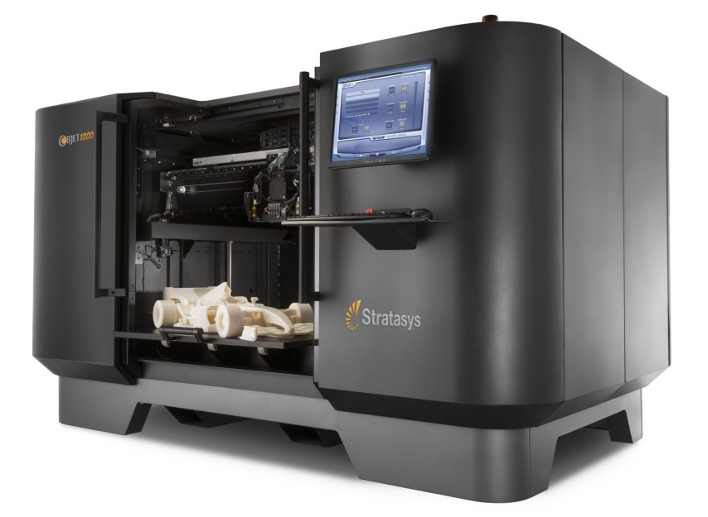
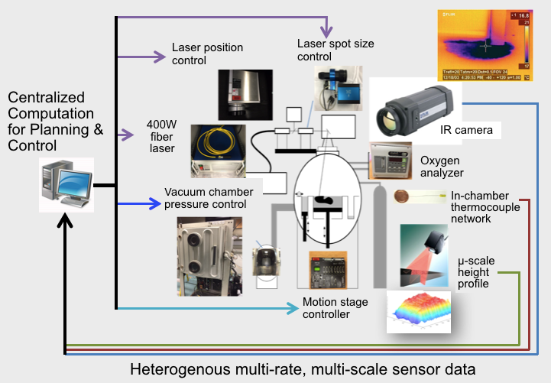
An emerging CPS application:
Additive manufacturing machines and processes
3D printing: Processes that rely on complicated physics
Rich actuation
Rich sensing
laser power, laser path, powder layer height, pressure, temperature profiles, melt pool geometries,…
IR cameras, pressure sensors, optical cameras, thermocouple network, µ-scale 3D position, non-destructive tomography, …
Decision at multiple (and demanding) time and spatial scales:
Processing power, memory, bandwidth and storage dictate what is possible at design and run time
Data-Driven CPS

