Slide 1
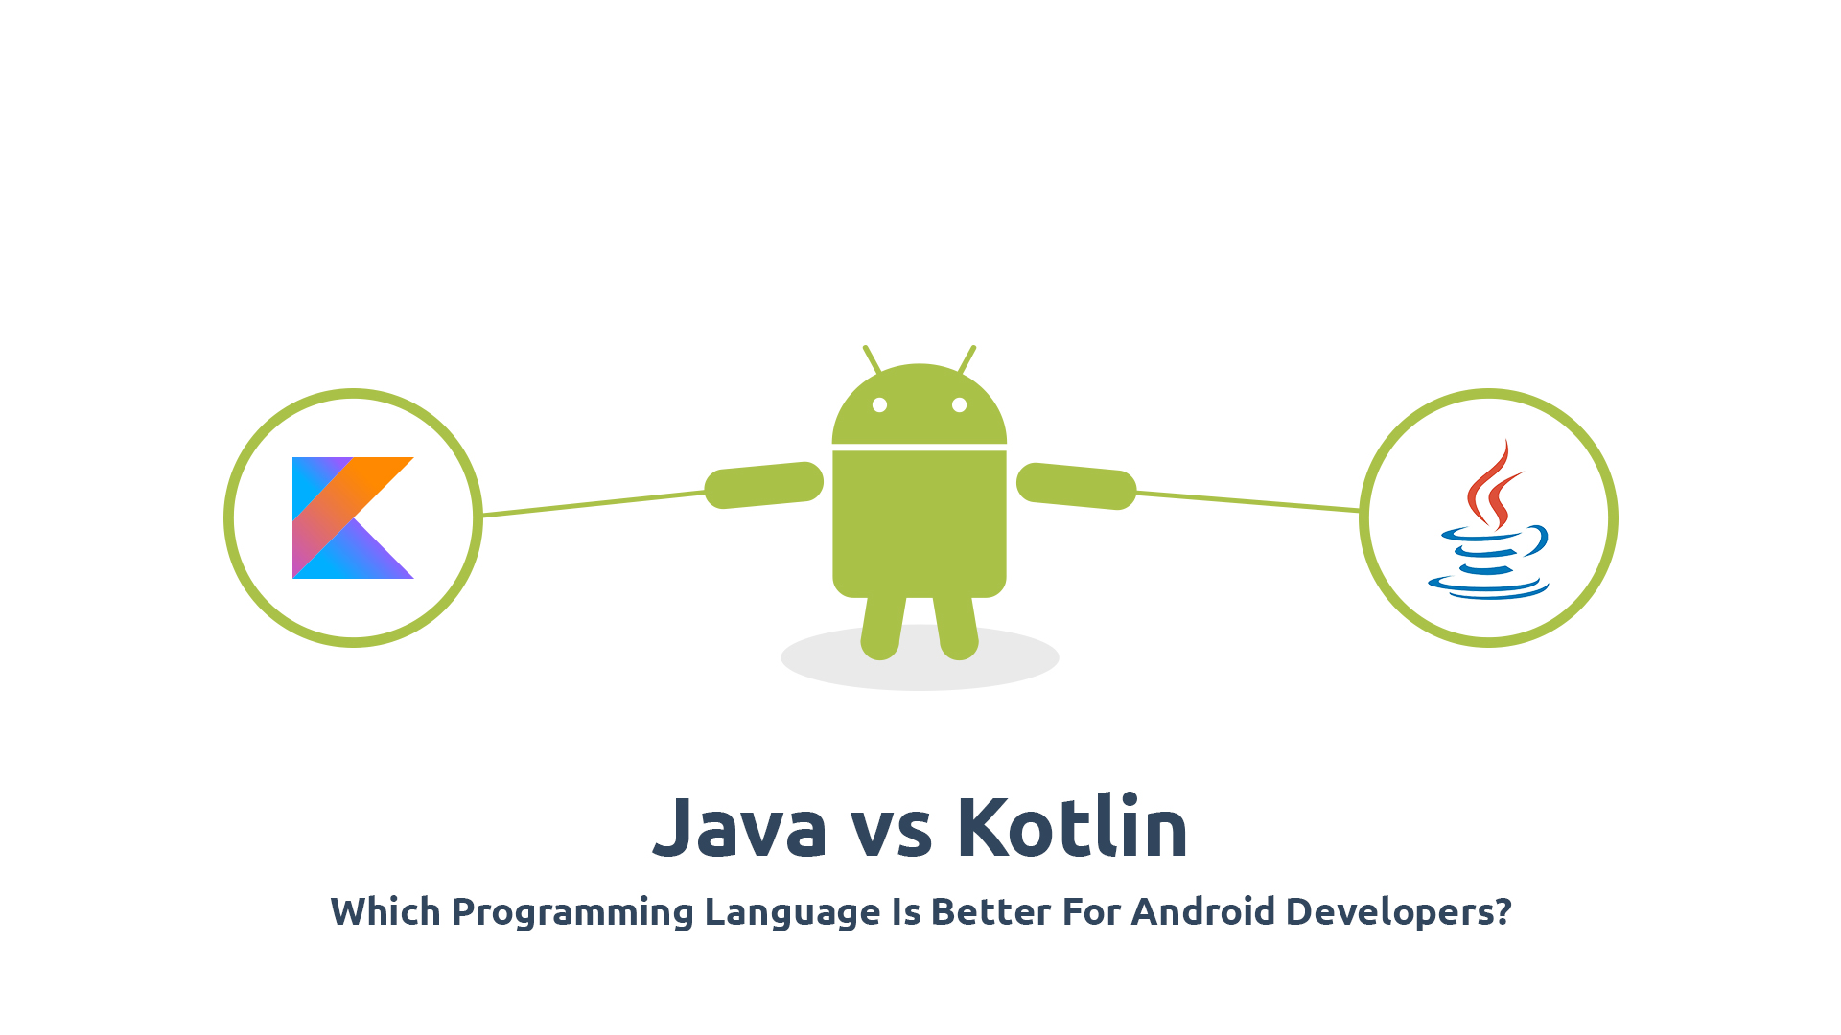
KHEL-ONN
CORRUPTED CODERS
PROJECT

Slide 2
CONTENTS
TEAM MEMBERS
PROBLEM DEFINITION
PROJECT DESCRIPTION
ADVANTAGES / FEATURES
TECHNOLOGY
ROLES & RESPONSIBILITY

Slide 3
Team members
Shashwat jain
Kartik dabas
Janmejay kumar

Slide 4
PROBLEM
DEFINITION
There is no medium that could provide us with the information of upcoming and ongoing sports events.
Unaware of available sports equipment.
Raise complaint regarding sports.
There is no interaction with the sports facilities.

Slide 5
project
Our outcome will be in the form of an application, which will contain all the information about the upcoming and past sports events that took place. Moreover, the application will contain the details of University’s team Achievements in a whole, as well as the player’s individual performance and accomplishments. Furthermore, this application will help the users to reach out the sport’s coaches and their coordinators, and vice-versa the sports coordinators can reach out the talents easily
description

Slide 6
Advantages / features
01
02
03
Player’s individual performance/ accomplishments
04
Availability of Equipment
Interaction/Details of Sports Coordinators
Alert about the upcoming Sports events
University’s team whole achievements
05
Registration for Sport’s events
06

Slide 7
Output will be a Application
Intellij
IntelliJ Community Software for code writing
Android os
Android OS SDKs for Application Development
Java
The whole application will be coded in Java
My SQL database for keeping the data
application
My sql database
technology

Slide 8



ROLES &
SHASHWAT JAIN
DESIGN OF THE PROJECT
BACK-END PROGRAMMING
KARTIK DABAS
RESPONSBILITY
CODE DEBUGGING
DESIGN & LAYOUT OF THE CODE
JANMEJAY KUMAR
DATA MANAGEMENT
DESIGN OF FRONT END

Slide 9
THANKYOU

