Slide 1
Boosting Operational Efficiency in Hospitality
Presented by
Sahadev Sutradhar
Bach No:- ML3-DA23

Slide 2
Objectives
Boost revenue streams.
Create a more efficient and satisfying experience for guests.
Optimizing operations and boosting revenue.
Understanding guest behaviour.
Revenue management.
Loyalty Programs and Repeat Business.
Customer Satisfaction, Marketing and Sales Optimization.

Slide 3
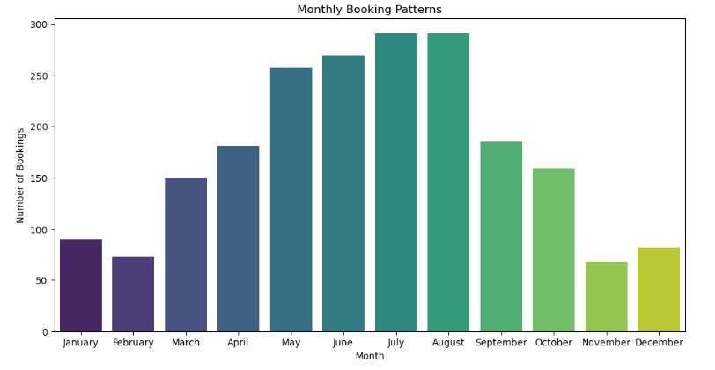
Business Questions
Q 1. What are the peak booking periods for the hotel?
July and August month have the highest pick booking period for the hotel.
June and May month have second highest booking period for the hotel.
Rest of the month have off session for booking hotel.

Slide 4
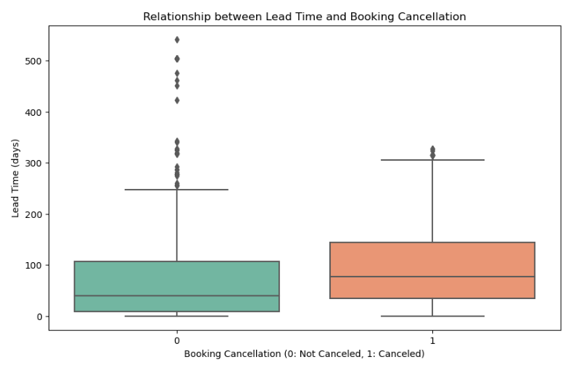
Q2. Is there a relationship between lead time and the likelihood of a booking being cancelled?
People Canceled hotel booking more then Not Canceled booking.
There is more outlier in the Not Cancelation part.
There is less outlier in the Canceled booking part.
The median of Not Canceled in 20 and the median of Canceled in 80.

Slide 5
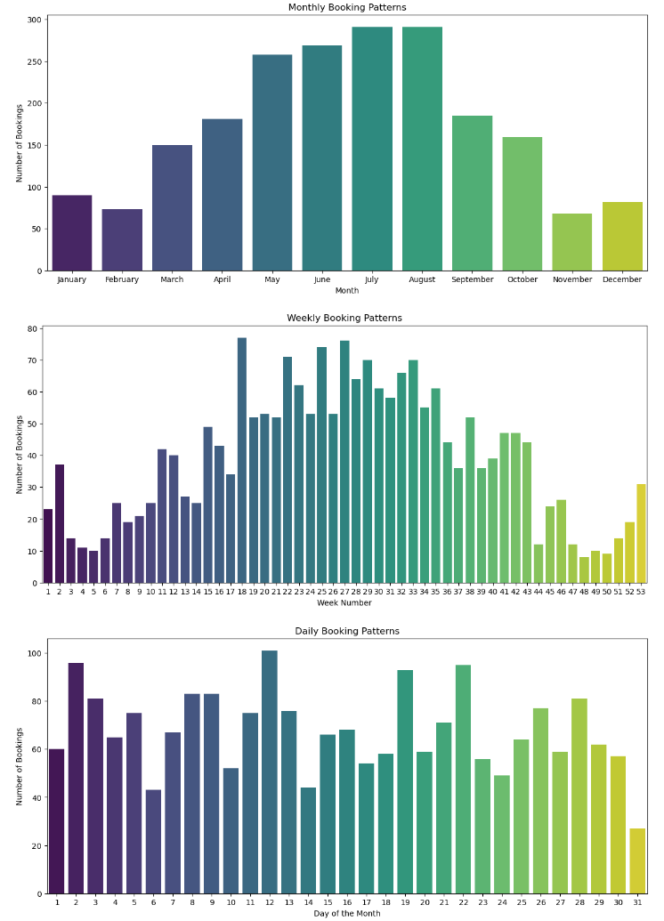
Q3 How do booking patterns vary by month, week, and day of the week?
July and August is highest monthly booking in a year.
In Weekly Booking 18,27,25 and 22 is the highest booking pattern.
12,2,23,and 19 is highest booking Days of the month.
Rest of the month, weekly and Days have less booing pattern.

Slide 6

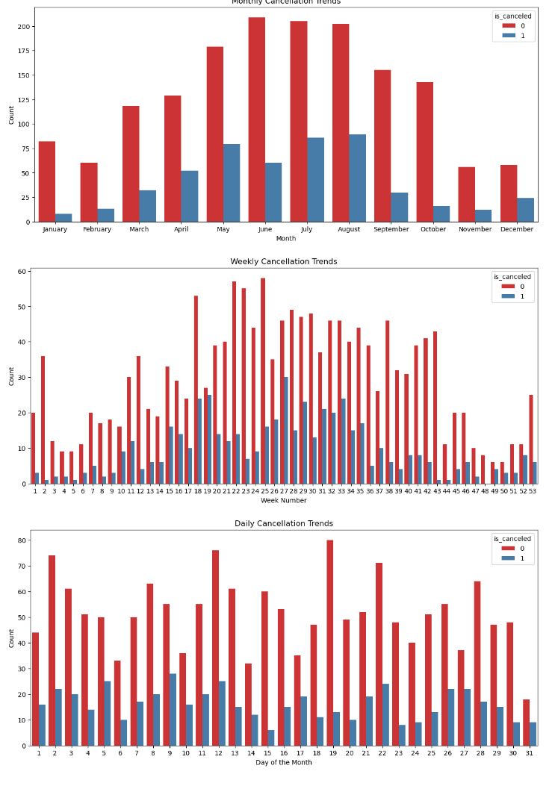

Q4 Are their specific trends or patterns in cancellations over time?
In June, July and August pick session people does not Cancelled the ticket.
In June people does not Cancelled the booking and very a smaller number of people Cancelled the booking in rest of the month.
25,22 and 23 week have less cancelled by people.
19, 12 and 2 Day of a month have less booking Cancelled in Hotel booking

Slide 7
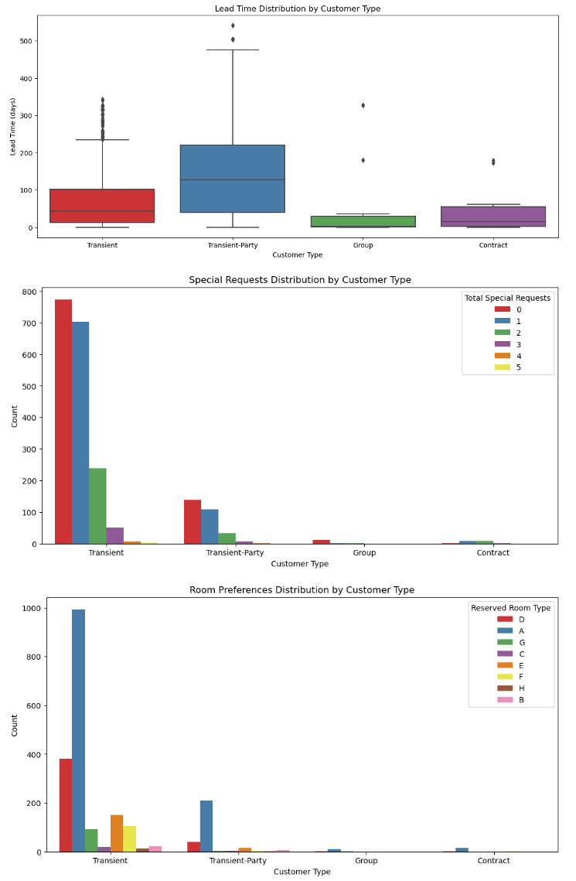
Q5 Are their distinct patterns in the lead time, special requests, or room preferences for different customer segments?
Most of the people has book the hotel for Transient-Party and there is only two outlier in Transient-Party.
0 people has Special Requests from the Hotel in Transient.
Most of the people prefer to book Type A room in the Hotel.
There are some outlier in Transient, Transient-Party, Group and Contract.

Slide 8
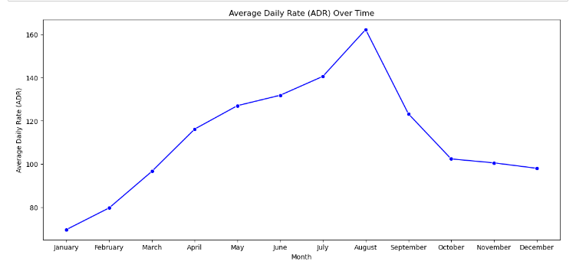
Q6 How does the Average Daily Rate (ADR) vary over time?
In August there is highest Average Daily Rate Over Time.
After August, July and June has the highest Average Daily Rate Over Time.
From January the Average Daily Rate is moving to Upward direction and while reaching October the line is again goes to Downward direction

Slide 9
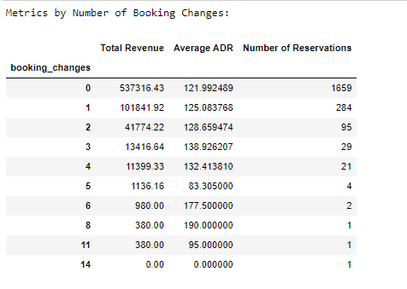
Q7 How do booking changes impact hotel operations?
Total Revenue generally decreases as the number of booking changes increases. This suggests that frequent changes in reservations may have a negative impact on the hotel's overall revenue.
The Average ADR shows some fluctuations but generally does not follow a clear trend with the number of booking changes. It's important to note that even though the Average ADR may vary, the overall impact on revenue is more pronounced.
The Number of Reservations decreases significantly as the number of booking changes increases. This indicates that a higher number of changes may lead to a reduction in the total number of bookings, possibly due to increased cancellations or modifications.
Instances where there are 5 or more booking changes have notably lower Total Revenue and Number of Reservations. This could be indicative of challenges in managing bookings with a high degree of changes.
High numbers of booking changes may pose operational challenges for the hotel staff, impacting efficiency and resource allocation

Slide 10
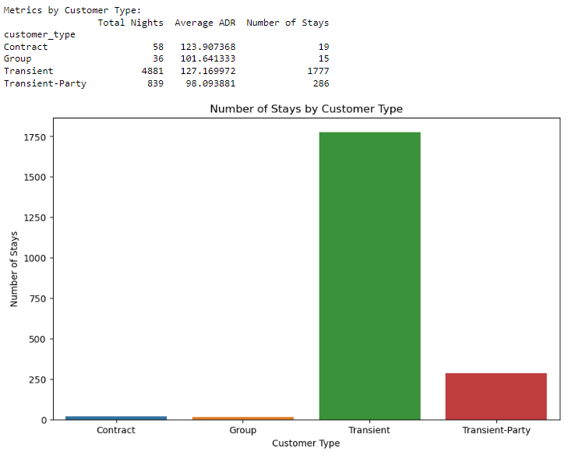
Q7 What is the behavior of repeated guests with respect to their nature of stay?
Transient is highest in repeated guest is 4881.
The second highest is Transients-party is 839.
Last is Contract and Group that is 58 and 38.
The Average ADR is highest in Transient and Second highest is Contract.
The Number of Stay s is highest in Transient that is 1777 and second highest is Transient-Party that is 286.

Slide 11
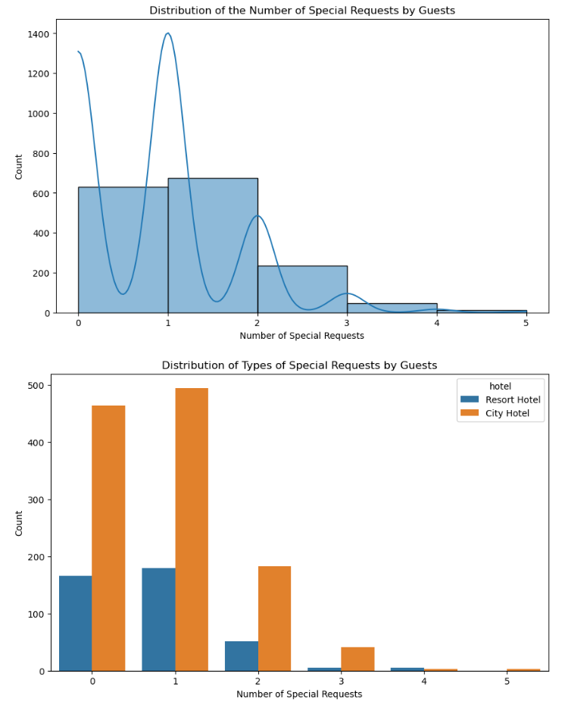
Q8. What is the distribution of the number and types of special requests made by guests?
There are only few guest who special request in Hotel Booking.
Highest number of guest prefer to have staded in City Hotel then Booking in Resort Hotel.

Slide 12
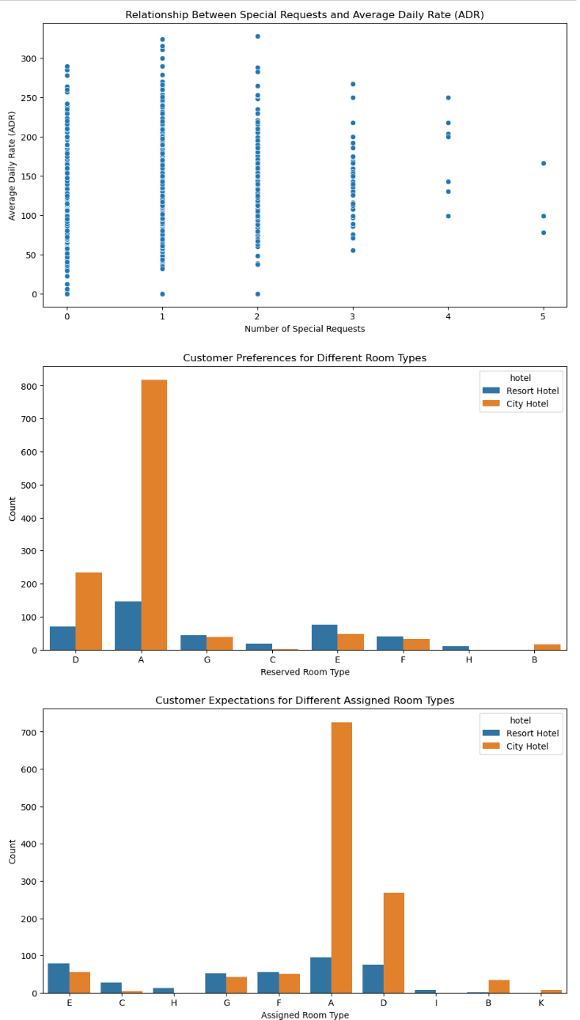
Q9. Is there any relation between special requests made by customers and the average daily rate? Additionally, explore customer preferences and expectations for different room types.
Code 1 and 2 has made highest Number of Special Requests and ADR.
The second highest is code 0 whivh provide highest Number of Special Requests and ADR.
The guest have preferred Type A room in City Hotel rather than Resort Hotel.
in Customer Expectations for Different Assigned Room Types A of City Hotel have highest preference then Resort Hotel.

Slide 13
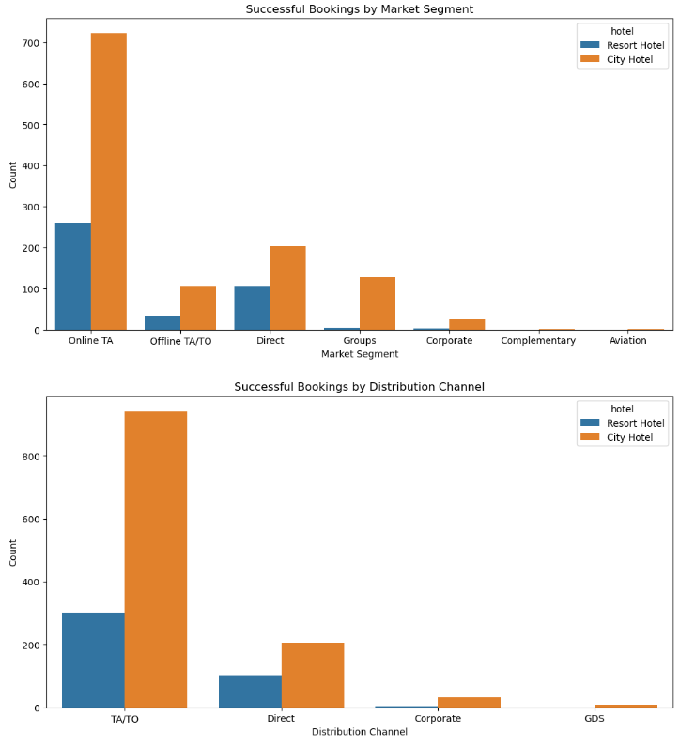
Q10. Which marketing channels and market segments contribute the most to successful bookings?
Online TA have Successful Bookings in terms of Market Segment is highest in City Hotel and in Online TA is lowest in Resort Hotel.
Direct guest have Successful Bookings in terms of Market Segment is scond highest in City Hotel and in Direct guest is lowest in Resort Hotel.
TA/TO is highest in terms of Successful Bookings by Distribution Channel in City Hotel then Resort Hotel.
Direct is scond highest in terms of Successful Bookings by Distribution Channel in City Hotel then Resort Hotel.

Slide 14
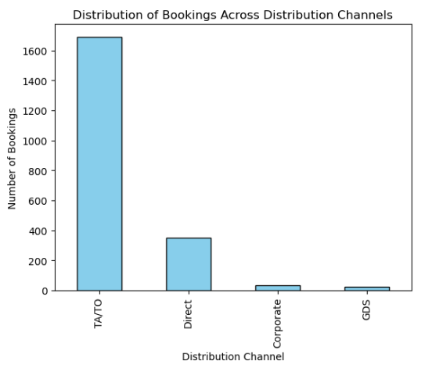
Q 11. What is the distribution of bookings across various distribution channels?
TA/TO is the highest Distribution of Bookings Across Distribution Channels.
The second highest is Direct Bookings Across Distribution Channels followed by Corporate ND GDS.

Slide 15
recommendations
Focus marketing efforts and promotions on July and August, as they are the peak booking months.
Consider offering special deals or incentives during June and May to capture the second-highest booking period.
Implement strategies to reduce cancellations, especially for non-canceled bookings with outliers.
Analyze reasons for cancellations in other months to tailor promotional strategies and increase customer retention.
Enhance online TA and direct booking experiences to maintain the popularity of these channels.
Explore opportunities to collaborate with online travel agencies for increased visibility and bookings.
Offer promotions for transient stays, particularly during weekends.
Consider package deals that include breakfast, as it positively impacts the Average Daily Rate (ADR).
Evaluate the feasibility of providing self-catering options for cost-conscious customers.

Slide 16
recommendations
Leverage the knowledge of weekly and monthly booking patterns for targeted marketing campaigns.
Implement strategies to encourage longer stays, especially during peak months.
Utilize dynamic pricing strategies, emphasizing higher rates in August and July.
Continuously monitor the impact of pricing changes on overall revenue and adjust strategies accordingly.
Allocate marketing budgets efficiently, with a primary focus on TA/TO and direct booking channels.
Tailor marketing messages to address the preferences of transient and transient-party segments.
Promote Type H and Type G rooms, which are associated with higher ADR.
Consider enhancing or introducing undefined amenities, given their higher ADR.
Encourage customer loyalty programs, especially for transient guests who show high loyalty.
Implement strategies to minimize booking changes, possibly through flexible cancellation policies.
Optimize marketing efforts on undefined amenities, as they contribute significantly to ADR.
Strengthen partnerships with TA/TO platforms to maintain the highest distribution channel for successful bookings.

Slide 17
Thank you

