Slide 1

FLOWERING PLANTS
Understanding Gymnosperms, Angiosperms,
Monocotyledons and Dicotyledons
Grade 6 Science •
Notes:
TEACHER: Welcome students. Show title slide while introducing the topic. Ask: 'Who can name a flowering plant they know?'

Slide 2

Classification of Seed-Producing Plants
SEED-PRODUCING PLANTS
(Phanerogams)
GYMNOSPERMS
(Naked seeds)
ANGIOSPERMS
(Enclosed seeds)
Example: Pine
Flowering plants
MONOCOTS
One cotyledon
DICOTS
Two cotyledons
❓ Can you predict the two main groups of seed-producing plants?
Notes:
TEACHER: First show only the top box. Ask the prediction question. Then reveal Gymnosperms + Angiosperms. Finally reveal Monocots + Dicots under Angiosperms. Emphasize: Gymnosperms = naked seeds, Angiosperms = enclosed seeds in fruits.

Slide 3
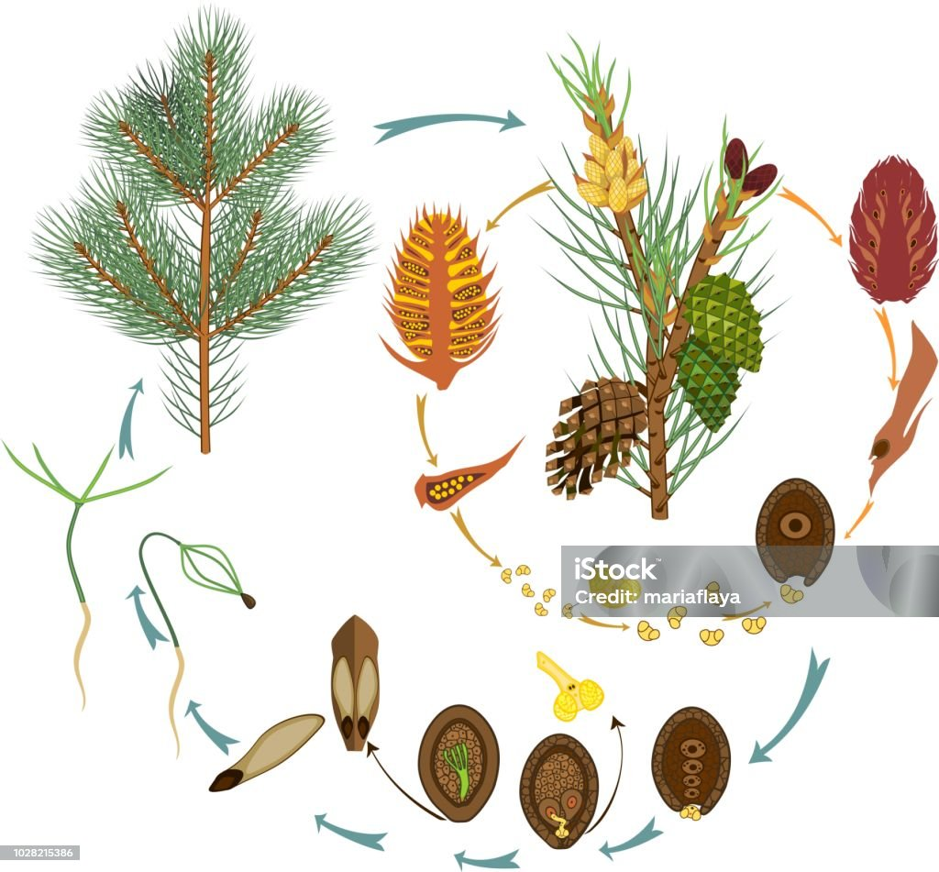
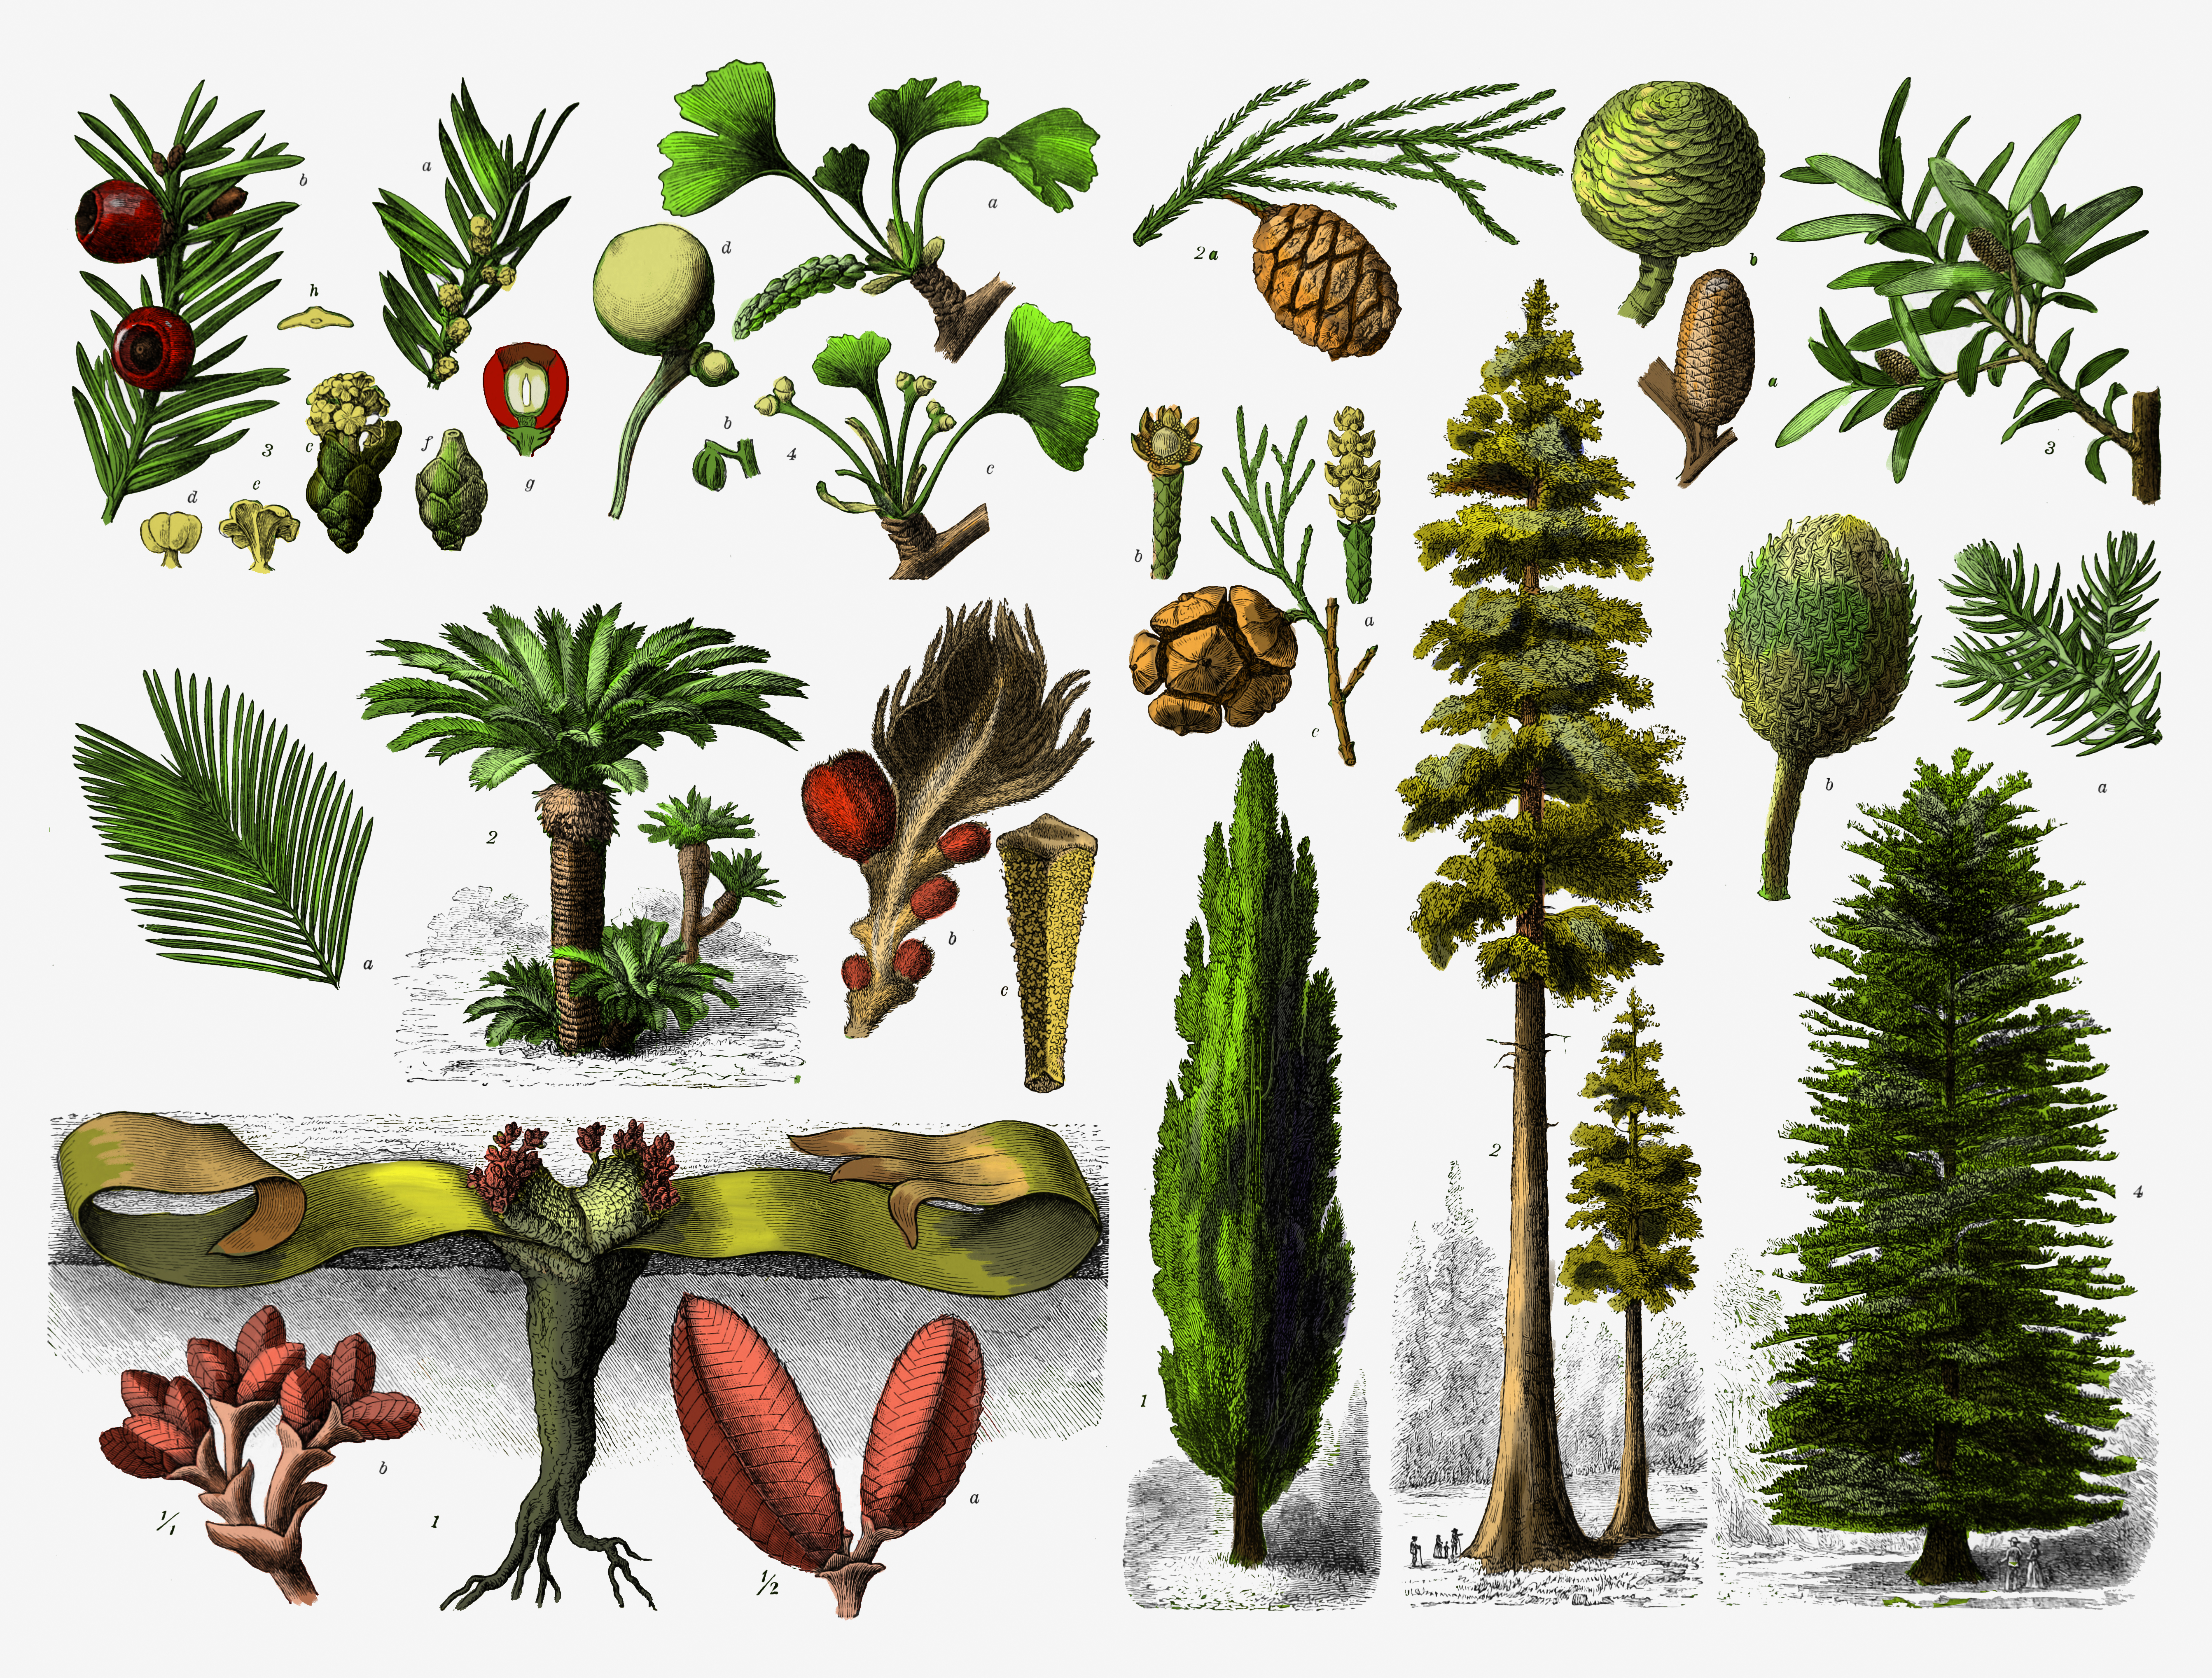
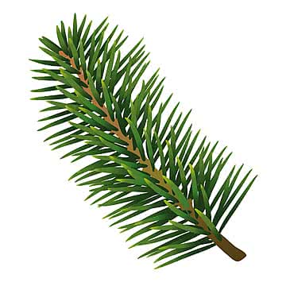


What are Gymnosperms?
Gymnosperms are seed-producing plants whose seeds are not enclosed inside a fruit.
Their seeds are called naked seeds.
Naked Seed
Needle-like leaves
A classic example
Not inside a fruit
Usually thin needles
Notes:
TEACHER: Emphasize 'naked seeds' means seeds are not protected by a fruit. Show a real pine cone if available. Ask: 'Have you ever seen a pine cone?'

Slide 4
Lets see Gymnosperms?
A classic example
Naked Seed
Not inside a fruit

Slide 5
How do Gymnosperms Reproduce?
Male Cone
Pollen Grains
3
Pollination
1
2
Produces pollen
Pollen travels
Tiny yellow dust
Female Cone
Fertilization
Seed Forms
4
5
6
Has ovules
Pollen + ovule
Naked seed
Notes:
TEACHER: Reveal steps one by one. Ask: 'Where does the pollen come from?' → Male cone. Ask: 'Where is the ovule found?' → Female cone. Stress that seeds are naked (not inside fruit).

Slide 6
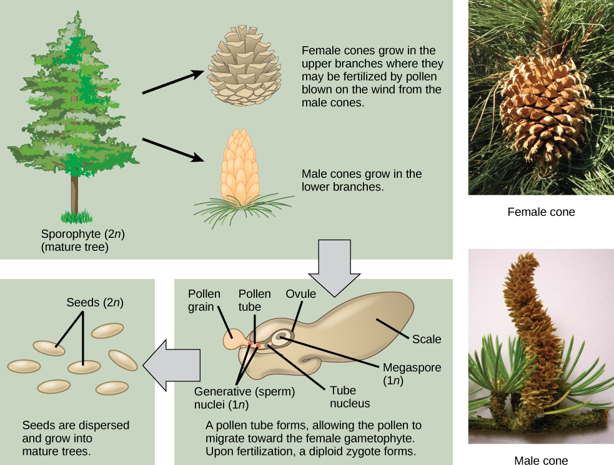
Male & Female Parts of Gymnosperms
MALE STRUCTURE
♀ FEMALE STRUCTURE
• Bears ovules
• Ovules become seeds after fertilization
• Seeds are naked (no fruit)
• Produces pollen grains
• Pollen is like fine yellow dust
• Carried by wind to female cone
Female Cone
Male Cone
Notes:
TEACHER: In many gymnosperms like pine, male and female cones are on the same plant. Pollen reaches ovule → fertilization → seed forms. Keep language simple.

Slide 7
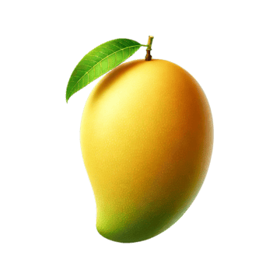
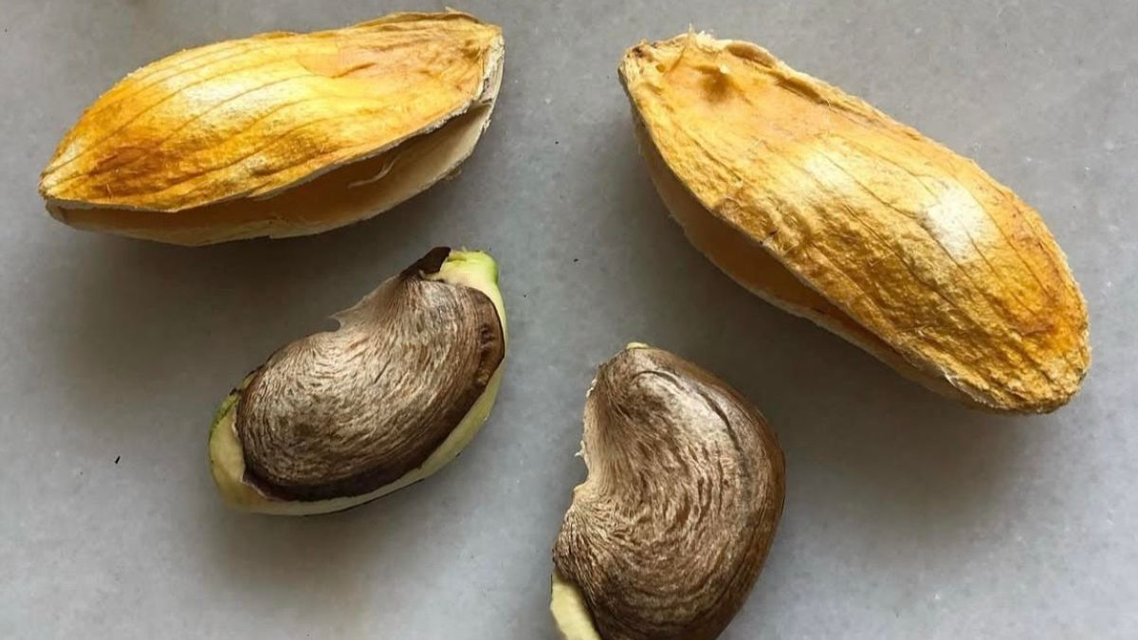
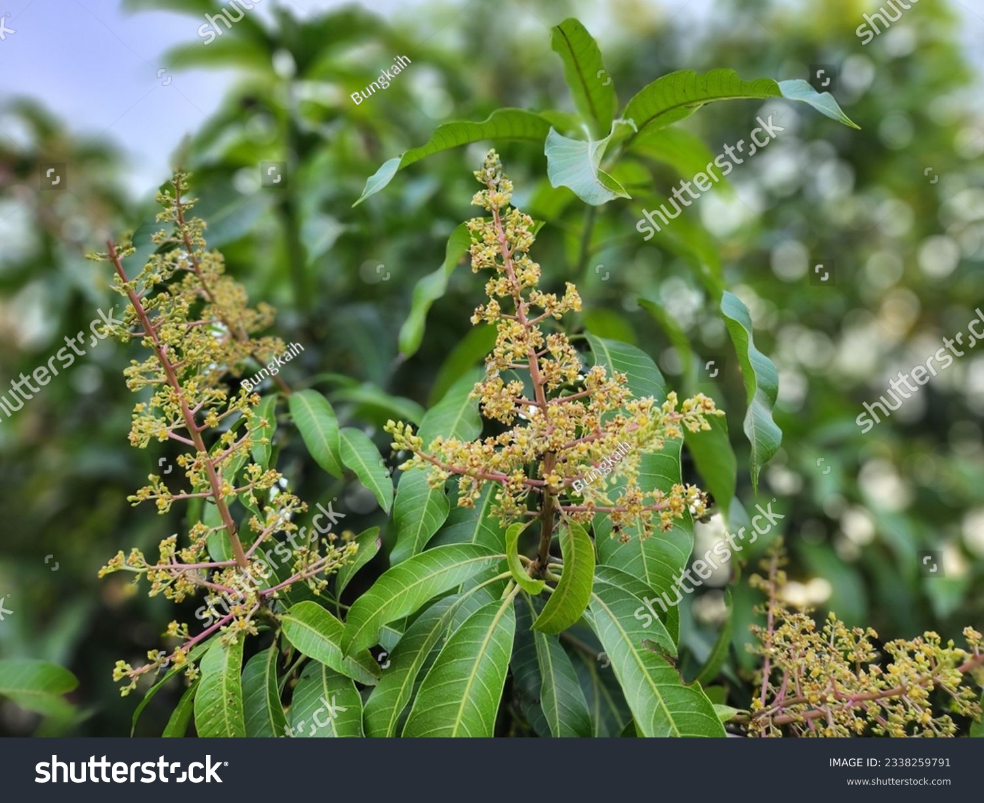

What are Angiosperms?
Angiosperms are flowering plants whose seeds are enclosed inside fruits.
Flower
Fruit
Seed
Examples • Pea • Mustard • Rice • Maize • Rose
Key idea: Seeds are protected inside a fruit!
Notes:
TEACHER: Angiosperms = flowering plants. Seeds develop inside fruits. Contrast with gymnosperms (naked seeds).

Slide 8
Gymnosperm vs Angiosperm Reproduction
Feature
Gymnosperms
Angiosperms
Reproductive structure
Cones
Flowers
Male structure
Male cone
Stamen
Female structure
Female cone
Pistil / Carpel
Seed
Naked
Enclosed in fruit
Example
Pine
Mango, Rose, Pea
Biggest difference: 🌲 Gymnosperm = Naked seed 🌸 Angiosperm = Seed in fruit
Notes:
TEACHER: Reveal each row one by one. Ask: 'What is the biggest difference between the seeds?' Reveal the answer at the bottom.

Slide 9
Angiosperms are Divided into Two Groups
ANGIOSPERMS
(Flowering plants)
MONOCOTYLEDONS
(Monocots)
DICOTYLEDONS
(Dicots)
One cotyledon in the seed
Two cotyledons in the seed
Notes:
TEACHER: Animate: first show Angiosperms, then reveal the two groups. Cotyledon = seed leaf that stores food for the baby plant.

Slide 10
Monocotyledonous Plants (Monocots)
One Cotyledon
Seed has a single seed leaf
Fibrous Roots
Many thin roots from base
Narrow Leaves
Long and narrow leaves
Examples
Rice, maize, wheat, bamboo, banana
Notes:
TEACHER: Show real examples if possible (rice grains, maize, wheat). Point out fibrous roots and long narrow leaves.

Slide 11
Dicotyledonous Plants (Dicots)
Two Cotyledons
Seed has two seed leaves
Tap Root
One main thick root with side branches
Broad Leaves
Wide leaves with net-like veins
Examples
Pea, beans, mustard, mango, rose
Notes:
TEACHER: Contrast with monocots. Show a bean or pea seed if possible. Point out broad leaves and tap roots.

Slide 12
Interactive: Find the Dicot
Which of these are dicotyledonous plants?
Rice
Mango
Maize
Pea
Wheat
Mustard
✅ Dicots: Mango • Pea • Mustard
Notes:
TEACHER: Students select first. Correct: Mango, Pea, Mustard. Rice, Maize, Wheat are monocots.

Slide 13
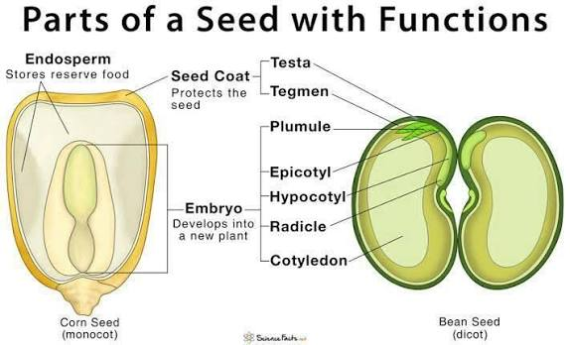
Let's Investigate Seeds 🔍
What happens when we open these seeds?
🌽 Maize Seed
Bean / Pea Seed
✅ One cotyledon
✅ Two cotyledons
Monocot = One cotyledon Dicot = Two cotyledons
Notes:
TEACHER: This is a prediction activity. Ask students first, then reveal. Ideally, have real soaked seeds for students to open.

Slide 14
Monocot vs Dicot — Comparison
Feature
🌾 Monocot
🌱 Dicot
Cotyledons
One
Two
Roots
Fibrous
Tap root
Leaves
Narrow & long
Broad
Examples
Rice, maize, wheat
Pea, beans, mango
Notes:
TEACHER: Reveal each row after asking students to predict. Use this as a summary of monocot vs dicot differences.

Slide 15
Quick Quiz — Question 1
Which plant is a gymnosperm?
A. Mango
B. Rice
C. Pine
D. Pea
Notes:
TEACHER: Students answer. Then reveal: ✅ C. Pine. Gymnosperm = naked seeds, pine is the classic example.

Slide 16
Quick Quiz — Question 2
Which part of a flower produces pollen?
A. Stigma
B. Anther
C. Ovary
D. Style
Notes:
TEACHER: Students answer. Reveal: ✅ B. Anther. The anther is the male part that makes pollen.

Slide 17
Quick Quiz — Question 3
How many cotyledons does a monocot have?
A. One
B. Two
C. Three
D. Four
Notes:
TEACHER: Students answer. Reveal: ✅ A. One. Mono = one. Dicot = two.

Slide 18
Quick Quiz — Question 4
Which plant is a dicot?
A. Rice
B. Maize
C. Wheat
D. Mango
Notes:
TEACHER: Students answer. Reveal: ✅ D. Mango. Rice, maize, wheat are all monocots.

Slide 19
Quick Quiz — Question 5
Where are the seeds of angiosperms enclosed?
A. Cone
B. Root
C. Fruit
D. Leaf
Notes:
TEACHER: Students answer. Reveal: ✅ C. Fruit. This is the key difference from gymnosperms.

Slide 20
What Did We Learn?
SEED-PRODUCING PLANTS
GYMNOSPERMS
Naked seeds • Cones
Example: Pine
ANGIOSPERMS
Seeds in fruits • Flowers
Example: Mango, Rose
MONOCOT
1 cotyledon
Fibrous root
Rice, maize
DICOT
2 cotyledons
Tap root
Pea, mango
🌱 Can you identify a plant around you as a monocot or dicot?
Notes:
TEACHER: Recap the whole classification. Challenge students to look at plants outside or at home and classify them.

