Slide 1

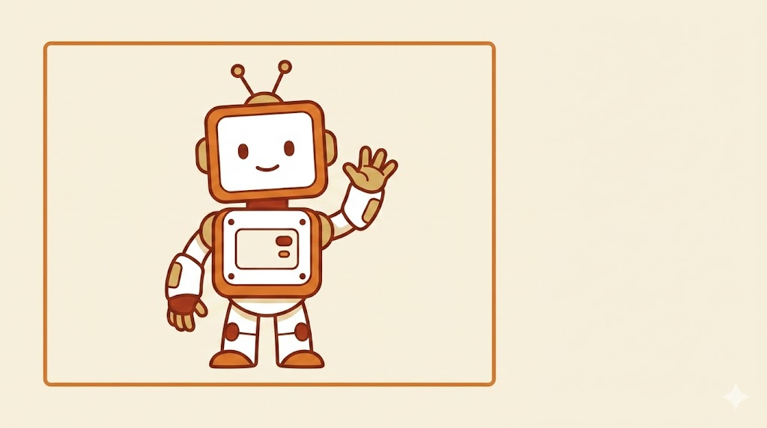
MODULE 1
What AI Is
and What It Can't Do
A simple start to using AI at work.
Module 1 of 5 · AI Skills for Everyone

Slide 2
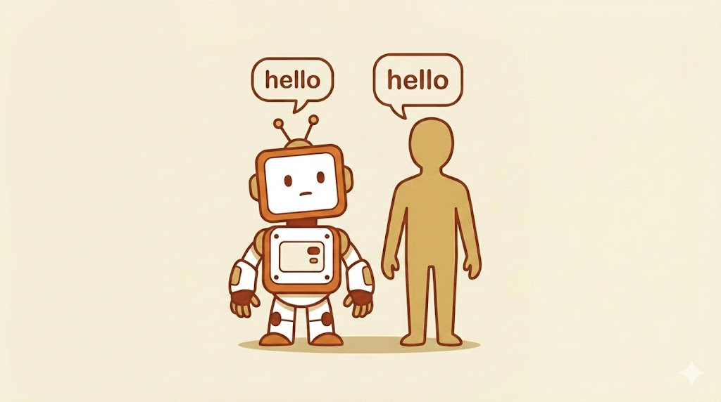

What is AI?
AI stands for "Artificial Intelligence."
That's a big name for a simple idea: AI is a computer helper. You can talk to it or type to it. It can answer back.
You may have heard of these AI helpers:
ChatGPT · Copilot · Gemini · Claude
Module 1 · What AI Is and What It Can't Do
2 / 20

Slide 3
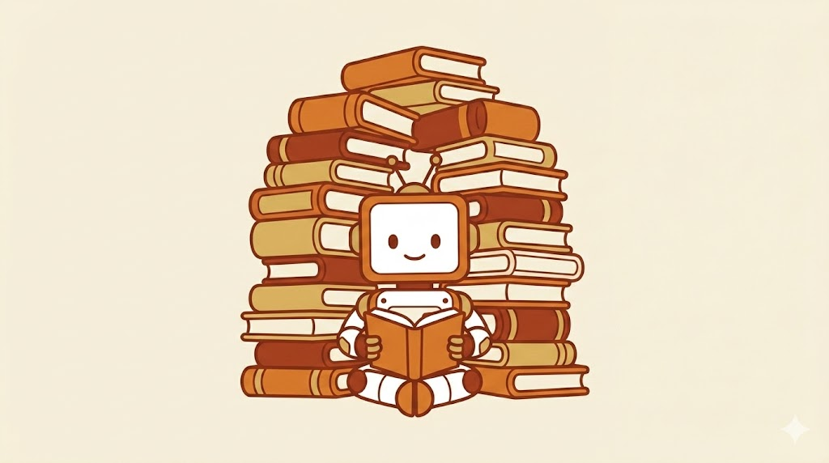

How Does AI Learn?
AI learned by reading.
A lot.
It read everything.
Books, websites, and stories — more than any person could read in a hundred lives.
Module 1 · What AI Is and What It Can't Do
3 / 20

Slide 4
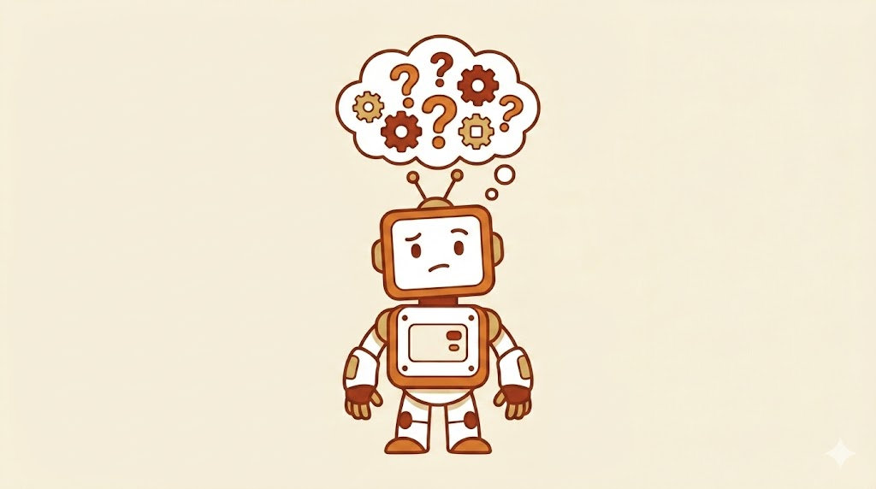
Here's the Tricky Part…
AI does not really "know" things the way you do.
It just gets very good at guessing the next word.
It is like a super smart guess machine.
Module 1 · What AI Is and What It Can't Do
4 / 20

Slide 5
What Can AI Do Well?
AI is great at lots of jobs.
Let's look at five of them — one at a time.
1
Write things
🖼 INSERT PICTURE HERE
2
Help you think
3
Sum it up
4
Answer questions
5
Help you plan
Module 1 · What AI Is and What It Can't Do
5 / 20

Slide 6

THING 1 OF 5
WHAT CAN AI DO WELL?
Write things
AI can write for you. Emails, notes, lists, even fixing your spelling.
🖼 INSERT PICTURE HERE
TRY ASKING:
"Write me a short, friendly email asking for a meeting next week."
Module 1 · What AI Is and What It Can't Do
6 / 20

Slide 7

THING 2 OF 5
WHAT CAN AI DO WELL?
Help you think
AI can give you lots of ideas, fast. Use it like a brainstorm partner.
🖼 INSERT PICTURE HERE
TRY ASKING:
"Give me 10 ideas for a fun work party."
Module 1 · What AI Is and What It Can't Do
7 / 20

Slide 8

THING 3 OF 5
WHAT CAN AI DO WELL?
Sum it up
AI can take a long story and tell you what it's about — in just a few words.
🖼 INSERT PICTURE HERE
TRY ASKING:
"Sum this up in 3 sentences." (then paste a long email)
Module 1 · What AI Is and What It Can't Do
8 / 20

Slide 9

THING 4 OF 5
WHAT CAN AI DO WELL?
Answer questions
AI can answer simple and big questions. Just remember to check what it says.
🖼 INSERT PICTURE HERE
TRY ASKING:
"Why is the sky blue? Explain it like I'm 8."
Module 1 · What AI Is and What It Can't Do
9 / 20

Slide 10

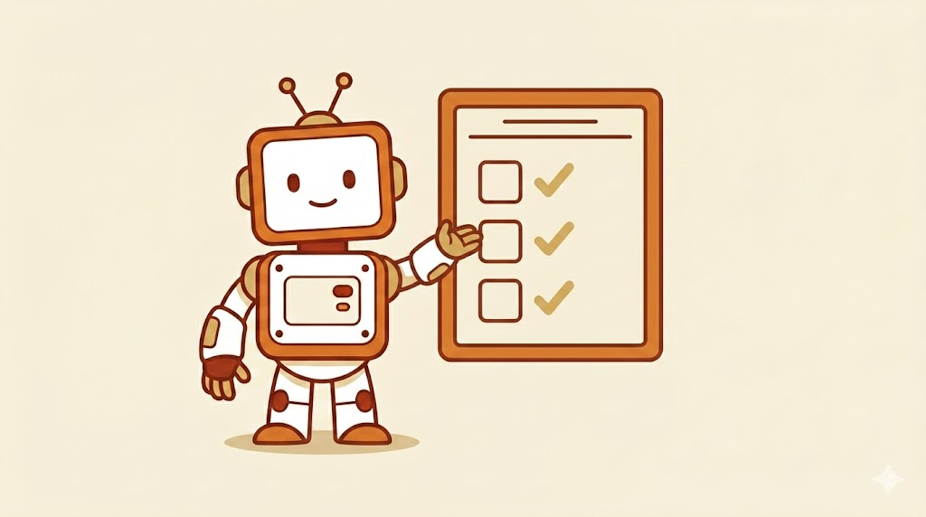
THING 5 OF 5
WHAT CAN AI DO WELL?
Help you plan
Trips. Parties. School projects. Big jobs at work. AI can help you map it out.
TRY ASKING:
"Make me a 3-day plan to clean out my office."
Module 1 · What AI Is and What It Can't Do
10 / 20

Slide 11
What is AI
not so good at?
🖼 INSERT PICTURE HERE
WE WATCH OUT
Module 1 · What AI Is and What It Can't Do
11 / 20

Slide 12
AI Can Make Stuff Up
NEW WORD: HALLUCINATION
hə-loo-sə-NAY-shun
It's when AI tells you something that sounds true… but is not true at all.
🖼 INSERT PICTURE HERE
It might give you a fake fact or a fake name. It does this with a smile, like it is sure. But it is wrong.
Module 1 · What AI Is and What It Can't Do
12 / 20

Slide 13
PROBLEM 1 OF 4
THINGS TO WATCH FOR
1
Doesn't know what's new
AI learned from old books, websites, and stories. It may not know what happened last week — or even yesterday.
🖼 INSERT PICTURE HERE
If you need today's news or fresh facts, double-check with a real source.
Module 1 · What AI Is and What It Can't Do
13 / 20

Slide 14
PROBLEM 2 OF 4
THINGS TO WATCH FOR
2
Can't feel
AI does not have a heart. It does not really care. It just sounds like it does because it learned from people who do.
🖼 INSERT PICTURE HERE
Feelings, comfort, and tough talks still belong to humans.
Module 1 · What AI Is and What It Can't Do
14 / 20

Slide 15
PROBLEM 3 OF 4
THINGS TO WATCH FOR
3
Doesn't know you
AI doesn't know your job, your team, your boss, or your customers. It is starting from zero every time.
🖼 INSERT PICTURE HERE
Tell it who you are and what you need. The more you share, the better it helps.
Module 1 · What AI Is and What It Can't Do
15 / 20

Slide 16
PROBLEM 4 OF 4
THINGS TO WATCH FOR
4
Not always right
Even when AI sounds smart and sure, it can still be wrong. Smart-sounding does not mean correct.
🖼 INSERT PICTURE HERE
Always check its work before you send, share, or save it.
Module 1 · What AI Is and What It Can't Do
16 / 20

Slide 17

TURN & TALK
Your turn.
When did AI not work the way you wanted?
🖼 INSERT PICTURE HERE
Or — when did it give you a result that you knew (or felt) was off?
Be ready to share with a partner.
Module 1 · What AI Is and What It Can't Do
17 / 20

Slide 18

HOW WE WORK WITH AI
Better together.
AI + You = a great team.
🖼 INSERT PICTURE HERE
Way #1 we team up:
AI gives ideas.
You pick the good ones.
Module 1 · What AI Is and What It Can't Do
18 / 20

Slide 19
HOW WE WORK WITH AI
Way #2 we team up:
AI writes a draft.
You fix it.
🖼 INSERT PICTURE HERE
AI gets you started fast — then you make it sound like you.
Module 1 · What AI Is and What It Can't Do
19 / 20

Slide 20
HOW WE WORK WITH AI
Way #3 we team up:
AI gives an answer.
You check it.
🖼 INSERT PICTURE HERE
Your eyes catch what AI misses. Together, the work is stronger.
Module 1 · What AI Is and What It Can't Do
20 / 20

