Slide 1
Monash Meal Kit System
Group 2
Anna Mary Almeida
Geoffrey Nelson
Sahaj Kishore Jain

Slide 2
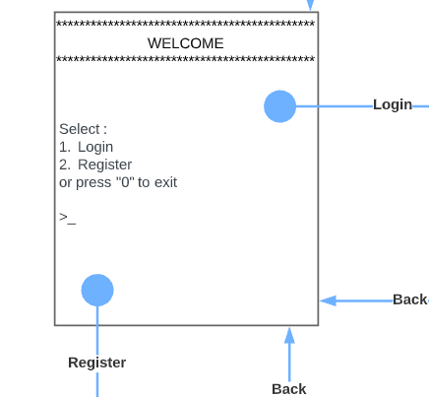
Welcome Screen
Text based application requiring user input via keyboard.
The initial screen that users see when they start the application is to log in or register.

Slide 3
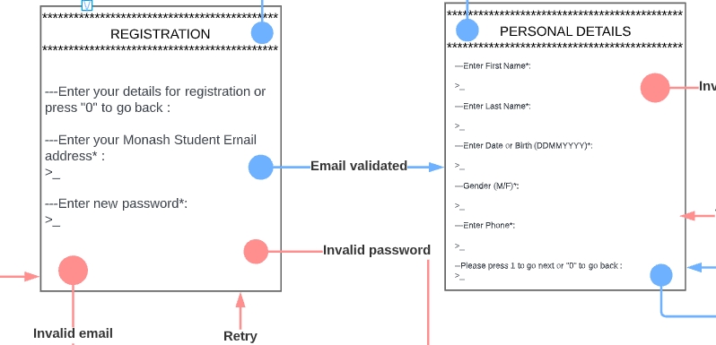
Registration Screen
In case user selects registration, they are required to fill in their details to become a part of this system.

Slide 4
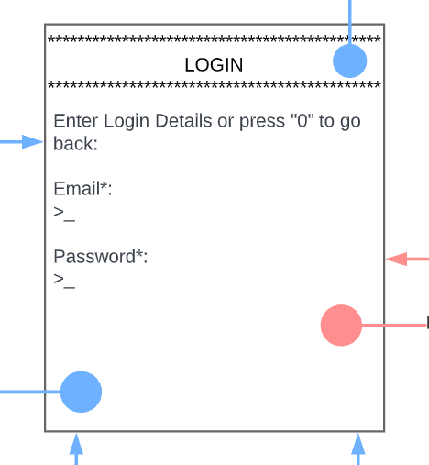
Login Screen
After registering successfully, the user will be allowed to now login using their Monash email and their selected password.

Slide 5
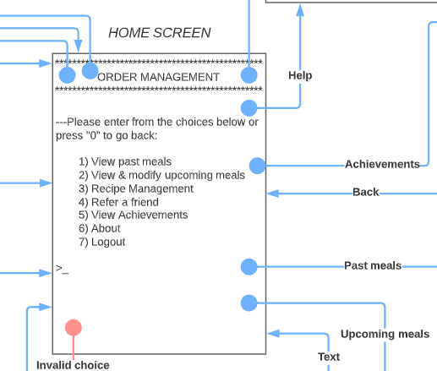
Order Management Screen
This screen provides the main menu for the app.
Users can choose between several options to manage their meal plans.

Slide 6
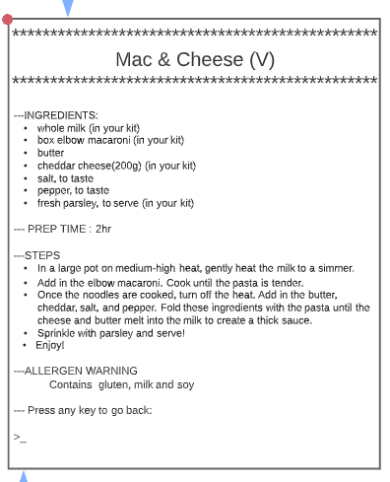
Example Meal Screen
There are multiple such meals to be chosen from.
Each of them consists of ingredients, what raw materials are provided in the kit, prep time, preparation steps and warnings regarding allergens.

Slide 7
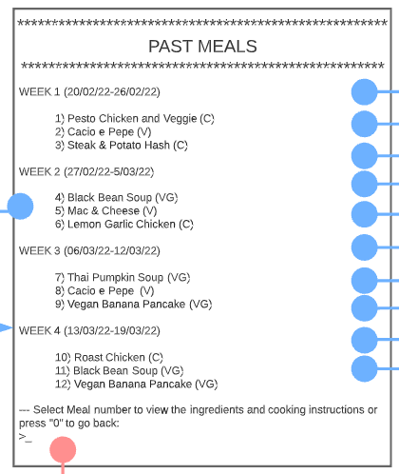
Past Meals Screen
This screen shows the past 4 weeks’ meals that the customer has ordered.
Users can view its ingredients and recipes.

Slide 8
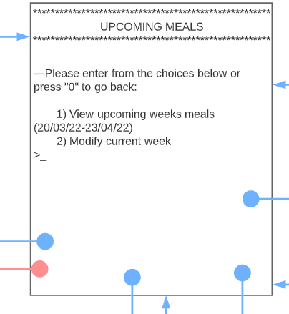
Upcoming Meal Menu Screen
The users have the option of viewing the meals for the next 4 weeks.
Users can choose to modify the current week’s meal plan.

Slide 9
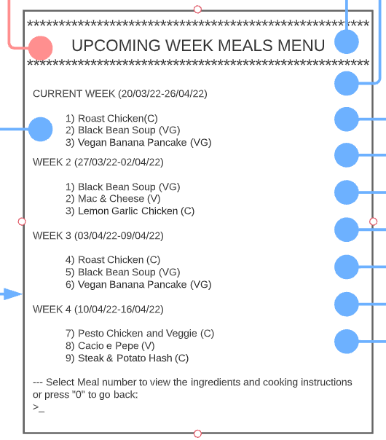
Upcoming Weeks Meals Screen
The meals for the next 4 weeks are displayed.
Users can choose to view the ingredients and recipes for these meals.

Slide 10
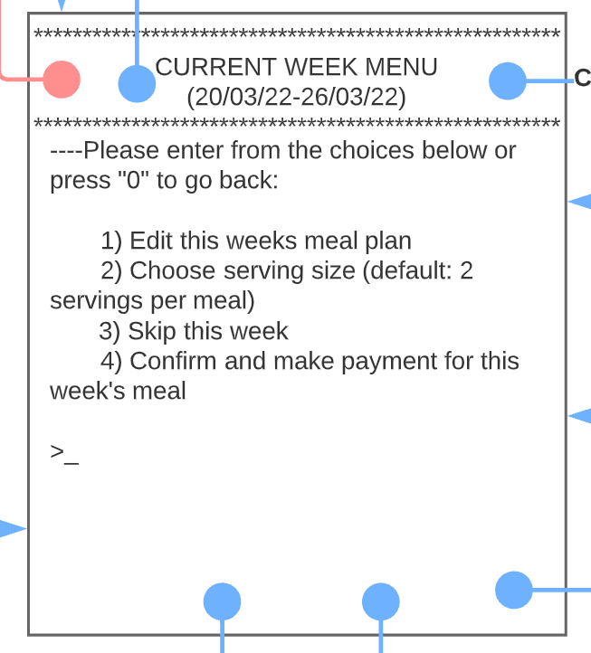
Modify Current Week Screen
Users can choose to edit the current week’s meal.
They can change its serving size.
They can choose to skip the week’s meal.

Slide 11
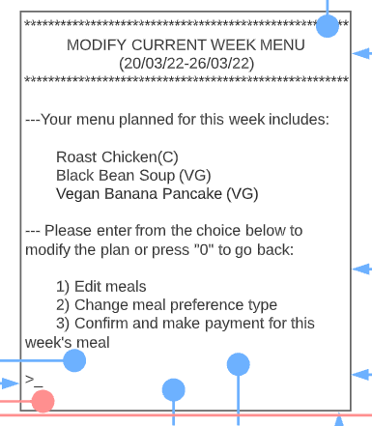
Modify Current Weeks Meal Screen
This shows the meals selected for the current week.
Users have the option to modify the meal plan.
Users can add the type of protein if needed.
Users can make payments to receive this week’s meals.

Slide 12
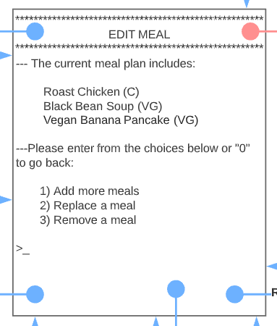
Edit Screen
This screen allows you to add, remove, replace a meal.

Slide 13
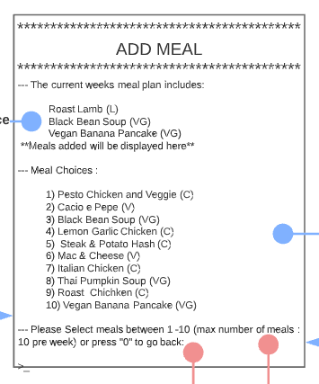
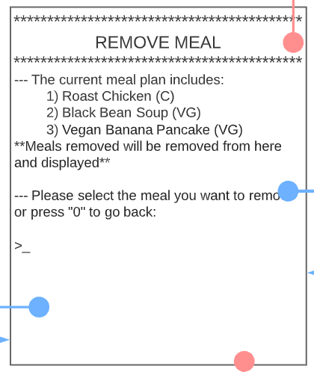
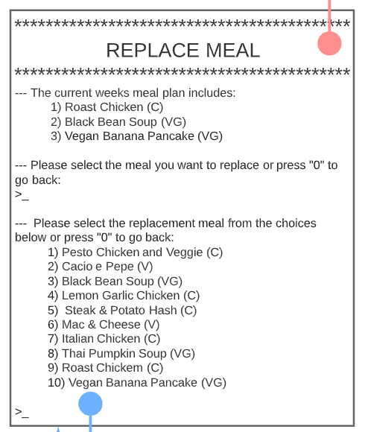
Add, Remove and Replace Screen
These screens are shown to perform the following tasks –
Add
Remove
Replace

Slide 14
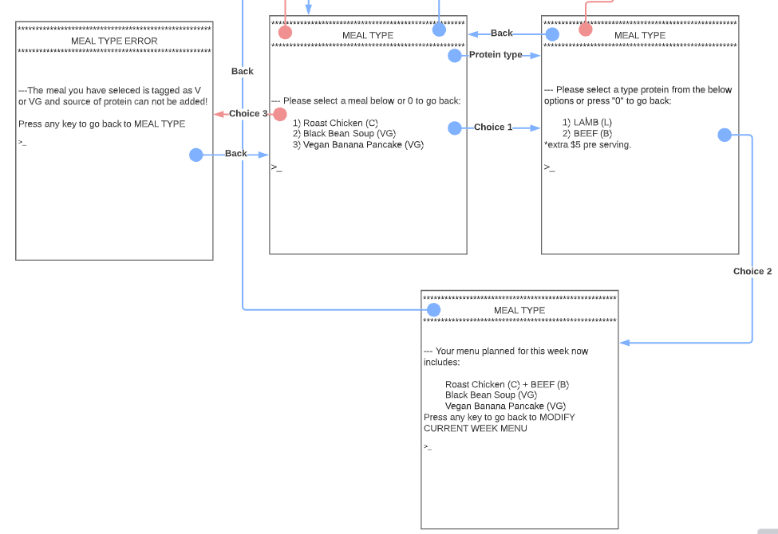
Meal Preference Screen
The user can select the meal they what to add their choice of protein too, with an extra charge of $5.

Slide 15
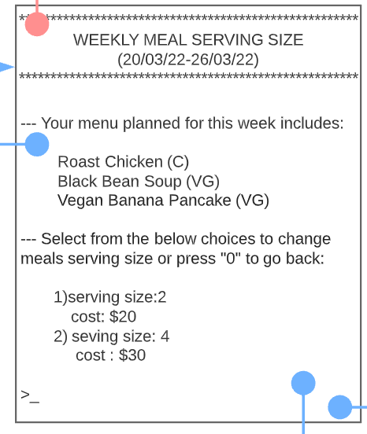
Change Serving Size Screen
User can change the serving size of the week’s meal plan.

Slide 16
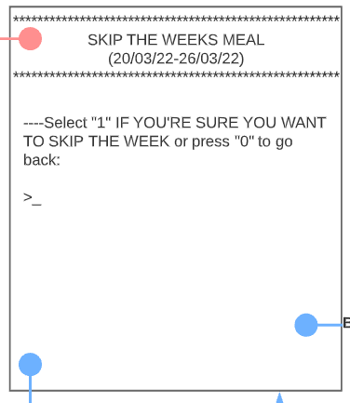
Skip Current Week Screen
This screen is used to skip the meal for the present week.

Slide 17
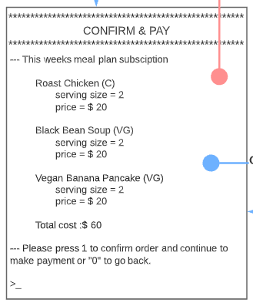
Confirmation Screen
The screen shows the meal size, cost and extra charges are applied if they choose beef or lamb in the kit for the current week.

Slide 18
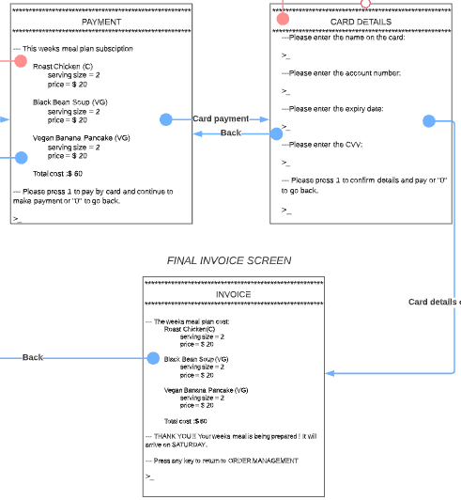
Payment Screen
The screens summarize the order and collects the payment details.
The user inputs their card details to make the payment.
The system confirms the order and provides an invoice.

Slide 19
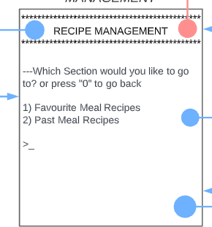
Recipe Management Screen
This section of the app allows to customer to view their favorite and past meal recipes.

Slide 20
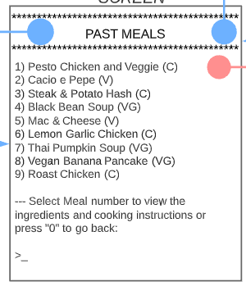
Past Meals Screen
The user can view all the meals that they have previously ordered and choose to see its ingredients and cooking instructions.

Slide 21
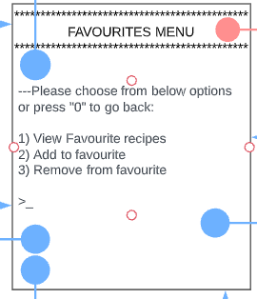
Favorites Menu Screen
This section allows the user to manage their favourite recipes.

Slide 22
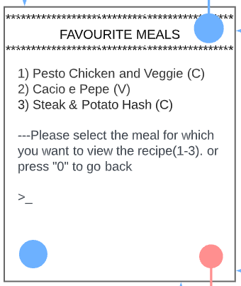
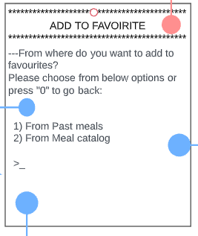
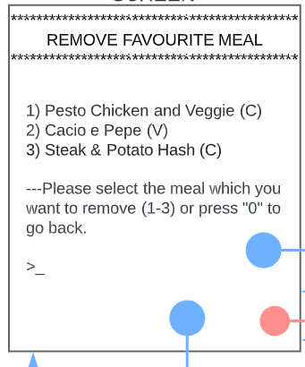
View, Add and Remove Favorite Screen
The system shows the list of meals that a user has favorited.
The screens how users can add or remove from favorites.
Users can add from either their past meals or the meal catalogue.

Slide 23
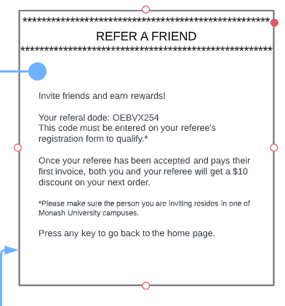
Referral Screen
The system provides a unique code for each user that can be shared with other Monash students to join this app and avail discounts.

Slide 24
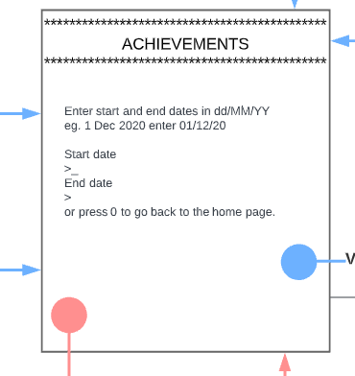
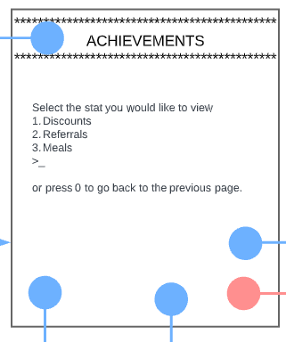
Achievements Screen
The system displays a section to show the users various achievements such as discounts, referrals and their meal stats.

Slide 25
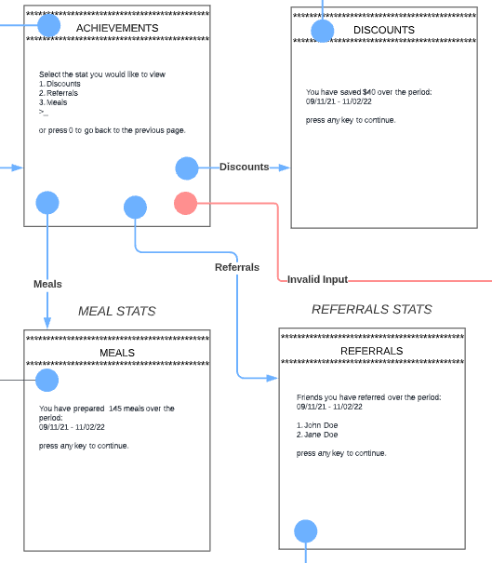
Achievements Screens
The various stats of the user are then displayed by the system.

Slide 26
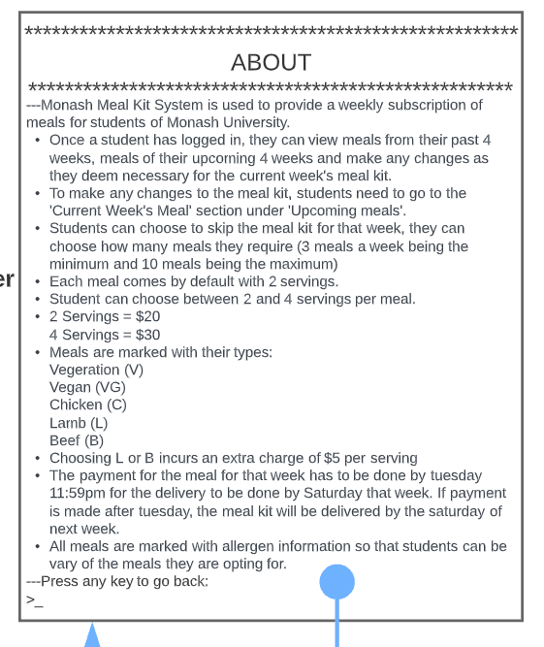
About Screen
The application has a section that tells the users about the different functions that can be performed by the app.

Slide 27
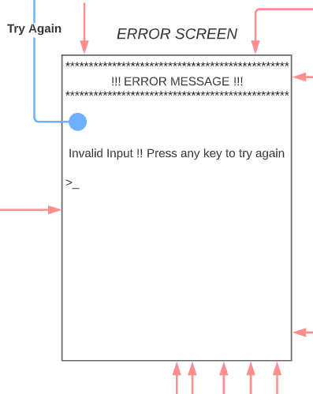
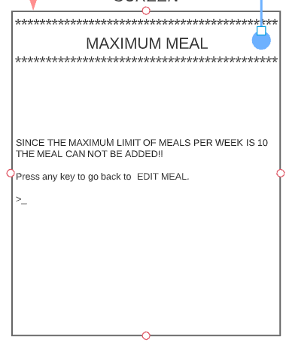
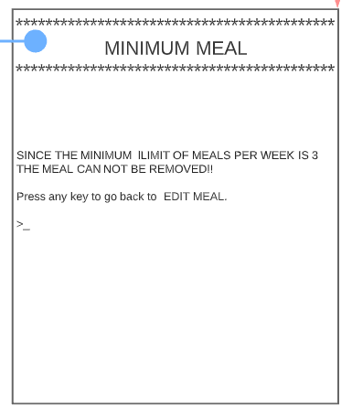
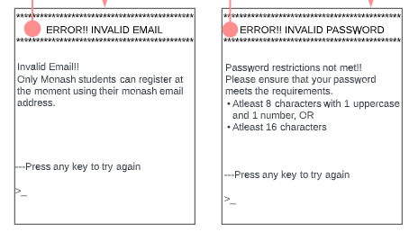
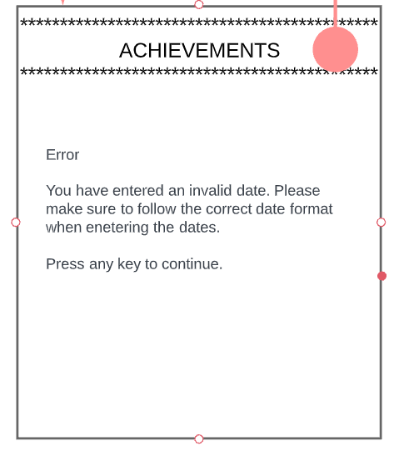
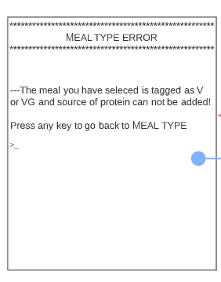
Error Screens
These are error screens that the user might encounter during the use of different functionalities of the app.
It also has a basic error screen that will occur when the user enters the incorrect input.

Slide 28
Design Overview

Slide 29
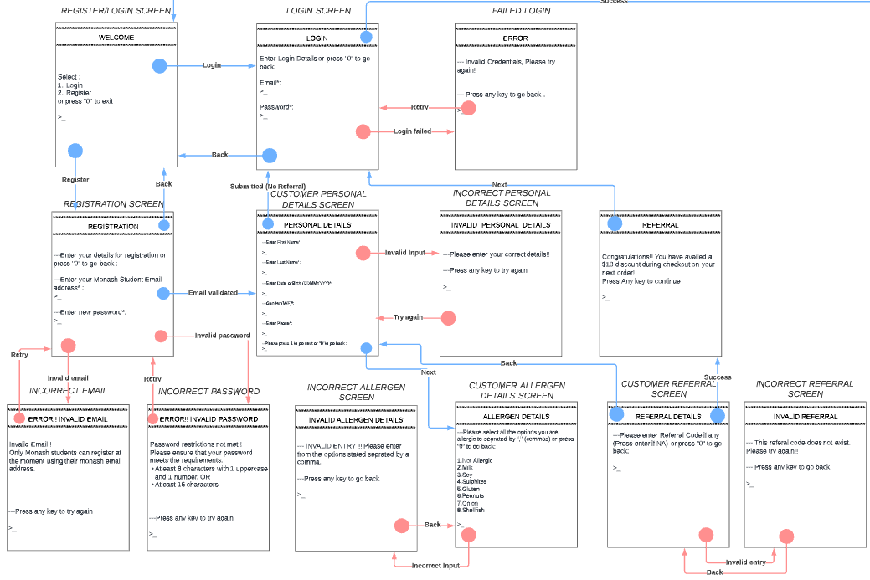
Feature 1: Login or Register

Slide 30
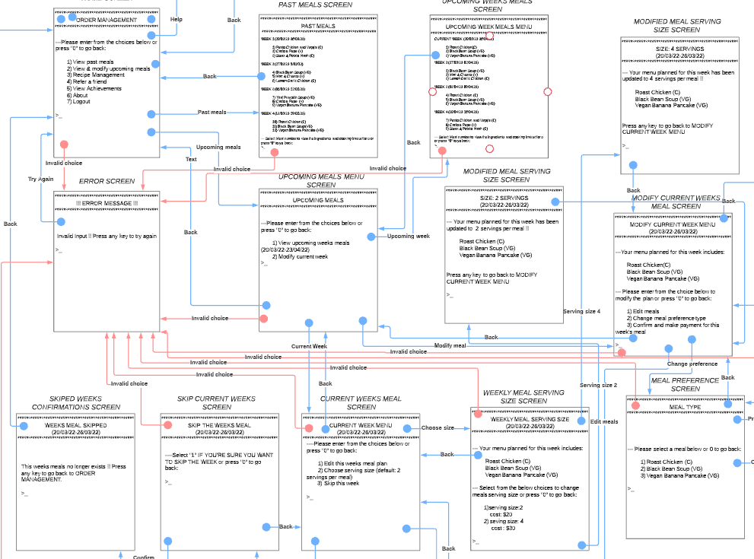
Feature 2: Recipe Management (Pt1)

Slide 31
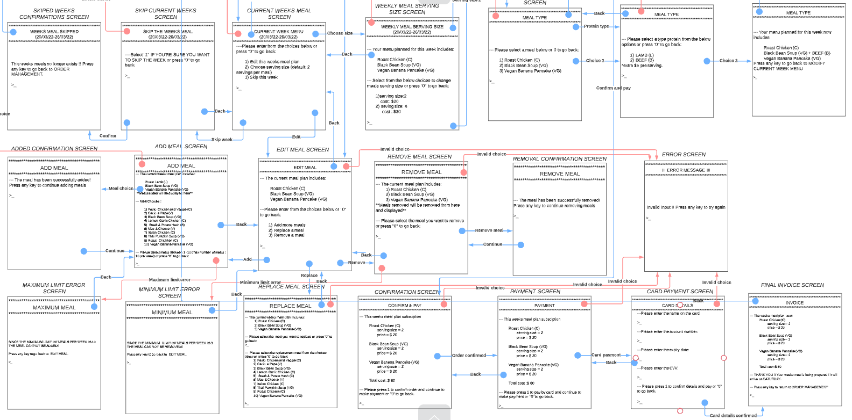
Feature 2: Recipe Management (Pt 2)

Slide 32
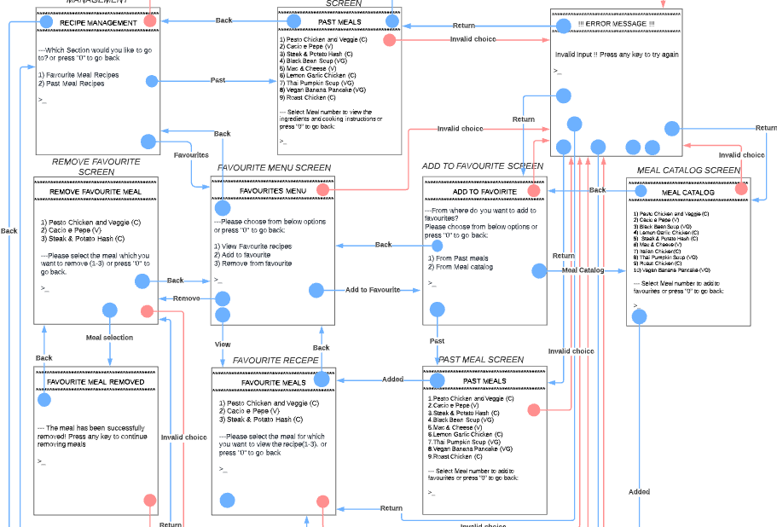
Feature 3 : Recipe Management

Slide 33
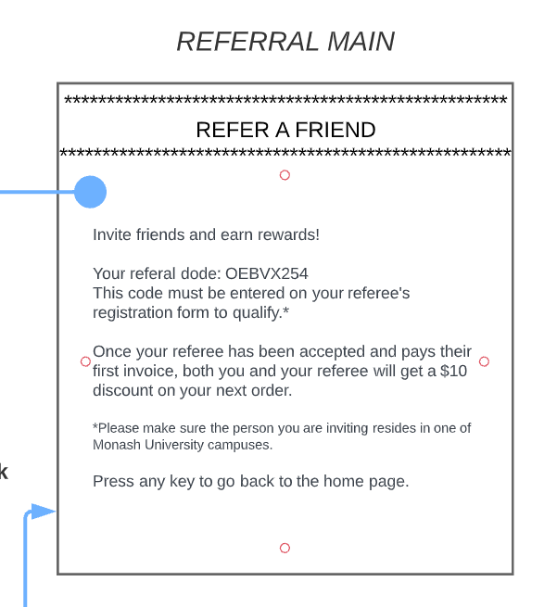
Feature 4: Referral

Slide 34
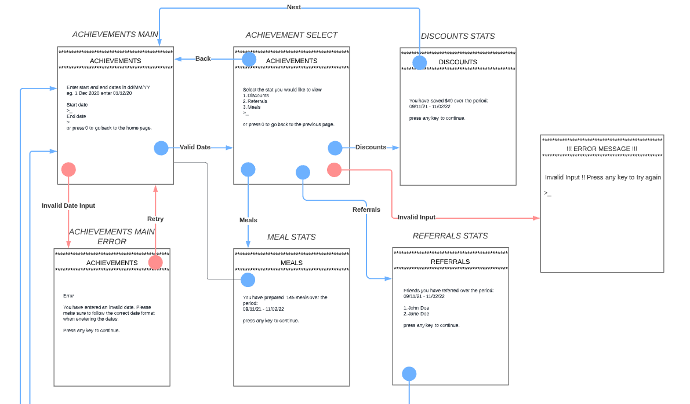
Feature 5: My Achievements

Slide 35
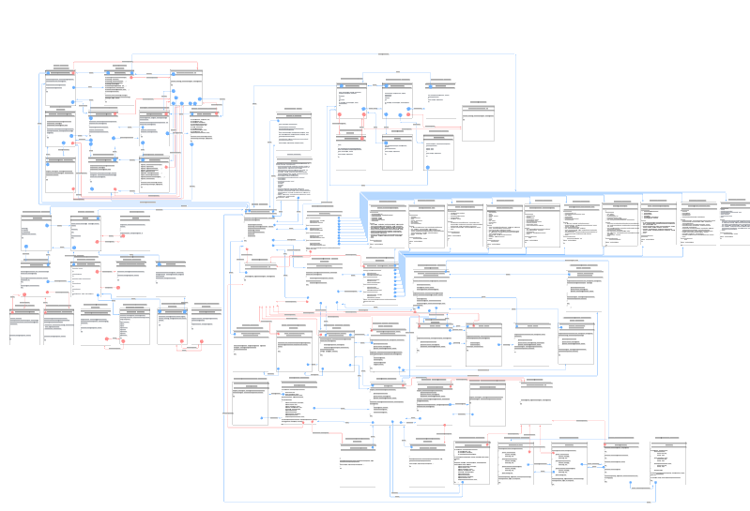
Appendix
To be able to view our entire prototype, please visit the below link:
Monash Meal Kit System - Wire flow Prototype (Lucid chart)

Slide 36
Thank You !!

