Slide 1

Krugna technologies
Project presentation
Title
bank loan approval prediction and analysis
Team member:
Sahana M A [4bd22cb030]

Slide 2
Agenda
Introduction
Objective
Dataset
Technologies
Methodology
Data Analysis
Machine Learning
Power BI Dashboard
Conclusion

Slide 3
Introduction
Loan approval is an important process in banking
Manual decisions are time-consuming
Data analytics helps automate decisions
This project uses PySpark and ML

Slide 4
Objective
Analyze loan applicant data
Identify key factors affecting approval
Build prediction model
Visualize results using dashboard

Slide 5
Dataset
Applicant Income
Loan Amount
Credit History
Gender
Education
Loan Status (Approved / Rejected)

Slide 6
Technologies Used
PySpark (Big Data Processing)
SQL (Data Analysis)
Logistic Regression (ML Model)
Power BI (Visualization)

Slide 7
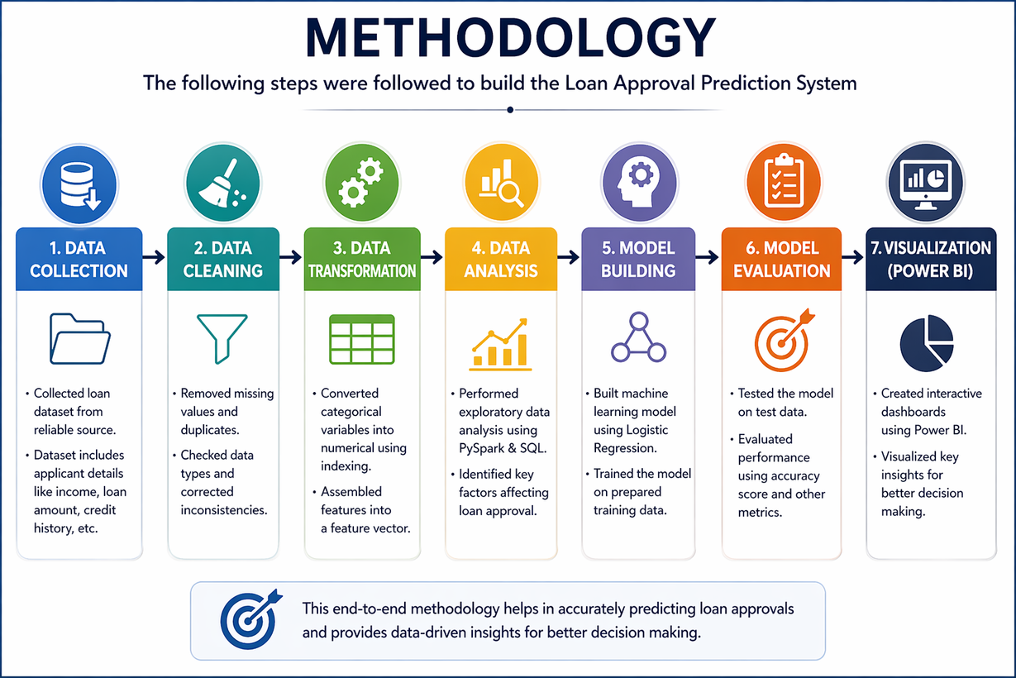
Methodology
Data Collection
Data Cleaning
Data Transformation
Data Analysis
Machine Learning Model
Evaluation
Visualization

Slide 8
PySpark Processing
Created Spark Session
Loaded dataset
Cleaned data (removed null values)
Performed analysis using PySpark

Slide 9
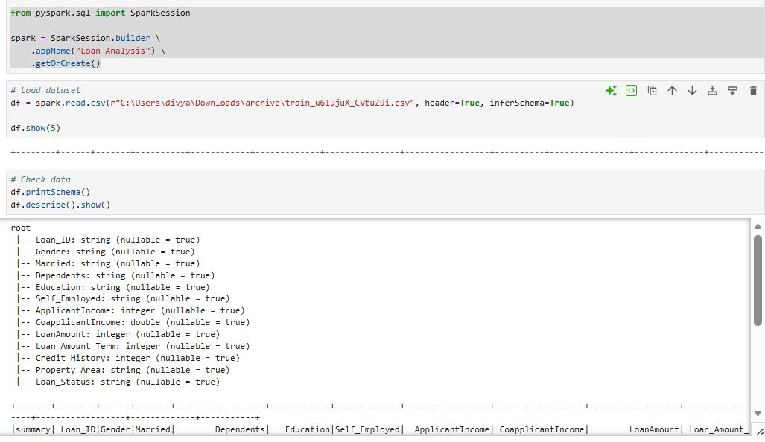
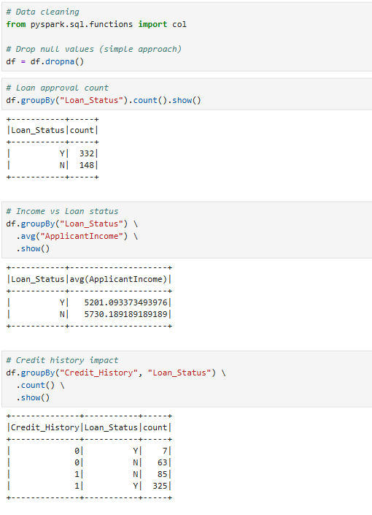
PySpark Processing

Slide 10
Data Analysis
Loan approval count
Income vs loan status
Credit history impact

Slide 11
SQL Analysis
Count of loan approvals
Average income calculation
Grouped data by loan status

Slide 12
Machine Learning
Model: Logistic Regression
Input: Income, Loan Amount, Credit History
Output: Loan Approved / Rejected

Slide 13
Model Performance
Accuracy: ~80%
Suitable for classification problems

Slide 14
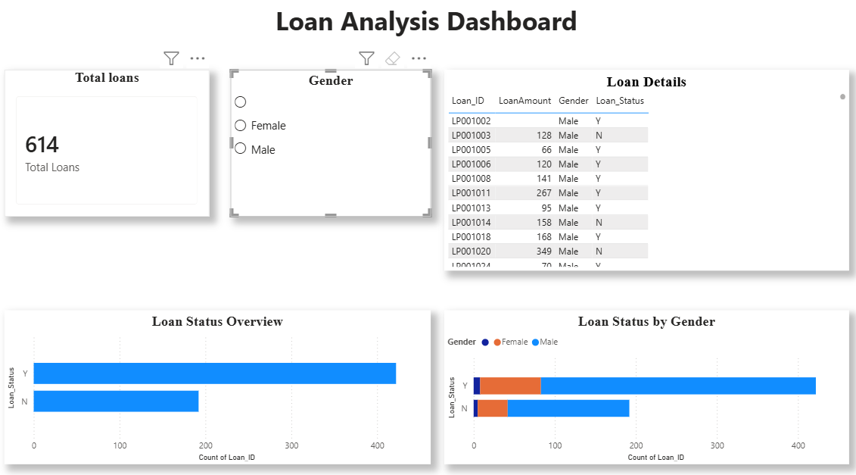
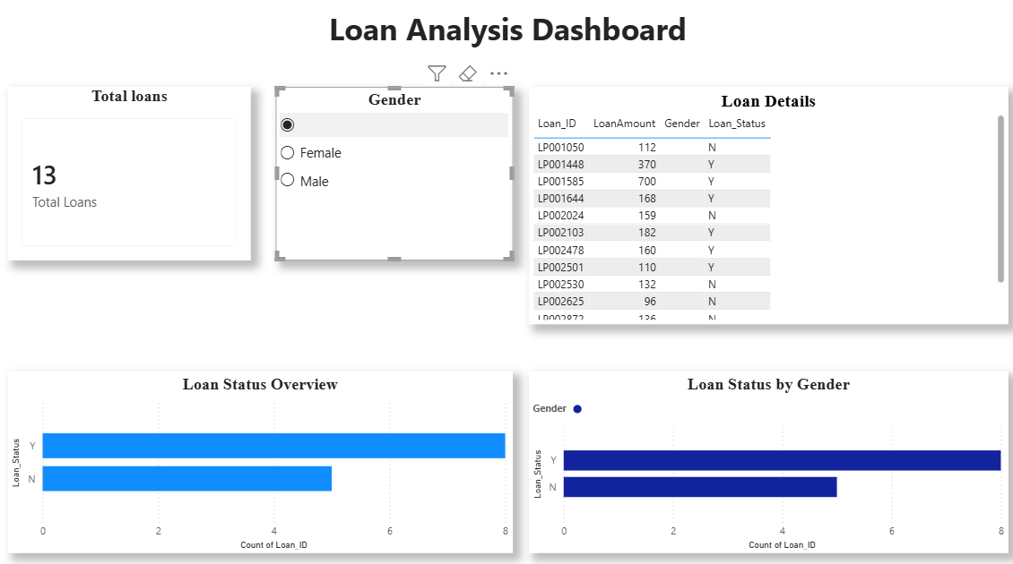
Power BI Dashboard

Slide 15
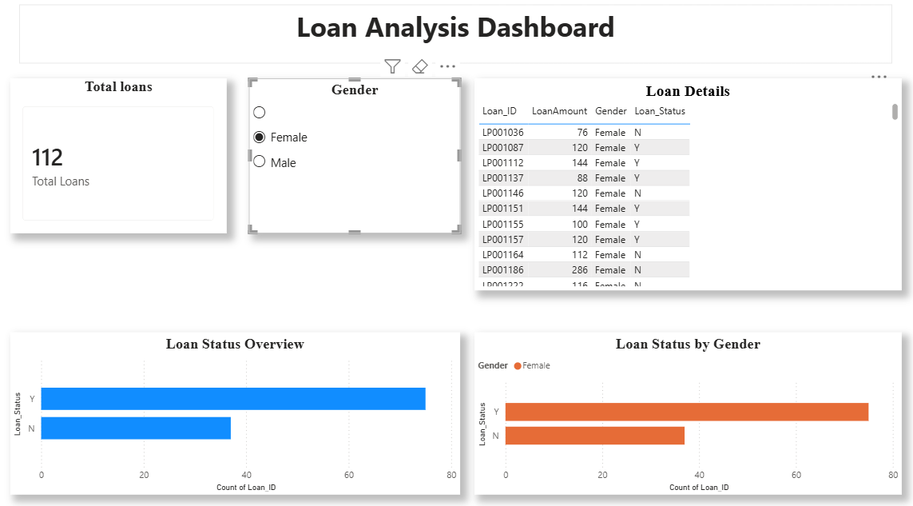
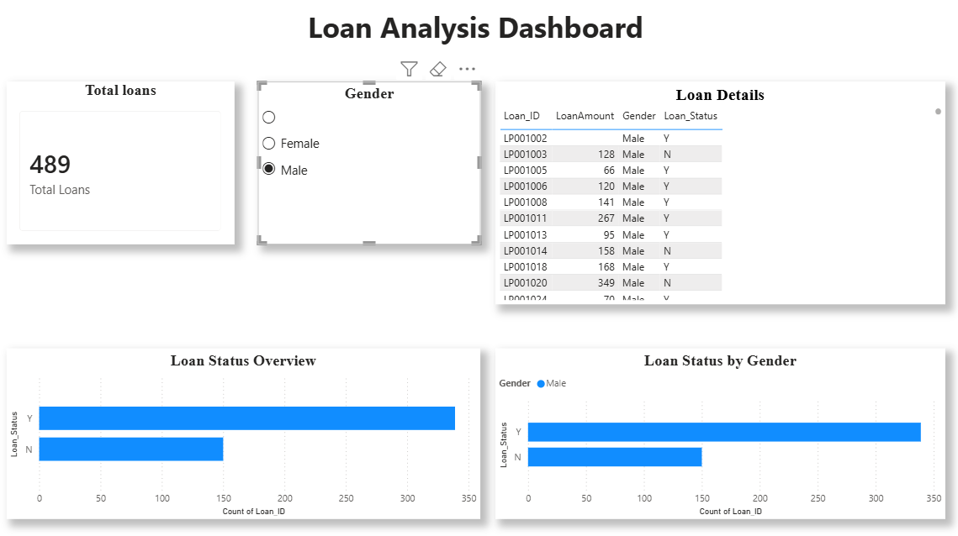
Power BI Dashboard

Slide 16
Key Insights
Credit history is most important factor
Higher income increases approval chances
Majority loans are approved

Slide 17
Conclusion
PySpark handles large data efficiently
Machine learning improves prediction
Power BI gives clear insights

Slide 18
Thank you

