Slide 1
ENGI 301 PCB Project
Sahana Prasanna
Due 12/12/2023 @ 11:59pm

Slide 2
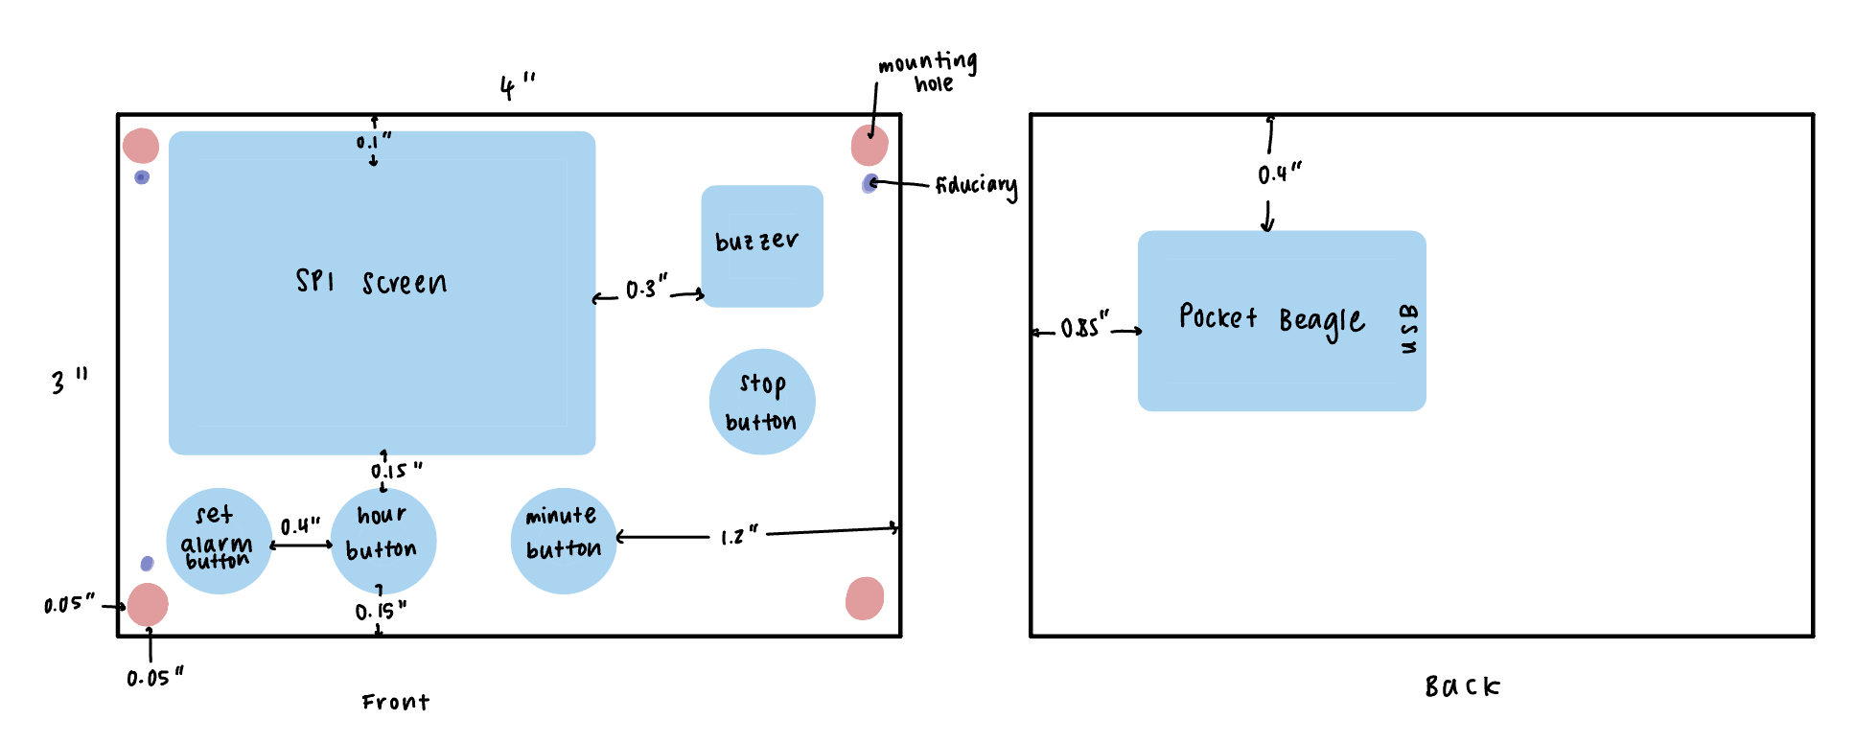
Mechanical Drawing
Complete For Project 2
See next slide for an example
FRONT
BACK

