Slide 1
ENGI 301 Sunrise Alarm Clock Proposal
09/24/2023
Sahana Prasanna

Slide 2
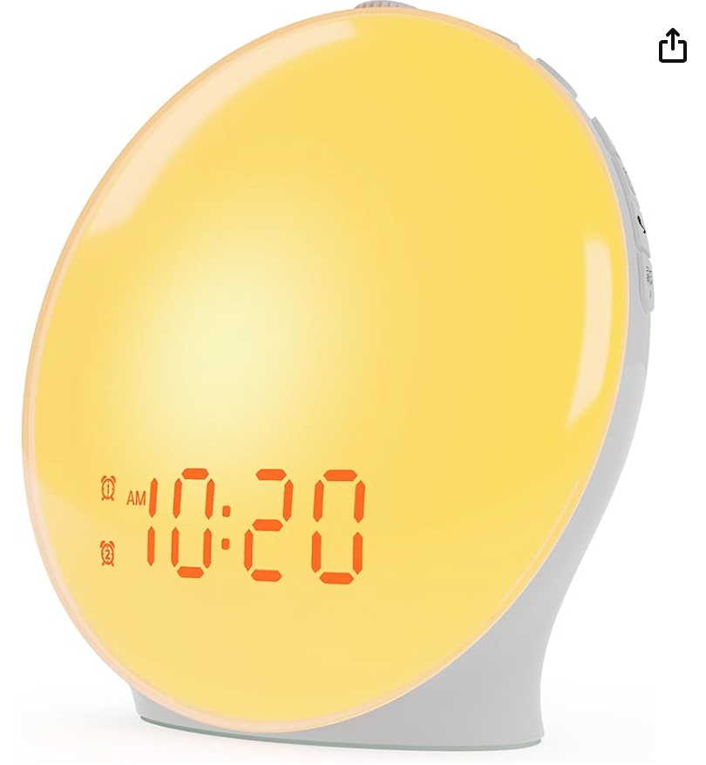
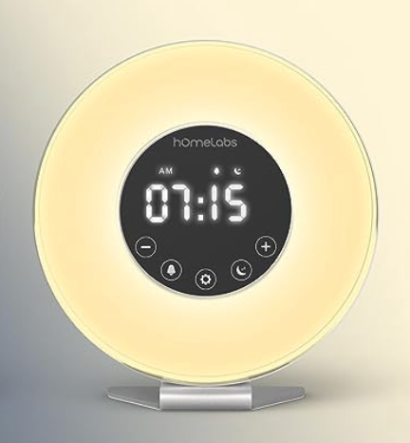
Background Information
Sunrise alarm clock - an alarm clock that mimics the colors of a sunrise when the alarm goes off, getting gradually brighter over a couple minutes
Amazon - Wake up sunrise alarm clock:
Amazon - Homelabs sunrise clock
What is new in mine?
Customizable light colors and display - can add purple, pink, blue lights
Customizable, advanced display
My story: I love being awake early mornings but I hate waking up! This clock would be a soothing addition to my mornings, by displaying a friendly message on the customizable screen, and slowly increasing the intensity of a sunrise lighting that would make it much easier to get out of bed. This would also as prevent me from using my phone in bed for an alarm, increasing the quality of my sleep.

Slide 3
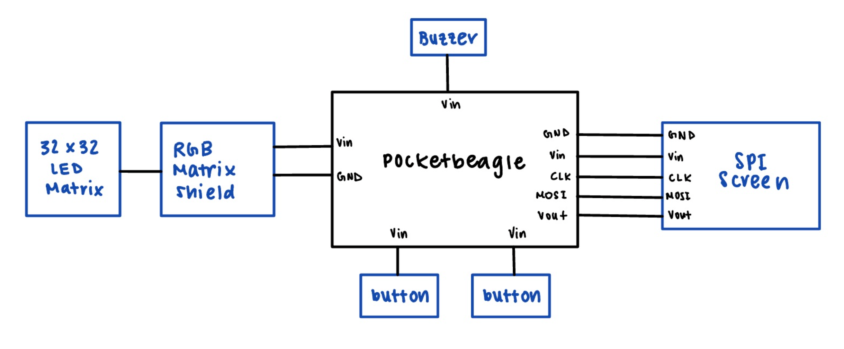
System Block Diagram
Create a System Block Diagram
Label interfaces / pins
Components (part numbers if possible)
Need Moderate Level of Detail

Slide 4
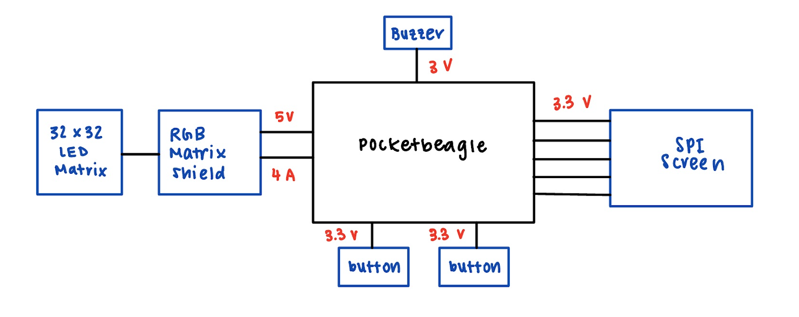
Power Block Diagram
Create a Power Block Diagram
Label voltages / currents of components
Need All Power Inputs and Outputs

Slide 5
Components / Budget
Component | Need to Buy | Cost ($)
SPI Screen - https://www.adafruit.com/product/1770 | Yes | 29.95
LED Strip Lights - https://shorturl.at/bksJU | Yes | 17.99
Buzzer - https://www.adafruit.com/product/1536 | No
BeagleBoard.org PocketBeagle | No
USB Wifi - https://shorturl.at/xBDT9 | Yes | 9.99
Push button x 2 | No
Level Shifters - https://shorturl.at/oqyJT | Yes | 7.99

Slide 6
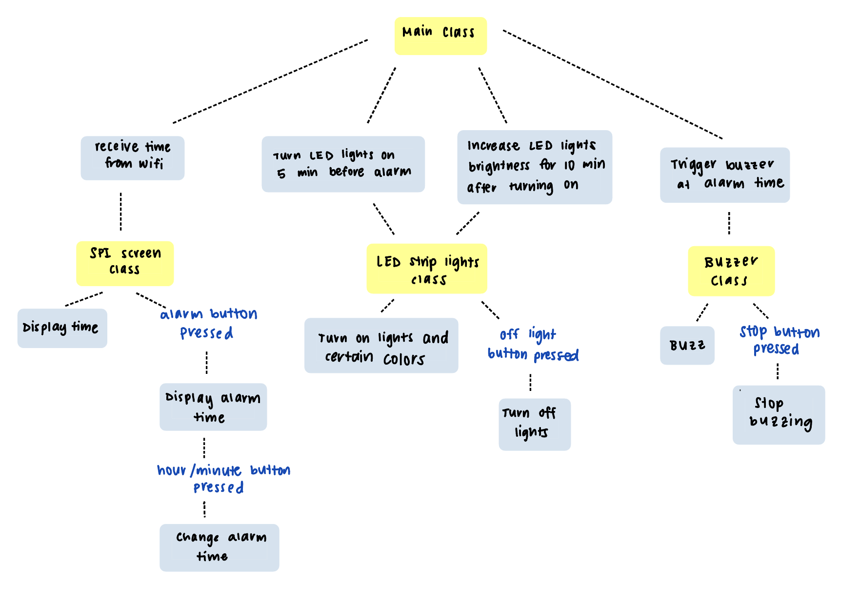
Software Diagram

