Slide 1
SANGYAN INVESTOR RESILIENCE HACKATHON
NiveshRakshak
Incoming Investment Message
⚡ VIP WEALTH ADVISORY
• Guaranteed 30% monthly return
• 100% Risk-Free Capital Guarantee
• Limited slots: Only 2 left today!
• Send ₹10,000 Now to UPI:
wealth.quickpay@okaxis
• Share OTP to activate ₹500 bonus
⚠️ HIGH-RISK FINANCIAL SIGNALS DETECTED
AI-Powered Investor Safety Assistant
“Before You Trust. Check with AI.”
“Guaranteed 30% Return”
“Limited Slots”
“Send ₹10,000 Now”
“Share OTP”
One message can become a financial loss.

Slide 2
THE PROBLEM
The Problem Starts Before the Money Moves
Pre-Transaction Risk
STAGE 01
Suspicious
Message
STAGE 02
Trust
STAGE 03
Pressure /
Urgency
STAGE 04
Payment /
Sensitive Info
STAGE 05
Potential
Financial Loss
→
→
→
→
KEY VULNERABILITY DRIVERS
• Misleading investment claims can look genuine.
Deceptive branding and professional phrasing mimic legitimate institutions.
• First-time investors may not recognize warning signs.
Rapid digital onboarding leaves new entrants unfamiliar with regulatory safeguards.
• Users often need help before they act, not after.
Traditional redressal is post-facto. Prevention must occur at the point of message delivery.
THE SYSTEMIC GAP
“There is a need for a simple safety layer between a financial message and an investor’s action.”
1. Intercept before fund transfer or credential disclosure
2. Break artificial urgency with objective risk explanation
3. Provide deterministic safe verification steps instantly

Slide 3
TARGET AUDIENCE & MISSION
A Safety Layer for Everyday Investors
Everyday Indian Investors
First-Time Investors
May not recognize common scam signals.
Tier-2 / Tier-3 Users
Need simple, accessible explanations.
Senior Citizens
May be targeted by impersonation and pressure tactics.
Recently Targeted Users
Need confidence to pause and verify.
THE PROTECTIVE SOLUTION
NiveshRakshak
Check suspicious financial messages before taking action.
Confusing Message
→
Understand the Risk
→
Take a Safer Next Step

Slide 4
SOLUTION ARCHITECTURE
From Screenshot to Safer Action
6-Step Solution Flow
STEP 01
Upload / Paste
Screenshot or message
STEP 02
OCR
Extract the text
STEP 03
Risk Signal
Analysis
Detect warning signs
STEP 04
Investor
Safety Meter
Show overall concern level
STEP 05
Evidence +
Explanation
Explain WHY it looks risky
STEP 06
Safe Action
Plan
Pause → Verify → Act
→
→
→
→
→
CORE DETECTED RISK SIGNALS
Guaranteed Returns
Urgency
OTP Requests
Payment Pressure
Impersonation
Suspicious Links
Clear, deterministic verification — intuitive for judges to evaluate in 5 seconds.

Slide 5
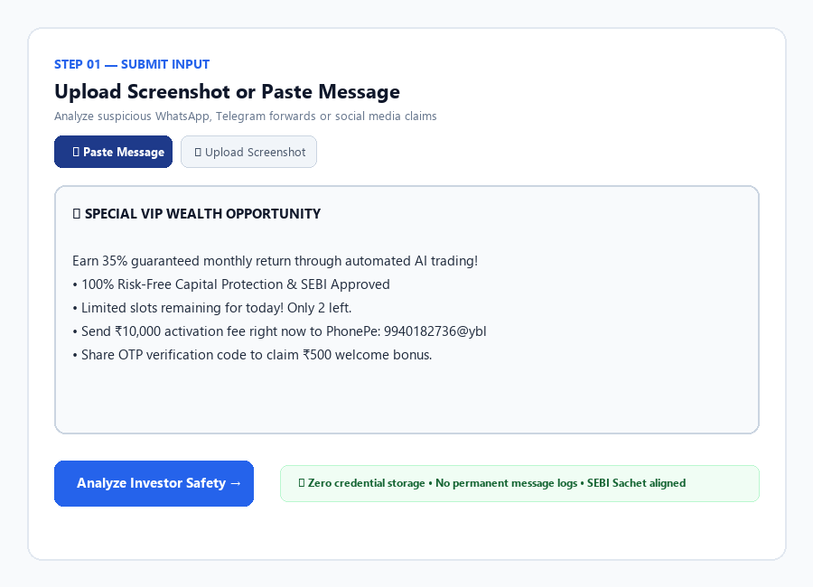
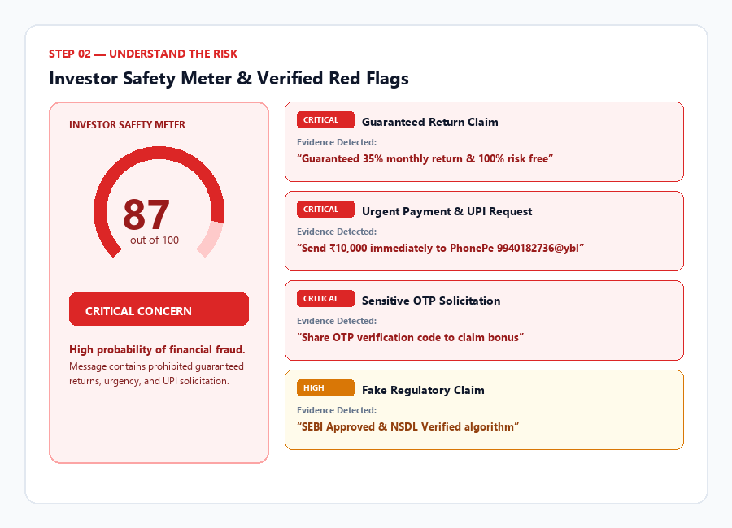
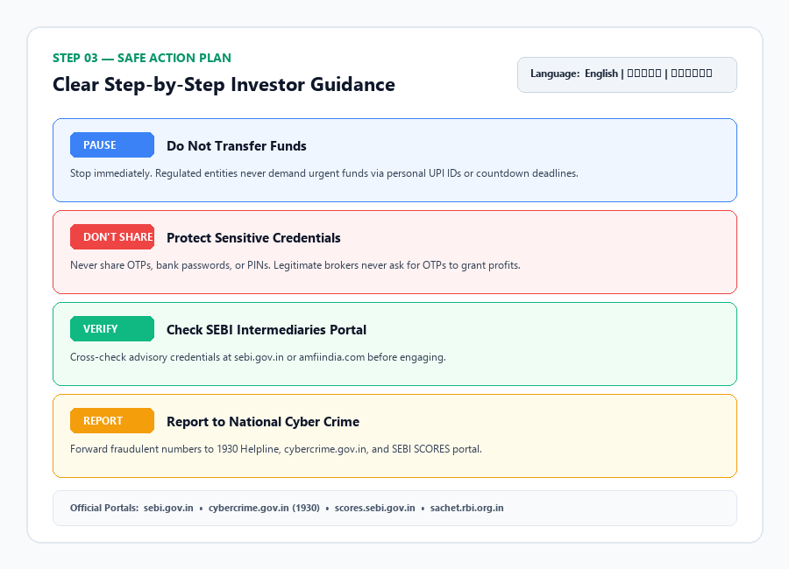
PROTOTYPE WALKTHROUGH
NiveshRakshak in Action
Working Prototype UI
01 — Submit
Upload or Paste Suspicious Message
02 — Understand
Safety Meter & Evidence Red Flags
03 — Act Safely
Safe Action Plan & Multilingual

Slide 6
GUARDRAILS & RESPONSIBLE AI
Explainable AI. Privacy First. No Investment Advice.
Trust Principles
User Input (Screenshot / Text)
Explainable
Shows the warning signs and verbatim evidence behind the concern level.
↓
OCR Text Extraction
↓
Risk Signal Detection
Private
No OTP, PIN, password, PAN/Aadhaar, or bank credentials required. No permanent screenshot storage.
↓
Rule-Based Safety Engine + AI Explanation
↓
Investor Safety Meter
Responsible
No stock tips, buy/sell/hold recommendations, price predictions, or broker promotion.
↓
Evidence + Plain-Language Explanation
↓
Safe Action Plan
AI explains the risk indicators. It does not decide what the investor should buy or sell.

Slide 7
IMPACT & CONCLUSION
Helping Investors Pause Before They Become Victims
Investor Resilience
BEFORE
Suspicious Message → Confusion → Pressure → Impulsive Action
WITH NIVESHRAKSHAK
Suspicious Message → Understand → Verify → Act Safely
Safer Digital Participation
Helps investors recognize common warning signs.
Bharat-First Accessibility
Simple explanations in English, Tamil and Hindi.
Scalable Safety Layer
Can support multiple digital fraud and misleading-content scenarios.
NiveshRakshak
“Before You Trust. Check with AI.”
PAUSE → UNDERSTAND → VERIFY → ACT SAFELY

