Slide 1
Sahana Security Considerations
ICTA

Slide 2
Main Risks
Divulging of confidential data over the web
  Data privacy
Exploitation of data records
  Malicious use of deceased records for identity theft, theft of land, etc
Emotional impact of incorrect and non-validated data
Balance accessibility with security

Slide 3
Sahana Change of Scope
Sahana is now going to work more like a back office system for the CNO and associated organizations
All reports will thus be authoritative

Slide 4
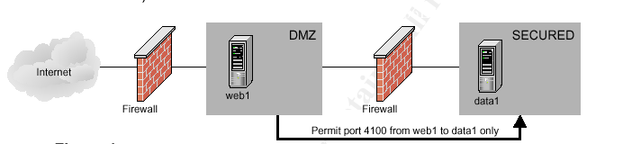
Deployment
1 Production Server
  optional: separate secured database server
1 Staging Server
  For pre-deployment QA
1 Backup Server
  Mirror of production server for fault tolerance

Slide 5
Administration Controls
2 Admins on the production server:
  Buddhika Siddhisena
  Sanjiva Weerawarna
  copy to Dr Ajith Maduraperuma (as backup)
Main administrative actions on production server
  run testing to production scripts
  firewall administration and securing the system
  user management
  backup and business continuity
  troubleshooting on database

Slide 6
Other areas of consideration for security
- Data classification
- Main people involved
- Access model - ACL or security level
- Role-Action based ACL
- Deployment to testing server
- Deployment to production server
- testing to production scripts
- Preventative controls
- Firewalls, access with ssh only
- systems upgrade
- virus guards

Slide 7
Other areas of consideration for security
- Disaster recover / BCP
- Backup/recovery system system
- Fault tolerance (e.g RAID levels)
- Load balanced
- incidence handling procedures
- Monitoring
- Access logging
- Import action auditing
- Testing and QA
- Penetration testing
- Load / fault tolerance testing

Slide 8
New Admin Module Requirement
Sahana Admin Module
  managing ACLs
    org/username by access per application
  user management
  monitoring of system (e.g. logs)
Admin module access
  Ownership with CNO
  Sahana Admins

Slide 9
Org/Username Password Policy
Introduce password checking controls
  Eliminate simple passwords
    username=password
    abcd1234
    blank

Slide 10
Organization registry actions
Password policy
  one day throw away password on a weekly rota.
  7 random words for password each day of the week
Actions
  Add orgnization
    CNO - Patrick and Judy who know the password
  Add another user to org
  Elevate authorization level of user / editing the username/pass
  List all organizations - everyone

Slide 11
People Registry Actions
Actions
- Search for missing people
- only registered users
- add a displaced person (IDP)
- update IDP record
- add missing person people
- search and rescue desk
- CNO data center, Police, Hospitals, District Secs,
- or registered who have been given access rights to add
- new report
- report found (alive, deceased)
- author
- statistics and charts
- anyone registered

Slide 12
Camp Registry Actions
Actions
- add camps
- IDP desk
- whoever is authorized to add camp
- edit camp records
- search camps
- close camp

