Slide 1
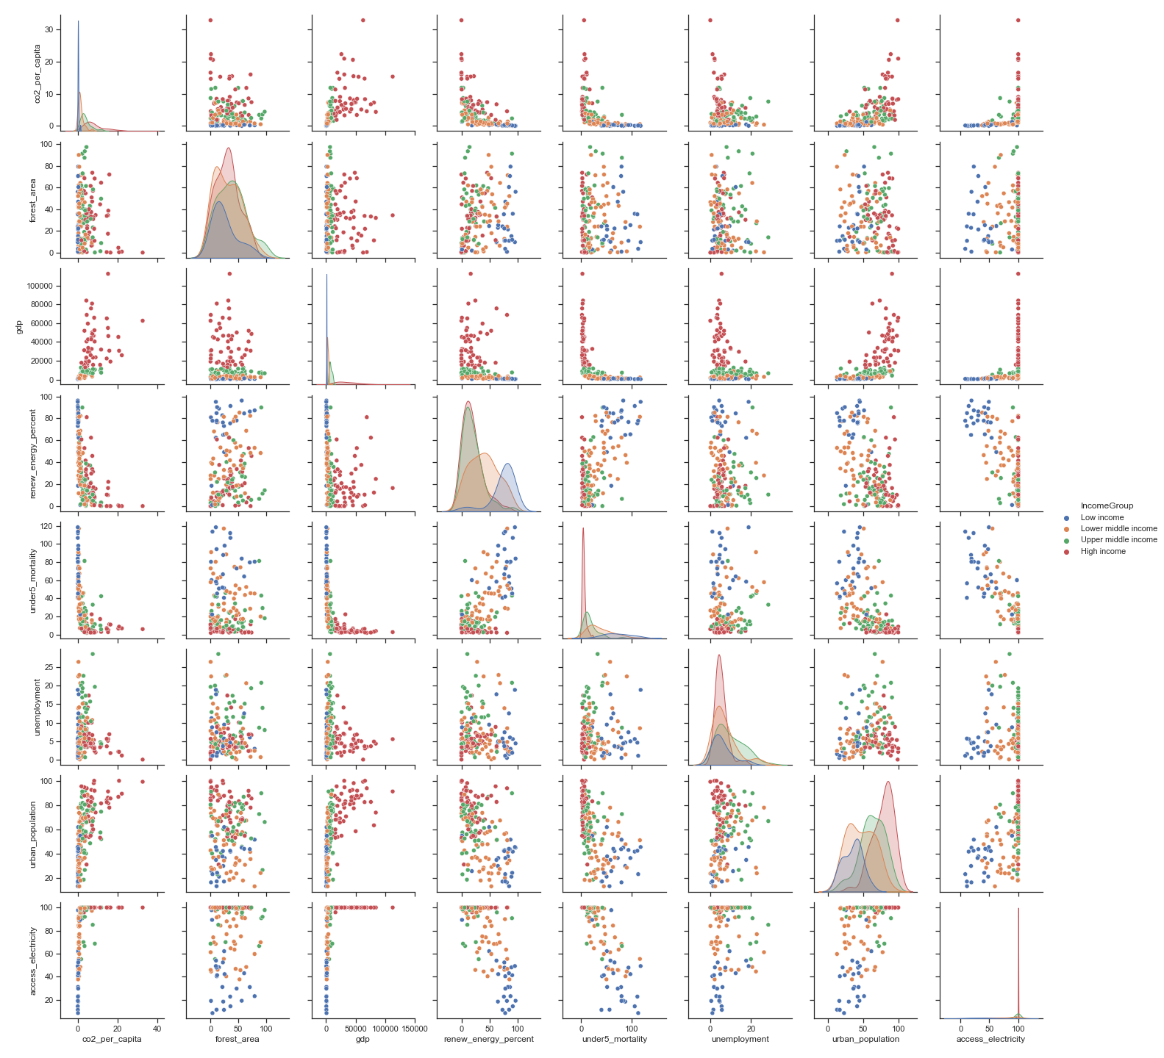
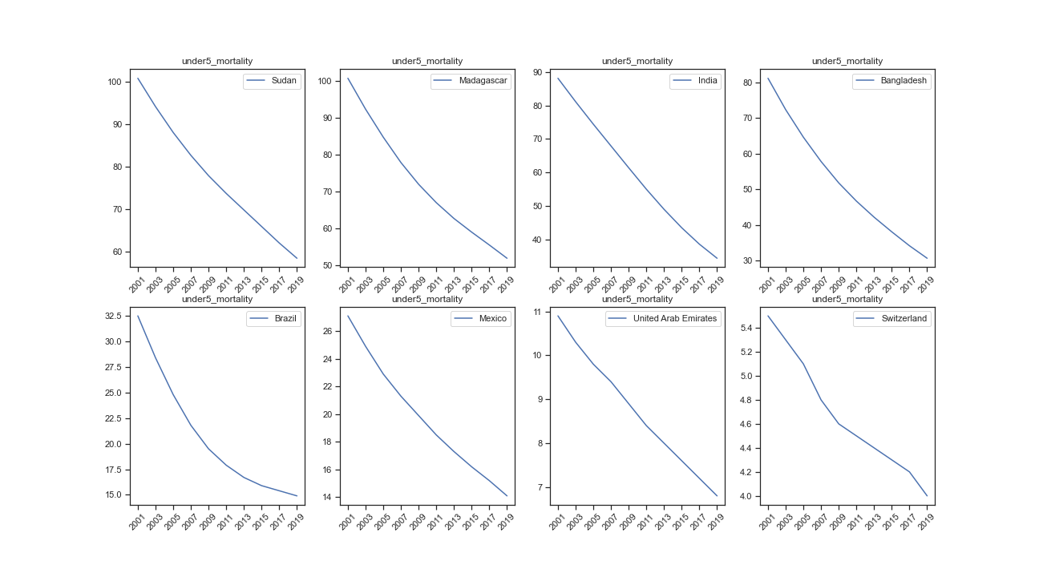
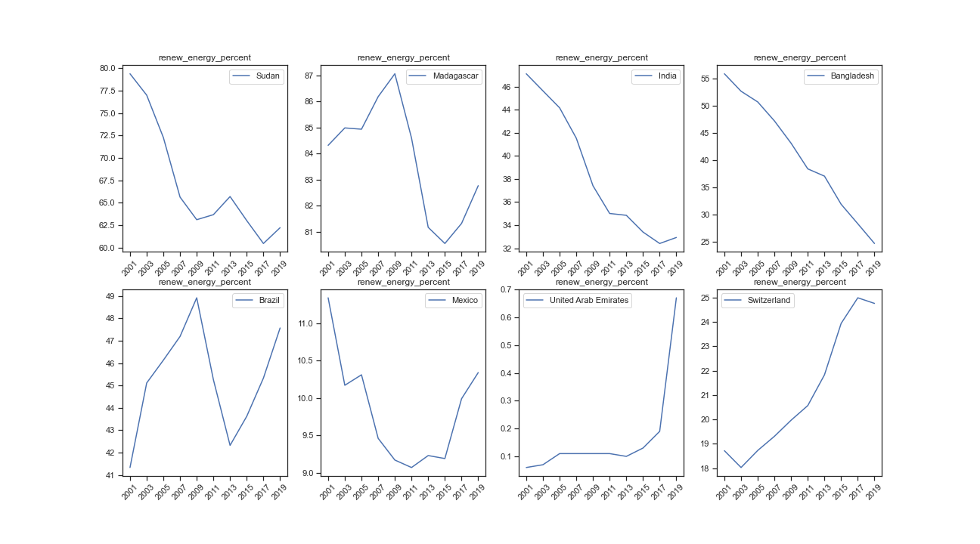
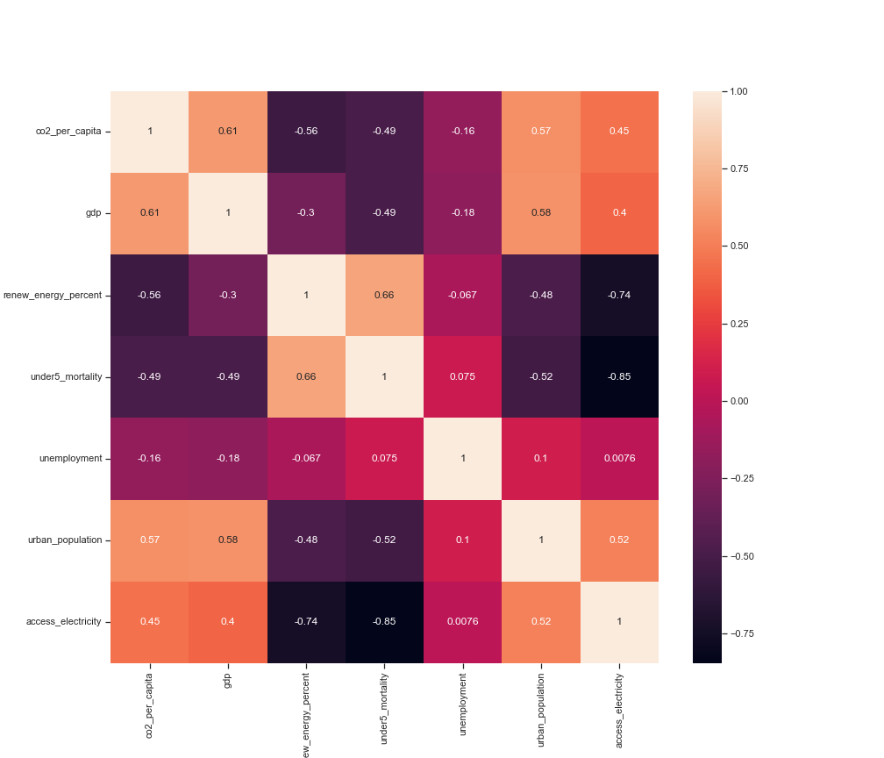
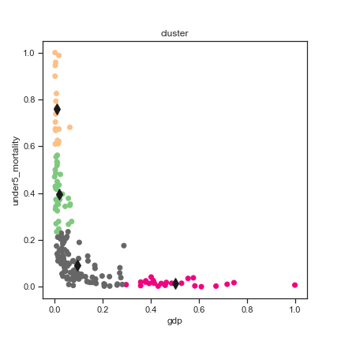
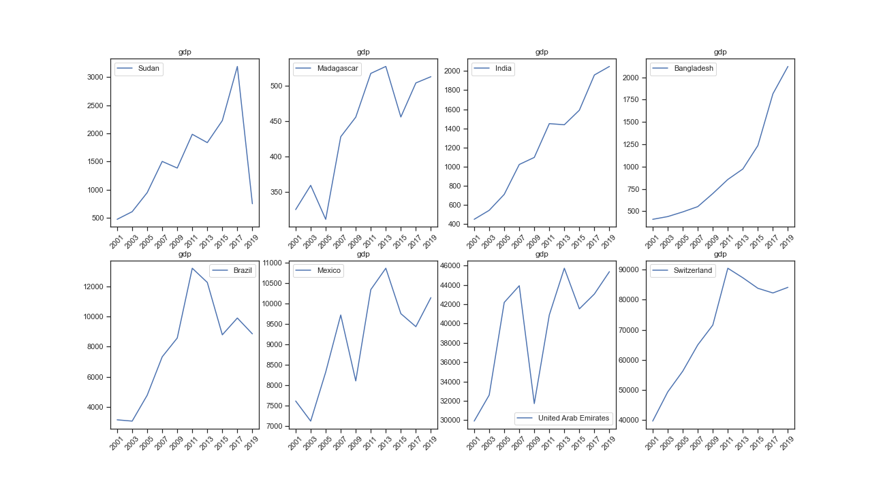
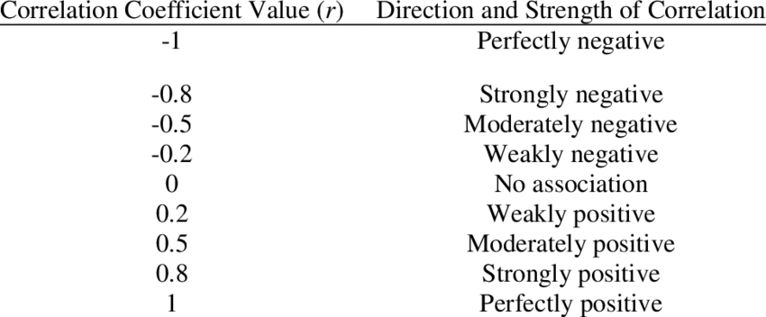
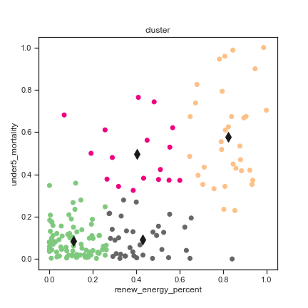
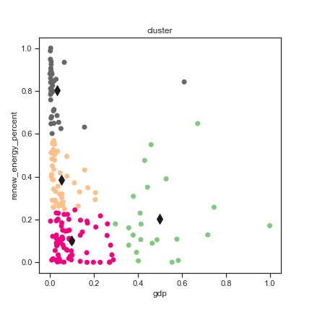
Climate change
Presented by: Sahana Muralidaran (21076516)
Course: MSc. Data Science (SW)
Introduction
Data Distribution
Data Distribution
Country’s development is affected by 10 main factors: Agriculture, International Trade, Culture, Economy, Education, Employment, Industrialization, Infrastructures, Politics, Health. Based on this we have taken a few factors for analysis like, Production of CO2 per capita, forest area, GDP, Percentage of renewable energy out of total energy usage, Mortality rate of children under 5 years of age, unemployment, urban population and access to electricity.
A countries economic growth is estimated using its GDP (Gross Domestic Product). Based on this, the countries are divided into 4 main categories: High income, High middle income, Low middle income and Low income. Based on these classifications, the data has been segregated.
Fig5: Subplots for mortality rate of children under 5 years
Factors affecting development
Fig3: Scatter matrix
The scatter matrix shows the correlation between various factors and they have been grouped into various clusters based on the income group.
Income group | Country Name
Low Income | Sudan
 | Madagascar
Lower Middle Income | India
 | Bangladesh
Upper Middle Income | Brazil
 | Mexico
High Income | United Arab Emirates
 | Switzerland
Below graphs shows the change in few of the above mentioned factors over the years for countries from different economic groups (as given in table).
Fig6: Subplots for percentage of renewable energy use out of total energy use.
Clustering
GDP vs mortality rate of children under 5
 | x | y
Centroid1 | 0.0191015 | 0.3937852
Centroid2 | 0.0102058 | 0.7596303
Centroid3 | 0.5034275 | 0.0156564
Centroid4 | 0.093203 | 0.0922623
GDP vs percent of renewable energy out of total energy
 | x | y
Centroid1 | 0.4987669 | 0.2045746
Centroid2 | 0.0504789 | 0.3853222
Centroid3 | 0.0993008 | 0.1002977
Centroid4 | 0.0314933 | 0.8030636
percent of renewable energy out of total energy vs mortality rate of children under 5
 | x | y
Centroid1 | 0.110041 | 0.085688
Centroid2 | 0.8231347 | 0.5785977
Centroid3 | 0.402792 | 0.4975469
Centroid4 | 0.4280993 | 0.0921706
Fig1: Heatmap
Fig7a: Cluster analysis, GDP vs mortality rate of children under 5
Fig4: Subplots for GDP
GDP of Mexico and UAE dropped from 2008 to 2009 due to the great recession and it recovered after 2009. GDP for Low middle income countries were not affected much and the continued to grow steadily over the years.
Fig2: Pearson Coefficient and its meaning
Fig7b: Cluster analysis, percent of renewable energy out of total energy
vs mortality rate of children under 5
Fig7c: Cluster analysis, GDP vs percent of renewable energy out of total energy

