Slide 1
FOOD WASTE RESCUE
AND DONATION SYSTEM
Project Presentation | Developed using Zoho Creator
Presented by: Sahana P
Register Number: 240701453
Department of Computer Science and Engineering
Rajalakshmi Engineering College

Slide 2
Introduction
1
Surplus food arises at restaurants, hotels, institutions and events.
The solution
The Food Waste Rescue and Donation System is a Zoho Creator application that records donors, donations, receivers, requests and deliveries in one place.
2
At the same time, individuals and organisations need food assistance.
3
Coordinating donors, receivers and delivery by phone and notebooks is slow and error-prone.

Slide 3
Problem Statement & Existing System
Problems faced
Existing system and limitations
No single place for donation information
Records duplicated across chats and sheets
Request status is often unclear
Admins must count and consolidate by hand
Donor calls a volunteer; details noted manually
Coordinator contacts receivers repeatedly
Delivery recorded separately
Hard to see available donations and pending requests together

Slide 4
Objectives
1
2
3
Maintain donor and receiver information in structured forms
Record surplus food: quantity, unit, preparation time, status
Let receivers submit requests linked to donations
4
5
6
Keep delivery records for allocated donations
Provide reports and a dashboard for monitoring
Reduce repeated communication with email workflows

Slide 5
Proposed System
A centralised application built on Zoho Creator
Donors register and submit surplus food details
Receivers register and request a donation
Each request is linked to a receiver and a donation
Delivery details and status are recorded
Administrators monitor reports and the dashboard
Who uses it
Donors
Receivers
Administrator
Coordinator

Slide 6
Technologies Used
1
Zoho Creator
2
Deluge
3
Creator Forms
Low-code platform used to build the application
Scripting for status updates and notifications
Capture and store donor, food, request data
4
Creator Reports
5
Page Builder
6
Workflows & Email
View and manage saved records
Administrative dashboard
Automate event-based notifications

Slide 7
System Architecture
1. User Layer
2. Application Layer
3. Data Layer
Donors
Receivers
Administrator
Coordinator
Zoho Creator forms
Reports and dashboard
Workflows
Deluge scripts
Donor records
Food donations
Receivers and requests
Delivery records
▶
▶

Slide 8
Main Modules
1
Donor Registration
Donor name, organisation, type, phone, email, city
2
Food Donation
Food, category, quantity, unit, preparation and safe-consumption time
3
Receiver Registration
Individuals or organisations that request food
4
Food Request
Receiver, donation, quantity, approval and collection status
5
Delivery Record
Volunteer, pickup and delivery time, quantity, status

Slide 9
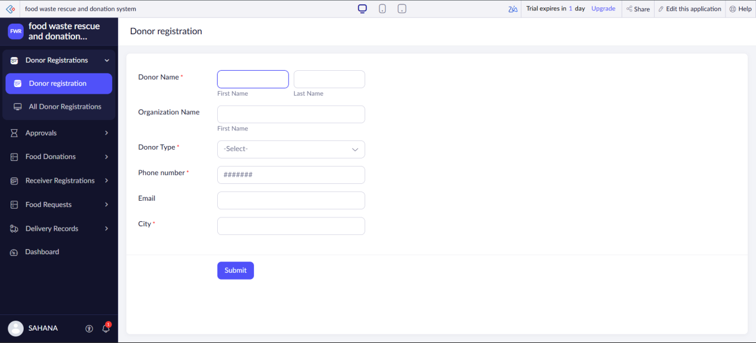
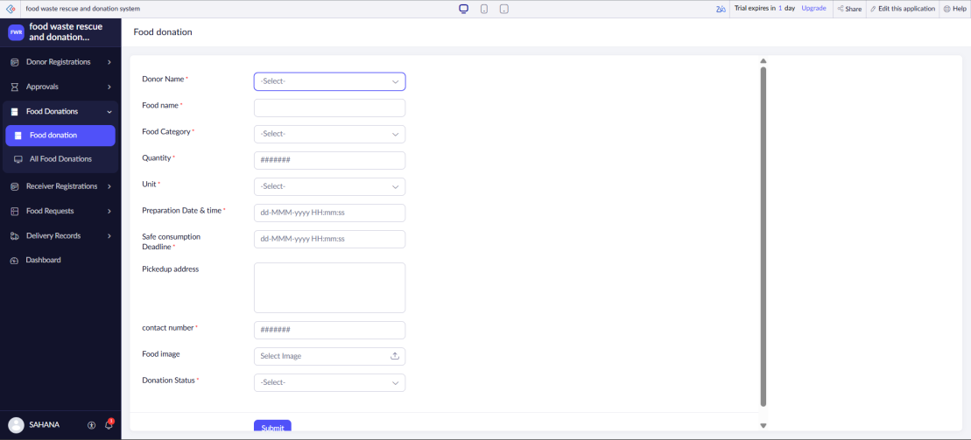
Key Modules: Donors & Donations
Donor Registration
Food Donation
Stores donor identity and contact details
Donor type separates individuals from organisations
Food, category, quantity, unit, pickup address
Safe-consumption deadline and donation status

Slide 10
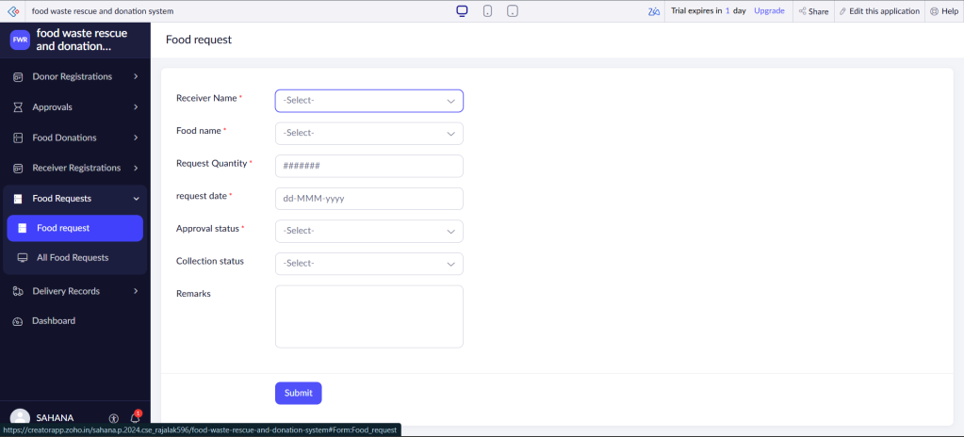
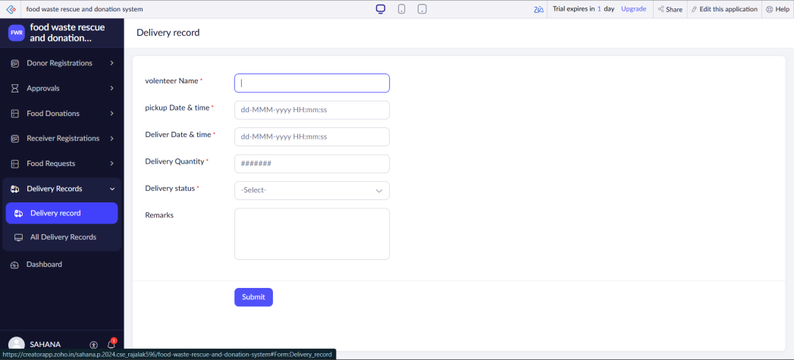
Key Modules: Requests & Delivery
Food Request
Delivery Record
Links a receiver to a donation
Tracks approval status and collection status
Volunteer, pickup and delivery date/time
Delivery quantity, status and remarks

Slide 11
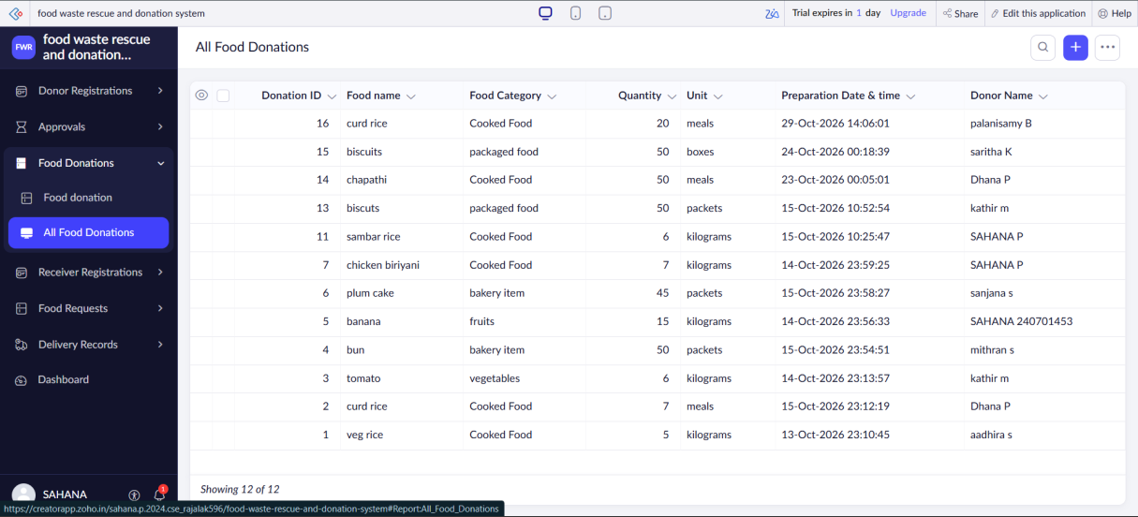
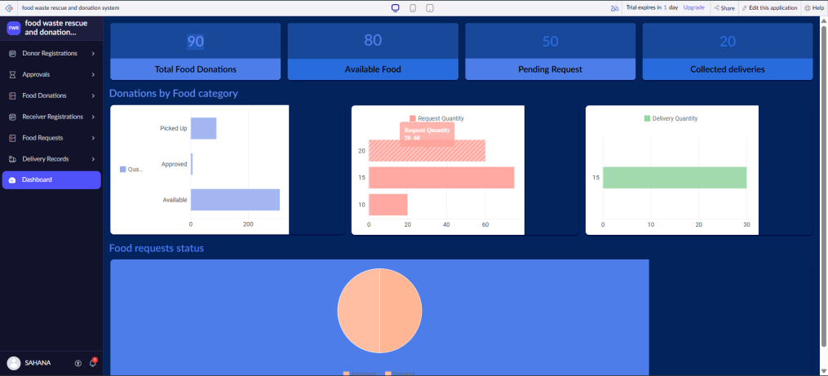
Reports & Admin Dashboard
Five reports
Page Builder dashboard
Donors, donations, receivers, requests, deliveries
KPI tiles and charts for donations and requests

Slide 12
Workflow and Process
1
2
3
▶
▶
Donor registers
Donor submits food donation
Receiver registers
4
5
6
▶
▶
Receiver requests a donation
Admin reviews / approves
Delivery recorded and status updated
Email notifications go to the administrator on a new donation and to the donor when a request is submitted.

Slide 13
Advantages & Future Enhancements
Advantages
Future enhancements
Centralised donation records
Clear donor-donation-request links
Admin overview in one dashboard
Less manual follow-up
Automatic donor-receiver matching
Location-based matching
SMS / WhatsApp notifications
Delivery tracking and expiry checks

Slide 14
Conclusion
A single Zoho Creator application for donation coordination
Connects donors, donations, receivers, requests and deliveries
Reports and dashboard give administrators a clear overview
Ready to grow with matching, location and notification features
THANK YOU | Questions?

