Slide 1
Keyword based exploration of Library Sources
PIP2001 Capstone Project
Review-0
Batch Number: CSG-G05
Under the Supervision of,
Dr. Manjula H M
Professor / Associate Professor / Assistant Professor
School of Computer Science and Engineering
Presidency University
Roll Number | Student Name
20211CSG0038 | Sunitha Gahana
20211CSG0037 | Amrutheshwari V S
20211CSG0003 | Sangeetha S K
20211CSG0017 | Sahana H
Name of the Program: B.Tech (Computer Science & Technology)
Name of the HoD: Dr. Saira Banu
Name of the Program Project Coordinator: Dr. Manjula H M
Name of the School Project Coordinators: Dr. Sampath A K / Dr. Abdul Khadar A / Mr. Md Ziaur Rahman

Slide 2
Content
Problem Statement
Analysis of Problem Statement
Timeline of the Project
References

Slide 3
Problem Statement Number: PSCS37
Organization : P.D.Hinduja Hospital & MRC
Category : Software
Problem Description: DNB students have to complete a dissertation/ thesis on a research topic for which they require library support. The students and their guides face challenges in searching and accessing relevant articles/ papers from the inhouse library. We want a software solution which will offer a platform that will download all the Indian and global references that are relevant to the students’ research topics.
Difficulty Level: Complex

Slide 4
Analysis of Problem Statement
Technology Stack Components:
Frontend (User Interface):
Framework: React.js or Angular.js (for building a responsive user interface).
Libraries: Bootstrap, Material UI (for designing user-friendly interfaces).
Backend (Server-Side Application):
Framework: Node.js, Django (for handling server logic).
API: RESTful or GraphQL (for communication between the frontend and backend).
Web Scraping and Automation: Python with libraries such as Scrapy, BeautifulSoup, and Selenium to automate the process of fetching references and papers.
Database:
SQL Database: MySQL (for structured data like user information, references).
NoSQL Database: MongoDB (for flexible and large-scale unstructured research data).
Authentication: JWT, OAuth (for secure user authentication).

Slide 5
Analysis of Problem Statement
Third-Party APIs:
Accessing Digital Libraries: APIs for major research paper databases like IEEE Xplore, Google Scholar, or open-access libraries.
Cloud Hosting & DevOps:
Hosting Platforms: AWS, Google Cloud, or Microsoft Azure (to deploy and host the application).
Version Control & CI/CD: GitHub, GitLab, Jenkins (for continuous integration and development).
Data Storage:
Cloud Storage: AWS S3, Google Cloud Storage (for storing large research papers and files).
File Processing: Pandas, NumPy (for large file processing and metadata extraction).

Slide 6
Analysis of Problem Statement (contd...)
Software Requirements:
Development Tools:
IDEs like Visual Studio Code, PyCharm, or Sublime Text (for development).
JIRA or Trello (for project management and issue tracking).
Libraries/Frameworks:
Research Libraries APIs: Integration with libraries like PubMed, IEEE, or Scopus.
NLP Libraries: For content summarization and tagging, use spaCy or Natural Language Toolkit (NLTK).
Security:
Secure authentication using OAuth2.
HTTPS and SSL certificates for secure data transmission.

Slide 7
Analysis of Problem Statement (contd...)
Hardware Requirements:
Development and Deployment Servers:
Minimum: 2-4 CPU cores, 8-16 GB RAM, 500 GB SSD storage for development environments.
Backup and Redundancy: Cloud backup with redundancy to ensure no data loss.
Networking: Reliable internet connection, firewall protection, load balancing.

Slide 8
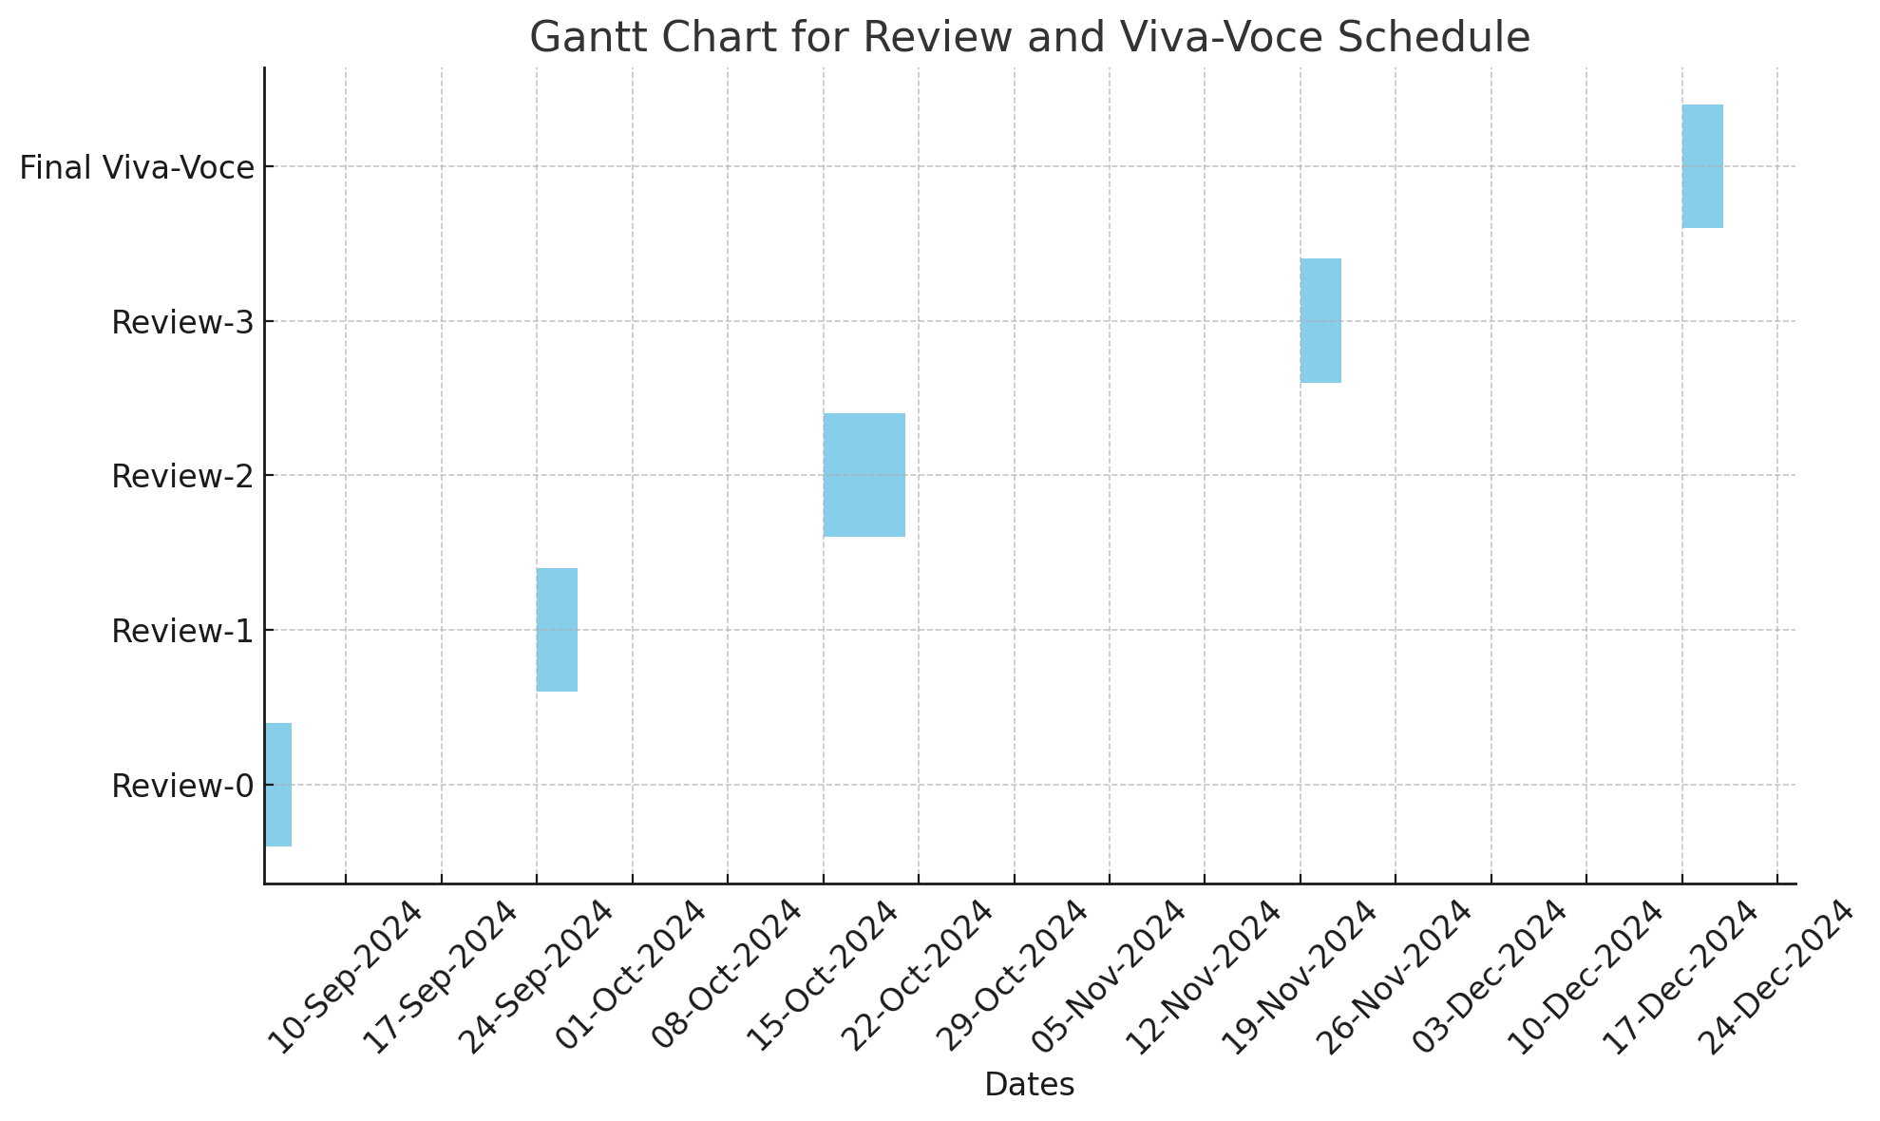
Timeline of the Project (Gantt Chart)

Slide 9


