Slide 1
Keyword based exploration of Library Sources
PIP2001 Capstone Project
Review-1
Batch Number: CSG-05
Roll No | Name
20211CSG0003 | Sangeetha S K
20211CSG0017 | Sahana H
20211CSG0037 | Amrutheshwari V S
20211CSG0038 | Sunitha Gahana
Under the Supervision of,
Dr. Manjula HM
Professor / Associate Professor / Assistant Professor
School of Computer Science and Engineering
Presidency University
Name of the Program: B.Tech (Computer Science & Technology)
Name of the HoD: Dr. Saira Bhanu
Name of the Program Project Coordinator:
Name of the School Project Coordinators: Dr. Sampath A K / Dr. Abdul Khadar A / Mr. Md Ziaur Rahman

Slide 2
Introduction
DNB (Diplomate of National Board) students in the medical field are required to complete a dissertation or thesis on a specific research topic. This process involves accessing a vast array of scholarly articles, research papers, and references from both Indian and global sources. However, many students and their mentors face significant challenges in effectively searching for and retrieving these resources due to limitations in library infrastructure and the availability of digital resources. The goal of this project is to design and develop a platform that provides comprehensive library support, allowing students to easily access, download, and manage research papers that are crucial to their academic work.
This platform is intended to bridge the gap between students and research resources by simplifying the search and retrieval process, thereby saving time and improving the quality of research.

Slide 3
Literature Review
In modern education, particularly in research-oriented fields, access to a robust library system is essential. Studies have shown that limited access to research materials can negatively impact the quality and efficiency of student research. Digital library systems such as Google Scholar and PubMed have transformed research but have limitations when it comes to access to paid content or region-specific resources.
For medical students, particularly those pursuing advanced degrees like DNB, the need for a system that aggregates resources from both Indian and global repositories is critical. Existing digital libraries offer limited access to Indian medical literature and are often not integrated with institutional repositories. This results in students facing a fragmented search experience, requiring multiple logins and manual downloads of papers from different platforms.

Slide 4
Existing method Drawback
Existing library systems like PubMed, Scopus, and Google Scholar provide access to a range of research papers, but these systems are limited by several key drawbacks:
Access to Paid Content: Many important research papers are behind paywalls, requiring costly subscriptions.
Lack of Region-Specific Focus: Current systems are primarily global and lack an emphasis on India-specific research that is crucial for DNB students.
Fragmented Search Results: Students often need to visit multiple websites to retrieve all relevant references, resulting in inefficiency.

Slide 5
Proposed Method
The proposed solution, ResearchNest, aims to create an integrated digital library platform tailored to DNB students. The platform will combine resources from both Indian and international repositories, ensuring easy access to relevant references in a single place. The key features include:
Unified Search Engine: Results from multiple databases, including Indian journals and global sources.
Advanced Filtering Options: Custom search options based on thesis requirements, enabling users to filter by topics, publication years, and regions.
Reference Management: Integrated tools for managing downloaded references and generating citations.

Slide 6
Objectives
To create a digital platform that offers a unified search experience for DNB students.
To integrate Indian and global research repositories, allowing seamless access to both.
To provide students with advanced filtering and citation management tools.
To reduce the time and effort required to collect and organize research materials.

Slide 7
Methodology/Modules
The platform will be developed using HTML, CSS, and JavaScript for the frontend, with a backend infrastructure that supports database aggregation. Key modules will include:
User Registration & Authentication: Secure login for students and guides.
Search Module: Implements the unified search engine across multiple repositories.
Filtering & Sorting Module: Allows users to refine search results based on topics, geography, etc.
Download & Management Module: Enables the user to download papers and organize them within the platform.

Slide 8
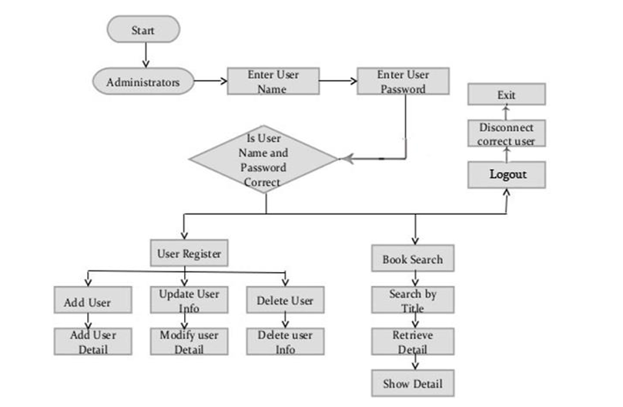
Architecture

Slide 9
Hardware/software components
Hardware:
Server with sufficient storage and processing power to manage user requests.
Secure hosting solution.
Software:
HTML, CSS, JavaScript for the frontend.
Node.js/Python for backend services.
MySQL for database management.
APIs for integrating external libraries.

Slide 10
Timeline of Project
S.NO | Review | Dates
1 | Review-0 | September
2 | Review-1 | October
3 | Review-2 | November
4 | Review-3 | December
5 | Final Viva-Voce* | December

Slide 11
Expected Outcomes
Ease of Access: Students will be able to easily access all relevant references, papers, and articles in one platform.
Time Efficiency: The platform will reduce the time required for searching and organizing research materials.
Enhanced Research Quality: By simplifying access to comprehensive research resources, the platform will improve the quality of student theses.

Slide 12
Conclusion
In conclusion, the ResearchNest platform aims to address the gaps faced by DNB students and their guides by providing a user-friendly digital library system.
With a focus on medical research and integrating both Indian and global resources, this platform has the potential to significantly improve the research process for students. By simplifying access, providing advanced filtering options, and reference management tools, ResearchNest will be an essential resource in the academic journey of DNB students.

Slide 13
Github Link
GitHub Link

Slide 14
References
Digital Library Systems:
Suber, P. (2012). Open Access. MIT Press.
Arms, W. Y. (2000). Digital Libraries. MIT Press.
Research Database Integration:
Google Scholar: https://scholar.google.com/
PubMed: https://pubmed.ncbi.nlm.nih.gov/
Scopus: https://www.scopus.com/
The New England Journal of Medicine: https://www.nejm.org/

Slide 15
Thank You

