Slide 1
COVID-19 High alert zones
An analysis of the neighbourhoods in Toronto to help Toronto Police Department fight against the virus outspread

Slide 2
INTRODUCTION
Location : Toronto, Canada
Toronto Police Department
Strategic Plan and Overview
Problem : To identify the neighbourhoods in the city which are highly prone to have a virus outspread.
Neighbourhood with high population and more busy venues
Success criteria: The classification into priority zones should be advantageous and easy to analyse.
It should have the capability to enable new information whenever available

Slide 3
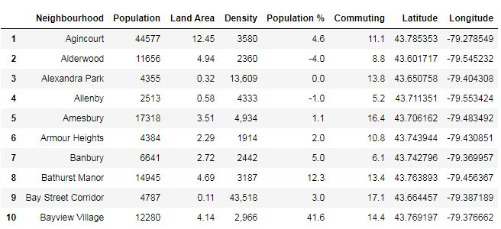
DATA DESCRIPTION
Data sources :
Wikipedia pages
Foursquare.com
Data preprocessing:
The Data needs to be cleaned
The data must be structured to the suitable format
Data Requirements:
Neighbourhood information ( Name, coordinates, population)
Venue information ( name, coordinates)

Slide 4
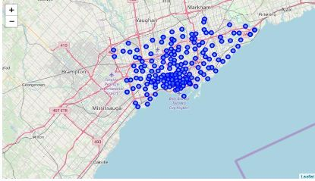
METHODOLOGY
Data scrapping technique:
To scap the neighbourhoods data from the wikipedia page
Structure the scrapped data
Foursquare.com
Retrieving venue information from the API
K-means Clustering :
Machine learning classification technique
segment and cluster similar neighbourhoods
grouping based on most common venues
Scoring weightage:
50% each for population and the common venues in the neighbourhood

Slide 5
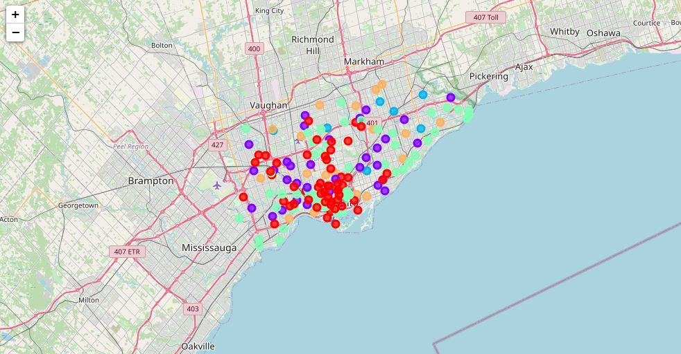
RESULT
Clustering the neighbourhoods:
Clustering the neighbourhoods based on the most common venues
Total score:
A score is calculated for each neighbourhood based on the venue score ( based on the top 10 common venues) and the normalised population score.
Higher the score, higher the virus outspread threat
High priority cluster:
The clusters obtained as the result help in indicating the priorities of the clusters

Slide 6
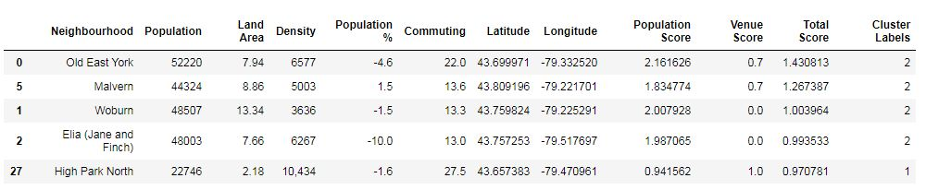
DISCUSSION
Result review:
the top high priority zones are identified with respect to the total score generated. According to the total score, the top 5 high priority zones are: Old East York, Malvern, Woburn, Elia(Jane & Finch) and High Park North.
The third cluster has the highest scores, hence it has to be prioritised.
Other observations:
The top neighbourhoods of each cluster could also be considered as virus hotspots, since they are the ones with high population and also more busy venues.
The zones can be assigned as per the clusters formed: Red zone: Cluster 2,3 and 5 Orange zone: Cluster 1 and 4

Slide 7
CONCLUSION
Analysis summary:
the top 5 high priority zones are: Old East York, Malvern, Woburn, Elia(Jane & Finch) and High Park North
Red Zone: Cluster 2,3 and 5
Orange Zone: Cluster 1 and 4
Additional note:
Rerun of program is encouraged to get the latest information.
Updated or additional information on the infected people in each neighbourhood will help analyze better.
Acknowledgement:
Appreciation notes from the Data Science team for this project

