Slide 1

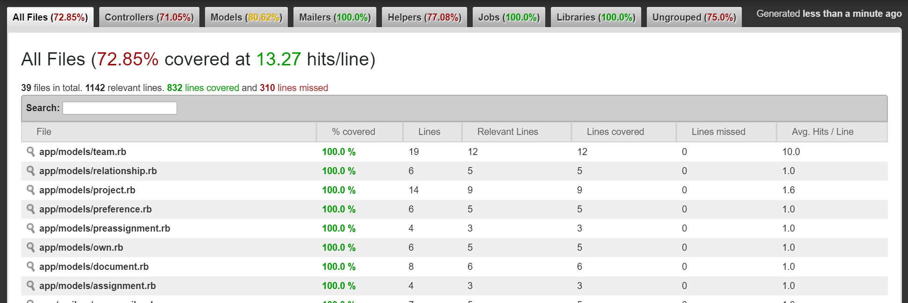
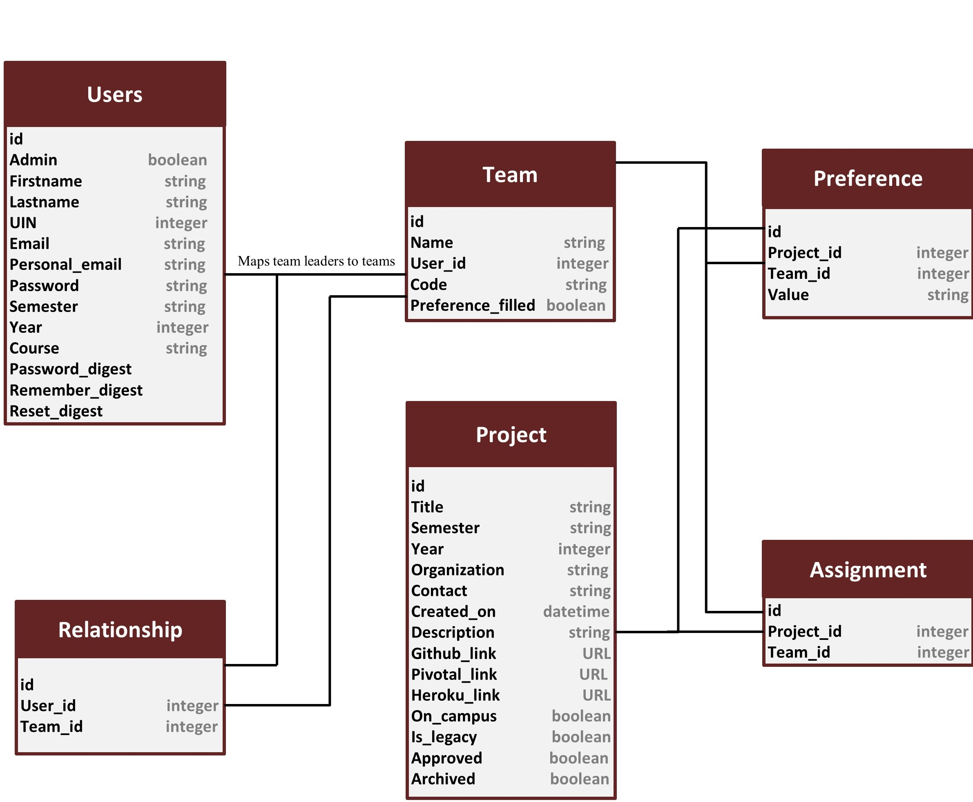
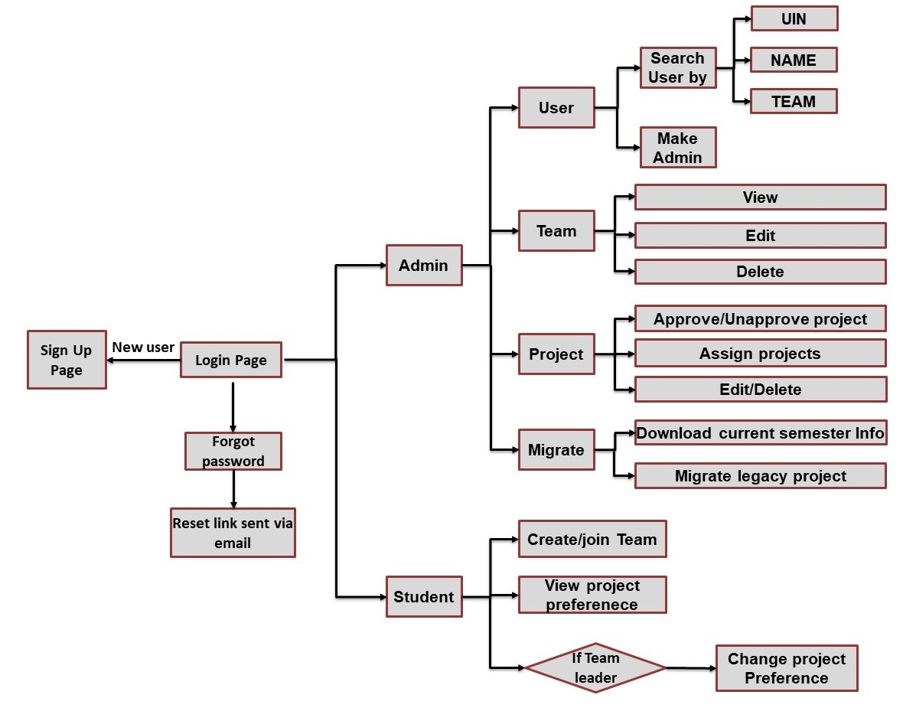
https://docs.google.com/presentation/d/1Nv9ELeEsZ7e9uPmnDuBfIr
CSCE 606 Project Collection and Assignment
Abishalini Sivaraman, Abraham Gerard Sebastian, Akansha Agarwal, Aurosmita Khansama, Harish Kumar, Sahan Suresh Alva, Vaishnavi Chauhan
Introduction
Features
Test Coverage
Application Objective -
Manage formation of teams.
Assign projects to team according to preferences .
Allow admin to easily modify team and project details.
Allow admin to easily transition data across semesters.
Customer - Dr. Hank Walker (CSCE 436/606 Instructor)
Stakeholders -
Course Instructor
Course TAs
Student of CSCE 436/606
New Features -
Search and Sort users by UIN, Name or Team.
Included Personal Email attribute to each User.
Semester Migration along with an option to download semester information in an excel sheet.
Granting and revoking admin privileges.
All students and admin can view their team’s project preferences(Only leader can edit, prior to assignment).
Fixes to Old Features -
Password Reset via email.
Removed login using NETID.
Teams with students and assigned projects cannot be deleted.
Original Code Coverage was at 35%, we fixed old tests and included new tests for every feature pushed.
New coverage is as shown below:
Database Schema
User Stories
Flowchart
current semester
As a Student,
I want to reset my password
so that I have an alternate way to login when I forget my password.
As an Admin,
I want to search and sort student’s information
so that I can find/edit information of a particular student.
As a Team Member,
I want to see the project selections
so that I can view the projects chosen by the team leader.
As an Admin,
I want to grant/revoke admin privileges to new users
so that I can have multiple admins and share work with the TAs.
As a Team Leader,
I want the capability to modify project preferences
so that I can change my preferences after the initial selection if required.
As an Admin,
I want to migrate to a new semester and download all information for current semester
so that I can save time and easily update the application for the new semester.

Slide 2
Introduction
Application Objective -
Manage formation of teams.
Assign projects to team according to preferences .
Allow admin to easily modify team and project details.
Allow admin to easily transition data across semesters.
Customer - Dr. Hank Walker (CSCE 436/606 Instructor)
Stakeholders -
Course Instructor
Course TAs
Student of CSCE 436/606

Slide 3
TDD/BDD Coverage
Original Code Coverage was at 35%, we fixed old tests and included new tests for every feature pushed.
New coverage is as shown below:

Slide 4
Features
New Features -
Search and Sort users by UIN, Name or Team.
Included Personal Email in User data.
Semester Migration along with an option to download semester information in an excel sheet.
Granting and revoking admin privileges.
All students and admin can view their team’s project preferences(Only leader can edit, prior to assignment).
Fixes to Old Features -
Password Reset via email.
Removed login using NETID.
Teams with students and assigned projects cannot be deleted.

Slide 5
Database Schema

Slide 6
User Stories
current semester
As a Student,
I want to reset my password
so that I have an alternate way to login when I forget my password.
As an Admin,
I want to search and sort student’s information
so that I can find/edit information of a particular student.
As a Team Member,
I want to see the project selections
so that I can view the projects chosen by the team leader.
As an Admin,
I want to grant/revoke admin privileges to new users
so that I can have multiple admins and share work with the TAs.
As a Team Leader,
I want the capability to modify project preferences
so that I can change my preferences after the initial selection if required.
As an Admin,
I want to migrate to a new semester and download all information for current semester
so that I can save time and easily update the application for the new semester.

Slide 7
Flowchart

Slide 8
https://docs.google.com/presentation/d/1Nv9ELeEsZ7e9uPmnDuBfIr
CSCE 606 Project Collection and Assignment
Abishalini Sivaraman, Abraham Gerard Sebastian, Akansha Agarwal, Aurosmita Khansama, Harish Kumar, Sahan Suresh Alva, Vaishnavi Chauhan
Introduction
Features
TDD/BDD Coverage
Application Objective -
Manage formation of teams.
Assign projects to team according to preferences .
Allow admin to easily modify team and project details.
Allow admin to easily transition data across semesters.
Customer - Dr. Hank Walker (CSCE 436/606 Instructor)
Stakeholders -
Course Instructor
Course TAs
Student of CSCE 436/606
New Features -
Search and Sort users by UIN, Name or Team.
Included Personal Email in User data.
Semester Migration along with an option to download semester information in an excel sheet.
Granting and revoking admin privileges.
All students and admin can view their team’s project preferences(Only leader can edit, prior to assignment).
Fixes to Old Features -
Password Reset via email.
Removed login using NETID.
Teams with students and assigned projects cannot be deleted.
Original Code Coverage was at 35%, we fixed old tests and included new tests for every feature pushed.
New coverage is as shown below:
Database Schema
User Stories
Flowchart
current semester
As a Student,
I want to reset my password
so that I have an alternate way to login when I forget my password.
As an Admin,
I want to search and sort student’s information
so that I can find/edit information of a particular student.
As a Team Member,
I want to see the project selections
so that I can view the projects chosen by the team leader.
As an Admin,
I want to grant/revoke admin privileges to new users
so that I can have multiple admins and share work with the TAs.
As a Team Leader,
I want the capability to modify project preferences
so that I can change my preferences after the initial selection if required.
As an Admin,
I want to migrate to a new semester and download all information for current semester
so that I can save time and easily update the application for the new semester.

