Slide 1
HR ANALYTICS DASHBOARD
Understanding Employee Attrition Through Data
SQL • Python • Power BI | 1,470 Employee Records

Slide 2
The Business Problem
Replacing an employee typically costs 50–200% of their annual salary. This project analyzes 1,470 employee records to find out who is leaving, why, and who is likely to leave next.
1
2
3
Which departments and roles
have the highest attrition?
What factors most strongly
predict an employee leaving?
Which active employees are
at risk of leaving next?
HR Analytics Dashboard | 2

Slide 3
Tools & Process
1
2
3
4
Data Cleaning
→
SQL Analysis
→
Python (EDA)
→
Power BI Dashboard
Removed 3 constant columns,
fixed data types, verified
no missing values
10+ queries calculating KPIs,
attrition breakdowns, and
high-risk employee lists
Pandas + Seaborn for
correlation analysis and
distribution charts
Two-page interactive
dashboard with KPI cards,
charts, and slicers
HR Analytics Dashboard | 3

Slide 4
Key Metrics
1,470
16.1%
$6,503
2.73 / 4.0
Total Employees
Attrition Rate
Avg Monthly Income
Avg Satisfaction
1,470 employees analyzed → 237 left → 1,233 remain active
HR Analytics Dashboard | 4

Slide 5
Finding 1 — Overtime Drives Attrition
3×
higher attrition for employees
working overtime
Action: review workload distribution and staffing levels in teams with high overtime hours.
HR Analytics Dashboard | 5

Slide 6
Finding 2 — Sales Reps Are Highest Risk
Sales Representative
39.8%
attrition rate — the highest of any role in the dataset, nearly 4 in 10 Sales Reps leave
Research Director sits at the opposite extreme — just 2.5% attrition, the lowest of any role.
HR Analytics Dashboard | 6

Slide 7
Finding 3 — Pay Gap & Early Departures
Avg Monthly Income
Avg Years at Company
HR Analytics Dashboard | 7

Slide 8
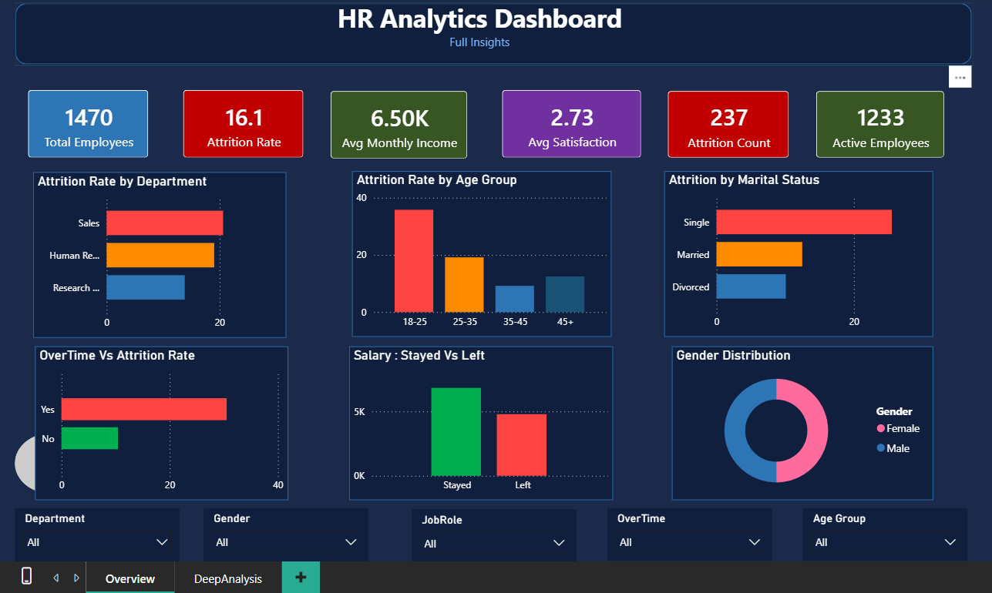
The Dashboard
Two interactive Power BI pages — Overview and Deep Analysis
HR Analytics Dashboard | 8

Slide 9
Recommendations
High
Review overtime policy
Across all departments, especially Sales
High
Salary benchmarking
For Sales Representatives and Lab Technicians
Medium
Strengthen onboarding
Most attrition happens in the first 2–3 years
Medium
Engagement for single employees
25.5% attrition vs 10.1% for divorced employees
HR Analytics Dashboard | 9

Slide 10
Skills Demonstrated
Data Cleaning
SQL Analysis
KPI Reporting
Dashboard Design
Python (EDA)
Business Storytelling
github.com/yourusername/HR-Analytics-Dashboard

