Slide 1
SALES INSIGHT DASHBOARD
Tracking Revenue, Zones & Payment Behavior Since 2022
Power BI • DAX • Data Modeling | 122.86K Transactions • ₹29M Revenue

Slide 2
The Business Problem
Business users needed a single, interactive view to monitor revenue performance, zone-level trends, and payment behavior across 14 billing locations and 89 sales representatives.
1
2
3
How is revenue trending
year-over-year vs target?
Which zones and locations
are over/under-performing?
How do customers prefer to
pay, and who sells the most?
Sales Insight Dashboard | 2

Slide 3
Key Metrics
14
122.86K
₹29M
89
Billing Locations
Billing Transactions
Total Payment Amount
Sales Representatives
₹9,611,572
+92.23%
achieved vs ₹5,000,000 goal
above target
Sales Insight Dashboard | 3

Slide 4
Finding 1 — HO Zone Leads by a Wide Margin
13x
the gap between HO (₹14.6M) and East (₹1.1M) — the highest and lowest performing zones
HO alone accounts for nearly half of total zone revenue, more than West and South combined.
Sales Insight Dashboard | 4

Slide 5
Finding 2 — Phone Pay Dominates Transactions
51%
of all payment volume comes through Phone Pay — the clear preferred channel among customers
Card follows at 33.8% and Cash at 15.19% — together, digital payment methods (Phone Pay + Card) make up nearly 85% of all transactions.
Sales Insight Dashboard | 5

Slide 6
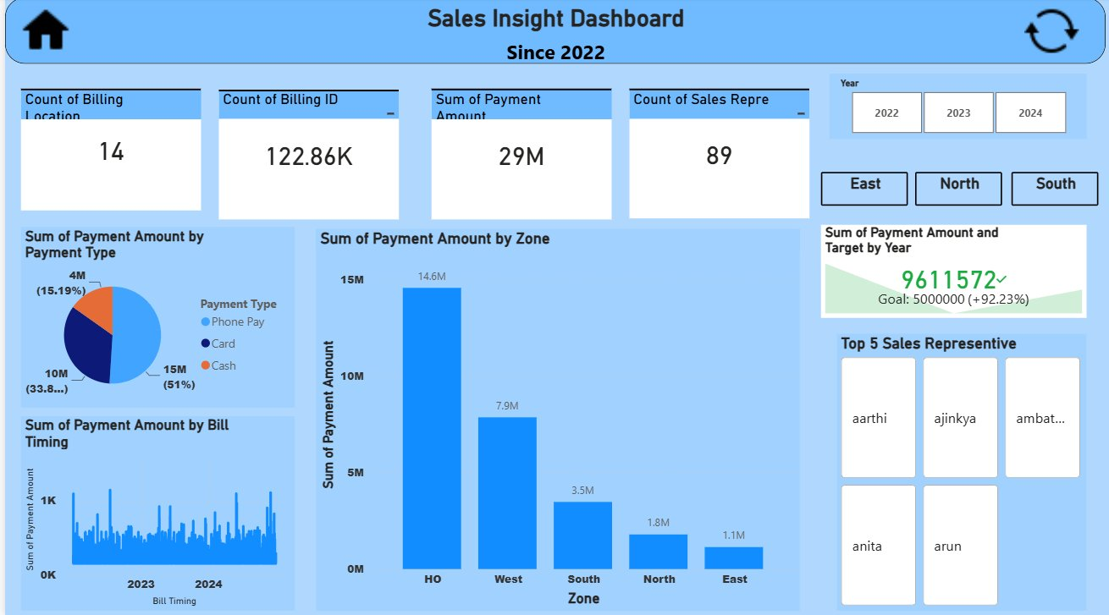
The Dashboard
Interactive Power BI report with year and zone filtering
Sales Insight Dashboard | 6

Slide 7
Tools & Process
1
2
3
Data Modeling
→
DAX Measures
→
Dashboard Design
Connected Sales Data, Location
Data, Customer Data, and
calendar tables
Built measures for payment
totals, targets, and year-over-
year comparisons
KPI cards, charts, and zone/
year filters for an interactive
single-page view
Sales Insight Dashboard | 7

Slide 8
Skills Demonstrated
Power BI
DAX Measures
Data Modeling
KPI Reporting
Data Visualization
Business Storytelling
github.com/yourusername/Sales-Insight-Dashboard

