Slide 1


EEG Signal Acquisition and alert system for Sleeping disorder patients using RISC-V Processor on FPGA
Review-I
AY 2025-26
Capstone Project – Introduction (PROJ2999)
GITAM (Deemed-to-be) University
Department of Electrical Electronics and Communication Engineering
Project Team:
H Sahana – BU22EECE0100475
Priyanka G-BU22EECE0100446
Project Mentor:
Dr M Arun Kumar
Project In-charge:
Dr Subhashish Tiwari
www.gitam.edu

Slide 2
Objective and Goals
Objective
Acquire brainwave signals (EEG) using external electrodes and preprocess them (filtering, noise removal, amplification) for reliable input into the FPGA-based RISC-V processor.
To implement real-time EEG signal analysis (e.g., detection of abnormal patterns like sleep apnea or insomnia indicators) using a RISC-V processor on FPGA for faster computation compared to software-only methods.
To design an alert mechanism (visual via LEDs/7-segment display or auditory via buzzer) that notifies caregivers or patients in case of detected abnormalities in EEG patterns related to sleeping disorders.
Goals
Main Goals:
Capture and process EEG signals in real time using an FPGA-based RISC-V processor.
Detect abnormal brainwave patterns linked to sleep disorders (apnea, insomnia).
Provide timely visual/audio alerts to patients or caregivers to prevent risks.
Additional Goals:
Ensure low-power and cost-efficient design for continuous patient monitoring.
Enable easy data logging and visualization for doctors to support diagnosis.

Slide 3
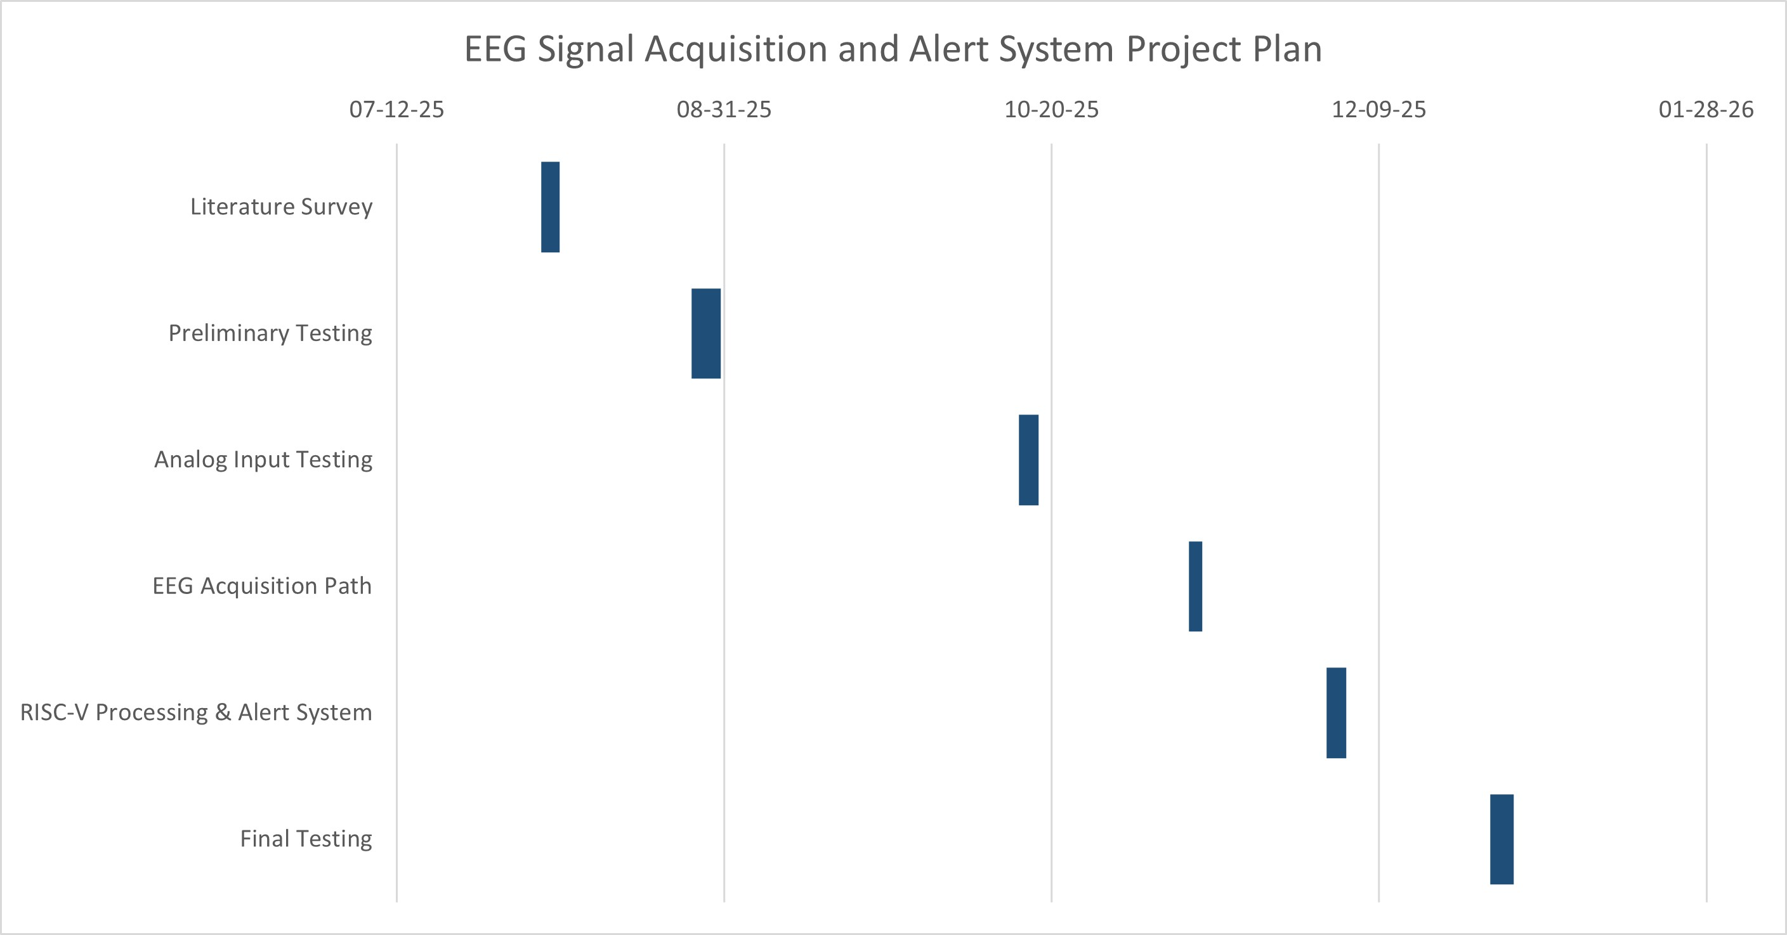
Project Plan (Clearly mention milestone for objectives under each reviews)

Slide 4
Literature Survey
Key Publications
Krithiga Sree, R., & Somasundareswari, D. (2024). Sleep Apnea Detection Based on FPGA Using EEG Signals. IRJMET, Vol. 6, Issue 7
de Chazal, P., et al. (2003). Automatic classification of sleep apnea from ECG signals. IEEE Transactions on Biomedical Engineering.
Seo, H., et al. (2020). Sleep quality assessment using wearable ECG-based monitoring.
Naveed, M. Z., Amar, M., Hussain, A., & Awan, Z. A. (2024). Design & Implementation of 5-Stage 32-bit RISC-V Pipeline Processor on FPGA. 9th MDSRIC, Pakistan
Ngu Teck Joung, D. (2023). Design and Simulate RISC-V Processor using Verilog. Master’s Dissertation, Universiti Tunku Abdul Rahman
Khairullah, S. S. (2022). Hardware realization of a 5-stage 16-bit RISC processor on FPGA.
Key Resources – Whitepaper| Application Notes | Datasheet| Others
Xilinx Vivado Design Suite Documentation (for simulation and FPGA synthesis).
Xilinx Vivado Documentation for FPGA-based implementation.
Existing Implementations – Products| Opensource| GitHub etc
Open-source RISC-V cores on GitHub (https://github.com/riscvarchive/riscv-cores-list)
Wearable EEG headbands (e.g., Muse, Emotiv).

Slide 5
Sl.no | Title | Methodology | Significance | Research Gaps
01 | "Design & Implementation of 5-Stage 32-bit RISC-V Pipeline Processor on FPGA" | A 5-stage pipelined RISC-V processor is designed with instruction fetch, decode, execute, memory access, and write back stages. A hazard detection unit is used to prevent pipeline hazards like data dependencies and stalls. A static branch predictor addresses branch instructions to enhance performance. The design is in Verilog, simulated in Vivado, and implemented on a ZedBoard Zynq FPGA | The design uses a free and open-source RISC-V ISA. Pipelining and branch prediction enhance the processor's efficiency and speed by reducing clock cycles per instruction (CPI). The project is a guide for beginners on processor architecture and Verilog coding | Future work should Improve branch prediction accuracy. The authors suggest advancing the RISC-V ecosystem by exploring multi-core pipeline designs and enhancing memory access.
02 | "DESIGN AND SIMULATE RISC-V PROCESOR USING VERILOG" | A 32-bit RISC-V processor is designed and simulated using Verilog, implementing a 5-stage pipeline. Key modules like ALU, memory (imem, dmem), and a register file are included. A hazard unit is implemented to mitigate hazards. The design's functionality is verified using ModelSim | The free and open RISC-V ISA provides a great alternative for designers, reducing barriers in the semiconductor industry. The 5-stage pipeline design is used to increase the processor's efficiency by executing multiple instructions simultaneously. | Future work could focus on improving branch prediction accuracy. The design can be improved by implementing different extensions to the base integer instruction set. Exploring different cache architectures and memory hierarchies is suggested to reduce memory access time

Slide 6
03 | "SLEEP APNEA DETECTION BASED ON FPGA USING EEG SIGNALS" | EEG signals from the UCDDB database are preprocessed and band-decomposed into five frequency sub-bands. Features like energy, mobility, and kurtosis are extracted from these sub-bands. A Linear Support Vector Machine (LSVM) classifier is used to distinguish between apnea and non-apnea episodes. The model's parameters are then implemented on an Artix-7 FPGA | The system achieves an impressive performance with a highest accuracy of 94.81%. It is energy-efficient, with a minimal dynamic power usage of 19mW. The hardware can be integrated into a wearable device for automated sleep apnea detection | The authors suggest connecting a wireless headset band for EEG recordings with an FPGA to improve comfort and efficiency
04 | "EEG Signal Processing for the Identification of Sleeping Disorder Using Hybrid Deep Learning with Ensemble Machine Learning Classifier" | EEG signals from the Sleep-EDF database are collected and preprocessed to remove noise and artifacts. A hybrid deep learning framework (CNN) and an ensemble machine learning classifier are used for detection. The approach combines CNN with classifiers like Random Forest, KNN, and XGBoost | The hybrid model achieves high accuracy (96.78%) and sensitivity (89.06%), outperforming conventional methods. The use of CNNs effectively extracts high-level features from EEG signals, while the ensemble learning improves generalization and reduces overfitting. | The model should be tested on larger and more varied datasets, including real-world clinical data. Further research is needed to understand the specific EEG characteristics thatcontribute tothehybridmodel's classification.

Slide 7
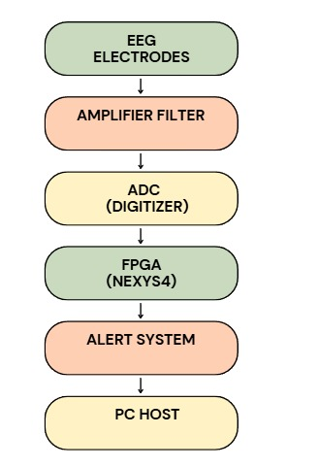
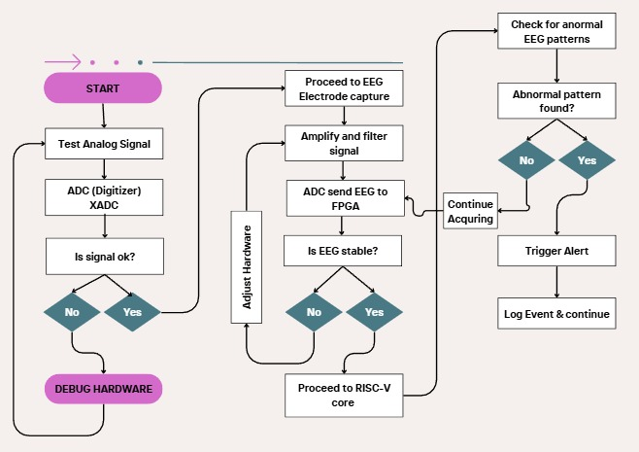
Architecture
Structural Diagram
Behaviour Diagram

Slide 8
Use Cases & Testing
Use Cases:
Use Case 1 — EEG Signal Acquisition
Goal: Capture brain signals and send them to FPGA.
Electrodes pick up EEG signals → amplifier filters noise → ADC converts to digital → FPGA receives.
Use Case 2 — FPGA Pre-Processing
Goal: Clean and store the EEG signal
FPGA receives samples → applies smoothing/threshold → stores them in FIFO or memory.
Use Case 3 — Sleep Disorder Detection
Goal: Detect abnormal patterns using RISC-V
FPGA sends processed samples → RISC-V identifies apnea, seizure, or abnormal activity → triggers alert.
Use Case 4 — Alert Generation
Goal: Notify user or doctor.
If abnormal EEG detected → buzzer/LED lights → notification sent through UART/USB.
Test Cases :
Test Case 1 – ADC Input Verification
Input: 0.5–1 V signal from function generator
Output:
FPGA shows stable waveform, correct digital sample values..
Test Case 2 – Noise Filter Verification
Input: Noisy sine wave
Expected Output:
Filtered output is smoother, noise reduced.
Test Case 3 – RISC-V Processing
Input: Stream of digital samples
Expected Output:
RISC-V predicts "normal" or "abnormal" based on logic.

Slide 9
Implementation and Results – Iteration 1
Implementation – Iteration 1
● Configured FPGA infrastructure: LEDs, switches, push buttons, 7-segment display
.
● Implemented clock divider for timing control.
● Mapped digital input signals (switches/buttons) → FPGA outputs (LEDs/7-segment).
● Verified functionality through simulation and on-board testing.
Results – Iteration 1
● FPGA synthesized and programmed successfully with no errors.
● Switches and buttons correctly controlled LEDs and 7-segment display.
● Digital signal flow validated from inputs → FPGA logic → outputs.
● Outcome: FPGA infrastructure is ready for sensor interface integration in Iteration 2

Slide 10
Implementation and Results – Iteration 2
Implementation – Iteration 2 (Analog Signal → FPGA → XADC Testing)
Established analog input interface on Nexys-4 using AD1P (VAUXP1) and AD1N (VAUXN1) pins.
Connected function generator + oscilloscope + FPGA with proper grounding to validate the analog input waveform.
Instantiated XADC core in Vivado and configured to sample Channel VAUXP1/VauxN1.
Developed Verilog module to acquire XADC 12-bit output and monitor it on LEDs / 7-segment display.
Verified correct sampling frequency, stable ADC output, and synchronization with system clock.
Results – Iteration 2
Proper analog waveform (0 – 1V) observed on oscilloscope, confirming safe signal range for XADC.
XADC successfully converted the input waveform into stable 12-bit digital values.
LEDs / 7-segment displayed real-time changes in waveform amplitude.
Function generator, oscilloscope, and FPGA were all synchronized and working correctly.
Outcome: Complete analog signal acquisition pipeline is validated, ready for EEG sensor integration in final stage.

Slide 11
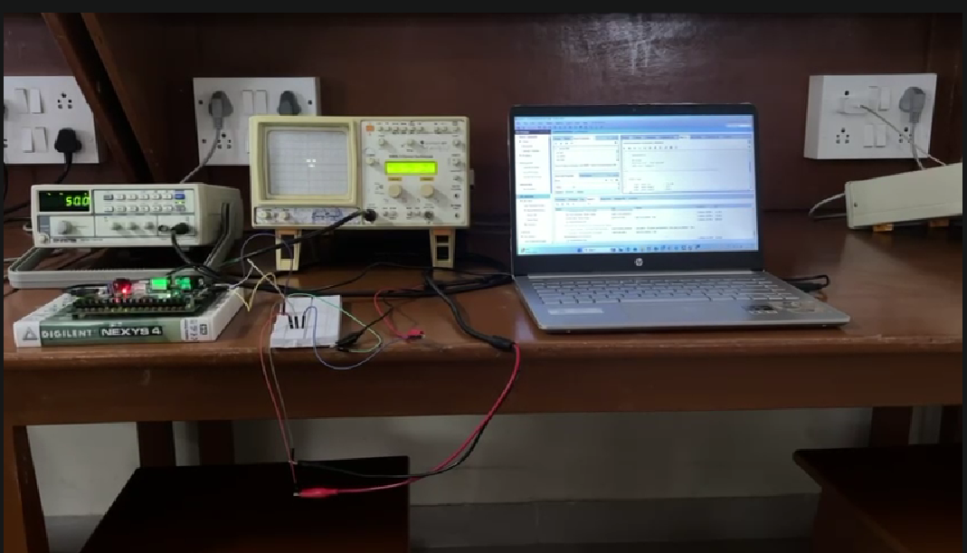
TESTING EQUIPMENTS:
CRO
VERILOG CODES
FUNCTIONAL GENERATOR
FPGA
Fig.1 Testing different frequency analog signal using JXADC In FPGA using functional generator and CRO in Analog Circuits Lab room 316

Slide 12
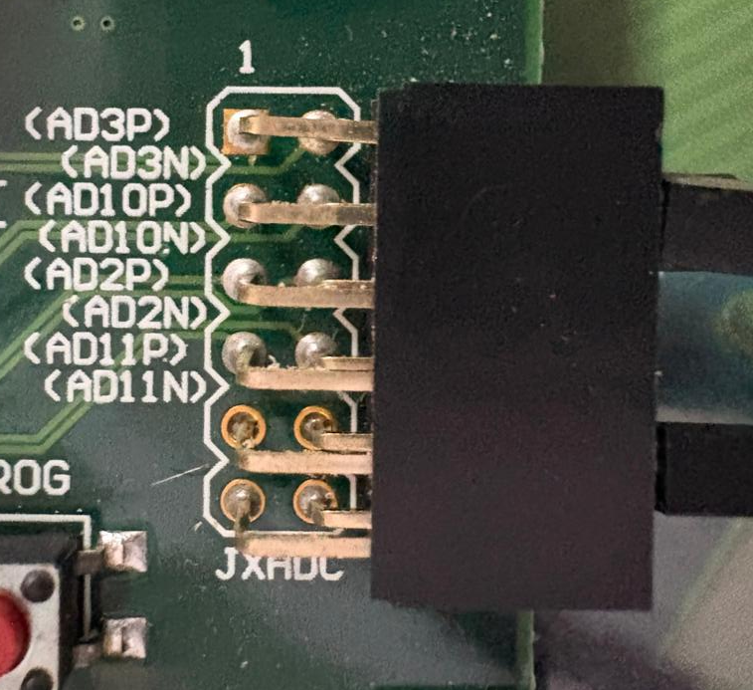
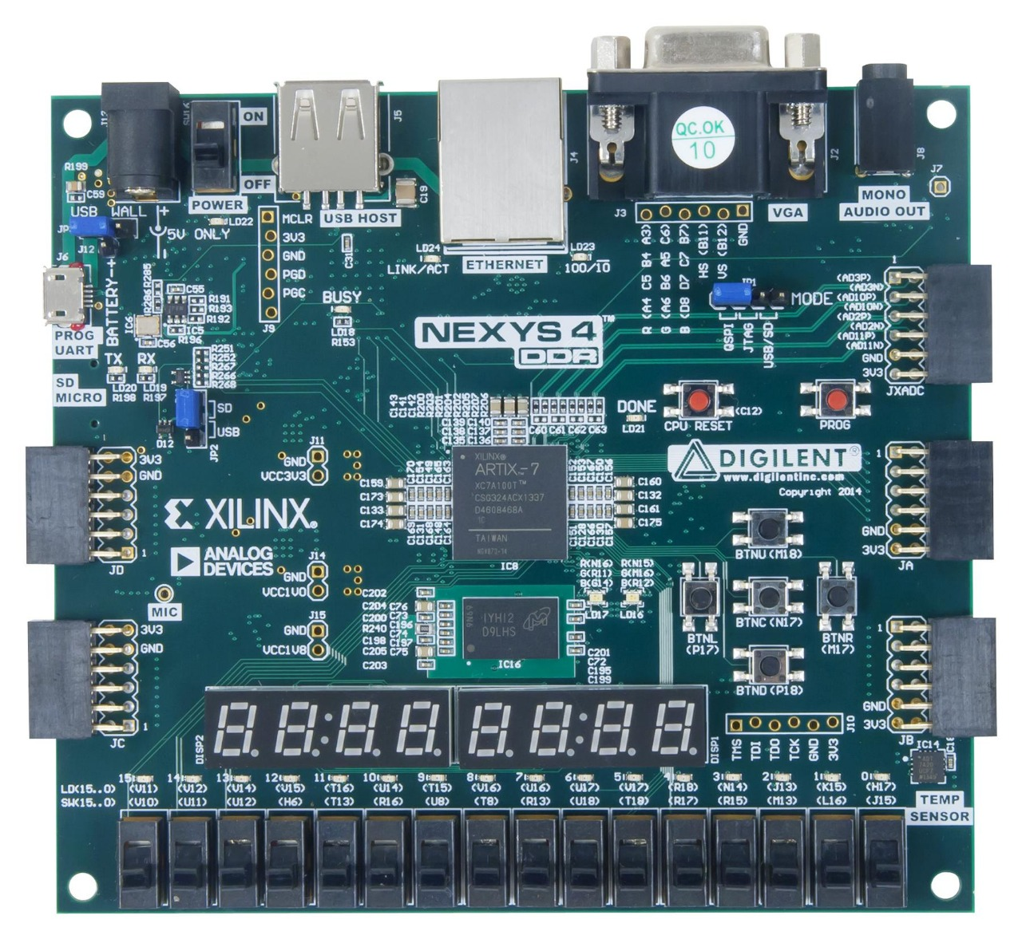
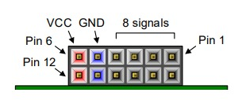
FPGA-NEXYS4
JXADC CONFIGURATION

Slide 13
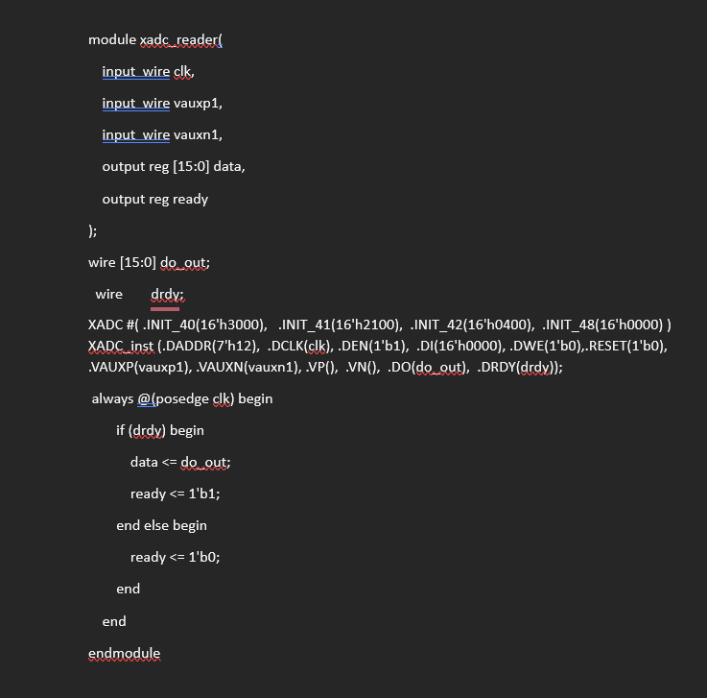
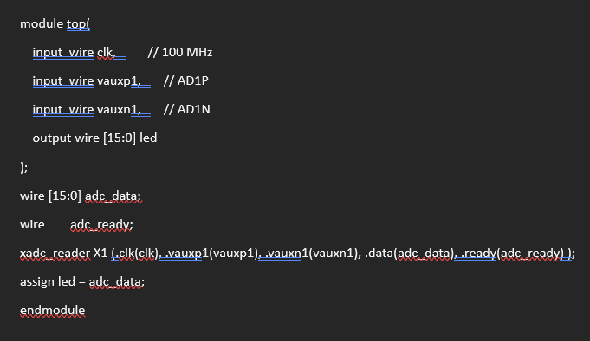
CODES
XADC Interface (reads VAUX1 channel)
Top Module(Connects XADC to LEDs)

Slide 14
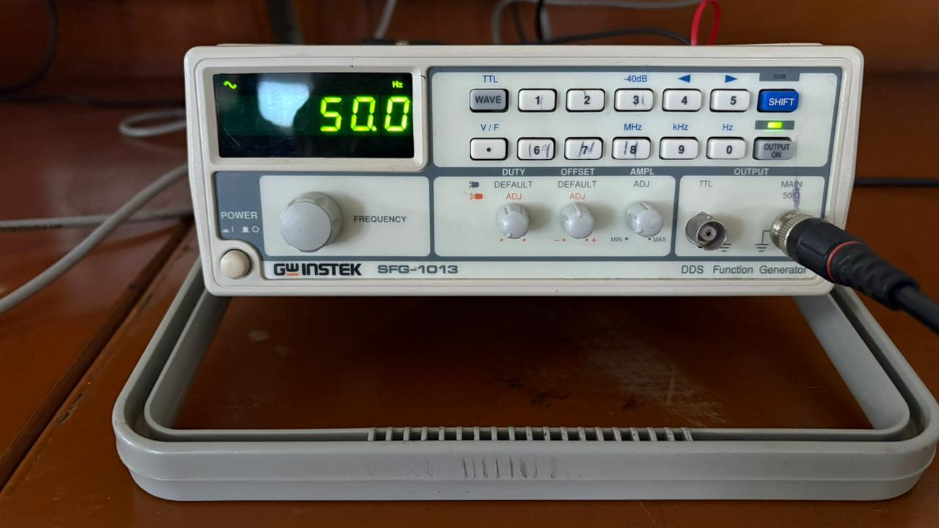
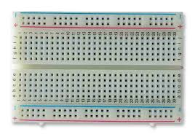
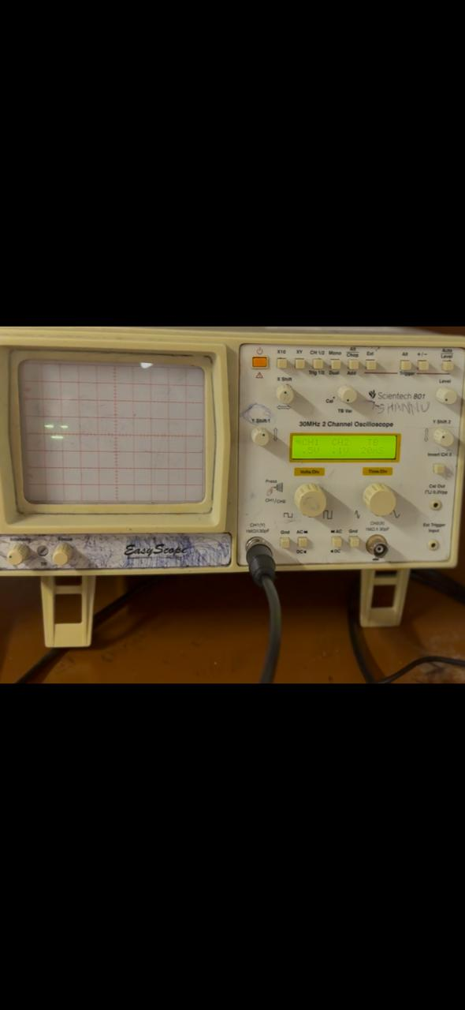
Components, Specifications, and their Physical Connections
Signal
Signal
GND
GND
Frequency – 50 Hz
Offset – o.5v
Amplitude –
Waves(TTL) – Sine
Gnd FPGA(AD10N)
Signal FPGA(AD10P)
Channel -1
Voltage – 0.5 v
Time/Div – 20ms
Gnd FPGA(AD10N)
Signal FPGA(AD10P)

Slide 15
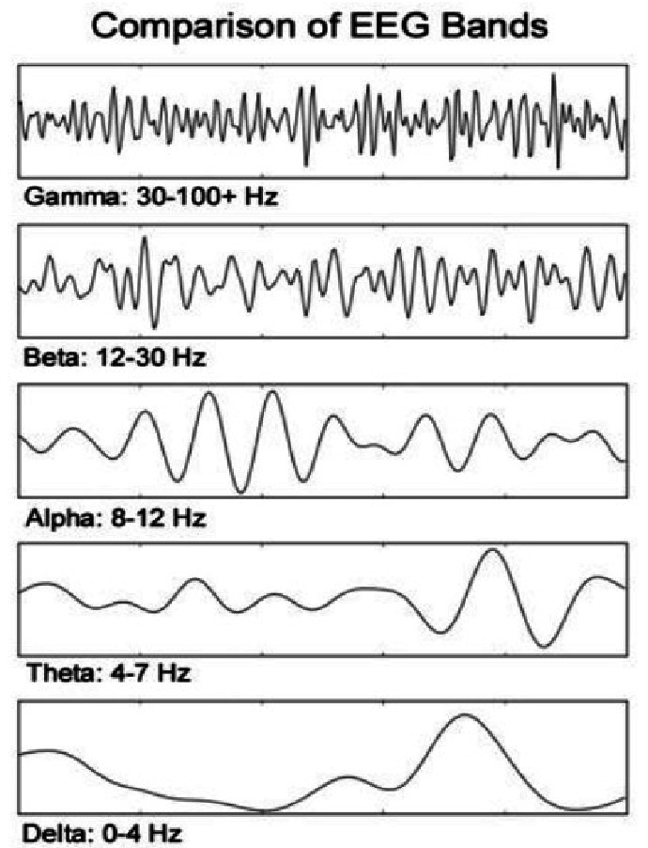
OUTPUT OF ITERATION 2 AND FUTURE WORK
OUTPUT RESULTS:
Verified that the Nexys4 XADC input (AD1P/AD1N) successfully receives an analog signal.
Checked the oscilloscope waveform to confirm correct amplitude and offset before feeding into FPGA.
Ensured the shared ground between FPGA, oscilloscope, and function generator is correct.
Confirmed that the analog-to-digital flow is working up to FPGA pins.
PHASE 2 WORK:
Ensures the FPGA can safely accept analog EEG-level signals via XADC.
Confirms our hardware connections (signal, ground, offsets) are correct before integrating real EEG amplifier output.
Validates the input path required for phase 2 signal processing.
Avoids hardware damage by correct voltage scaling (critical for EEG levels).
Gives confidence that next steps—ADC reading, RISC-V processing, alert logic—will work as expected.

Slide 16
Conclusion & Future Work
Summary and Conclusion:
The project successfully developed a robust system by integrating a high-performance RISC-V processor with advanced machine learning on an FPGA. The processor's 5-stage pipeline efficiently handled instruction execution and managed data flow. Key to its reliability is the hazard unit, which ensures correct program execution by mitigating data dependencies via forwarding and stalling. For diagnostics, the system utilizes a Hybrid Deep Learning/Ensemble Classifier to process EEG signals and classify sleep disorders with high accuracy, up to 96.78%. This validates a model for creating a low-power, high-accuracy System-on-a-Chip (SoC) solution suitable for wearable health monitoring.
Future Work
Future development should prioritize clinical readiness and further optimization. The next step is to integrate the FPGA design with a wireless headset band and communication protocol for real-time testing using genuine clinical data. On the hardware side, efficiency can be boosted by implementing a dynamic branch predictor and exploring new cache architectures and memory hierarchies to reduce memory access time. Finally, further testing on a larger, more diverse clinical dataset is required to ensure the model's reliability and generalizability across various patient populations.

Slide 17
THANK YOU
Have a Great Day !

