Slide 1
Intelligent E-Commerce Search with Retrieval Augmented Generation
Professor. Bertin Cordova-Diba, Ph.D. CMPE 255 - Data Mining
Sahana Srinivasa Babu - 019175975
Bishakha - 019178354
Kevin Anto Jesus William Basker - 017478604
Shiyuan Wang - 015632175

Slide 2
Problem & Motivation
Traditional keyword search often misses user intent Keyword search has limited understanding of user intent .
Semantic retrieval improves search relevance. Semantic retrieval better understands user intent and returns more relevant products.
RAG combines retrieval with LLM generation. RAG retrieves relevant products and uses an LLM to generate recommendations.
Generates accurate and context-aware recommendations. Provides recommendations based on the user's intent and retrieved product information.
" Budget phone with good battery life."
“budget” or “battery"
“long-lasting battery” or “value for money smartphone”

Slide 3
Dataset and Data Preprocessing
Data Acquisition
Kaggle E-Commerce Products Dataset
6,506 Amazon products
28 product categories
Product attributes: title, category, price, rating and reviews
Preprocessing
Merge category-specific datasets
Remove duplicate products
Clean and normalize text fields
Create unified search corpus (search_text)
Generate MiniLM embeddings (all-MiniLM-L6-v2)
Store embeddings in ChromaDB
Exploratory Analysis
EDA on category distribution, ratings, and pricing patterns
Analyze product counts across categories
Compare lexical and semantic retrieval behavior
Evaluation Metrics: 1. Precision@5 2. NDCG@5 3. ​​Answer Relevancy 4. Faithfulness 5. Latency

Slide 4
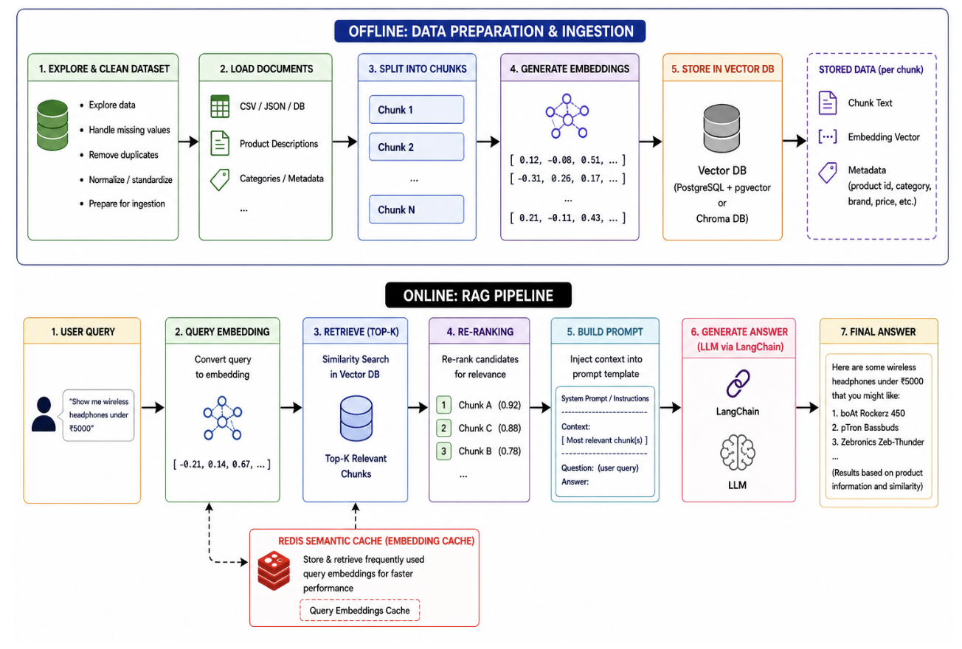
RAG Pipeline Architecture
Retrievers Used
BM25
SBERT
Hybrid
Models Used
all-MiniLM-L6-v2
BGE Reranker
Llama 3.3 70B
RAG Framework
1. ChromaDB
2. Retriever
3. Reranker
4. Generate context aware
response with LLM

Slide 5
List Of Experiments
SBERT + BGE + Redis
HYBRID RETRIEVAL
Semantic retrieval with reranking, query and context stored as key value pair in Redis Instance.
KEY COMPONENTS
SBERT, BGE , Redis
More Accurate and Faster Response with Cache.
BM25
LEXICAL RETRIEVER
Keyword-based retrieval using BM25
KEY COMPONENTS
BM25 Retriver
Strong keyword matching and interpretable retrieval.
SBERT + BGE SEMANTIC RETRIEVER
Semantic search using MiniLM embeddings stored in Chroma DB and reranked using BGE.
KEY COMPONENTS
MiniLM SBERT
Captures user intent beyond exact keywords.
Hybrid + BGE
HYBRID RETRIEVAL
Combines BM25 and semantic retrieval through Reciprocal Rank Fusion before reranking.
KEY COMPONENTS
BM25 and Ensemble Retriever
Highest faithfulness and answer relevancy.
BGE
SBERT
RRF
Performance Improvement Strategies
Category Filtering
Reranking
Redis Semantic Cache

Slide 6
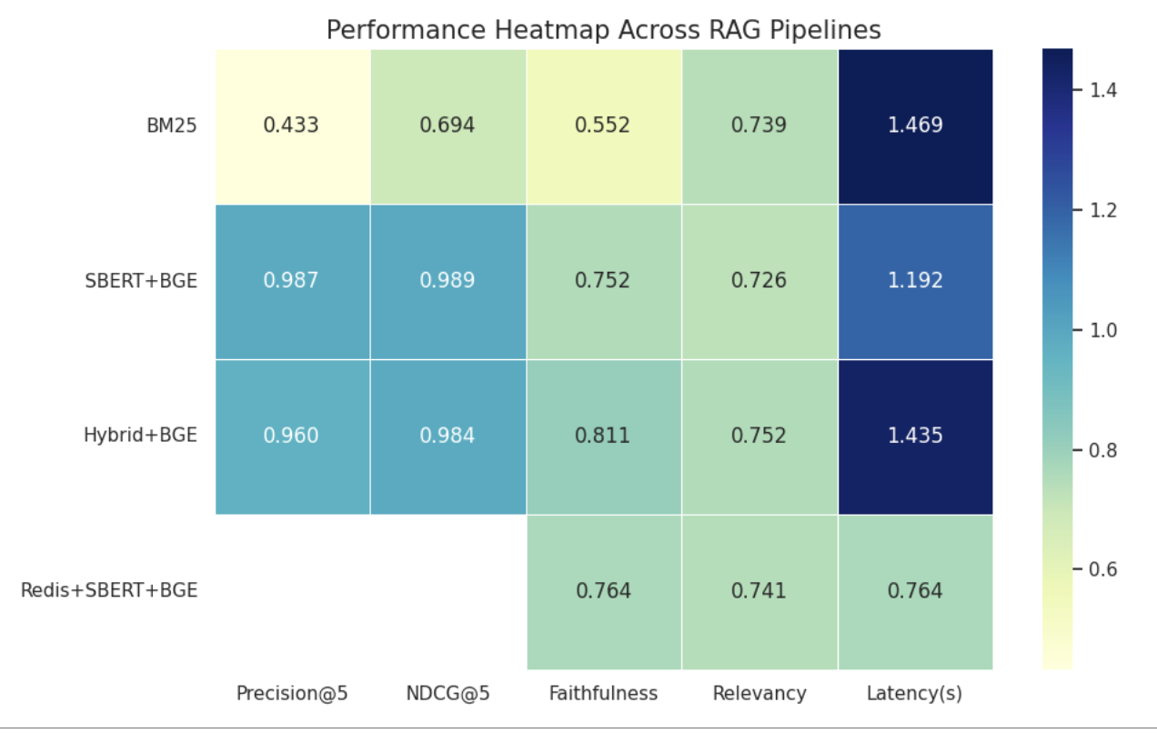
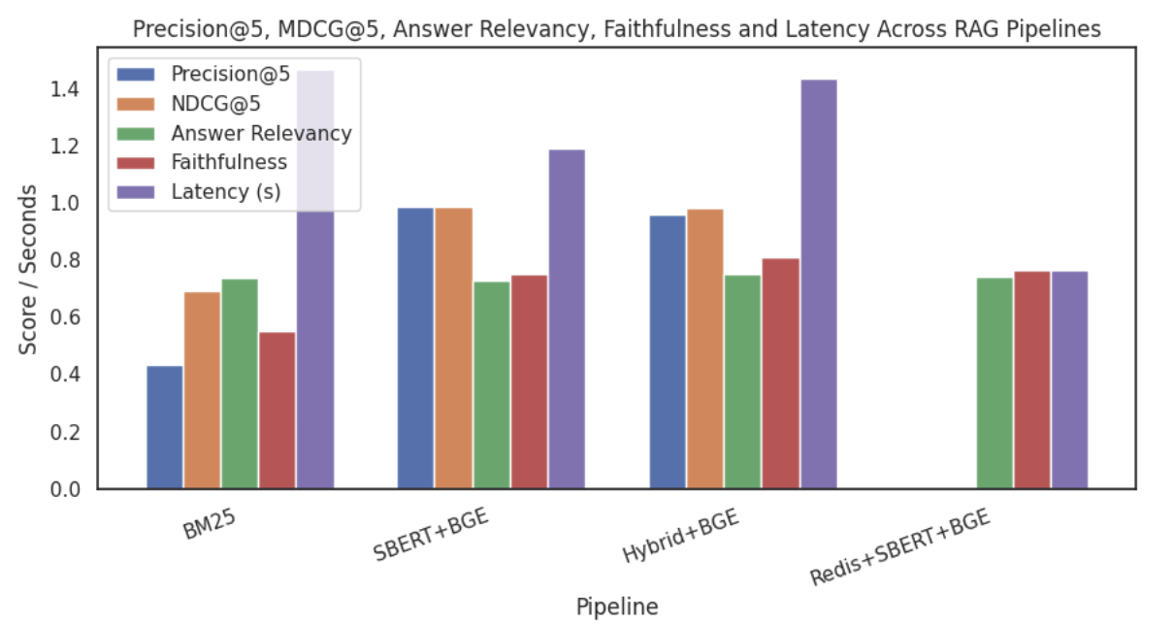
Performance and Scalability
Highest Faithfulness + Relevancy
0.811 → HYBRID + BGE 0.752 → HYBRID + BGE Achieved the strongest grounding and factual consistency.
Lowest Latency 0.764→ REDIS + SBERT + BGE Semantic caching significantly reduced retrieval and response time.
Highest Precision + NDCG
0.9867 —> SBERT + BGE
0.989 —> SBERT + BGE
Retrieved the most relevant top-ranked products for user queries.
Key Findings
Best Overall Quality Hybrid + BGE as the best overall pipeline because it achieved the highest Faithfulness and Answer Relevancy scores while maintaining retrieval performance that was very close to SBERT + BGE.
Semantic Search Works Better SBERT produced more accurate and trustworthy answers than traditional BM25 keyword search. It also returned more relevant products and ranked them more effectively than BM25-based retrieval.
Fastest Performance Redis + SBERT + BGE returned answers the fastest while still maintaining good quality.
Quality vs. Speed Hybrid + BGE delivered the best answer quality, while Redis + SBERT + BGE offered the best balance between speed and quality.

Slide 7
Conclusion & Future Work
Project Takeaways
Future Directions
Retrieval Matters The choice of retrieval strategy has a significant impact on the quality of generated responses.
Larger Evaluation Dataset Evaluate retrieval performance on a wider variety of product categories and user intents.
Semantic Search Improves RAG Embedding-based retrieval helps better understand user intent and improves answer grounding.
Stronger Retrieval Models Explore larger embedding models and advanced reranking approaches.
Caching Enhances Efficiency Semantic caching can substantially reduce response time without sacrificing answer quality.
Real-Time Deployment Develop a scalable web application with live indexing and monitoring.

Slide 8
Thank You!
Intelligent E-Commerce Search with Retrieval Augmented Generation for
Improving product discovery through semantic retrieval, reranking, and large language models.
🔹 Python 🔹 LangChain 🔹 ChromaDB 🔹 Redis 🔹 Hugging Face Embeddings 🔹 BGE Reranker 🔹 Groq / Llama 3.3

