Slide 1
Neural Style Transfer

Slide 2
Agenda
Abstract
Introduction
Literature Survey
Objectives
Methodology
Technology and Domain
Dataset, Front End and Back End Details
Modules Explanation (Few modules with demo)
Output images
Conclusions
Proof of publication / patent / Application Development
Reference

Slide 3
Introduction
Neural style transfer (NST) is based on the fundamental concept that a convolutional neural network (CNN) can learn separate representations for content and style during a computer vision task such as image recognition.
To transfer styles from one image to another, neural style transfer (NST) utilizes a pre-trained convolutional neural network (CNN). This is achieved by creating a loss function that attempts to minimize the discrepancies between a content image, a style image, and an image that is generated during the process.
Although deep neural networks have already achieved superior performance compared to humans in tasks such as object recognition and detection, generating artistic artifacts with high perceptual quality has been a challenge for these networks until recently. Therefore, improving the quality of machine-generated art is crucial to achieving human-like capabilities and unlocking new possibilities in this domain. With advancements in computer hardware and the widespread adoption of deep learning techniques, deep learning is now being utilized to create art.

Slide 4
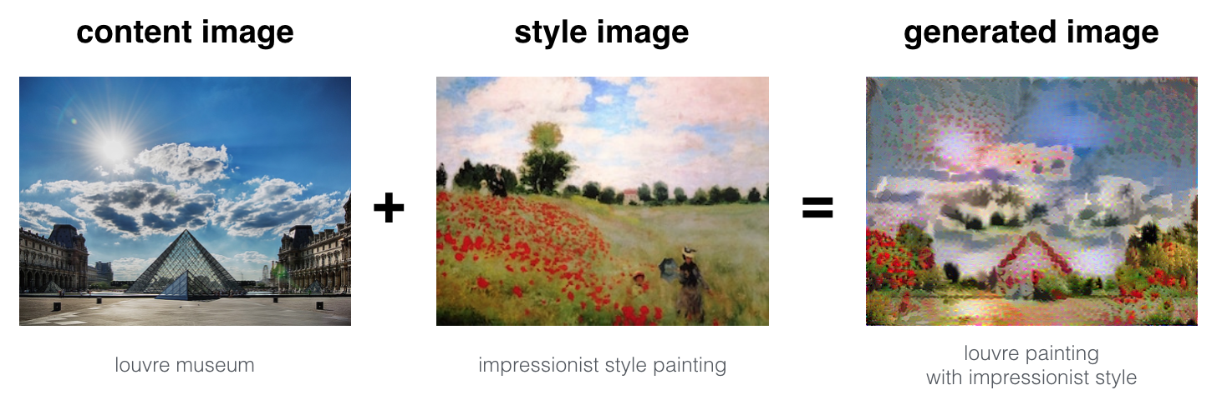
Problem Statement
Neural Style Transfer (NST) is one of the most fun techniques in deep learning. As seen above, it merges two images, namely,
a “content” image (C) and
a “style” image (S),
to create a “generated” image (G). The generated image G combines the “content” of the image C with the “style” of image S.
In this example, we are going to generate an image of the Louvre museum in Paris (content image C), mixed with a painting by Claude Monet, a leader of the impressionist movement (style image S).

Slide 5
Research Aims & Objective
The aim of this project is to enhance the performance of Neural style transfer.
Following are the research questions :
How can we improve the quality of the generated images in terms of realism, detail, and visual coherence?
What are the most effective techniques for combining content and style features in neural style transfer, and how can we optimize these techniques for different applications?
How can we develop more efficient algorithms for neural style transfer that can generate high-quality images in real-time or near real-time?
How can we apply neural style transfer to practical applications such as website design, mobile applications, or personalization of digital content?

Slide 6
Following are the objective of the proposed research: ​
The objective of proposed research in the field of neural style transfer would be to advance our understanding of this technique,​
Improve its capabilities and applications.​
Contribute to the broader field of artificial intelligence and creative expression.
NST employs a pre-trained Convolutional Neural Network with added loss functions to transfer style from one image to another and synthesize a newly generated image with the features we want to add.​

Slide 7
Literature review
Si No | Author Name, Publisher, Journal Name, Year | Title of the Paper | Objectives | Accuracy / Performance (Result Analysis) | Future Scope
1 | Leon A Gatys, Alexander S Ecker and Matthias Bethge (2016) | A Neural Algorithm of Artistic Style | It is trained to perform one of the core computational tasks of biological vision automatically learns image representations that allow the separation of image content from style | 30% accurate. | Their work offers a path forward to an algorithmic under standing of how humans create and perceive artistic imagery.
Overview of the review done.

Slide 8
Literature review
Si No | Author Name, Publisher, Journal Name, Year | Title of the Paper | Objectives | Accuracy / Performance (Result Analysis) | Future Scope
2 | Roey Mechrez, Eli Shechtman, Lihi Zelnik-Manor(2017) | Photorealistic Style Transfer with Screened Poisson Equation | It is a technique that transforms a stylised image into something more lifelike. | Their results are more accurate than the state-of-the-art and have finer details. | They have developed a quick, easy, fully automated process that successfully renders stylised images photorealistic. Their results are more accurate than the state-of-the-art and have finer details.

Slide 9
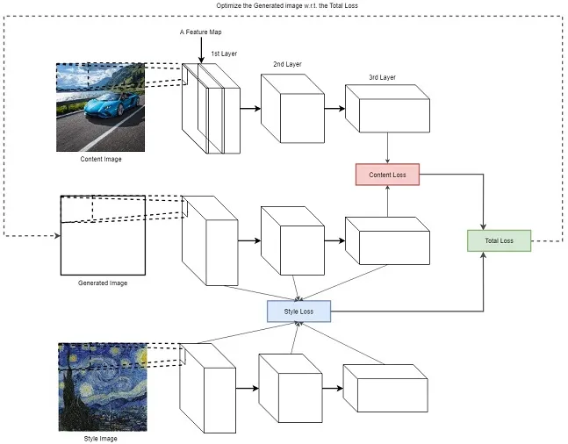
Methodology
As stated earlier, neural style transfer uses a pretrained convolution neural network. Then to define a loss function which blends two images seamlessly to create visually appealing art, NST defines the following inputs:
A content image (c) — the image we want to transfer a style to
A style image (s) — the image we want to transfer the style from
An input (generated) image (g) — the image that contains the final result (the only trainable variable)

Slide 10
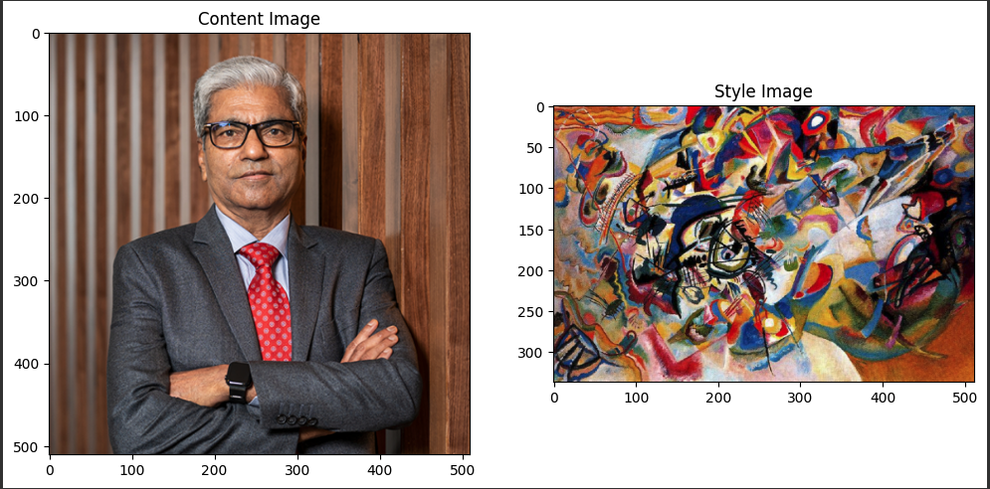
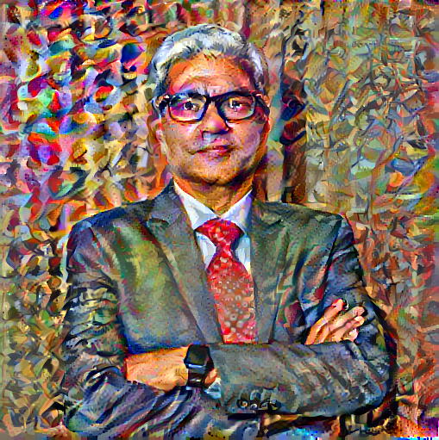
Results
The output of NST is a new image that retains the content of the original image but is stylized in the visual style of the second image. This can result in a wide variety of artistic effects, such as creating images that look like they were painted in the style of Van Gogh or Picasso, or images that look like they were created using a specific visual theme, such as a comic book or manga.
Stylized image(output)

Slide 11
Conclusion
Neural style transfer is a powerful technique that has revolutionized the way we create and appreciate art. It combines the power of deep learning with artistic styles to generate unique and visually stunning images that are both fascinating and inspiring.
For future work, there is an opportunity to apply neural style transfer to a range of practical applications, such as enhancing the visual aesthetics of websites or mobile applications, or enabling users to personalize their digital content with unique artistic styles. As the technology continues to evolve and improve, it has the potential to transform the way we interact with visual media, and open up new avenues for creativity and expression.

Slide 12
References
A Neural Algorithm of Artistic Style
Tensorflow Tutorial on Neural Style Transfer
Quora Article about Neural Style Transfer
Demystifying Neural Style Transfer
https://arxiv.org/pdf/1508.06576.pdf
https://arxiv.org/abs/1604.08610
https://arxiv.org/abs/2006.09029

Slide 13
THANK YOU

