Slide 1

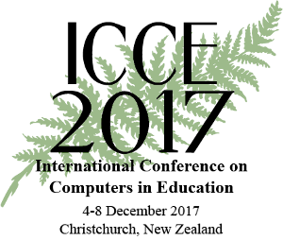
Large-scale teacher professional development for effective technology integration
Sahana Murthy
Indian Institute of Technology Bombay
December 6, 2017

Slide 2
Educational Technology, IIT Bombay
Inter-Disciplinary Program, started 2010
Core faculty, also from departments of Engineering, Science, Design, H&SS
Focus on:
TELoTS: Technology enhanced learning of pan-domain thinking skills
TUET: Teacher use of educational technologies
Hosted ICCE 2016 ☺
This talk is about research, development and outreach from Project TUET.

Slide 3
The problem
ICT is everywhere, but potential lost without integration strategies
Barriers: Access & infrastructure; attitudes & beliefs towards ICT
Difficulty in designing and implementing learner-centric practices with ICT
How to promote effective ICT integration practices of teachers?
(Ertmer 1999, Angeli & Valanides, 2009, Tsai & Chai, 2012)

Slide 4
Existing work
Courses on ICT-integration in pre-service education
Theoretical frameworks - TPACK, SoLT
Government led initiatives – ProInfo (Brazil), ITT (Chile), PT3 (US), …
Research - many studies, some metastudies
(Mishra & Koehler, 2006; Hutchings, Huber & Ciccone, 2011; Joia, 2001; Brun & Hinostroza, 2014; Tondeur et.al, 2012)
Notes:
JK – what other categories? Other examples?

Slide 5
The problem in Indian context
Effective integration of ICT:
Problem pronounced since resource constrained
Problem compounded since scale is large
Existing solutions need examination since tertiary-ed context
Solutions unsustainable since pay-off is low
(Murthy, Iyer & Warriem, 2015)
Notes:
Tertiary education context - mention?
Complexity due to scale: availability of infrastructure and resources, diversity in operating conditions (such as curriculum, student background & interest), and ensuring engagement and learning

Slide 6
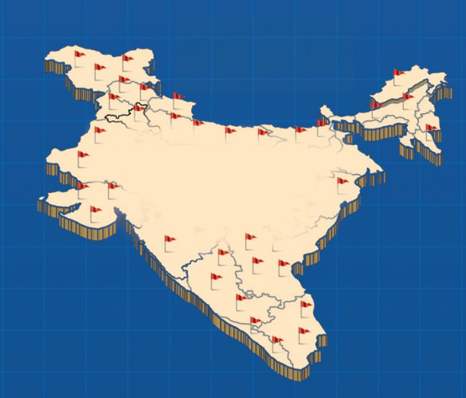
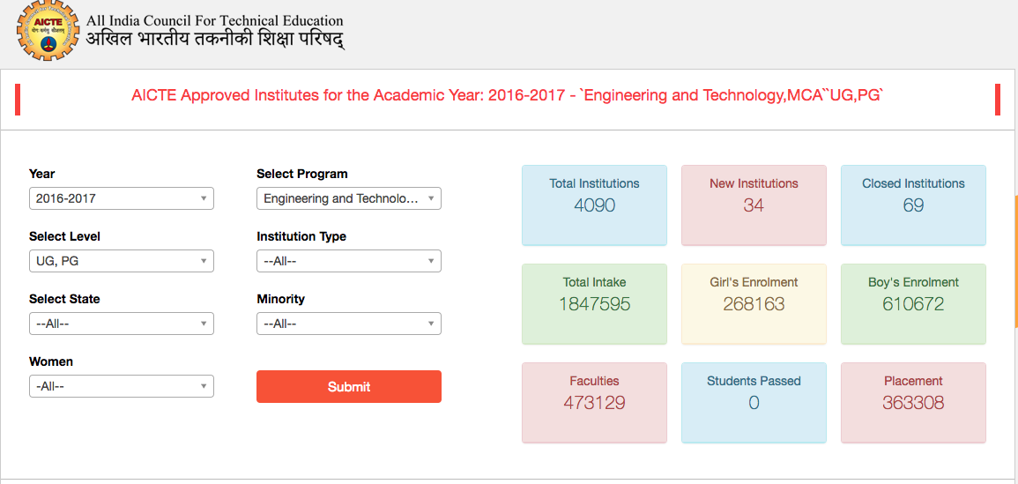
Large-scale in India
Geographical distribution (> 3,00,000 km²)
Source: http://www.facilities.aicte-india.org/

Slide 7
Large-scale in India
Institutions
4090
Students
1847595
Faculty
473129
Geographical distribution (> 3,00,000 km²)
Source: http://www.facilities.aicte-india.org/

Slide 8
Requirements
Instructors need explicit training in ICT integration- knowing & doing
customized to their own context
with specific, meaningful and immediate takeaways

Slide 9
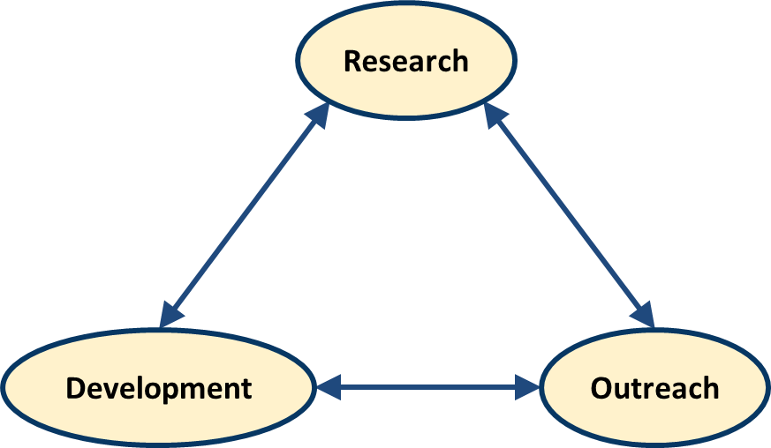
Project TUET: Efforts at IIT Bombay India

Slide 10
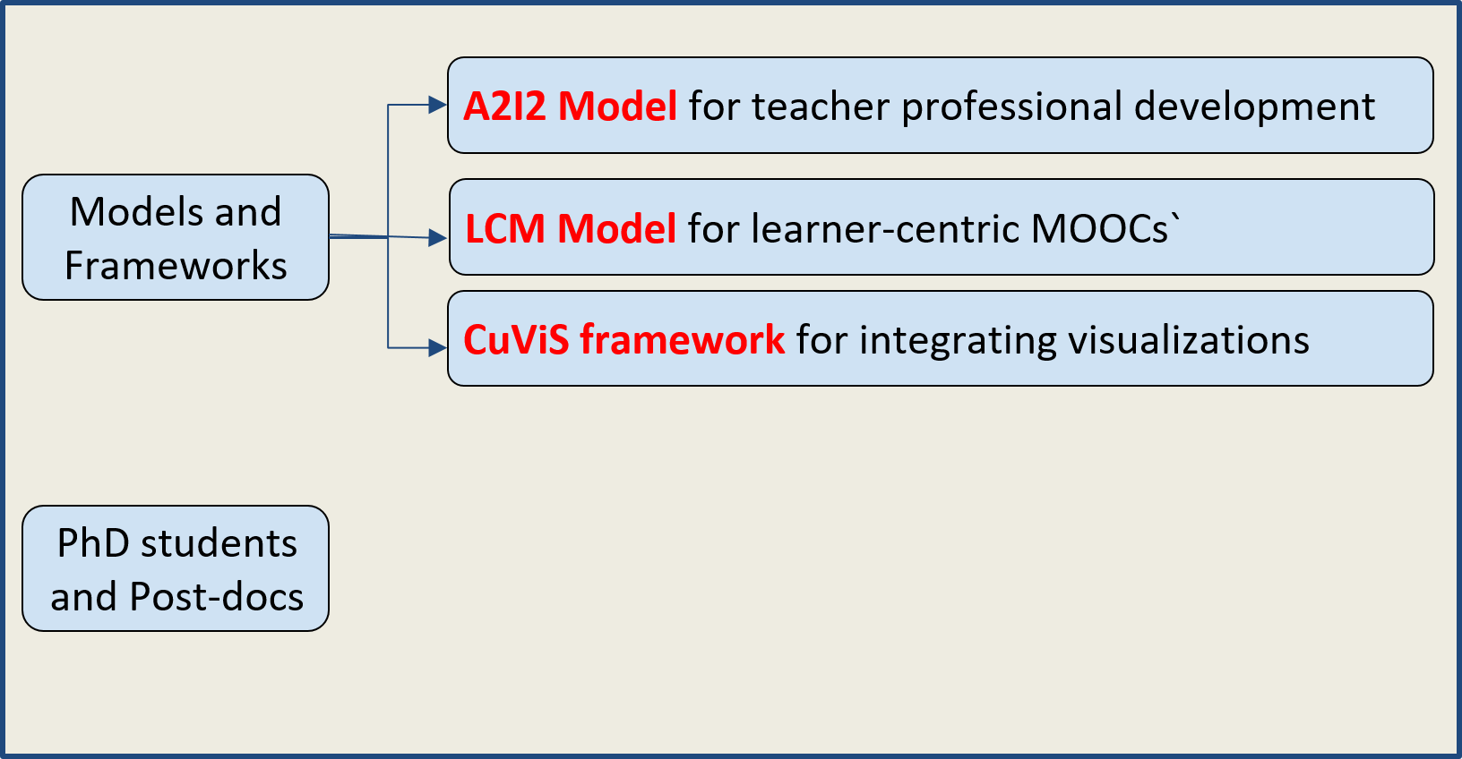
Project TUET: Research

Slide 11
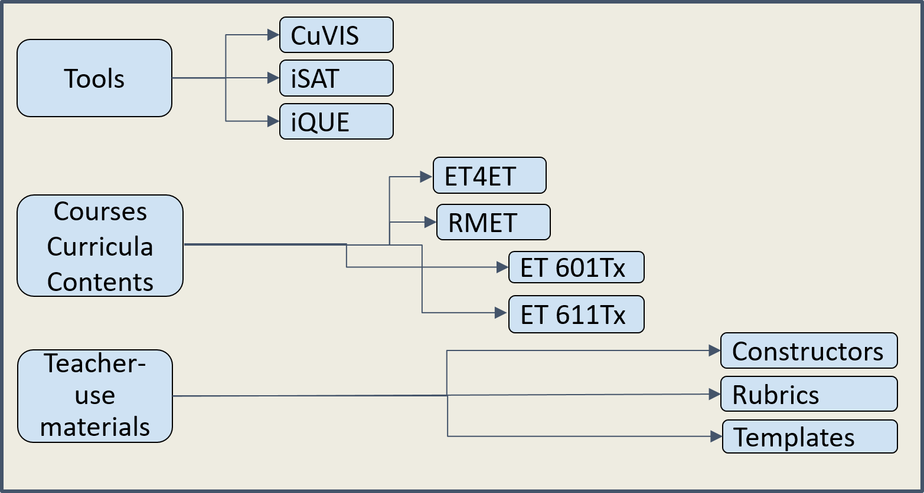
Project TUET: Development

Slide 12
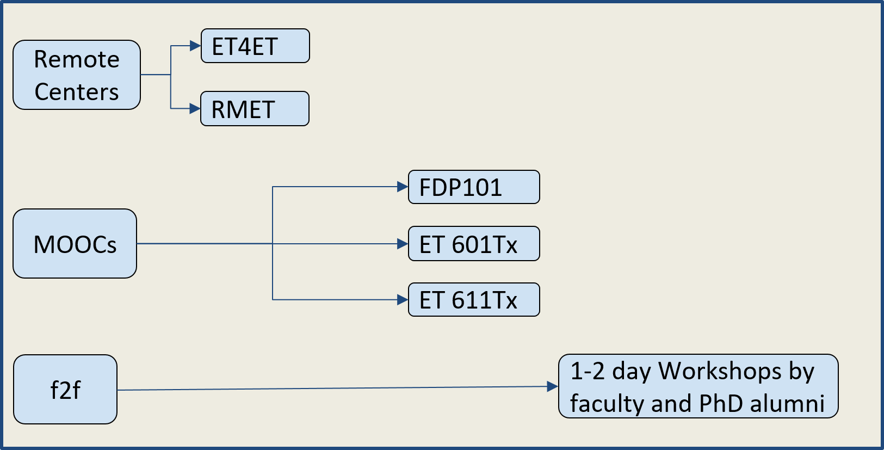
Project TUET: Outreach

Slide 13
What is this talk about?
How to design effective training programs to develop teachers’ ICT integration practices?
How to scale such training programs?
How to promote sustainability of teachers’ practices?
Why should you believe me …
- To what extent did our efforts work?

Slide 14
Case 1: ET4ET Teacher Professional Development Program (Educational Technology for Engineering Teachers)

Slide 15
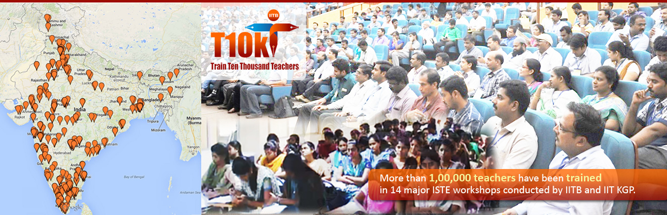
Context of ET4ET program
Goal: Integrate learner-centric pedagogy with meaningful ICT
Mode : Blended – synchronous via RC + asynchronous via Moodle
Duration: 2-week equivalent; 2014 & 2015
Participants: 5000+ engineering instructors, 250 Remote Centres
Supported by T10KT: Govt of India’s National Mission in Education via ICT

Slide 16
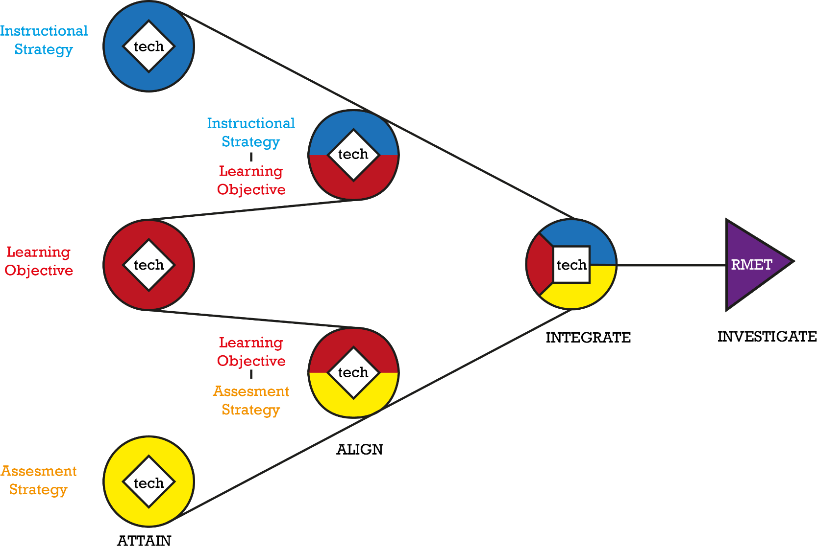
Design of ET4ET program
A2I2 Model
Informs overall design
4 phases
Based on:
Constructive alignment
Spiral curriculum
Investigate
Integrate
(Biggs 1996; Harden & Stamper, 1999)
Align
Attain

Slide 17
Design of activities in ET4ET program
Make teachers do..
use the tool and do activity with tool
participate in AL in the TPD
.. before they design learning activities for their students.
Immersivity Principle:
Experience as a learner first, then practice as a teacher in order for teachers to reflect on the activity itself before they incorporate it into their practice.
Give examples tailored to teachers’ domain
Make teachers design activities they can use immediately in their class
Pertinency principle:
Relate to the teacher’s context and immediate practice in order for teachers to attain fluency in practice.
Warriem, Murthy & Iyer, 2015

Slide 18
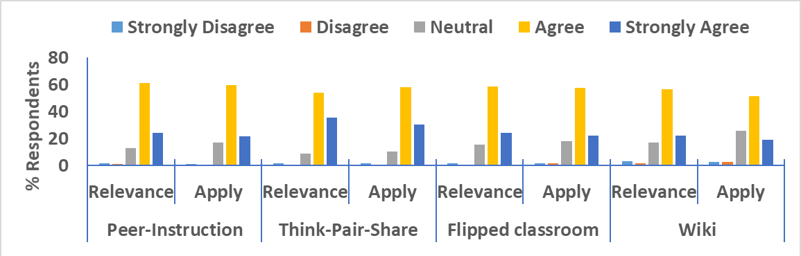
Results – ET4ET
High cognitive engagement during ET4ET program
4880 submissions of lesson design using Active Learning
2958 participants registered in the Wiki
19,501 pages created, with 118890 views and 10281 edits (in 2 days)
High intent to apply learning after ET4ET program:
83% intend to apply, 0.47 correlation between intent and perceived relevance

Slide 19
Results
High cognitive engagement during ET4ET program
High intent to apply learning after ET4ET program
Actual practice, X months later:
“I was able to engage the backbenchers with the activities”
“We conducted a training program for about 120 faculty members [34%] in our college and shared the important topics learned this program”
Warriem, Murthy & Iyer, 2015

Slide 20
Case 2: ET601Tx - MOOC version of ET4ET
Notes:
ET 601 MOOC

Slide 21
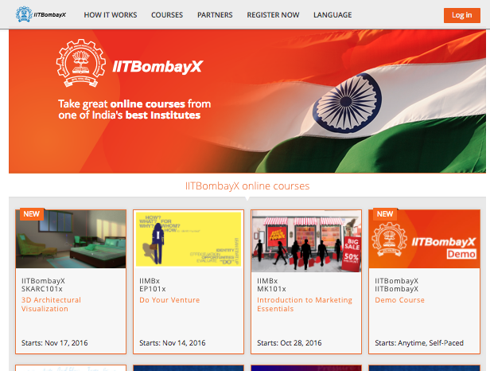
Context of ET601Tx MOOC
Goal: constructive alignment practices for effective ICT integration
Mode : MOOC, IITBombayX platform
Duration: 8 weeks; 2016
Participants: 5000+ engg instructors
Supported by T10KT: Govt of India’s National Mission in Education via ICT

Slide 22
Incorporating learner-centricity in MOOC
Active learning
Formative assessment
Customized response & feedback
Peer-learning
Learner diversity

Slide 23
Learner-Centric MOOC Model
Learner Experience Interaction
Learning Dialogues
Learning by Doing
Learning Extension

Slide 24
Learner-Centric MOOC Model
Focus question for discussion + Peer interaction + Reflection Quiz
Content + Reflection Spot
Activities + Customized Feedback
Resources + Assimilation Quiz
Learner Experience Interaction
Learning Dialogues
Learning by Doing
Learning Extension

Slide 25
Results – ET601Tx MOOC
Active participants: 67%, Persistence rate: 37%, Completion rate: 23%
Average 399 participants accessed course daily
5023 Threads started and 9861 comments by participants
Participant self-report, post survey – High relevance and usefulness
I found useful
Learning Dialogs (learn active learning strategies, motivate constructive alignment)
Learning by Doing (reinforce concept from LeD, design activities in my class)
Learning Experience Interactions (to connect and get feedback with peers, see challenges faced by fellow instructors)
Warriem, Murthy & Iyer, 2016

Slide 26
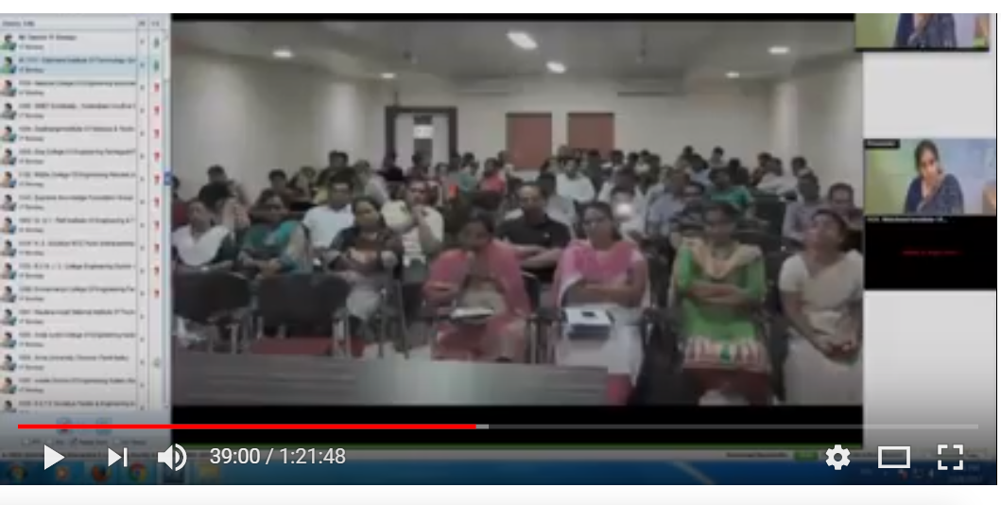
Voices from the field
[Video] https://www.youtube.com/watch?v=nbJX4znpGa4 [17.34-18.27]

Slide 27
Voices from the field
Overall 22000 engineering college instructors trained over 4 years

Slide 28
How did we get here: Design-based Implementation Research
Identified Problems of Practice
leading to
PRACTICE
PRACTITIONERS
improves
requires
Design
Evaluation
Implementation
Literature
and/or
Exploration within context
informs
RESEARCHERS
refines
improves
THEORETICAL UNDERSTANDING
Peneul, 2011

Slide 29
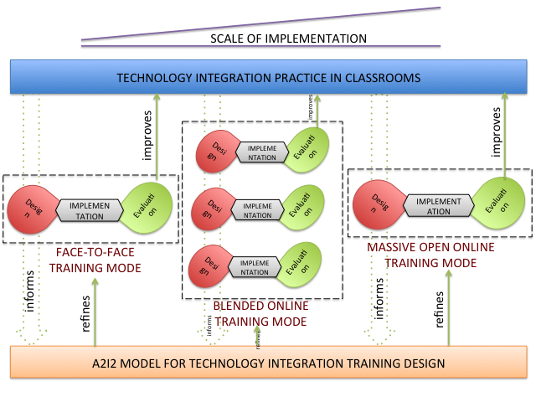
How did we get here: 5 DBIR iterations
A2I2 MODEL, LCM MODEL FOR MOOCs

Slide 30
Going further: MEET- Mentoring Educators beyond ET4ET

Slide 31
Goals
Engage with participants from ET4ET and ET601Tx beyond the programs
Participants to go beyond basic application of knowledge from programs

Slide 32
Ongoing efforts
Scaffold motivated participants towards SoLT, via Action Research
MEET: Blended workshop on action research - asynchronous (4mos) + f2f (1week)
Templates for planning, designing, conducting, reporting action research
Mentor participants through various phases of their studies
Identify top performers, include them as “associate faculty” in subsequent offerings of TPD programs in mentor role
SoLT: Shulman, 2004
MEET Workshop: Warriem, Murthy & Iyer, 2017

Slide 33
Results
Transfer of ownership
Indications of secondary implementations
Classroom Action Research:
52 studies designed, 19 implemented, 15 conference papers published
Communities of practice
20000+ Open Educational Resources created, some available at https://etrepository.wikispaces.com/
174 Associate Faculty identified, mentoring 7100 faculty across India
Towards sustainability …

Slide 34
Takeaway-1: Design principles for TPD programs
Immersivity and pertinency are key design principles for teacher professional development programs targeting effective ICT integration.
Design TPD program to provide participants:
Experience as a learner first, then practice as a teacher
Relevant learning activities –
Challenge, and guideline
Domain-specific examples
Context-appropriate tools & strategies
Practice-oriented design
Notes:
Obvious – TPD program should be relevant to the teacher
Our contribution – Points in operationalization of immersivity

Slide 35
Takeaway-2: Guidelines for scaling
To scale,
use synchronous remote classrooms or MOOCs or some appropriate technology (f2f wont scale).
To be effective at scale,
maintain learner-centricity, in both design and implementation.
Notes:
Obvious – To scale – standard distance learning techniques.
Our contribution (non obvious) – How to be effective at scale.

Slide 36
Takeaway-3: Recommendations for sustainability
Go beyond completion rates; focus on learner persistence rate.
Enhance communities of practice by using a mentor-mentee model.
Promote transfer of ownership by leveraging potential of classroom action research.
Notes:
Obvious – Create CoP (standard, known)
Our contribution – Focus on perseverance. – immersivity and pertinency can help here.
Our contribution - Enhance CoP by doing …
Be careful about confusion for audience between pertinency and perseverance.

Slide 37
References
Angeli, C., & Valanides, N. (2009). Epistemological and methodological issues for the conceptualization, development, and assessment of ICT–TPCK: Advances in technological pedagogical content knowledge (TPCK). Computers & education, 52(1), 154-168.
Biggs, J. (1996). Enhancing Teaching through Constructive Alignment. Higher Education , 32, 347-364
Ertmer, P. A. (1999). Addressing first- and second-order barriers to change: Strategies for technology integration. Educational Technology Research and Development, 47(4), 47-61.
Harden, R., & Stamper, N. (1999). What is a Spiral Curriculum? Medical Teacher, 21 (2), 141-143.
Hutchings, P., Huber, M. T., & Ciccone, A. (2011). The scholarship of teaching and learning reconsidered: Institutional integration and impact (Vol. 21). John Wiley & Sons.
Mishra, P., & Koehler, M. J. (2006). Technological pedagogical content knowledge: A framework for teacher knowledge. Teachers college record, 108(6), 1017.
Murthy, S., Iyer S., & Warriem, J. ET4ET: A large-scale professional development program on effective integration of educational technology for engineering faculty. Educational Technology & Society, vol. 18(3), pp. 16-28, 2015.
NMEICT. (2014) Homepage of the Government of India’s National Mission on Education through ICT.
Penuel, W. R., Fishman, B. J., Cheng, B. H., & Sabelli, N. (2011). Organizing research and development at the intersection of learning, implementation, and design. Educational Researcher, 40(7), 331-337.
Shulman, L. S. (2004). Visions of the possible: Models for campus support of the scholarship of teaching and learning. In W. E. Becker & M. L. Andrews (Eds.), The scholarship of teaching and learning: Contributions of research universities (pp.9-23). Bloomington: University of Indiana Press.
Train 10000 Teachers. http://www.it.iitb.ac.in/nmeict/About_T10kT.html
Tondeur, J., van Braak, J., Sang, G., Voogt, J., Fisser, P., & Ottenbreit-Leftwich, A. (2012). Preparing pre-service teachers to integrate technology in education: A synthesis of qualitative evidence. Computers & Education, 59(1), 134-144.
Tsai, C. C., & Chai, C. S. (2012). The" third"-order barrier for technology-integration instruction: Implications for teacher education. Australasian Journal of Educational Technology, 28(6).
Warriem, J. M., Murthy, S. & Iyer, S. (2015). Sustainability at scale: Evidence from a large scale teacher professional development program. Proceedings of the 23rd International Conference on Computers in Education, ICCE 2015, Hangzhou, China.
Warriem, J. M., Murthy, S. & Iyer, S. (2016). Shifting the focus from learner completion to learner perseverance: Evidence from a teacher professional development MOOC. Proceedings of the 24th International Conference on Computers in Education, (ICCE 2016), Mumbai, India.
Warriem, J. M., Murthy, S. & Iyer, S. (2017). Transfer of Ownership: Designing for Scholarship of Learning and Teaching. The Sixth International Workshop on ICT Trends in Emerging Economies (WICTTEE 2017). Proceedings of the 25th International Conference on Computers in Education, ICCE 2017, New Zealand.

Slide 38
Contributions
Faculty member ET-IITB
Sridhar Iyer
D. B. Phatak
PhD alumni, ET-IITB
Gargi Banerjee
Sameer Sahasrabudhe
Madhuri Mavinkurve
Yogendra Pal
Mrinal Patwardhan
Rekha Ramesh
PhD students, Project TUET
Jayakrishnan M. Warriem
Rwitajit Majumdar
Anita Diwakar
Supported by:
Many PhD students as TAs

Slide 39
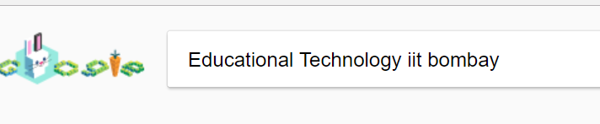
Thank you!
This presentation available at www.et.iitb.ac.in/~sahanamurthy
More resources http://www.et.iitb.ac.in/projects/tuet/
This presentation is released under Creative Commons-Attribution 4.0 License.
You are free to use, distribute and modify it , including for commercial purposes,
provided you acknowledge the source.

