Slide 1

Creating your Elevator Pitch
IDP in Educational Technology
As part of HS 791 course, IIT Bombay
Taught by:
Sridhar Iyer (Oct 2014, March 2015)
Sahana Murthy (Oct 2015, March 2016)

Slide 2
Scenario
Consider that you are at a job interview and the interviewer says: “Tell me about yourself”. You have one minute to make a good impression.
What do you say?
Write down some points for your answer in your notebook.
(you will get a chance to revise it later, so write your initial
ideas now).

Slide 3
The answer to such questions
“Tell me about yourself”
“Let’s introduce ourselves” (around a table, GD,…)
“So what are you working on?”
“What is your research about?”
…
The Elevator Pitch

Slide 4
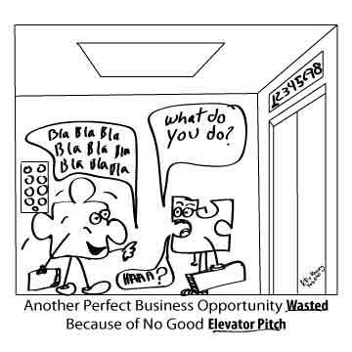
Elevator Pitch
An elevator pitch is a short summary used to quickly and simply define a person, profession, product, service, organization or event, and its value proposition.
It should be possible to deliver the pitch in the time span of an elevator ride, or approximately thirty seconds to two minutes
Source: en.wikipedia.org/wiki/Elevator_pitch

Slide 5
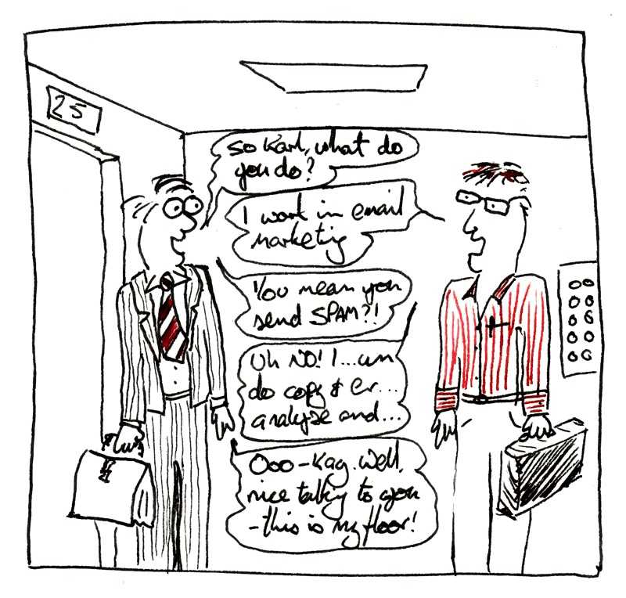
Why should you care?
Important for:
Job interviews
Talking about your research
Conference meetings
You get only one chance to make a first impression.
Being able to sum up unique aspects of yourself, your service or product in a way that excites others, is a fundamental skill.

Slide 6
Why prepare an elevator pitch?
Many interviews start with a question like “Tell me about yourself."
The interviewer doesn't want to know about your childhood.
The interviewer wants to know your background, achievements, future goals, and determine if you are a good fit for XYZ company.
If you learn how to address this open-ended question smoothly and effectively, your interview will start off on a great note.

Slide 7
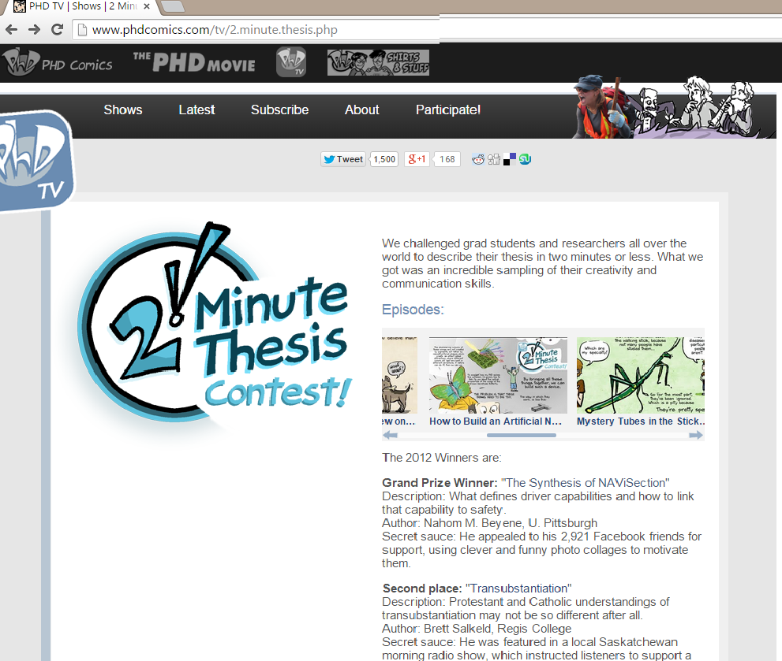
Ph.D students’ → 2-minute thesis

Slide 8
Example
Hi, my name is Samantha Atcheson, and I am a senior Environmental Sciences major. I am looking for a position that will allow me to use my research and analysis skills. Over the past few years, I’ve been strengthening these skills through my work with a local watershed council on conservation strategies to support water quality and habitats. Eventually, I’d like develop education programs on water conservation awareness. I read that your organization is involved in water quality projects. Can you tell me how someone with my experience may fit into your organization?
Source: career.uoregon.edu/blog/students/2010/04/elevator-speech-30-seconds-interview

Slide 9
Activity – Peer Discussion
Why is this a weak pitch: I have spent the last three years in market research. I want to move to a larger platform. I graduated from XYZ university.
Why is this a strong pitch: I have three years of market research experience with expertise in research design, construction of analytical models and data analysis. I developed a new tool using Facebook that was adopted by my last company. I am looking for bigger challenges. I graduated from XYZ university as a marketing major.

Slide 10
Example: Ph.D students’ → 2-minute thesis

Slide 11
Activity: Compare elevator pitches
Below are two elevator pitches. Which is better ?
1) Ex-1 2) Ex-2 3) Both are equally good.
EX-1: I graduated from XYZ college in 2012 with courses in marketing and research methods. I worked for my college annual festival team on their publicity. I have spent the last three years in market research for ABC company. I want to move to an interesting platform and use my skills.
EX-2: I have expertise in research design, modeling and data analysis through three years of market research experience. As a student in XYZ college, I developed a tool using Facebook that was adopted by my college annual festival team. I would like to create marketing programs for non-profit organizations.

Slide 12
Class Discussion: Compare elevator pitches
EX-1: I graduated from XYZ college in 2012 with courses in marketing and research methods. I worked for my college annual festival team on their publicity. I have spent the last three years in market research for ABC company. I want to move to an interesting platform and use my skills.
EX-2: I have expertise in research design, modeling and data analysis through three years of market research experience. As a student in XYZ college, I developed a tool using Facebook that was adopted by my college annual festival team. I would like to create marketing programs for non-profit organizations.

Slide 13
Example of a popular elevator pitch
MIT 100K Business Plan contest
https://www.youtube.com/watch?v=a22T27rU4b0
(0.01-0.53)

Slide 14

What makes a good elevator pitch?
FASTEST FINGER FIRST!
Based on the video and the previous examples, come up with 2 features for a good elevator pitch.
30 seconds …

Slide 15
What makes a good elevator pitch? Answers from class
Precise, specific (not broad, vague)
Problem that needs to be addressed – emphasized
Give a context – listener should relate to it
Is unique, shows how are you different
Explains why what you do matters
Come to the core problem soon
Shows clearly how my solution / service / product helps
Give examples, back up statements
Tailor your pitch to the audience – examples, tone
Use interesting visual aids

Slide 16
Features of a good elevator pitch
Explain what you do (not just what you studied)
Explain why you do what you do, why it’s intersting
Focus on the listener - what you can offer them?
Communicate your USP (Unique Selling Proposition)
Include an engaging hook – you want the listener to get interested in you, your work
Say what you want the listener to remember most
What should the listener do after hearing you?

Slide 17
How to craft your elevator pitch
Decide for what purpose – Introduce your research? Job interview? Pitch for start-up to investor…?
Decide what is your engaging hook? USP? What you want the listener to remember?
Write 100 – 200 words. Say aloud in ~1min
Practice saying it aloud

Slide 18
Activity: Create your elevator pitch
Suppose you are going for a job interview.
Think (Individually) - Create your own elevator pitch. ~ 100 words. Write this down.
Pair (with your neighbour) - Examine your neighbor’s pitch for strong and weak features.
Share (with the class) – Some samples.

Slide 19
Elevator pitch for research
More focus on “selling” your research than yourself
Have a clear answer to : why is your research needed
Use a story or real-life scenario related to your research.
Cryptography : what happens when someone steals your credit card
Make the audience care
Connect to – power, climate, food/perfume, education, disease … or something you know listener cares about
Tell something unexpected or counter-intuitive
Do you know blind people also gesture? And to other blind people?

Slide 20
Use of Technology
Elevator pitch need not be only a written statement
It can be a prezi, video, code demo, other ...
T4E 2012 teaser video – Minute 6:30
https://www.youtube.com/watch?v=JE9142TWpA8
Elevator pitch for STEM cell research
https://www.cirm.ca.gov/our-progress/video/darryl-dlima-scripps-health-cirm-stem-cell-sciencepitch

Slide 21
How-to: Technology
Many tools exist for creating short videos
Some of these tools are: Camstudio, Camstatia Studio, Jing, Screen-o-matic, RecordMyDesktop
The websites for these tools have easy-to-follow tutorials for their usage. Simply follow the instructions and create your video/screencast

Slide 22
Introduction to Assignment
1. Read the following for what to include in your pitch:
http://www.wikihow.com/Develop-Your-Personal-Elevator-Pitch
http://www.mindtools.com/pages/article/elevator-pitch.htm
http://www.prepary.com/how-to-create-an-elevator-pitch/
2. Choose a tool and create your pitch:
http://www.techsmith.com/jing.html
http://process.spoken-tutorial.org/index.php/Main_Page#Technology
3. Upload your elevator pitch on your website:
Submit a link to your pitch as the assignment.

Slide 23
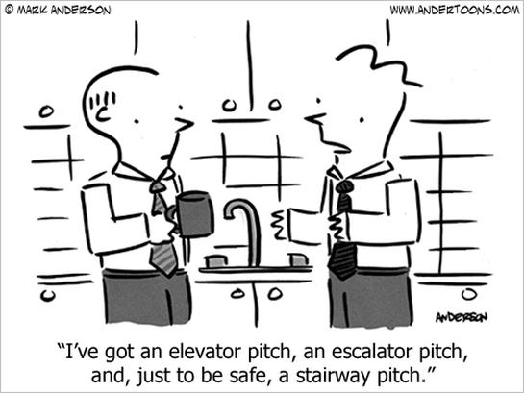
Conclusion
Your elevator pitch is not static
Refine it over time:
As you do more projects
Find better ways to express your contributions
Pitch to different audiences
Devise multi-resolution pitches
Load your pitch onto your phone and you are good to go!

Slide 24
Resources for crafting elevator pitch
Job interview focused
Some how-to’s for creating elevator pitch a 4-question guide, and examples http://idealistcareers.org/a-quick-guide-to-writing-your-elevator-pitch-with-examples/
Two examples of college graduates’ elevator pitches for job interview: http://career.uoregon.edu/blog/students/2010/04/elevator-speech-30-seconds-interview
See the prescribed structure and examples from various fields (last section) http://successwise.com/crafting-your-elevator-pitch
Research / academic focused
Two contrasting examples for a PhD student’s elevator pitch, and some how-to’s: https://cfn.upenn.edu/aguirre/wiki/public:elevator_pitch
Videos of STEM cell research elevator pitch contest winners (understandable and exciting for non-biologists too!): https://www.cirm.ca.gov/our-funding/stem-cell-elevator-pitch-challenge
Tips for a scientific elevator pitch: https://dynamicecology.wordpress.com/2014/08/05/perfecting-the-elevator-pitch/
Search for ‘3-minute thesis’ (or 2-minute thesis) on YouTube for several examples

