Slide 1

Peer-Instruction: An active learning strategy to promote student conceptual understanding
Sahana Murthy
IDP in Educational Technology
Indian Institute of Technology Bombay
June 17, 2014
ISTE Workshop on Computer Programming
June 17, 2014

Slide 2
Sample question – vote individually
You toss an old 1-rupee coin and a new 1-rupee
coin. Which is the most likely outcome:
Two heads
Two tails
One head and one tail
Each of 1, 2, 3 above is equally likely

Slide 3
Discuss with your neighbour, vote again
You toss an old 1-rupee coin and a new 1-rupee
coin. Which is most likely:
Two heads
Two tails
One head and one tail
Each of 1, 2, 3 above is equally likely
Notes:
3

Slide 4
How many of you changed your answer?

Slide 5
What you just did was Peer Instruction!

Slide 6
What you just did was Peer Instruction!
Examine more closely:
What exactly did you do? (you are the students in this case)
PAIR - Turn to your neighbor.
Write two specific actions that students (you) did. Don’t simply say “we solved the problem”
SHARE – Discuss with entire class, facilitated by coordinator.
Come with a list of behaviours that a student does during the Peer-Instruction activity.

Slide 7
What you just did was Peer Instruction!
Examine more closely:
What do students do in Peer-Instruction ?
Talk to each other
Listen to their classmates
Argue about the content
Reason, solve steps of the problem
Write or draw to solve the problem…

Slide 8
Dissecting Peer-Instruction method
What do students do? What are the benefits? Talk, argue, listen (sometimes), reason, draw => Actively engaged Learn from each other, teach each other (teach<=>learn) Those who don’t know willing to think, reason, answer Those who do know also participate Pre-existing thinking is elicited, confronted, resolved (How many of you changed your answer?)
What are benefits to instructor? To the class atmosphere? Immediate feedback to instructor Students realize that even others are struggling Builds a friendly, yet scientific atmosphere Improve communication

Slide 9
Recall - Requirements of active learning strategies
Instructor creates carefully designed activities that require students to talk, write, reflect and express their thinking.
Majority of students go beyond listening, copying of notes, execution of prescribed procedures.
9
Notes:
9

Slide 10
Key elements of active learning strategies
Students engage in problem-solving activities during class time.
The problems posed are in a variety of contexts, often real-life.
Speciﬁc student ideas are elicited and addressed.
Students are asked to “ﬁgure things out for themselves.”
Students are asked to express their reasoning explicitly.
Students work collaboratively.
Students receive rapid feedback on their work.
Qualitative reasoning and conceptual thinking are emphasized.
10
Notes:
10

Slide 11
Peer-Instruction is a classroom active learning strategy based on specific, well-designed questions.
Notes:
11

Slide 12

Anatomy of Peer-Instruction method
Ask Question
(May vote individually)
…Lecture…
Debrief /
Class Discussion
Peer Discussion
Vote
Figure attributed to: Stephanie Chasteen and the Science Education Initiative at the University of Colorado
See also: Peer Instruction, A User’s Manual. Eric Mazur.
12
Notes:
12

Slide 13
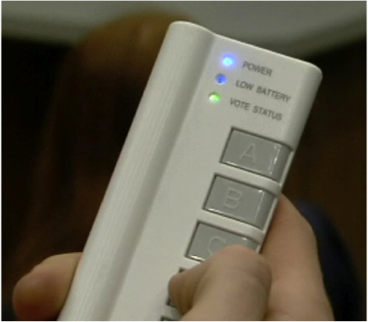
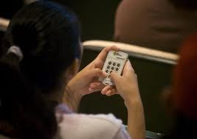

Implementing Peer-Instruction with clickers

Slide 14
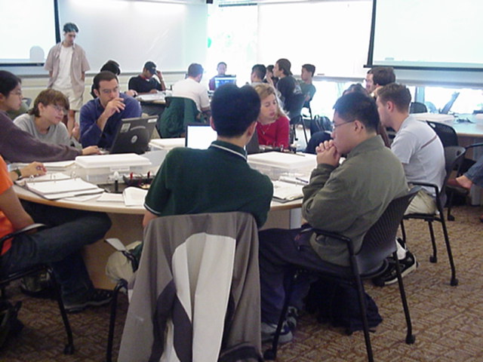
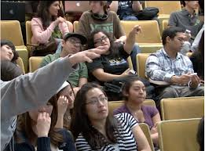
But clickers are not Peer-Instruction
MIT TEAL classroom
From blog.peerinstruction.net

Slide 15



How to implement Peer-Instruction without clickers

Slide 16
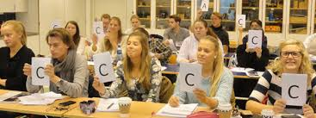
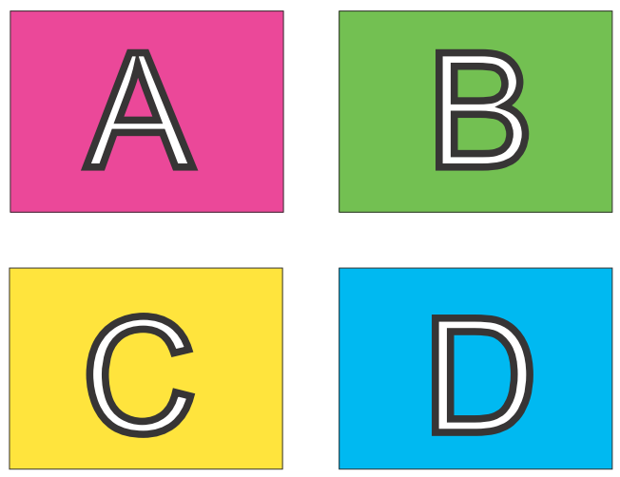
How to implement Peer-Instruction in your class
Image from Monash University Peer Instruction in the Humanities Project http://tinyurl.com/kh7uo2o
OR:
A4 sheet of paper
Fold it in four
Marker – A, B, C, D

Slide 17
PI one of the most widely researched* strategies (* This is good because …)
Extent of research
300+ research articles
Physics, biology, chemistry maths, CS, engineering, psychology, medicine & nursing …
Many controlled studies using standardized tests
Courses using peer instruction outperform traditional lecture courses on a common test
Students can better answer a question on their own, after peer instruction discussion, (especially difficult questions) – study with 16 pairs of isomorphic questions Smith et al, Science 2009
Research on student perception says: clickers help students show up for class, feel part of class community, make their voice heard, hold them accountable …

Slide 18
Writing effective Peer-Instruction questions
Notes:
18

Slide 19
Debate: Is a multiple-choice question good?
Coordinators: Make 2 groups - A and B.
Participants:
Those in group A should list points for why multiple choice questions can be “good.”
Those in group B should list points for why multiple choice questions are NOT “good.”
Coordinators: Send two main points in favour of what MCQs can be good and two points against it, through A-view chat.

Slide 20
What makes a peer-instruction question “good”?
An effective peer-instruction question:
Is usually conceptual (avoid long analytic computation)
Elicits pre-existing thinking, students’ alternate conceptions
Has believable distractors
Asks students to predict results of experiment, or algorithm
Makes students apply ideas in new context
Relates different representations
is not ambiguous
is not leading
is not ‘trivial’
Adapted from Clicker Resource Guide, Science Education Initiative/ CU-Boulder .
20

Slide 21
What makes a good Peer-Instruction question?
clarity | Students should waste no effort trying to figure out what’s being asked.
context | The topic of the question should be relevant to the class.
connection to learning goals | Does the question make students do the right thing to demonstrate they grasp the concept.
distractors | i) Must be plausible. ii) “Wrong” choices should tell you something about students’ thinking.
difficulty | Check that the question is not too trivial or too hard (note – there exists a theory for this)
stimulates thoughtful discussion | The question should engage students and spark thoughtful discussions. Is there potential for you to be “agile”?
Adapted from “Writing Questions” by Stephanie Chasteen and the Science Education Initiative at the University of Colorado
Notes:
Courtesy of Cynthia Heiner and Peter Newbury
You may then show a series of questions to participants and ask them to consider these aspects: clarity, context, connection, distractors, difficulty, and discussion
21

Slide 22

How to come up with believable distractors
Talking with other instructors that have taught the course in the past.
Talking with your students one-on-one before class, after class, during office hours.
Using student responses to open-ended questions that you include in HW and exams.
Asking your students to come up with answers that will be used as the choices.
Use researched and documented student misconceptions.
Courtesy: D. Duncan, Univ. of Colorado. From from “Writing Questions” by Stephanie Chasteen and the Science Education Initiative at the University of Colorado
22

Slide 23
Types of Peer-Instruction questions

Slide 24
Counting iterations
Below is the for loop for calculating the factorial of a number. How many times is this set of code executed ?
for (i = 1; i <= N; i ++) {
nFactorial = nFactorial * i;
}
1 time
N times
N -1 times
N + 1 times

Slide 25
What does this code do?
main () {
int vn=9; va[vn];
for (int i = 0; i < vn; i++) va[i] = i * (vn – 1 –i);
for (int i = 0; i < vn; i++) cout << va[i] << “,”;
cout << endl;
}
What does this code do?
Calculates values of array va[]
Prints the values of first vn elements of va
Initializes the array va and prints it
Finds maximum element in the array

Slide 26
Predict the outcome of a program
What is the output of the code shown below?
int main() {
int a = 1; b = 2; c = 3;
int *p, *q;
p = &a; q = &b;
c = *p; p = q;
*p = 13;
cout << a << b << c;
}
a=1, b=2, c=3
a= 1, b=13, c=1
a=1, b=2, c=1

Slide 27
What will happen if …. were changed
Consider the function and main program shown below.
void fun (int x) { x = 5; }
int main () {
int a = 3;
fun(a);
cout << a << endl;
}
What will happen if we change the function call from
fun (int x) to fun (int& x) ?
No change in the output
Program will not compile
a = 5 will be printed
a = 3 will be printed

Slide 28
Debug
Int val = 5;
Switch (val) {
case 5: cout << “five ”;
break;
case 4: cout << “four ”;
break;
default: cout << “default”;
break;
}
What will happen if we forget to include ‘break’ statement?
Compiler error
It will print only five
It will print five four
It will print five four default

Slide 29
Activity – write your own question
Choose a topic in an Intro-to-programming course.
Write a peer-instruction question in that topic.
Make sure you include the choices too ~ 3 to 5.
Recall – An effective PI question :
Elicits pre-existing thinking, students’ misconceptions
Has believable distractors
Asks students to predict results of a program or algorithm
Makes students apply ideas in new context
Relates different representations
Avoid
Long calculations
Trivial questions

Slide 30
Activity – write your own question
Choose a topic in an Intro-to-programming course.
Write a peer-instruction question in which:
You show part of a program.
Then ask students to predict the output of the program
Include 3-5 choices for the output

Slide 31
When to use Peer-instruction questions
Notes:
31

Slide 32
Questions within the learning cycle
BEFORE
Setting up instruction
(beginning of module)
DURING
Developing knowledge
(middle of module)
AFTER
Assessing learning
(end of module)
Questions to:
Motivate
Discover
Provoke thinking
Assess prior knowledge
Questions to:
Check knowledge
Application
Analysis
Evaluation
Synthesis
Elicit misconception
Questions to
Relate to big picture
Demonstrate success
Review or recap
Exit poll
Adapted from From from “iClicker” by Stephanie Chasteen and the Science Education Initiative at the University of Colorado
32
Notes:
An alternate presentation of the Question Cycle by Peter Newbury
32

Slide 33
Challenges and Best Practices
Notes:
33

Slide 34
Challenges you might face
REPORTED CHALLENGES | RECOMMENDED STRATEGIES
The class is too quiet. | Be patient – students’ reluctance to discuss improves after 3-4 iterations Do solo vote, allow enough time
The class is too noisy. | That’s ok, this is good noise. Most students are seen to be on task.
Some students just may not participate. | Explain why you are doing this, use challenging & interesting questions, … let them be
Students may not know how to reason. | This is not quite true provided questions are designed well
The class will get chaotic. How do I get students back? | Use a cue such as a bell
Notes:
34

Slide 35
Best Practices
On Writing Questions
Recommended – questions requiring conceptual reasoning (verbal, logical, diagrammatic)
Avoid – questions involving number crunching (but can use PI to precede a numerical problem, for ex … )
Recommend – Mix it up.
WHY: different pedagogical goals : bringing out a misconception, predicting an outcome, recall point from last class
WHAT: different types of questions: survey, representations, reasoning, Y/N
WHEN: at a variety of points during class (beginning / middle / end)
Avoid - questions that can be answered by memorization (unless that’s your goal, then use sparingly).
Notes:
35

Slide 36
Best Practices
On Facilitating Peer-Instruction
DON’T SKIP ON PEER DISCUSSION (if single vote, only after group talk)
FOCUS ON REASONING NOT ON RIGHT ANSWER.
Withhold judgment. Do not give ‘rapid rewards’ (nodding in assent)
Discuss reasons for right and wrong answers
Ask multiple students to give answers.
TIME. Recommended 2-5 minutes per question.
FREQUENCY. Recommended – a “few” per class, 2-4.
CREDIT. Do not assign heavy credit for right / wrong answers. Some instructors (with clickers) assign a “whiff” of credit for participation.
I like to circulate, listen to student reasoning, give individual attention
Notes:
36

Slide 37
Important good practice – Applicable for all active learning strategies
GET STUDENT BUY-IN.
Create it by explaining why you are doing this.
Better still demonstrate why you are doing this.
Notes:
37

Slide 38
Plenty of resources
Peer-instruction How-tos, workshop slides, videos, research … Carl Wieman Science Education Institute http://www.cwsei.ubc.ca/resources/clickers.htm
and host of links from within
Instructors in many disciplines have posted peer-instruction questions for their courses – physics, CS, Statistics – use Google (search with varied nomenclature – PI, clickers, PRS)
BUT …
We need to create a library of questions for our courses, report experiences in our context.
Please participate!
Notes:
38

