Slide 1

Peer-Instruction: An interactive learning strategy to promote students’ conceptual reasoning
Sahana Murthy
IDP in Educational Technology
Indian Institute of Technology Bombay
Symposium on teaching-learning in higher education
IIT Madras
May 28, 2014

Slide 2
Teaching
Ph.D. Program, began 2010
20 Ph.D. research scholars
Faculty members
  Core
  Associated (from IITB Depts – EE, CSE, ChE, HSS, IDC …)
  Visiting (from India and abroad)
PhD Students
  Coursework
  Research projects
  Outreach activities

Slide 3
Ph.D. theses – IIT Bombay ET
Framework for scaffolding programming to Hindi-medium learners
Development and assessment of engineering design competencies
Computer-based training for improvement of spatial skills
Development the scientific ability of modeling using learning objects
Development of students’ problem posing skills
Teacher integration of technology in classroom
Framework for customized visualization selection and integration
Interactive Visualizations in engineering education
Development of guidelines to design and evaluate Virtual Labs
Collaborative approach for programming using Spoken Tutorials
Automated generation and evaluation of assessment instrument
Automation in constructing customized textbooks from lecture transcripts
Learning pan-domain cognitive skills
Teacher use of ET
Effective design of educational technology
Automated content generation & assessment

Slide 4
Outreach
T10KT workshop (Feb. 2013):
Research Methods in Educational Technology
  4000 engineering college instructors participated
  50 participants mentored to conduct action research
  12 participants presented paper in T4E 2013 conference
20+ Workshops on:
  Integrating educational technology in engg. education
  Effective teaching-learning strategies for engg. education
Materials uploaded under Creative Commons at
  http://www.et.iitb.ac.in/resources
  http://www.it.iitb.ac.in/nmeict/eVideos/RMET_Teachers/content/content.html

Slide 5
What is active learning?
Approach to teaching and learning whose goal is to engage students with the content via specific activities that get students to talk, write, reflect and express their thinking.
  There are several instructional strategies that can come under active learning.
  Many informal strategies may have the same goal, but to be termed as active learning, they need to meet the following requirements.
Requirements of active learning strategies:
Instructor creates carefully designed activities that require students to talk, write, reflect and express their thinking.
Students go beyond listening, copying of notes, execution of prescribed procedures.
Explicitly based on theories of learning.
Evaluated repeatedly through empirical research.
D. E. Meltzer and R. K. Thornton. "Resource letter ALIP–1: active-learning instruction in physics." Am.J.Phys 80.6 (2012): 478-96

Slide 6
But my lectures are plenty interactive!
I often pause to ask students if they understood the material
Students can even interrupt with doubts
I never hesitate to answer their questions
I show them demos and videos
….
Aren’t these enough?

Slide 7
Lecture quality does not seem to matter
EXPERIMENT Two videos of same instructor | Group 1- ‘Fluent’ video speaks fluently, no notes, upright, maintains eye-contact | Group 2 – ‘Disfluent video speaks haltingly, often sees notes, slouches, poor body language
MEASURE-MENT | student performance by post-test on topic
RESULTS | Perceived learning greater than actual learning |  | Perceived equal to actual learning
 | Same actual learning for both groups
If it is not quality of lectures, what does lead to better learning?
S. K. Carpenter et al. “Appearances can be deceiving: instructor fluency increases perceptions of learning without increasing actual learning”. Psychonomic bulletin & review,20(6), 1350-1356, 2013.

Slide 8
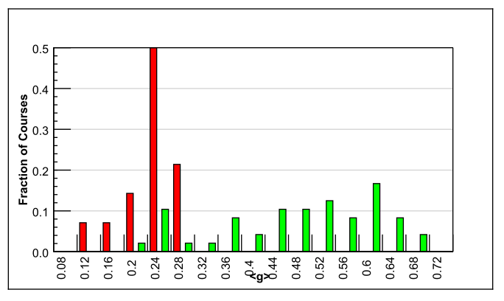
Comparing good lectures with interactive engagement strategies
Traditional lecture (14)
Interactive engagement strategies (48)
Normalized gain
<g> = ^{(post-pre)}/^{(100-pre)}
90% PI courses
Harvard
R. Hake, “Interactive-engagement versus traditional methods: A six-thousand student survey of mechanics test data for introductory physics courses” Amer. Jour. Phy., 66 (1998)
6542 students
62 courses – Physics (many instructors with high evals)
Variety of institutions: high school, college, university
Standardized test used – Force Concept Inventory
Desirable to incorporate interactive engagement strategies
Notes:
The unit here is a course. We know that interactive engagement works. But how can we achieve it?

Slide 9
How can we achieve active learning?
Peer-Instruction
Think-Pair-Share
This is the talk right after lunch – Prof Sridhar Iyer, IIT Bombay
Team-Pair-Solo
Many others:
  Problem-based learning, Productive failure, Role-play, Jigsaw,

Slide 10
What exactly is Peer-Instruction?
How is it different from other types of questioning?
How is Peer-Instruction related to clickers?

Slide 11
Student
Question - Vote individually
You toss an old 1-rupee coin and a new 1-rupee
coin. Which is the most likely outcome:
Two heads
Two tails
One head and one tail
Each of 1, 2, 3 above is equally likely
September 4, 2013
IITB CEP - BATU
Notes:
50-50 on choice 3 vs 4

Slide 12
Discuss with your neighbour
and vote again
Student
You toss an old 1-rupee coin and a new 1-rupee
coin. Which is most likely:
Two heads
Two tails
One head and one tail
Each of 1, 2, 3 above is equally likely
September 4, 2013
IITB CEP - BATU
Notes:
LOTS of discussion, debate! Converge to 80% choice 3, 20% choice 4

Slide 13
How many of you changed your answer?
September 4, 2013
IITB CEP - BATU

Slide 14
Dissecting Peer-Instruction method
Teacher
What did students (you in the previous slide) do?
Talk, argue, listen (sometimes), reason, draw => Actively engaged
Learn from each other, teach each other (teach<=>learn)
Those who don’t know willing to think, reason, answer
Those who do know also participate
Pre-existing thinking is elicited, confronted, resolved
What are other benefits? To instructor? To class atmosphere
Immediate feedback to instructor
Students realize that even others are struggling
Builds a friendly, yet scientific atmosphere
Improve communication

Slide 15
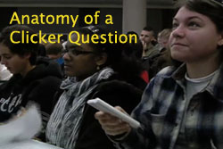
Anatomy of Peer-Instruction method
Ask Question
(May vote individually)
…Lecture…
Debrief /
Class Discussion
Peer Discussion
Vote
Figure attributed to: Stephanie Chasteen and the Science Education Initiative at the University of Colorado
See also: Peer Instruction, A User’s Manual. Eric Mazur.

Slide 16
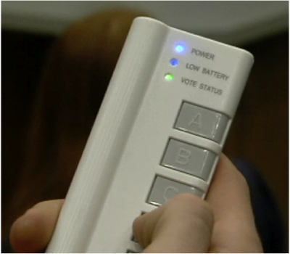
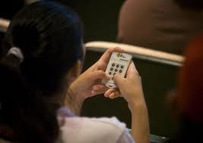

Peer-Instruction with clickers

Slide 17
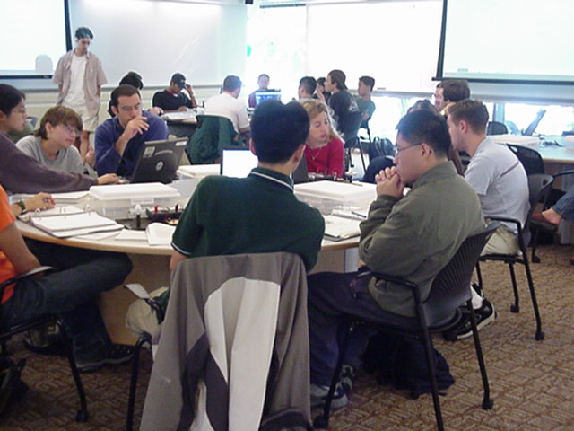
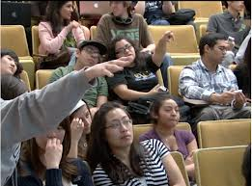
But clickers are not Peer-Instruction
MIT TEAL classroom
From blog.peerinstruction.net

Slide 18
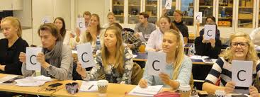
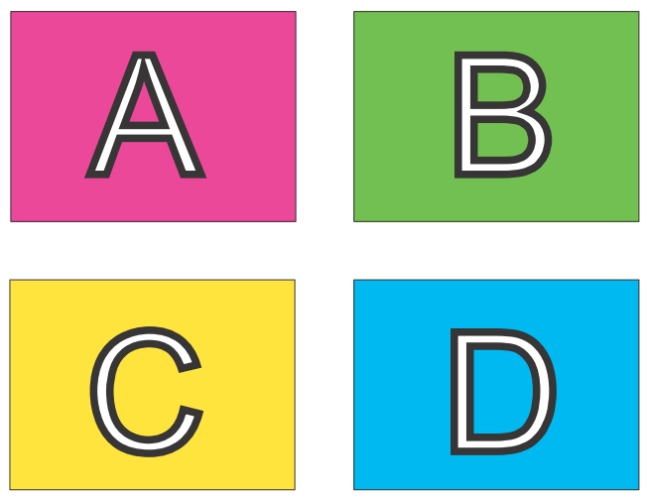
Peer-Instruction without clickers – 1
Image from Monash University Peer Instruction in the Humanities Project http://tinyurl.com/kh7uo2o
OR:
A4 sheet of paper
Fold it in four
Marker – A, B, C, D

Slide 19



Peer-Instruction without clickers - 2

Slide 20
Research on Peer-Instruction

Slide 21
PI one of the most widely researched* strategies
(* This is good because …)
Extent of research
  300+ research articles
  Physics, biology, chemistry maths, CS, engineering, psychology, medicine & nursing …
  Many controlled studies using standardized tests
Courses using peer instruction outperform traditional lecture courses on a common test
Students can better answer a question on their own, after peer instruction discussion, (especially difficult questions) – study with 16 pairs of isomorphic questions Smith et al, Science 2009
Research on student perception says: clickers help students show up for class, feel part of class community, make their voice heard, hold them accountable …
From ‘iClickerJan292014’ ppt, Stephanie Chasteen / Science Education Initiative/ CU-Boulder .

Slide 22
Writing effective Peer-Instruction questions

Slide 23
What makes a good peer-instruction question?
An effective peer-instruction question:
  Is usually conceptual (avoid long analytic computation)
  Elicits pre-existing thinking, students’ alternate conceptions
  Asks students to predict results of experiment, or algorithm
  Makes students apply ideas in new context
  Relates different representations
  Has believable distractors
  is not ambiguous
  is not leading
  is not ‘trivial’

Slide 24
Types of Peer-Instruction questions

Slide 25
Survey questions
I would like to know a little about your background. Which domain do you identify with the most?
Physics
Chemistry
Computer Science
Electrical Engg
Mechanical Engg
Other engg domain
None of the above

Slide 26
Survey questions
Since this is the first class of PH103 – Electricity & Magnetism, I would like to know your background.
Are you familiar with vector calculus?
I only know basic differentiation and integration
I have heard the terms gradient, divergence, curl, but I do not know how to calculate them
I can calculate gradient, divergence, curl of functions but I do not know how to draw the functions
I can calculate vector derivatives as well as comfortably draw the functions
I used this in the first class in PH103 E&M

Slide 27
Different questions for different goals, pedagogical strategies
Survey questions
Conceptual reasoning
Predict an outcome (e.g., of experiment, program)
Reason using representations
As a stepping stone to problem-solving
Recall point from previous lecture
Personal opinion

Slide 28
Conceptual reasoning
A parallel plate capacitor is charged to a total charge Q
and the battery removed. A dielectric slab is inserted
between the plates.
What happens to the energy stored in the capacitor?
Increases
Decreases
Stays the same
Typical conceptual reasoning question.

Slide 29
Concepts (and misconceptions)
Which of the following best describes the concept of a networking "protocol"?
A) A protocol is a connection for peer layers of a network to communicate with each other.
B) A protocol is a set of rules which govern the syntax and semantics of communication between corresponding layers in a network.
C) A protocol defines standards that determine the format and
interpretation of data in a network.
D) A protocol is a set of services that one layer uses from layers
below it.
Choose one of the options below.
1. All of the above
2. A), B) and C)
3. B) and C)
4. D) only

Slide 30

Predict the outcome
(of an experiment, video, program)
A helium balloon is attached to a string tied to the bottom of a cart on wheels. The sides of the cart are encased in clear plastic. A person will abruptly push the cart to the
left. Will the balloon move?
  Yes, to the left
  Yes, to the right
  No
Let students vote, then show movie for what happens. http://paer.rutgers.edu/pt3/experiment.php?topicid=13&exptid=121
Get students to predict, show video URL, discuss reasoning in wrap-up

Slide 31
Predict results of experiment
A light bulb lights up when it’s connected to a power source through a weak acid.
What will happen if we use a 100% acid solution?
Brighter
Dimmer
Same brightness
September 4, 2013
IITB CEP - BATU

Slide 32
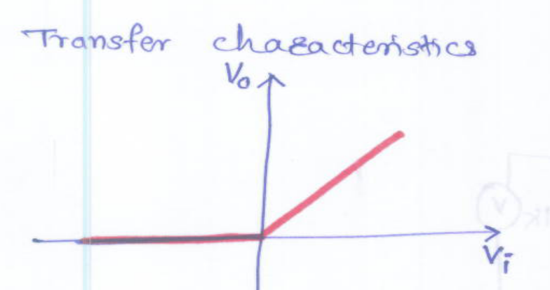
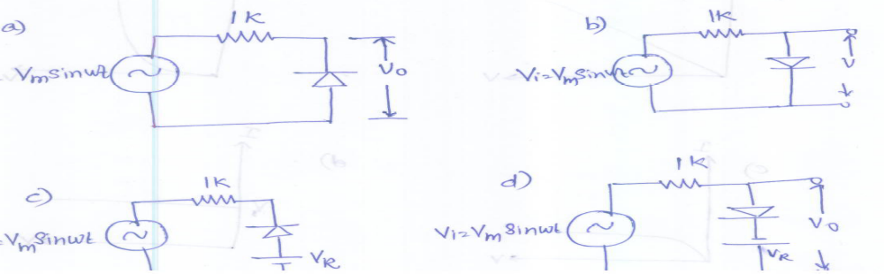
Reasoning with representations
Which circuit will satisfy given input output relationship?
Diagrammatic representations in question AND choices

Slide 33
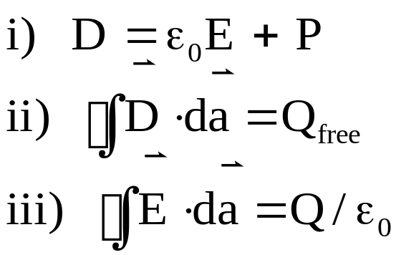

A very large capacitor has charge Q. A neutral dielectric is inserted into the gap . Your goal is to find D everywhere. You can use the following relations:
As a stepping stone to problem-solving
+Q
-Q
Which equation would you use first?
The one with P
The one with Q_{free}
The one with Q/
D) I can use any of them first
Such questions are useful to start the problem solving process, before students begin to flex their mathematical muscles.
Notes:
CORRECT ANSWER: B
USED IN: Fall 2008 (Dubson), Spring 2008 (Pollock)
LECTURE NUMBER: Dubson (Week 8, Lecture 20), Pollock (24)
STUDENT RESPONSES: 0% [[84%]] 5% 9% 2% (FALL 2008)
15% [[35%]] 20% 0% 30% (SPRING 2008)
INSTRUCTOR NOTES: This was towards the end of class, and it was all over the place. 35% voted B, nobody went for D, but all other answers well represented.
Note that I did NOT say it was a linear dielectric, and I clearly pointed that out to them, I did NOT want them to *assume* it was a linear dielectric.
My answer is B - that’s certainly what you do, you argue Qfree is known, and find D everywhere.
In the course of discussion, though, my students pointed out I could be wrong.
If the material is nonlinear, then there’s e.g. no guarantee that it’s homogeneous, which means it could polarize more on the left than on the right. Which would rearrange the Q on the capacitor, which means you’ve lost symmetry.... (Not sure how to fix this - I want to assume nonlinearity, which is nominally irrelevant IF you know sigma(free) is a uniform sheet, but still keep it symmetric in the x-y directions to ensure the latter... ) -SJP
WRITTEN BY: Steven Pollock (CU-Boulder)

Slide 34
Recall point from previous lecture
Positive ions flow right through a liquid, negative ions
flow left. Is there a net current through the liquid?
(Same density and speed of both ions)
A) Yes, to the right
B) Yes, to the left
C) No
D) Not enough information given
I used this in the class after the definition of current was introduced
Question based on Concept Test from University of Colorado Upper Division Electrostatics course

Slide 35
Personal opinion
The pace of this class is:
Too fast
Too slow
Just about right
Useful as a mid-semester feedback every 4 weeks or so
The quiz was:
Easy
Somewhat challenging, but I could do it
Too challenging
Used right after Quiz 1

Slide 36
Summary – Question types
Survey questions
Conceptual reasoning
Predict an outcome (e.g., of experiment, program)
Reason using representations
As a stepping stone to problem-solving
Recall point from previous lecture
Personal opinion

Slide 37
When to use Peer-instruction questions

Slide 38
Questions within the learning cycle
BEFORE
Setting up instruction
(beginning of module)
DURING
Developing knowledge
(middle of module)
AFTER
Assessing learning
(end of module)
Questions to:
Motivate
Discover
Provoke thinking
Assess prior knowledge
Questions to:
Check knowledge
Application
Analysis
Evaluation
Synthesis
Elicit misconception
Questions to
Relate to big picture
Demonstrate success
Review or recap
Exit poll
Adapted from From from “iClicker” by Stephanie Chasteen and the Science Education Initiative at the University of Colorado
Notes:
An alternate presentation of the Question Cycle by Peter Newbury

Slide 39
Peer Instruction Resources
Carl Wieman Science Education Initiative - Clicker Resources http://www.cwsei.ubc.ca/resources/clickers.htm.
Used over 20 years in physics – several repositories, books
“Peer Instruction: A User’s Manual” by Eric Mazur
Becoming popular in intro CS courses www.peerinstruction4cs.org
Lots on Google …
September 4, 2013
IITB CEP - BATU
Notes:
Constructivism -- make conections to own knowlegde

Slide 40
Challenges and Best Practices

Slide 41
Challenges you might face
REPORTED CHALLENGES | RECOMMENDED STRATEGIES
The class is too quiet. | Be patient – students’ reluctance to discuss improves after 3-4 iterations Do solo vote, allow enough time
The class is too noisy. | That’s ok, this is good noise. Most students are seen to be on task.
Some students just may not participate. | Explain why you are doing this, use challenging & interesting questions, … let them be
Students may not know how to reason. | This is not quite true provided questions are designed well
The class will get chaotic. How do I get students back? | Use a cue such as a bell

Slide 42
Best Practices
On Writing Questions
Recommended – questions requiring conceptual reasoning (verbal, logical, diagrammatic)
Avoid – questions involving number crunching (but can use PI to precede a numerical problem, for ex … )
Recommend – Mix it up.
  WHY: different pedagogical goals : bringing out a misconception, predicting an outcome, recall point from last class
  WHAT: different types of questions: survey, representations, reasoning, Y/N
  WHEN: at a variety of points during class (beginning / middle / end)
Avoid - questions that can be answered by memorization (unless that’s your goal, then use sparingly).

Slide 43
Best Practices
On Facilitating Peer-Instruction
DON’T SKIP ON PEER DISCUSSION (if single vote, only after group talk)
FOCUS ON REASONING NOT ON RIGHT ANSWER.
  Withhold judgment. Do not give ‘rapid rewards’ (nodding in assent)
  Discuss reasons for right and wrong answers
  Ask multiple students to give answers.
TIME. Recommended 2-5 minutes per question.
FREQUENCY. Recommended – a “few” per class, 2-4. (Some instructors for ex Eric Mazur entirely use PI, no lectures).
CREDIT. Do not assign heavy credit for right / wrong answers. Some instructors (with clickers) assign a “whiff” of credit for participation.
I like to circulate, listen to student reasoning, give individual attention

Slide 44
Important good practice –
Applicable for all active learning strategies
GET STUDENT BUY-IN.
Create it by explaining why you are doing this.
Better still demonstrate why you are doing this.

Slide 45
Plenty of resources
Peer-instruction How-tos, workshop slides, videos, research … Carl Wieman Science Education Institute http://www.cwsei.ubc.ca/resources/clickers.htm
and host of links from within
Instructors in many disciplines have posted peer-instruction questions for their courses – physics, CS, Statistics – use Google (search with varied nomenclature – PI, clickers, PRS)
BUT …
We need to create a library of questions for our courses, report experiences in our context.
Please participate!

