Slide 1

Peer-Instruction: An interactive learning strategy How to promote student conceptual reasoning in your course
Sahana Murthy
IDP in Educational Technology
Indian Institute of Technology Bombay
February 27, 2014
This presentation is released under Creative Commons-Attribution 4.0 License.
You are free to use, distribute and modify it , including for commercial purposes,
provided you acknowledge the source.

Slide 2
From Tomorrow’s Professor, Feb 25 2014
Sometimes at the end of a workshop, a participant asks: "If I want to try just one thing you told us about, what should it be?"
My answer is always active learning.
[…] that means engaging students in course-related activities in class other than watching and listening to the instructor. They may be asked to answer a question, begin a problem solution or derivation or figure out the next step, explain a concept, interpret an observation, brainstorm a list, predict the outcome of an experiment, or any of a hundred other things.
Stanford Center for Teaching and Learning
2
2
Notes:
2

Slide 3
A quick word on nomenclature
Active learning
Interactive learning
Interactive engagement
Different names used by different communities but all are
learner-centric strategies
3
3
Notes:
3

Slide 4
Requirements of active learning strategies
Instructor creates carefully designed activities that require students to talk, write, reflect and express their thinking.
Students go beyond listening, copying of notes, execution of prescribed procedures.
Explicitly based on theories of learning.
Evaluated repeatedly through empirical research.
Note:
Many informal strategies may have the goal of engaging students, but to be termed as active learning, they need to meet the above requirements.
Meltzer, David E., and Ronald K. Thornton. "Resource letter ALIP–1: active-learning instruction in physics." American journal of physics 80.6 (2012): 478-496.
4
Notes:
4

Slide 5
But my lectures are plenty interactive!
I often pause to ask students if they understood the material
Students can even interrupt with doubts
I never hesitate to answer their questions
I show them demos and videos
….
Aren’t these enough?
5
Notes:
5

Slide 6
Lecture quality does not seem to matter
EXPERIMENT Two videos of same instructor | Group 1- ‘Fluent’ video speaks fluently, no notes, upright, maintains eye-contact | Group 2 – ‘Disfluent video speaks haltingly, often sees notes, slouches, poor body language
MEASURE-MENT | student performance by post-test on topic
RESULTS | Perceived learning greater than actual learning |  | Perceived equal to actual learning
 | Same actual learning for both groups
If it is not quality of lectures, what does lead to better learning?
S. K. Carpenter et al. “Appearances can be deceiving: instructor fluency increases perceptions of learning without increasing actual learning”. Psychonomic bulletin & review,20(6), 1350-1356, 2013.
6
6
Notes:
6

Slide 7
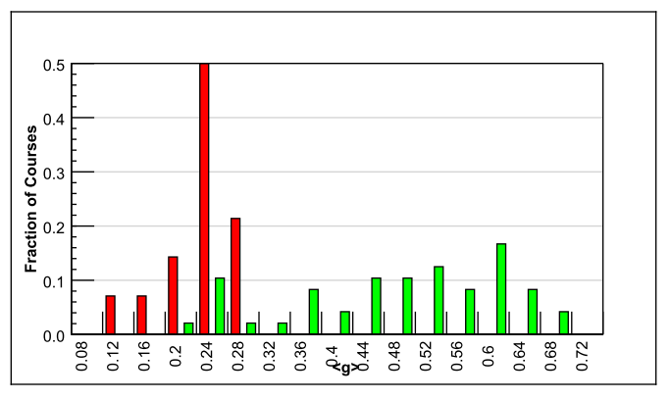
Comparing good lectures with interactive engagement strategies
Traditional lecture (14)
Interactive engagement strategies (48)
Normalized gain
<g> = ^{(post-pre)}/^{(100-pre)}
90% PI courses
Harvard
R. Hake, “Interactive-engagement versus traditional methods: A six-thousand student survey of mechanics test data for introductory physics courses” Amer. Jour. Phy., 66 (1998)
6542 students
62 courses – Physics (many instructors with high evals)
Variety of institutions: high school, college, university
Standardized test used – Force Concept Inventory
Desirable to incorporate interactive engagement strategies
Notes:
The unit here is a course. We know that interactive engagement works. But how can we achieve it?
7

Slide 8
How can we achieve active learning?
Think-Pair-Share [Frank Lyman, University of Maryland, early 1980s]
(IDP-ET mini-workshop Dec 2013, Sridhar Iyer)
Peer-Instruction [Eric Mazur, Harvard University, early 1990s]
Team-Pair-Solo [Spencer Kagan, University of California, early 2000s]
Many others:
Problem-based learning, Productive failure, Role-play, Jigsaw,

Slide 9
What exactly is Peer-Instruction?
How is it different from other types of questioning?
How is Peer-Instruction related to clickers?
Notes:
9

Slide 10
Sample question – vote individually
Student
A
A
B
B
C
C
Battery
Battery
Switch closed
Switch open
BEFORE
AFTER
What happens to brightness of bulb A after the switch S is closed?
Brightness of A decreases
Brightness of A increases
Brightness of A stays the same
I am not sure how to answer this

Slide 11
Discuss with your neighbour, vote again
Student
A
A
B
B
C
C
Battery
Battery
Switch closed
Switch open
BEFORE
AFTER
What happens to brightness of bulb A after the switch is closed?
Brightness of A decreases
Brightness of A increases
Brightness of A stays the same
I am not sure how to answer this
Notes:
11

Slide 12
Another sample Peer-Instruction Question
What is the relationship between the vectors
in the figure?
Notes:
12

Slide 13
When did I ask this question?
The first class after mid-sem (Electricity & Magnetism course)
before I gave back student answers.
Notes:
13

Slide 14
Mid-sem question, result and action
QUESTION: Use Biot-Savart law to calculate the magnetic field due to a long wire carrying current I, as a function of distance from the wire.
RESULT: Students did not do well on the question. (Answer should be a formula with distance from wire as a parameter).
ACTION:
1) Identified main places where students went wrong:
Setting up of integral → Vectors (r minus r-prime)
Problem in vector addition of infinitesimal magnetic fields
Many had nonsensical final answers – needed limiting case checks
2) Created a series of conceptual multiple-choice questions aimed to elicit above common difficulties. The questions required verbal and diagrammatical reasoning.
3) Did Peer-Instruction with these questions while discussing midsem. Discussion phase in PI helped students resolve these difficulties. (see the PI Qs used, on next 3 slides)
Notes:
14

Slide 15
Peer-Instruction Q1
In the figure, with “dl” shown, which pink vector best represents used in Biot Savart’s law?
P
B
A
D
C
Origin
dl
I
E) None of these is close!
Question based on Concept Test from University of Colorado Upper Division Electrostatics course
Notes:
15
CORRECT ANSWER: A
USED IN: Fall 2008 (Dubson), Spring 2008 (Pollock)
LECTURE NUMBER: Dubson (Week 10, Lecture 25), Pollock (30)
STUDENT RESPONSES: [[96%]] 0% 2% 0% 2% (FALL 2008)
[[100%]] 0% 0% 0% 0% (SPRING 2008)
INSTRUCTOR NOTES: 100% correct in SP08, silent. Guess they know this! Answer is A, from the source, to the target point. -SJP
WRITTEN BY: Steven Pollock (CU-Boulder)

Slide 16
To find the magnetic field B at P due to a current-carrying wire we use the Biot-Savart law,
Peer-Instruction Q2
What is the direction of the infinitesimal contribution dB at point P created by current in dl?
Up the page
Directly away from dl to left (on the plane of the page)
Into the page
Out of the page
Question based on Concept Test from University of Colorado Upper Division Electrostatics course
Notes:
16
CORRECT ANSWER: C
USED IN: Fall 2008 (Dubson),Spring 2008 (Pollock)
LECTURE NUMBER: Dubson (Week 10, Lecture 25), Pollock (30)
STUDENT RESPONSES: 2% 0% [[96%]] 0% 2% (FALL 2008)
0% 0% [[ 94%]] 0% 6% (SPRING 2008)
INSTRUCTOR NOTES: 94% correct, (1 vote for E) Silent. Guess they know this too! -SJP
WRITTEN BY: Steven Pollock (CU-Boulder)

Slide 17
Which of the following expressions makes sense for the magnetic field B at P due to a current-carrying wire?
Peer-Instruction Q3
r
2)
3)
Notes:
17
CORRECT ANSWER: C
USED IN: Fall 2008 (Dubson),Spring 2008 (Pollock)
LECTURE NUMBER: Dubson (Week 10, Lecture 25), Pollock (30)
STUDENT RESPONSES: 2% 0% [[96%]] 0% 2% (FALL 2008)
0% 0% [[ 94%]] 0% 6% (SPRING 2008)
INSTRUCTOR NOTES: 94% correct, (1 vote for E) Silent. Guess they know this too! -SJP
WRITTEN BY: Steven Pollock (CU-Boulder)

Slide 18
Dissecting Peer-Instruction method
What did students (you in the previous slide) do? Talk, argue, listen (sometimes), reason, draw => Actively engaged Learn from each other, teach each other (teach<=>learn) Those who don’t know willing to think, reason, answer Those who do know also participate Pre-existing thinking is elicited, confronted, resolved (How many of you changed your answer?)
What are other benefits? To instructor? To class atmosphere Immediate feedback to instructor Students realize that even others are struggling Builds a friendly, yet scientific atmosphere Improve communication

Slide 19
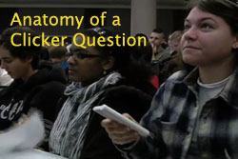
Anatomy of Peer-Instruction method
Ask Question
(May vote individually)
…Lecture…
Debrief /
Class Discussion
Peer Discussion
Vote
Figure attributed to: Stephanie Chasteen and the Science Education Initiative at the University of Colorado
See also: Peer Instruction, A User’s Manual. Eric Mazur.
19
Notes:
19

Slide 20
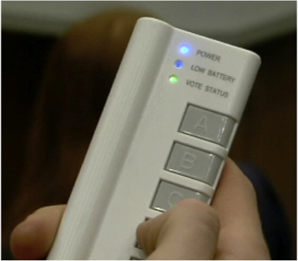
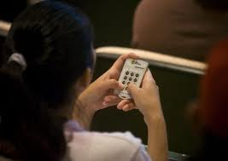

Peer-Instruction with clickers

Slide 21
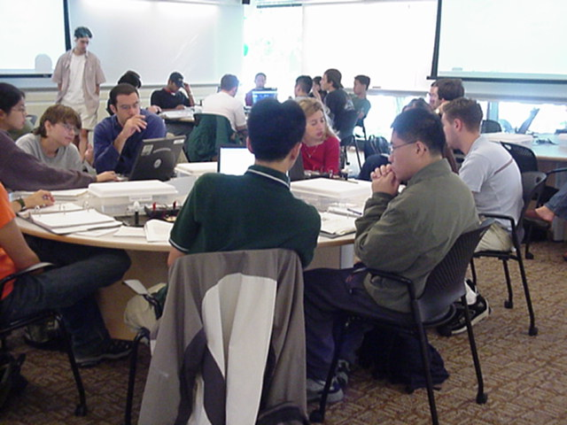
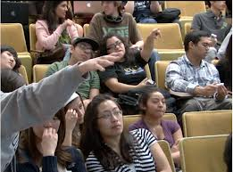
But clickers are not Peer-Instruction
MIT TEAL classroom
From blog.peerinstruction.net

Slide 22
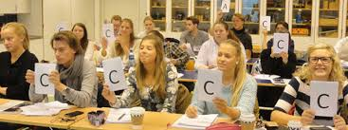
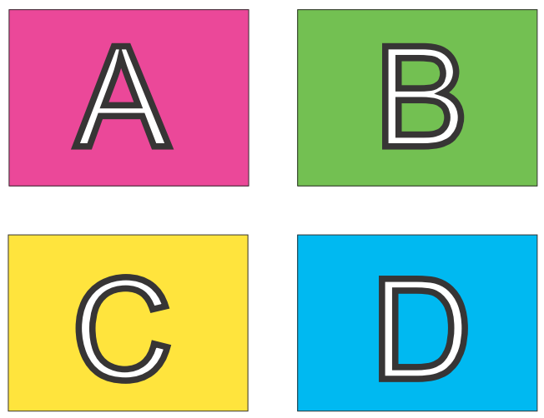
Peer-Instruction without clickers – 1
Image from Monash University Peer Instruction in the Humanities Project http://tinyurl.com/kh7uo2o
OR:
A4 sheet of paper
Fold it in four
Marker – A, B, C, D

Slide 23



Peer-Instruction without clickers - 2

Slide 24
Research on Peer-Instruction
Notes:
24

Slide 25
PI one of the most widely researched* strategies (* This is good because …)
Extent of research
300+ research articles
Physics, biology, chemistry maths, CS, engineering, psychology, medicine & nursing …
Many controlled studies using standardized tests
Courses using peer instruction outperform traditional lecture courses on a common test
Students can better answer a question on their own, after peer instruction discussion, (especially difficult questions) – study with 16 pairs of isomorphic questions Smith et al, Science 2009
Research on student perception says: clickers help students show up for class, feel part of class community, make their voice heard, hold them accountable …
From ‘iClickerJan292014’ ppt, Stephanie Chasteen / Science Education Initiative/ CU-Boulder .

Slide 26
Activity: Write your own Peer-Instruction question, based on a mid-sem question
Consider a mid-sem question in your course.
Identify what points the students might find difficult in answering it (if you have already graded this, you know exactly what)
Choose one such difficulty / error.
Write a PI question to help address the above difficulty / error. Some possible questions:
Ask students to reason conceptually (increase / decrease, greater / less, left / right, what would happen if … )
If different representations are part of the problem, create a question based on the representation (translate words to diagram, equation to graph … )
Give a few possible choices and ask students to argue plausibility of answers using dimensional analysis, limiting cases

Slide 27
Writing effective Peer-Instruction questions
Notes:
27

Slide 28
Group Brainstorm: What are features of a “good” multiple-choice question?
DISCUSS | DISCUSS

Slide 29
What makes a good peer-instruction question?
An effective peer-instruction question:
Is usually conceptual (avoid long analytic computation)
Elicits pre-existing thinking, students’ alternate conceptions
Has believable distractors
Asks students to predict results of experiment, or algorithm
Makes students apply ideas in new context
Relates different representations
is not ambiguous
is not leading
is not ‘trivial’
Adapted from Clicker Resource Guide, Science Education Initiative/ CU-Boulder .
29

Slide 30
What makes a good Peer-Instruction question?
clarity | Students should waste no effort trying to figure out what’s being asked.
context | The topic of the question should be relevant to the class.
connection to learning goals | Does the question make students do the right thing to demonstrate they grasp the concept.
distractors | i) Must be plausible. ii) “Wrong” choices should tell you something about students’ thinking.
difficulty | Check that the question is not too trivial or too hard (note – there exists a theory for this)
stimulates thoughtful discussion | The question should engage students and spark thoughtful discussions. Is there potential for you to be “agile”?
Adapted from “Writing Questions” by Stephanie Chasteen and the Science Education Initiative at the University of Colorado
Notes:
Courtesy of Cynthia Heiner and Peter Newbury
You may then show a series of questions to participants and ask them to consider these aspects: clarity, context, connection, distractors, difficulty, and discussion
30

Slide 31

How to come up with believable distractors
Talking with other instructors that have taught the course in the past.
Talking with your students one-on-one before class, after class, during office hours.
Using student responses to open-ended questions that you include in HW and exams.
Asking your students to come up with answers that will be used as the choices.
Use researched and documented student misconceptions.
Courtesy: D. Duncan, Univ. of Colorado. From from “Writing Questions” by Stephanie Chasteen and the Science Education Initiative at the University of Colorado
31

Slide 32
Types of Peer-Instruction questions

Slide 33
Different questions for different goals, pedagogical strategies
Conceptual reasoning “one right answer” questions
Discussion “no one right answer” questions
Predict an outcome (e.g., of experiment, program)
Embed reasoning in answers (give choice and its reason)
Reason using representations
As a stepping stone to problem-solving
Recall point from previous lecture
Survey questions / personal opinion

Slide 34
Facts and Concepts - reason towards the “one right answer”
This is an important fact / concept. Can use this question to start discussion on plant growth, photosynthesis etc. Can repeat the question after instruction.
From ‘iClickerJan292014’ ppt, Stephanie Chasteen / Science Education Initiative/ CU-Boulder .

Slide 35
Facts and Concepts - reason towards the “one right answer”
A parallel plate capacitor is charged to a total charge Q
and the battery removed. A dielectric slab is inserted
between the plates.
What happens to the energy stored in the capacitor?
Increases
Decreases
Stays the same
Typical conceptual reasoning question.

Slide 36
Discussion - “no single right answer”
A block m sits on a rough inclined surface, attached with a spring (extended) to a fixed point at the other end. As the block moves up the incline a small distance, how many forces are exerted on the block?
One force
Two forces
Three forces
Four forces
Five forces
More than five forces
Impossible to determine
None of the above
Good question to get students to model a physical system
From ‘Example Questions’ ppt, Stephanie Chasteen / Science Education Initiative/ CU-Boulder . Original credit Bill Gerace, U. Mass Amherst

Slide 37
Activity – write your own question
Choose one of the two goals:
Conceptual reasoning “one right answer” questions
Discussion “no one right answer” questions
Write a peer-instruction question for your course.
(Make sure you include the choices too ~ 3 to 5)

Slide 38

Predict the outcome (of an experiment, video, program)
A helium balloon is attached to a string tied to the bottom of a cart on wheels. The sides of the cart are encased in clear plastic. A person will abruptly push the cart to the
left. Will the balloon move?
Yes, to the left
Yes, to the right
No
Let students vote, then show movie for what happens. http://paer.rutgers.edu/pt3/experiment.php?topicid=13&exptid=121
Get students to predict, show video URL, discuss reasoning in wrap-up

Slide 39
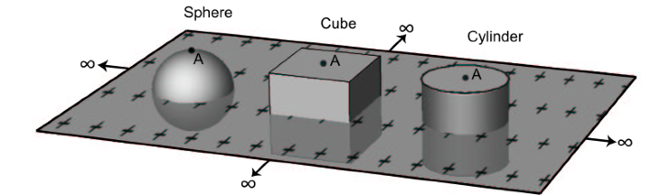
Beyond Yes / No: Embed reasoning in answers
For which of these Gaussian surfaces will Gauss’ law help us to calculate E at point A (top center) due to the infinite sheet of charge?
Only the sphere since it is the only one with full symmetry
Only the cylinder because it has circular symmetry and side walls have zero flux
Only the cylinder and the cube because they have side walls perpendicular to the sheet and end caps parallel to the sheet
Only the sphere and cylinder because they have circular cross section
All surfaces will work because they are all symmetric
Question based on Concept Test from University of Colorado Upper Division Electrostatics course

Slide 40
Activity – write your own question
Choose one of the two goals:
3. Predict an outcome (e.g., of experiment, program)
4. Embed reasoning in answers (give choice and its reason)
Write a peer-instruction question for your course.

Slide 41
Reasoning with representations
Which circuit will satisfy given input output relationship?
Diagrammatic representations in question AND choices

Slide 42
A very large (effectively infinite) capacitor has charge Q. A neutral dielectric is inserted into the gap (and of course, it will polarize) . Your goal is to find D everywhere. You can use the following relations:
As a stepping stone to problem-solving
+Q
-Q
Which equation would you use first?
The one with P
The one with Q_{free}
The one with Q/
D) I can use any of them first
Such questions are useful to start the problem solving process, before students begin to flex their mathematical muscles.
Notes:
42
CORRECT ANSWER: B
USED IN: Fall 2008 (Dubson), Spring 2008 (Pollock)
LECTURE NUMBER: Dubson (Week 8, Lecture 20), Pollock (24)
STUDENT RESPONSES: 0% [[84%]] 5% 9% 2% (FALL 2008)
15% [[35%]] 20% 0% 30% (SPRING 2008)
INSTRUCTOR NOTES: This was towards the end of class, and it was all over the place. 35% voted B, nobody went for D, but all other answers well represented.
Note that I did NOT say it was a linear dielectric, and I clearly pointed that out to them, I did NOT want them to *assume* it was a linear dielectric.
My answer is B - that’s certainly what you do, you argue Qfree is known, and find D everywhere.
In the course of discussion, though, my students pointed out I could be wrong.
If the material is nonlinear, then there’s e.g. no guarantee that it’s homogeneous, which means it could polarize more on the left than on the right. Which would rearrange the Q on the capacitor, which means you’ve lost symmetry.... (Not sure how to fix this - I want to assume nonlinearity, which is nominally irrelevant IF you know sigma(free) is a uniform sheet, but still keep it symmetric in the x-y directions to ensure the latter... ) -SJP
WRITTEN BY: Steven Pollock (CU-Boulder)

Slide 43
Activity – write your own question
Choose one of the two goals:
5. Reason using representations (for ex interpret graph) or translate between representations (for ex convert between graph / equation / words / diagram)
6. Conceptual question as a stepping stone to solve a problem
Write a peer-instruction question for your course.

Slide 44
Recall point from previous lecture
Positive ions flow right through a liquid, negative ions
flow left. Is there a net current through the liquid?
(Same density and speed of both ions)
A) Yes, to the right
B) Yes, to the left
C) No
D) Not enough information given
I used this in the class after the definition of current was introduced
Question based on Concept Test from University of Colorado Upper Division Electrostatics course

Slide 45
Survey questions
I would like to know a little about you. Choose the most appropriate response.
Are you familiar with vector calculus?
I only know basic differentiation and integration
I have heard the terms gradient, divergence, curl, but I do not know how to calculate them
I can calculate gradient, divergence, curl of functions but I do not know how to draw the functions
I can calculate vector derivatives as well as comfortably draw the functions
I used this in the first class in PH103 E&M

Slide 46
Survey questions
Are you concerned about global climate change?
Yes
No
I don’t think the climate is changing
I don’t know if the climate is changing
Use such questions to begin open discussions on topics where varied opinions exist
Notes:
46
climate change_abbott_2

Slide 47
Personal opinion
The pace of this class is:
Too fast
Too slow
Just about right
Useful as a mid-semester feedback every 4 weeks or so
The quiz was:
Easy
Somewhat challenging, but I could do it
Too challenging
Used right after Quiz 1

Slide 48
Summary: question types
Conceptual reasoning “one right answer” questions
Discussion “no one right answer” questions
Predict an outcome (e.g., of experiment, program)
Embed reasoning in answers (give choice and its reason)
Reason using representations
As a stepping stone to problem-solving
Recall point from previous lecture
Survey questions / personal opinion

Slide 49
Activity – write your own question
Write a survey / personal opinion question as a peer-instruction question for your course.

Slide 50
When to use Peer-instruction questions
Notes:
50

Slide 51
Questions within the learning cycle
BEFORE
Setting up instruction
(beginning of module)
DURING
Developing knowledge
(middle of module)
AFTER
Assessing learning
(end of module)
Questions to:
Motivate
Discover
Provoke thinking
Assess prior knowledge
Questions to:
Check knowledge
Application
Analysis
Evaluation
Synthesis
Elicit misconception
Questions to
Relate to big picture
Demonstrate success
Review or recap
Exit poll
Adapted from From from “iClicker” by Stephanie Chasteen and the Science Education Initiative at the University of Colorado
51
Notes:
An alternate presentation of the Question Cycle by Peter Newbury
51

Slide 52
Challenges and Best Practices
Notes:
52

Slide 53
What are some challenges you might face
Your concerns?
Notes:
53

Slide 54
Challenges you might face
REPORTED CHALLENGES | RECOMMENDED STRATEGIES
The class is too quiet. | Be patient – students’ reluctance to discuss improves after 3-4 iterations Do solo vote, allow enough time
The class is too noisy. | That’s ok, this is good noise. Most students are seen to be on task.
Some students just may not participate. | Explain why you are doing this, use challenging & interesting questions, … let them be
Students may not know how to reason. | This is not quite true provided questions are designed well
The class will get chaotic. How do I get students back? | Use a cue such as a bell
Notes:
54

Slide 55
Best Practices
On Writing Questions
Recommended – questions requiring conceptual reasoning (verbal, logical, diagrammatic)
Avoid – questions involving number crunching (but can use PI to precede a numerical problem, for ex … )
Recommend – Mix it up.
WHY: different pedagogical goals : bringing out a misconception, predicting an outcome, recall point from last class
WHAT: different types of questions: survey, representations, reasoning, Y/N
WHEN: at a variety of points during class (beginning / middle / end)
Avoid - questions that can be answered by memorization (unless that’s your goal, then use sparingly).
Notes:
55

Slide 56
Best Practices
On Facilitating Peer-Instruction
DON’T SKIP ON PEER DISCUSSION (if single vote, only after group talk)
FOCUS ON REASONING NOT ON RIGHT ANSWER.
Withhold judgment. Do not give ‘rapid rewards’ (nodding in assent)
Discuss reasons for right and wrong answers
Ask multiple students to give answers.
TIME. Recommended 2-5 minutes per question.
FREQUENCY. Recommended – a “few” per class, 2-4. (Some instructors for ex Eric Mazur entirely use PI, no lectures).
CREDIT. Do not assign heavy credit for right / wrong answers. Some instructors (with clickers) assign a “whiff” of credit for participation.
I like to circulate, listen to student reasoning, give individual attention
Notes:
56

Slide 57
Important good practice – Applicable for all active learning strategies
GET STUDENT BUY-IN.
Create it by explaining why you are doing this.
Better still demonstrate why you are doing this.
Notes:
57

Slide 58
Plenty of resources
Peer-instruction How-tos, workshop slides, videos, research … Carl Wieman Science Education Institute http://www.cwsei.ubc.ca/resources/clickers.htm
and host of links from within
Instructors in many disciplines have posted peer-instruction questions for their courses – physics, CS, Statistics – use Google (search with varied nomenclature – PI, clickers, PRS)
BUT …
We need to create a library of questions for our courses, report experiences in our context.
Please participate!
Notes:
58

