Slide 1

Academic excellence through quality technical education: Challenges and opportunities
Sahana Murthy
Inter-Disciplinary Program in Educational Technology
IIT Bombay
AICTE sponsored national seminar
Thakur College of Engineering and Technology
January 23, 2014

Slide 2
Our goals as educators
We want students to learn:
Content
  how does it all fit together, hierarchy of concepts
Engineering “abilities’
  complex problem solving, designing experiments, making predictions, checking solutions
Attitudes and skills
  communication, ethics, teamwork, social responsibility

Slide 3
Our goals as educators
We also need to fulfill:
Prepare students for the globalized 21st century world
Make sure our students are employable
NBA criteria
Possibly target ABET criteria, Washington accord
…

Slide 4
Challenges and solutions

Slide 5
Teaching-learning scenario
What did the teacher do?
Explained logic circuits using truth table and Boolean expressions.
Solved multiple problems to find Boolean expression for given logic diagrams, and vice-versa.
What did students do?
Studied all gates.
Solved number of problems related to finding of Boolean expression for logic diagram and vice-versa.
What were exam questions?
Real life scenario was given in which students were supposed to identify the gates, draw logic diagram and write Boolean expression.
What was the result?
Most students were not able to solve this problem
Students unhappy; teacher unhappy.

Slide 6
Who’s right?
Students’ comment:
The question was out of syllabus. We have not done such problems in the class.
Teacher’s comment:
The question is simple since students know truth table for gates. They just have to apply logic to the given scenario and solve the problem.
Vote
The teacher is right, but not the students.
The students are right, but not the teacher.
Both are in fact right.

Slide 7
Both are right … but what went wrong?
Teachers expectations not conveyed to students.
Students understanding not clear to teachers.
Lack of alignment: goals, strategies, assessment

Slide 8
Challenge #1: Mismatch
Teachers’ expectations
Teaching strategy
Students’ study plan
Assessment questions

Slide 9
Addressing the challenge
Teachers’ expectations
Teaching strategy
Learning objectives
Students’ study plan
Assessment questions

Slide 10
From syllabus …
Today’s class | Description from syllabus
Section 2.3 from textbook | Logic gates AND, OR, NOR, NAND gates, logic diagram, Boolean expressions, gate combination

Slide 11
From syllabus … to learning objectives
Today’s class | Description from syllabus | Learning Objective On completion of this class, the student will be able to:
Section 2.3 from textbook | Logic gates AND, OR, NOR, NAND gates, logic diagram, Boolean expressions, gate combination | Draw symbol of logic gates. Write truth table of AND, OR, NOR, NAND gates. Draw logic diagram for given mathematical expression. Calculate outputs for logic gate combinations. Solve real-life problem by identifying logic gate combination

Slide 12
From syllabus … to learning objectives
Today’s class | Description from syllabus | Learning Objective On completion of this class, the student will be able to:
Section 2.3 from textbook | Logic gates AND, OR, NOR, NAND gates, logic diagram, Boolean expressions, gate combination | Draw symbol of logic gates. Write truth table of AND, OR, NOR, NAND gates. Draw logic diagram for given mathematical expression. Calculate outputs for logic gate combinations. Solve real-life problem by identifying logic gate combination
Precise, measureable

Slide 13
Why learning objectives?
Learning objectives will help us answer:
What knowledge, skills, attitudes do we want students to develop?
How should we structure the content of your material?
What resources and strategies should we use in our instruction?
How should we assess the students’ learning?
Learning: systematic process
Teaching: systematic process
Assessment: Clear, fair, accurate

Slide 14
What is a learning objective?
Indicates specific measurable performance outcome of learner
Recall – On completion of this class, the student will be able to:
Draw symbol of logic gates. Write truth table of AND, OR, NOR, NAND gates. Draw logic diagram for given mathematical expression. Calculate outputs for gate combinations. Solve real-life problem by identifying logic gate combination.

Slide 15
Is this a valid learning objective?
Students will know how logic gates work.
VOTE - 1) Yes 2) No
Notes:
Assessment – leads to

Slide 16
Is this a valid learning objective?
Students will know how logic gates work.
VOTE - 1) Yes 2) No
Notes:
Assessment – leads to

Slide 17
Is this a valid learning objective?
Students will know how logic gates work.
VOTE - 1) Yes 2) No
How will you measure?
The “knowing” is inside students’ head.
Notes:
Assessment – leads to

Slide 18
Is this a valid learning objective?
Students will be able to understand the function of logic gates.
VOTE - 1) Yes 2) No
Notes:
Assessment – leads to

Slide 19
Is this a valid learning objective?
Students will be able to understand the function of logic gates.
VOTE - 1) Yes 2) No
What precisely do you mean by “understand?”
Different interpretations -
1) Students should be able to describe function of given logic gate.
2) Students should be able to convert the logic diagram to a mathematical expression.
2) Students should be able to apply the function of a gate to solve a real-life problem.
Notes:
Assessment – leads to

Slide 20
Is this a valid learning objective?
Students will be able to understand the function of logic gates.
VOTE - 1) Yes 2) No
What precisely do you mean by “understand?”
VOTE -
1) Students should be able to describe function of given logic gate.
2) Students should be able to convert the logic diagram to a mathematical expression.
2) Students should be able to apply the function of a gate to solve a real-life problem.
Notes:
Assessment – leads to

Slide 21
Is this a valid learning objective?
Students will appreciate real-life potential of logic gates.
VOTE -- 1) Yes 2) No
Notes:
Assessment – leads to

Slide 22
Is this a valid learning objective?
Students will appreciate real-life potential of logic gates.
VOTE -- 1) Yes 2) No
How can we measure if students “appreciate”?
Notes:
Assessment – leads to

Slide 23
Is this a valid learning objective?
Students will appreciate real-life potential of logic gates.
VOTE -- 1) Yes 2) No
How can we measure if students “appreciate”?
Notes:
Assessment – leads to

Slide 24
Constructing learning objectives
Indicates specific measurable performance outcome of learner
DON’T | Instead DO | Need to be
Understand logic gates Know how logic gates work Appreciate potential of logic gates | Formulate using “action” verbs: identify, list, describe, explain, solve, analyze, design, compare | Specific and measurable
Notes:
Assessment – leads to

Slide 25
Is this a valid learning objective?
Give lecture on function of logic gates.
1) Yes 2) No
Show visualization of how logic gates work
1) Yes 2) No
Notes:
Assessment – leads to

Slide 26
Is this a valid learning objective?
Give lecture on function of logic gates.
1) Yes 2) No
Show visualization of how logic gates work
1) Yes 2) No
Learning objectives should be concerned with learners’ actions, not teacher’s.
Notes:
Assessment – leads to

Slide 27
Constructing learning objectives
Indicates specific measurable performance outcome of learner
DON’T | Instead DO | Need to be
Understand logic gates Know how logic gates work Appreciate potential of logic gates | Formulate using “action” verbs: identify, list, describe, explain, solve, analyze, design, compare | Specific and measurable
Lecture on logic gates Show visualization of logic gates function | The student will be able to … | Concerned with learner
Notes:
Assessment – leads to

Slide 28
How to write learning objectives
Start with: The student should be able to …
Use action verbs
identify, list, describe, draw, explain, solve, analyze, compare, design
(avoid understand/know)

Slide 29
How to incorporate “difficulty” of cognitive level in learning objectives
Simple, less effort
Draw symbol of logic gates.
Write truth table of AND, OR, NOR, NAND gates.
Draw logic diagram for given mathematical expression.
Calculate outputs for gate combinations.
Solve real-life problem by identifying logic gate combination.
Design circuits for math operations using gates.
Complex, demanding
Formal theory: Hierarchy of cognitive levels
Revised Bloom’s Taxonomy – 6 levels

Slide 30
Hierarchy of cognitive levels
Level | Description | Action verbs | Example Q
Recall | Recognize, recall facts | cite, label, list, define, quote, identify, state | Define the AND operation using a mathematical expression. Draw symbol for OR gate
Understand | Grasp meaning, explain, interpret, translate, paraphrase | explain, rephrase, convert, give examples, summarize translate, illustrate reword, interpret, Paraphrase | Explain why NAND and NOR gate are called universal gates. Give an example of …
Apply | Use knowledge in a new situation. Involves rules, methods, laws, principles | Apply, relate, solve, classify, predict calculate, prepare | Calculate the output of:

Slide 31
Hierarchy of cognitive levels
Level | Description | Action verbs | Example Q
Analyze | Separate whole into parts until structure of whole and relation betwn parts is clear. | analyze, infer examine, ascertain, associate, dissect discriminate, | Get the output given by the following equation: A+AB+AB
Evaluate | Judge value based on criteria, decision making. | assess, conclude, decide, contrast, compare, evaluate | Decide if it is better to use NAND or NOR gate for goal
Create | Combine parts to make (new) whole, creative behaviours, propose plans | design, combine, devise, modify, plan, extend, compile, generalize | Design a half adder circuit using AND, OR, NOT gates.

Slide 32
Match between Teacher, Student, Exam
Teacher’s
plan
Instructor will plan lecture as:
Explain gates with symbol and truth table.
Show real life situations to identify different gates.
Solve problems to draw logic diagrams for Boolean expression
Learning objectives
Student will be able to:
Draw symbol of logic gates.
Construct a logic diagram for given Boolean expression.
Identify gate combinations for given real life problem.
Student
plan
Student will:
Practice symbols for logic gates
Solve problems to identify gates for given situation.
Practice problems to draw logic diagram for Boolean expression.
Exam
plan
Exam questions:
Construct logic diagram for given situation
Draw logic diagram for Boolean expression

Slide 33
To summarize -
Challenge (#1)
Mismatch between teacher expectation, student study plan, exam questions
Address
Write valid learning objectives for course, module, lecture unit.
Set exam questions aligned to learning objectives
Benefits
Our goals met – deep content, engineering skills
NBA criteria met
Students’ employability increases.

Slide 34
More challenges …. and some solutions

Slide 35
Challenge of student engagement
How many of you have faced this in your class:
Students not engaged, bored, tuned out …
All the time!
Often
Sometimes
Never

Slide 36
Challenge of student engagement
How many of you have faced this in your class:
Students not engaged, bored, tuned out …
All the time!
Often
Sometimes
Never
Leading to decrease in learning

Slide 37

Examples – challenge and addressal
Challenge: Engage students in a 1st year programming class
Strategy: Think-Pair-Share
Challenge: Student learning of basic programming concepts
Strategy: Students interact with a program visualization

Slide 38

Examples – challenge and addressal
Challenge: Low achieving students lack confidence, poor communication skills
Strategy: Active learning approach focused on low achievers
Challenge: Non-CS majors find details of n/w course daunting
Strategy: Use real life analogies and group problem solving

Slide 39
Strategies based on education research
Peer instruction w/ clickers
Think-Pair-Share
Collaborative problem solving
Just-in-time-teaching
Use of computer-visualizations
Concept maps
…
Not just tool, but also pedagogy

Slide 40
Converting challenges to opportunities through Educational Technology

Slide 41
Converting challenges to opportunities through Educational Technology

Slide 42
Which of the following would you consider to be educational technology?
Use ICT tools – computers, WWW, ppt, LMS, wiki
Design guidelines for an educational game
Plan group activities to be conducted in a classroom (such as collaborative project)
All the above

Slide 43
Educational Technology is
technology of education
as well as
technology for education

Slide 44

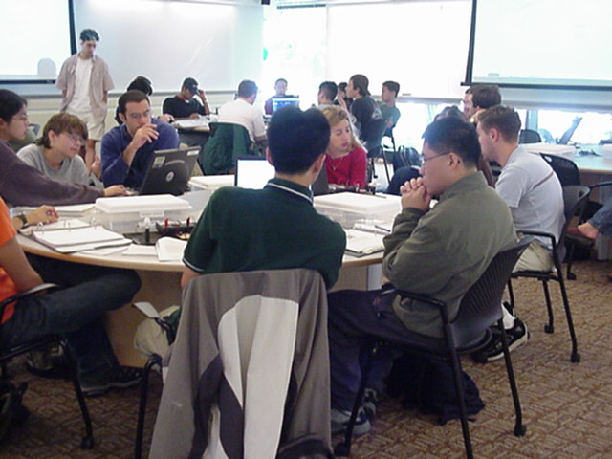


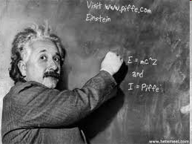


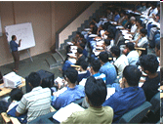
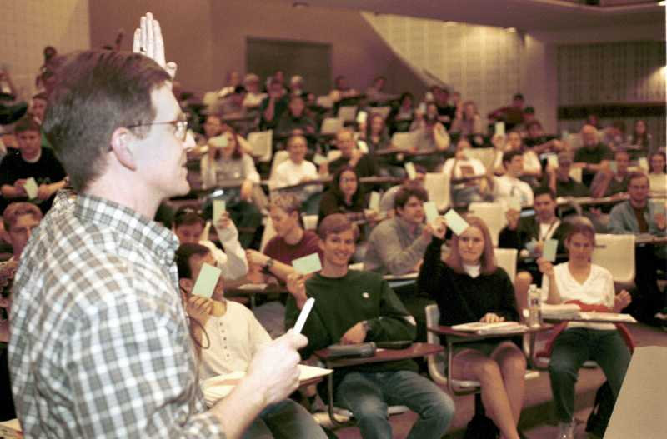


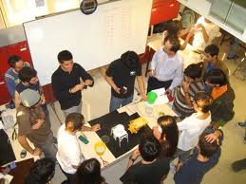

What is Educational Technology?
The application of methods, strategies and tools that facilitate the teaching-learning process, with a focus on current technological tools
Simply using ppt in lecture is NOT educational technology

Slide 45
All-round academic excellence through educational technology
How do people learn?
What are its implications for pedagogy and technology?
Who is the target audience? What are the goals?
Which teaching strategies best address above?
What technology tools provide best advantages for above?
How to systematically design educational material?
Did it all work ?
Learning
Course design
Evaluation

Slide 46
Converting challenges to opportunities through Educational Technology

Slide 47
What you can do
Attend workshops : T10KT, QIP, within college …
Participate in NMEICT projects
Conduct ET action research in your class
Consider PhD in ET

Slide 48
Participate in faculty development workshops
Effective teaching strategies for engg education
Integrating educational technology in engg courses
Research methods in ET
Offered through T10KT, IITB-QIP, other colleges …
See video tutorials on IITB ET webpage → Resources
Opportunity:
Go beyond “showing ppt”
Learn new strategies and effective ET tools, Implement in your class

Slide 49


Slide 50


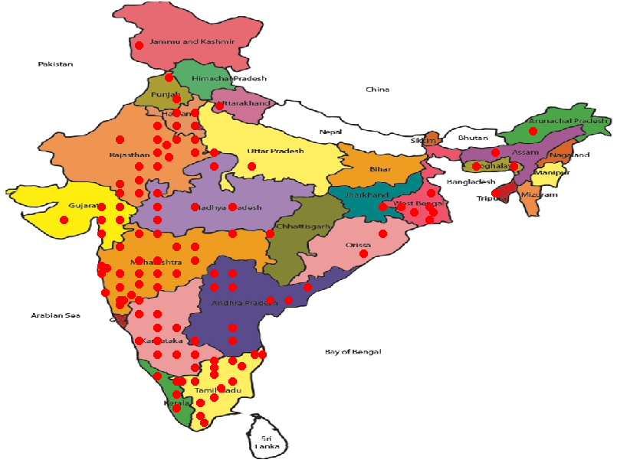
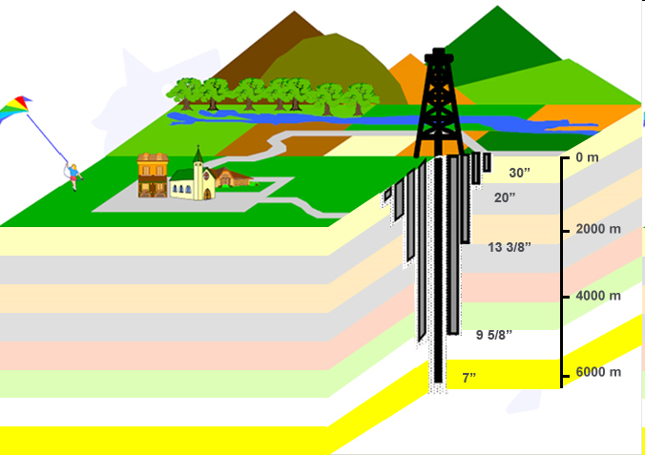
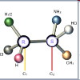
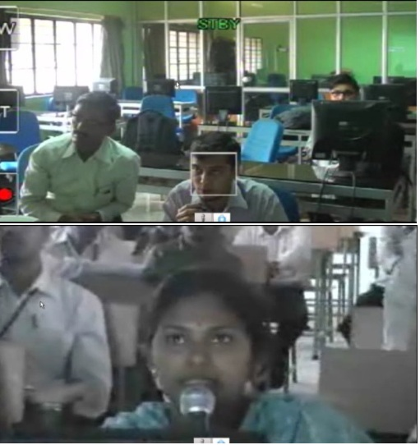

Participate in NMEICT Projects
MHRD - National Mission on Education through ICT
http://nptel.iitm.ac.in/
www. spoken-tutorial.org
300+ tutorials, 20 languages
http://oscar.iitb.ac.in
300 animations, simulations
Teach 10000 Teachers
www.it.iitb.ac.in/nmeict

Slide 51
NMEICT - Pedagogy Project Curriculum Design
Institute
Department(s)
Courses
Modules
Units
Problems /
Assignment
Dept #1: Bachelors
in XYZ
Program educational Objectives
Course A: Module 1
Objective
Dept 2: Course A
Course objectives
Module 2: Unit 1 objectives
Problem 1
Module 2: Unit 1 objectives
Problem 2
Mission and Vision of the Institute
Course A: Module 2
Objective
Dept 2: Course B
Course objectives
Problem 3
Dept #2:
(PEO)
Module 2: Unit 1 objectives
Problem 4
Course A: Module 3
Objective
Problem 5
Dept #3:
(PEO)
Module 2: Unit 1 objectives
Dept 2: Course C
Course objectives
Problem 6
Problem 7
Dept #3:
(PEO)
Course A: Module 4
Objective
Module 2: Unit 1 objectives
Problem 8
Problem 9

Slide 52
Conduct ET action research
Research enhances teaching
Classroom “action research” to integrate research and teaching
  Propose a novel teaching idea (for ex., new TEL strategy)
  Implement teaching idea in your class
  Execute research study in your class
    collect and analyze data
    reflect on findings
  Write paper for ET conference such as T4E
    position wrt related work
    describe rigorous methodology
    draw claims, conclusions
Improve quality of teaching and learning
Conduct research, publish papers

Slide 53
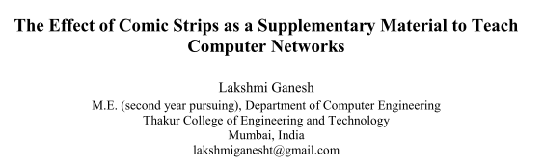
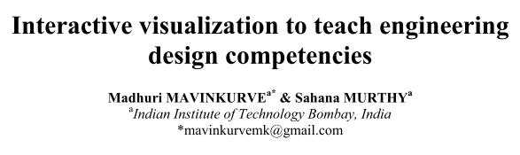
Conduct ET action research
T4E 2013
ICCE 2012
Opportunity: Conduct a study and submit a paper to
IEEE International Conference on Technology for Education T4E
http://www.ask4research.info/t4e/2014/

Slide 54
IITB Educational Technology
Inter-Disciplinary Programme http://www.et.iitb.ac.in
Started April 2010
Ph.D. programme
20 Ph.D. students
Faculty :
  Core faculty in Educational Technology
  CS, engineering, science, social science, design...
Courses in ET, research methods
R & D projects
Notes:
Prof Narayanan, Prof Meenakshi Gupta

Slide 55
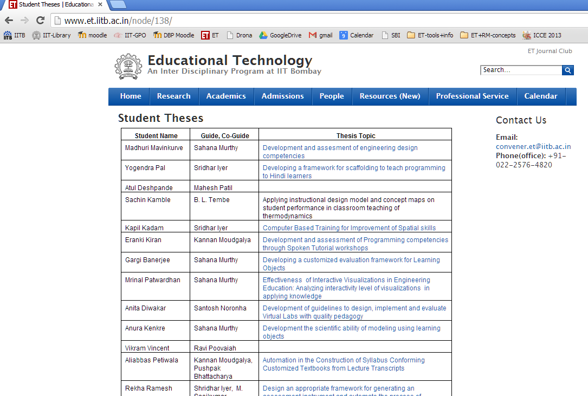
Opportunity: Do PhD
http://www.et.iitb.ac.in/admissions

Slide 56
ET Research Areas at IITB
Pedagogy for technology enhanced learning.
Innovative pedagogies and assessment
Learner-centered strategies
Technology integration for teachers
Development of technology-enhanced learning environments Visualizations - animations, simulations
ITS and adaptive learning systems
Discipline based education research
Physics, CS, Electronics

Slide 57
An Appeal to Principals, Deans, AICTE…

Slide 58
An Appeal to Principals, Deans, AICTE…
Encourage your faculty to pursue Ph.D. in ET.
Recognize ET as a valid discipline for PhD
It is a tremendous opportunity towards achieving academic excellence in quality technical education

Slide 59
Thank you!
    Contact:
    Email: office.et@iitb.ac.in
    sahanamurthy@iitb.ac.in
    Phone: +91-022-2576-4820
    Info: http://www.et.iitb.ac.in
    (PhD admissions, workshops, resources)

