Slide 1

Interactive visualizations to develop scientific abilities
Sahana Murthy
Indian Institute of Technology Bombay
HBCSE
November 22, 2012
Scientific Abilities

Slide 2
Visualizations for learning
  Very well studied : >2500 results on ERIC
  Improved cognitive outcomes
  Improved affective outcomes
  Better immersion
  (… if designed ‘well’)
Scientific Abilities

Slide 3
Interactive visualizations definition
Interactive visualizations, computer simulations
a computer program that contains a model of a system (natural or artiﬁcial; e.g., equipment) or a process (de Jong & van Joolingen 1998)
computer supported, interactive, visual representations of data to amplify cognition (Tory &Moller, 2004)
Scientific Abilities
Notes:
I will use Interactive visualizations, computer simulations interchangably

Slide 4
Interactive visualizations in science education
Several repositories
Computer simulations widely available and integrated into a range of science curricula, available under FOSS / CC (PhET, MERLOT)
Lots of research, for example, studies within
Review on computer simulations in science education (Rutten, van Joolingen & van der Ween, 2012)
Scientific Abilities

Slide 5
Interactive visualizations in science education - effectiveness
Better conceptual understanding of domain (Windschitl & Andre, 1999; Meir 2005; Stern et al., 2008; Zacharia, 2007) Improved student satisfaction and participation (Duran et al, 2007) Perceptions of classroom environment (Kiboss et al, 2004) Higher motivation (Tan et al 2009) Attitudes’ towards subject (Kiboss et al, 2004) Effective for familiarity with lab equipment (Dalgarno,2009) Improves comprehension of lab techniques (Baltzis &Koukias,2007) Potential to generate higher learning outcomes (Akpan, 2001) More constructivist knowledge acquisition (Fund, 2007) Promotes scientific discovery learning (Zhang et al 2004) Better prediction of results of experiment (McKagan et al 2009) | Domain knowledge Engagement Lab skills Science reasoning
Scientific Abilities

Slide 6
Summary of use of visualization
Most studies focus on conceptual understanding of domain
Many on student engagement and motivation
Some on practical lab techniques
Few on scientific reasoning, science process skills
Teaching Science
Concepts
Skills
Attitudes
(science process- related)
Scientific Abilities
Notes:
But science learning and teaching involves all three – concept , skills (both cognitive and procedural/motor) and attitudes towards the subject. We focus on the skills part, especially science process related cognitive skills

Slide 7
Broad problem
Pedagogical design of interactive visualizations to develop scientific abilities in students.
Scientific Abilities

Slide 8
What are scientific abilities?
Processes routinely used by professional scientists in their work.
Ability to:
Represent physical processes in multiple ways
Devise, modify an explanation or quantitative relationship
Design an experimental investigation
Collect and analyze data
Evaluate experimental outcomes, problem solutions, claims
Communicate effectively
(Etkina et al, 2006)
Scientific Abilities

Slide 9
Why scientific abilities?
Scientific abilities are the processes, methods, procedures used by scientists & engineers in their work.
Learning outcomes and competencies recommended by professional organizations and accreditation agencies for college graduates. (NSF, ABET)
Focus of the science education community (also known as science process skills, procedural understanding).
Scientific Abilities

Slide 10
Prior work on developing scientific abilities
CURRICULUM AND MATERIAL FOR | GOALS | INSTRUCTIONAL SETTING
Collaborative, open-ended labs (Roth & Roychoudhary 1993) | Develop science process skills identify relevant variables, transform and analyze data, design an experiment, formulate hypotheses | Science, grade 8; Physics grades 11 & 12.
Inquiry-type laboratories (Krajcik et al, 2001; Hofstein et al, 2005, Hofstein & Mamlok-Naaman, 2007) | Develop students' skills to form hypotheses, design and conducting scientific investigations, formulate and revise scientific explanations pose scientific questions. | Science; Chemistry,high school
Integrated course with carefully designed classroom, lab and homework activities (Etkina et al, 2006). | Develop scientific abilities: represent scientific information in multiple ways, design experiments, evaluate reasoning. | Introductory physics, college level.
Scientific Abilities
Notes:
Work exists in developing sci-ab in f2f scenarios. We have considered the successful ones and borrowed from them.

Slide 11
Our starting point and Our goal
Successful studies & guidelines on developing scientific abilities.
Studies mostly implemented in classroom and lab environments
Today’s learning environments are rich in ICT, ubiquitous use
Exploit affordances of ICT for the important goal of developing scientific abilities.
Scientific Abilities

Slide 12
Research question
What pedagogical features and learning activities should interactive visualizations contain to develop scientific abilities?
Scientific Abilities

Slide 13
Solution Approach
Define scientific abilities as competencies
Devise instrument to measure competencies
Develop instructional material (interactive visualizations) in a given domain to address competencies
Test interactive visualizations, measure students’ acquisition of competencies
Scientific Abilities
Notes:
Philosophy of ‘Backward Design’ - Understanding by Design McTighe & Wiggins

Slide 14
Applying the solution approach
Scientific Abilities

Slide 15
Context of our work
Engineering & science students at college level
Indian university system
Core courses – Basic electronics, solid state physics
Project OSCAR – develop animations and simulations for college level science and engineering courses
http://oscar.iitb.ac.in
Scientific Abilities
Notes:
Why core courses – because these come first, if students learn these skills early on, and repeat them frequently we hope that they will indeed learn by the time they graduate.
Talk a bit about NMEICT and OSCAR

Slide 16
Defining scientific abilities
Scientific ability → Competencies → Sub-competencies
Example
Ability to design experimental investigations:
Competencies
  Structure open-ended problem
  Gather appropriate information
  Think divergently
  Think convergently
Scientific Abilities
Notes:
Will use this example to illustrate our approach

Slide 17
Defining scientific abilities
Scientific ability → Competencies → Sub-competencies
Ability to design experimental investigations
  Structure open-ended problem
  Gather appropriate information
  Think divergently
  Think convergently
Extract specifications from open-ended problem
Use specifications to structure problem
Sequence steps of process
Write structured problem statement
Scientific Abilities

Slide 18
Measuring scientific abilities - Rubrics
Rubrics are descriptive indicators of student achievement of competencies.
Each item in the rubrics corresponds to one sub-competency.
Scale of 0–3. Detailed description of what it means to obtain a score of 0,1,2,3.
Guide writing of curricular material and guide student work.
Score Sub-competency | 3 Adequate | 2 Needs improvement | 1 Inadequate | 0 Missing
Is able to …
Scientific Abilities

Slide 19
Measuring scientific abilities - Rubrics
Competency: Structure open-ended problem
Score Sub-competency | 3 Adequate | 2 Needs improvement | 1 Inadequate | 0 Missing
Is able to extract relevant specifications from open ended problem | All specifications: apparent and hidden are identified and interpreted accurately . | Most apparent specifications are identified, but few hidden ones missing. | An attempt is made but specifications identified are incomplete or incorrect. | No attempt is made to extract specifications
Is able to use specifications to structure open problem | All apparent and hidden specifications are used to structure problem. | An attempt is made to use specifications to structure the problem, but some minor specifications are not used. | An attempt is made to structure the problem but specifications are wrongly applied or not used. | No attempt is made to use specification to identify structure
Scientific Abilities

Slide 20
Developing interactive visualizations
Scientific Abilities

Slide 21
Developing the material
Decide learning objectives based on design competency
Identify requirements in instructional activity
Identify various possible instructional activities to fulfill instructional goals
Filter activities using education research principles and affordance of visualization
Instructional activity (with features decided by filter characteristics)
Scientific Abilities

Slide 22
Educational Research Basis
Research-based strategies for effective learning
  Scaffolding (Holton &Clarke (2006); Hmelo-Silver (2006); Fund (2007))
  Formative assessment (Black & Wiliam 1998,Black et al 2003)
  Multiple representations
Principles to design educational multimedia
  Linking multiple representations (van der Meir & de Jong (1996); Blake &Scanlon (2007))
  Consistency, coherence (Mayer & Clark (2002))
Scientific Abilities

Slide 23
Developing the material
Design Competency / Learning Objective:
Extract relevant specifications from given open design problem
Student is able to | Instructional material should | Learning Activity/ Feature
1) Understand meaning of specification 2) Decide which specifications are needed to solve design problem | Focus students’ attention on specs through examples and explanations Provide information on all specifications of the design problem Assist students in making decisions | Concept clarification tasks Info Box Decision-making tasks Variable Manipulation Design Tips
Scientific Abilities
Notes:
Show one example of each

Slide 24
Developing instructional material
We made choices of:
What format of learning activities
Where to place activity/ feature
What sequencing (mostly non-linear, choice with student)
What feedback to give, what should come next
Guideline underlying above choices:
Help students identify decision points, explore options, make decisions, test effects of decisions
explore
DESIGN
PROCESS
decision
decision
explore
Scientific Abilities

Slide 25
Pilot Test
Scientific Abilities

Slide 26
Methodology – Quantitative Study
2-group post-test quasi-experimental design
Test ‘Structure Open Ended Problem Competency’
Scientific Abilities

Slide 27
Sample
2nd year EE students at Thakur College, Mumbai University
N = 71
Students were familiar material in a course prior to experiment
Familiar with usage of ICT materials
Students expected to perform lab on topic
Random assignment to two groups.
  Experimental group : N=37 (Male - 22, female - 15)
  Control group : N = 34 (Male - 20, female -14)
Equivalence between groups tested on basis on previous semester’s grades. No significant difference.
Scientific Abilities

Slide 28
Instrument
Rubrics to assess “Structure Open Ended Problem” competency
Rubrics validated prior to experiment:
  Content validity with experts
  Construct validity. Students’ written responses to open design problem compared with an independent grade of design ‘product’.
Inter-rater reliability with 3 instructors of domain : 86%
Scientific Abilities

Slide 29
Procedure
Interactive visualization containing identified pedagogical features developed
Topic: Electronics Circuits, amplifier design
Treatment
  Experimental group: interactive visualization.
  Control group: Slides with appropriate diagrams on same topic.
Students work with material for 45 minutes in lab.
Post-test: Students write response to open-ended design problem related to (but not identical) instruction topic. 45 min.
Responses coded using rubrics. 2 raters code responses, discuss till agreement in scores.
Data analysis: chi-square test for differences between groups.
Scientific Abilities

Slide 30
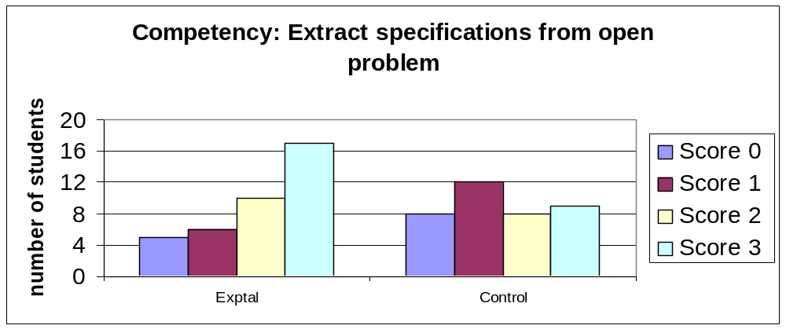
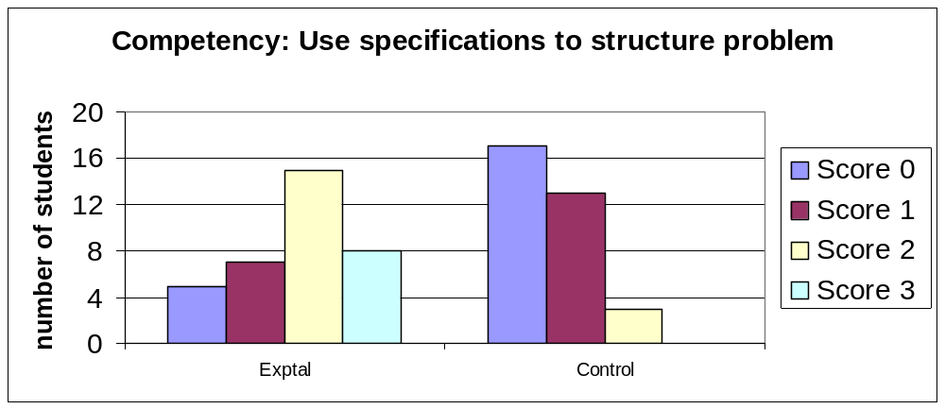
Results
N=71
df = 3
chi-sq = 9.9,
sig at 0.95
N=71
df = 3
chi-sq = 25.8,
sig at 0.99
Scientific Abilities

Slide 31
Summary of Quantitative Study Results
Experimental group shows improves competencies of structure open-ended problem for :
  SOP 1 - extract specifications from open-ended problem
  SOP 2 - use specifications to structure problem
  SOP 3 - sequence steps of process
No significant difference between groups for
  SOP 4 - Write structured problem statement
What worked for SOP 1,2,3? Why SOP4 not work?
Enhanced treatment needed for SOP 4
Scientific Abilities

Slide 32
Follow-up Qualitative Study
Semi-Structured Interviews with 7 students from quantitative study:
  What worked ? (to determine reasons for high achievement of SOP1, 2, 3 abilities)
  Why did students not develop SOP 4 ?
Students’ responses coded to identify factors related to
  Design features in visualization
  Student characteristics
  External factors (e.g. lack of time)
Scientific Abilities

Slide 33
Additional studies (under analysis)
How do students navigate through the instructional material, given that navigation choice (mostly) lies with students?
  How much time spent on various learning activities?
  Do they go through variable manipulation activities?
  What happens when they answer self-assessment questions wrongly?
  Do they spend time on feedback, act on it?
Methodology: Screen-capture software (Camstudio) to acquire data on students’ navigation through the visualization
Scientific Abilities

Slide 34
Cycle of Research & Development
Define scientific ability
Develop, validate rubrics
Revise instructional material
Develop instructional material
Test if students develop abilities
Classroom deployment, teacher training
Guidelines for design of visualizations
Scientific Abilities

Slide 35
Limitations
Topic of test similar to instruction
Transfer to new topic not measured
Not fully clear if higher scores on rubric => “better” overall ability to design experiment (but…)
Applicability of rubrics to different domains not tested yet
Scientific Abilities

Slide 36
Contribution
Teaching-Learning:
ICT-based materials to develop scientific abilities – self-study / supplementary material
Research:
Guidelines to design interactive visualizations for goal of developing scientific abilities
Scientific Abilities

Slide 37
What next?
Short-term:
Repeat similar study with larger, wider sample
Extend to wider range of topics
Medium-term:
Other competencies of experimental design ability:
  information gathering
  convergent / divergent thinking
Modeling ability
  create model : devise qualitative explanation for a phenomenon or a quantitative relationship
  test model: make predictions, test if outcome matches prediction?
Long-term:
Integrating scientific ability visualizations as part of a course / Create stand-alone course
Scientific Abilities

Slide 38
Collaboration
Current
Madhuri Mavinkurve
Anura Kenkre
Mrinal Patwardhan
Gargi Banerjee
Aditi Kothiyal
Previous (post-doctoral work)
Rutgers Physics & Astronomy Education Research Group
MIT Technology Enhanced Active Learning (TEAL) project
Ph.D. students and Research Associates
Educational Technology department
IIT Bombay
Scientific Abilities

Slide 39
References
Akpan, J. P. (2001). Issues associated with inserting computer simulations into biology instruction: a review of the literature. Electronic Journal of Science Education, 5(3), Retrieved from: http://ejse.southwestern.edu/article/viewArticle/7656/5423.
Baltzis, K. B., & Koukias, K. D. (2009). using laboratory experiments and circuit simulation IT tools in an undergraduate course in analog electronics. Journal of Science Education and Technology, 18(6), 546–555.
Dalgarno, B., Bishop, A. G., Adlong, W., & Bedgood, D. R. (2009). Effectiveness of a virtual laboratory as a preparatory resource for distance education chemistry students.
Computers & Education, 53(3), 853–865.
de Jong, T., & van Joolingen, W. R. (1998). Scientiﬁc discovery learning with computer simulations of conceptual domains. Review of Educational Research, 68(2), 179–201.
Duran, M. J., Gallardo, S., Toral, S. L., Martinez-Torres, R., & Barrero, F. J. (2007). A learning methodology using Matlab/Simulink for undergraduate electrical engineering
courses attending to learner satisfaction outcomes. International Journal of Technology and Design Education, 17(1), 55–73.
Etkina, E., Van Heuvelen, A., White-Brahmia, S., Brookes, D. T., Gentile, M., Murthy S., Rosengrant, D. & Warren, A. (2006). Scientific abilities and their assessment, Physical Review, Special Topics, Physics Education Research, 2, 020103.
Fund, Z. (2007). The effects of scaffolded computerized science problem-solving on achievement outcomes: a comparative study of support programs. Journal of ComputerAssisted Learning, 23(5), 410–424.
Kiboss, J. K., Ndirangu, M., & Wekesa, E. W. (2004). Effectiveness of a computer-mediated simulations program in school biology on pupils’ learning outcomes in cell theory. Journal of Science Education and Technology, 13(2), 207–213.
Martinez-Jimenez, P., Pontes-Pedrajas, A., Polo, J., & Climent-Bellido, M. S. (2003). Learning in chemistry with virtual laboratories. Journal of Chemical Education, 80(3), 346–352.
McKagan, S. B., Handley, W., Perkins, K. K., & Wieman, C. E. (2009). A research-based curriculum for teaching the photoelectric effect. American Journal of Physics, 77(1), 87–94.
Mitnik, R., Recabarren, M., Nussbaum, M., & Soto, A. (2009). Collaborative robotic instruction: A graph teaching experience. Computers & Education, 53(2), 330–342.
MERLOT website (2012). (2012). Retrieved 20.06.12.: http://merlot.org/
Physics Education Technology website. (2012). Retrieved 20.06.12.: http://phet.colorado.edu.
Scientific Abilities

Slide 40
References
Roth, W. M. & Roychoudhary, A. (1993) The Development of Science Process Skills in Authentic Contexts. Journal of Research in Science Teaching, 30(2), 127-152.
Stern, L., Barnea, N., & Shauli, S. (2008). The effect of a computerized simulation on middle school students’ understanding of the kinetic molecular theory. Journal of Science
Education and Technology, 17(4), 305–315.
Tan, H.S., Tan, K.C., Fang, L., Wee, M.L., Koh, C. (2009). Using Simulations to Enhance Learning and Motivation in Machining Technology. In Kong, S.C., Ogata, H., Arnseth, H.C., Chan, C.K.K., Hirashima, T., Klett, F., Lee, J.H.M., Liu, C.C., Looi, C.K., Milrad, M., Mitrovic, A., Nakabayashi, K., Wong, S.L., Yang, S.J.H. (eds.) (2009). Proceedings of the 17th International Conference on Computers in Education. Hong Kong: Asia-Pacific Society for Computers in Education.
Tory M. and Moller, T. "Rethinking Visualization: A High-Level Taxonomy", IEEE Symposium on Information Visualization, pp. 151-158, 2004
van Joolingen, W. R., & de Jong, T. (1991). Characteristics of simulations for instructional settings. Education & Computing, 6(3-4), 241–262.
Windschitl, M., & Andre, T. (1998). Using computer simulations to enhance conceptual change: the roles of constructivist instruction and student epistemological beliefs. Journal of Research in Science Teaching, 35(2), 145–160.
Zhang, J. W., Chen, Q., Sun, Y. Q., & Reid, D. J. (2004). Triple scheme of learning support design for scientiﬁc discovery learning based on computer simulation: experimental research. Journal of Computer Assisted Learning, 20(4), 269–282.
Scientific Abilities

Slide 41
Concept clarification tasks
Engineering design competencies
Scientific Abilities

Slide 42


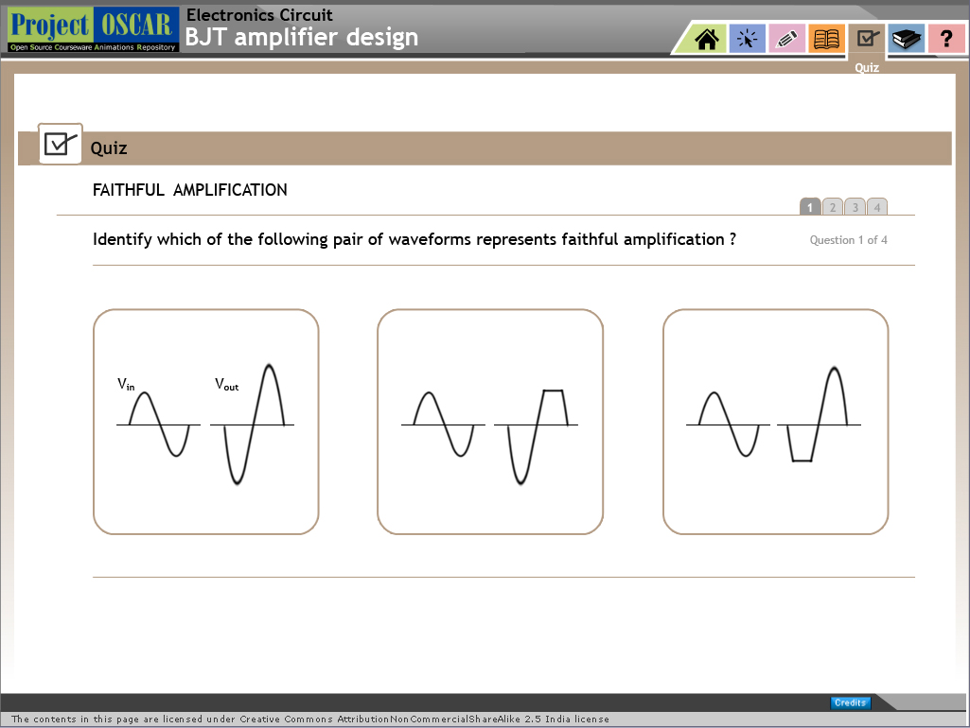
Specification 1
Specification 2
Connecting specifications
Amplifier
3
1 mV
Gain in dB
RO
RI
1K
10K
100K
1M
10M
Frequency
Q. The frequency response of the above amplifier is shown in the graph. Bandwidth of the amplifier is
1 KHz
3 KHz
0.999 MHz
1MHz
Try again.
Hint: Bandwidth is calculated as f2-f1.
Try again.
Hint: Bandwidth is calculated as f2-f1 where f1 and f2 are frequencies measured on the x-axis
You are right! Bandwidth of the given amplifier is f2-f1 = 1Mhz-0.001Mhz = 0.999MhZ
Try again.
Hint: Bandwidth is calculated as f2-f1.
Back
Scientific Abilities

Slide 43
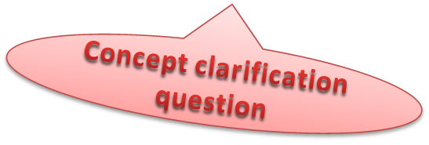


Q. Which of the following pair of waveforms represents faithful amplification ?
Look at the upper part of waveform – note that it is clipped, which shows distortion in output waveform. Hence output is not faithful amplification of input signal
Look at the lower part of waveform – note that it is clipped, which shows distortion in output waveform. Hence output is not faithful amplification of input signal
Look at both lower and upper part of waveform – note that they are clipped, which show distortion in output waveform. Hence output is not faithful amplification of input signal
You are right! This is perfect sine wave with no clippings at extremities and known as faithful amplification
Back
Try again
Scientific Abilities

Slide 44
Decision making tasks
Engineering design competencies
Scientific Abilities

Slide 45



Specification 1
Specification 2
Connecting specifications
Amplifier
INFO BOX
1 mV
3dB
Gain in dB
RO
RI
1K
10K
100K
1M
10M
Frequency
Q. Which of the following circuit combinations can provide a bandwidth of 0.99MHz? (Refer to info box if needed)
Single Stage BJT CE Amplifier
Two Stage BJT CE Amplifier
Single Stage FET CS Amplifier
Two Stage FET CS Amplifier
You need a high bandwidth. BJT cannot provide it. Refer to Info Box and try again
You need a high bandwidth. A single BJT provides low bandwidth and further increase in number of stages reduces bandwidth. Refer to Info Box and try again
You are right! FET amplifier can provide the needed high bandwidth. For more details refer to Info Box.
Single stage FET can provide high bandwidth but bandwidth reduces with increase in number of stages. Refer to Info Box and try again.
Back
Scientific Abilities

Slide 46
Specification 1
Specification 2
Connecting specifications
Q. Which of the following circuit combination will provide gain=1000 and bandwidth=100KHz?
Single stage BJT amplifier
Two stage BJT amplifier
Two stage FET amplifier
Gain of 1000 can not be achieved using single stage amplifier although bandwidth is achievable. Try again
You are right! Gain of 1000 can be achieved using two stage amplifier as well as bandwidth of 100 KHZ is achievable
FET as active device cannot provide gain of 1000 with single or two stages. Bandwidth available is approximately 1MHz try again
Back
Try again
Scientific Abilities

Slide 47
Information box
Engineering design competencies
Scientific Abilities

Slide 48


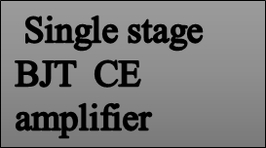
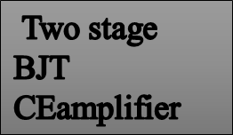
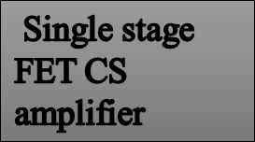
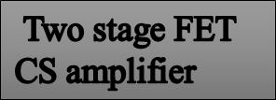
Specification 1
Specification 2
Connecting specifications
Amplifier
1 mV
INFO BOX
3dB
RO
RI
Gain in dB
F1=1K
F2=1MHz
1K
10K
100K
1M
10M
Frequency
Which of the following circuit combination can provide given bandwidth of 0.99MHz?
Bandwidth given by BJT is less in KHz. cannot provide high bandwidth .Refer to Info Box and try again
BJT as active device provide less bandwidth Further increase in number of stage reduces bandwidth. Refer to Info Box and try again
You are right! FET amplifier can provide high bandwidth .For more details refer to Info Box.
Single stage FET can provide high bandwidth but bandwidth reduces with increase in number of stage. Refer to Info Box and try again.
Try again
Scientific Abilities

Slide 49
INFO
BOX
BJT active device provides low bandwidth of order of KHz.
FET active device will have high bandwidth of the order of MHz
Increase in number of amplifier stages will decrease in bandwidth.
Back
Scientific Abilities

Slide 50
Design Tips
Engineering design competencies
Scientific Abilities

Slide 51
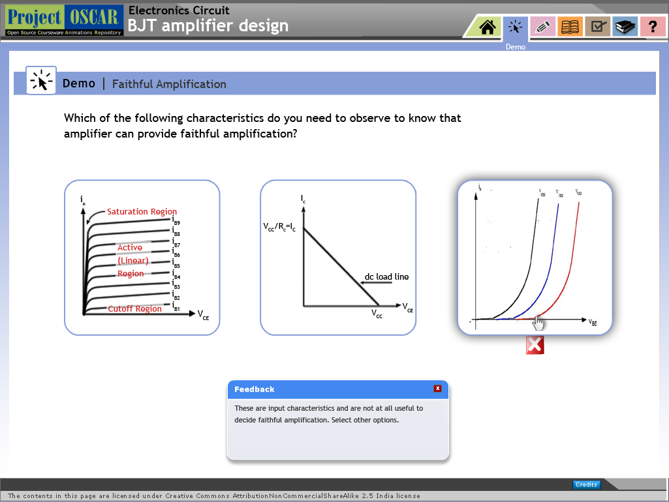
Design tips
Gain and bandwidth of given amplifier system is constant
Voltage amplifier requires high input impedance and low output impedance to avoid loading effect
Back
Scientific Abilities

Slide 52
Variable Manipulations
Engineering design competencies
Scientific Abilities

Slide 53
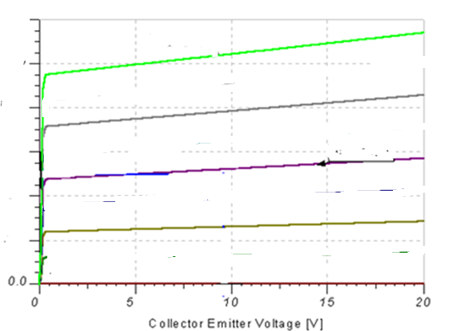
How will variation in Q point location affect faithful amplification?
Saturation region
40 µA
Change the location of Q point by selecting value of I_{BQ}
Click on the box to select value of I_{BQ}
4mA
30 µA
3mA
Collector Current( I_{C})
20 µA
2mA
10 µA
1mA
Cut off region
Back
Scientific Abilities

Slide 54

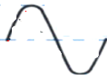
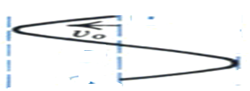
Saturation region
40 µA
  FIG.1
4mA
Collector Current( I_{C})
Input voltage
30 µA
3mA
20 µA
2mA
Q
10 µA
Q point is at
lower extremity and input goes to cut off region)
1mA
Cut off region
output current waveform
This is output waveform in which upper part of waveform is clipped ,hence does not represent faithful amplification
output voltage waveform
Vary Q point
Scientific Abilities

Slide 55


Input voltage
Saturation region
40 µA
Collector Current( I_{C})
  FIG.1
4mA
30 µA
Q point at the centre of load line
3mA
Q
2mA
20 µA
1mA
10 µA
output current waveform
Cut off region
output voltage waveform
This is perfect sine wave with no clippings at extremities and known as faithful amplification
Vary Q point
Scientific Abilities

Slide 56
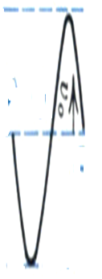
Input voltage
Q point at upper extremity and upper portion of input voltage saturates transistor
Q
output current waveform
Saturation region
40 µA
4mA
30 µA
  FIG.1
3mA
Collector Current( I_{C})
20 µA
2mA
10 µA
1mA
Cut off region
This is output waveform in which only upper portion of the waveform is present and lower portion is clipped ,hence does not represent faithful amplification
Vary Q point
output voltage waveform
Scientific Abilities

Slide 57
Collector
Current( I_{C})
For this location of Q point upper portion of the input just reaches to saturation
Saturation region
40 µA
Input voltage
4mA
30 µA
Q
3mA
20 µA
  FIG.1
2mA
output current waveform
10 µA
1mA
Cut off region
output voltage waveform
This is output waveform in which small part of lower portion of the waveform is clipped ,hence does not represent faithful amplification
Vary Q point
Scientific Abilities

