Slide 1

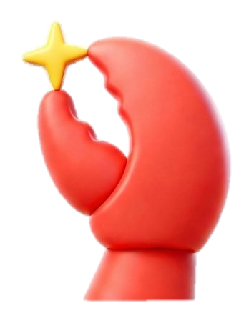
| Tech Management, SRI-B
CLAWS
CLASH OF THE
<College>_<Team Name>
<Tagline 1 liner of your idea>
<Members Name>

Slide 2
Idea
Problem Statement
Why you selected this theme ( Ondevice, Productivity, GenAI research) What problem are you solving
Who Faces it ( persona)
Why is it important
Any others
Keep it real, not generic

Slide 3
Idea
Current Solution & Gaps
Existing solutions( if any) What’s missing/broken
Opportunity
Keep it real, not generic

Slide 4
Idea
Your Solutions
What you built
Core Ideas Explanation
Key Features
Keep it real, not generic

Slide 5
Idea
Demo/Product Walkthrough
Screen/Flow How User Interacts
Key Moments
This is the most important Slide

Slide 6
Idea
Tech & Architecture
Tech Stack
AI usage( model, APIs, Framework) System Flow( simple)
Keep it real, not generic

Slide 7
Idea
Impact & Use cases
Real life scenario ->3/4 different
Scale Potential
Keep it real, not generic

Slide 8
Idea
Differentiation
Why your solution stands out
1-2 Strong MOAT
In business, a moat is a sustainable competitive advantage that protects a company from competitors and helps maintain long-term profitability

Slide 9
Idea
Demo Link
GitHub Repo Demo Link Document submitted

Slide 10
Idea
<Brownie Slide>
If you want to add something which is not added above, use this slide

