Slide 1
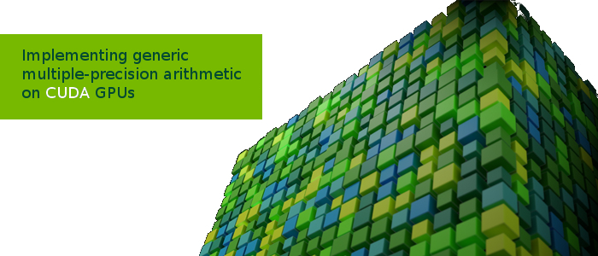
Semester Project Presentation
Alexandre Carlessi
Sahand Kashani-Akhavan

Slide 2
Why GPU?
Traditionally used for graphics
Specialized in parallel processing of independent data
Computational throughput has increased rapidly
Scientists are now starting to use them for high performance computations (simulations, research, …)

Slide 3
What is CUDA?
Framework made by NVIDIA to promote use of GPUs for computations
C++ extension
Allows programmer to access GPU memory
Can create custom computational kernels

Slide 4
Our Project
Learning GPU programming through experimentation to see what works best
Experiment: multiple-precision arithmetic

Slide 5
Goals
Wanted implementation to be
Re-usable
Have configurable precision
Efficient
No need of user knowledge about internals (like a library)

Slide 6
First steps
Started implementing everything in C
Advantages:
Pre-processor can make custom code
Downside:
Not enough low-level control (e.g. cannot access carry bits easily)
Hard to avoid thread divergence and optimize simultaneously
Pre-processor can only create one version of the optimized code

Slide 7
Initial Solution
Assembly
Advantages
Good low-level control
Not hidden behind a compiler: we know exactly what's going on
Downsides
Hard to debug
Like C, only one version of optimized code

Slide 8
Chosen Solution
Meta-programming using scripts.
Use scripts to generate precision-specific optimized assembly code (handles corner cases)
Advantages?
Power of assembly
Configurable output
Straight-line unrolled assembly
Multiple versions of optimized code

Slide 9
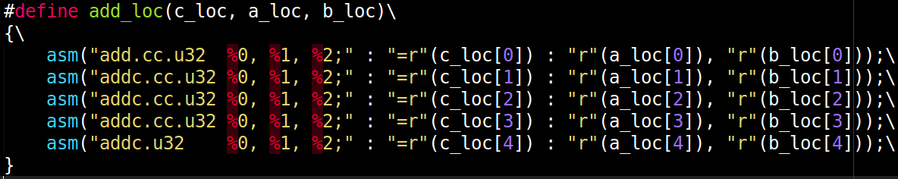

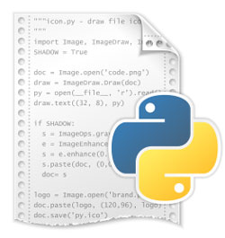



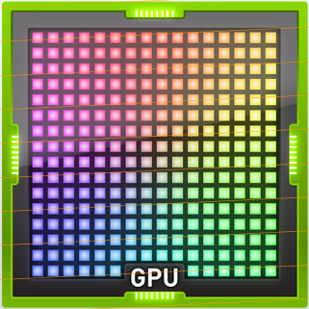
Our Framework
operations.h
constants.py
Precision
Bits per word
Output file
Block & thread count
…
operator_generator.py
nvcc -arch=sm_30 file.cu
Network transfer to lacalgpu2.epfl.ch
execution

Slide 10
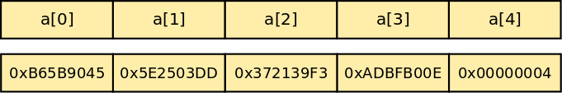
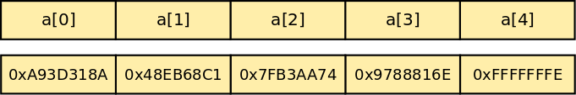
Implementation
Number representation
Unsigned integer array
Uses primary data type of device for efficiency
Two’s complement representation

Slide 11
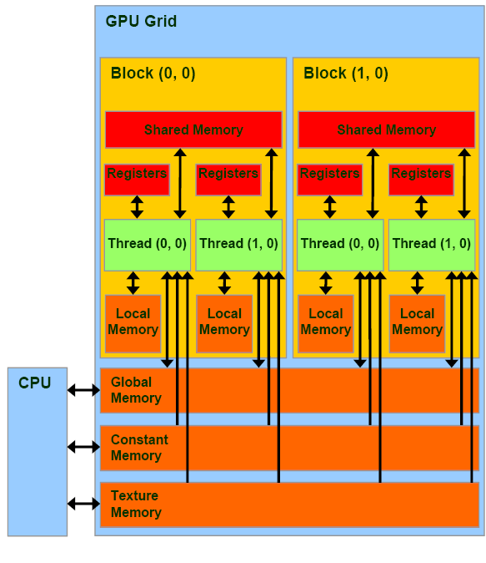
Operation Memory Access
2 versions of each operator
Differ in operand addressing
“global” operator: expects data to be in global coalesced memory
“local” operator: expects data to be in local non-coalesced memory

Slide 12
Implemented Operations
Addition
Subtraction
Multiplication
Karatsuba Multiplication (1-level)
Modular Addition
Modular Subtraction
Montgomery Reduction*
* unfinished

Slide 13
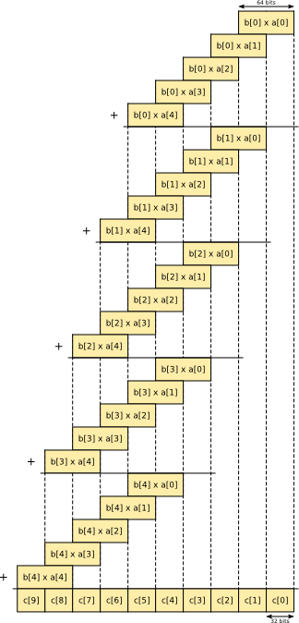
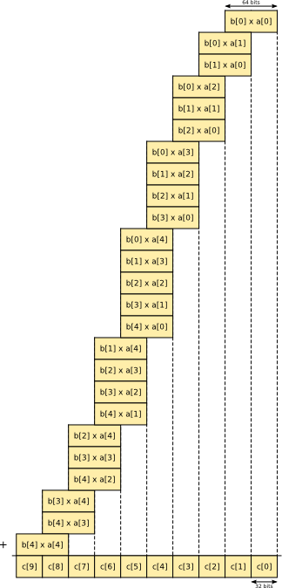
Multiplication

Slide 14


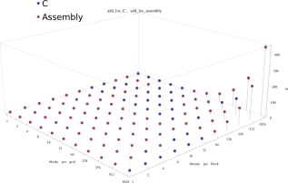
Benchmark Infrastructure
compile
->
Executable
GMP
Generate coalesced bignum arrays
nvprof
nvprof --print-gpu-trace --normalized-time-unit us executable
mathematica
<-
Benchmark results

Slide 15
Benchmarks
Involve 10 consecutive executions of an operation.
Types of benchmarks
Assembly vs. C (addition kernel only)
Local vs. global memory access
Importance of operand layout in memory
Classical vs. Karatsuba multiplication
Kepler vs. Fermi execution time
Warp occupation

Slide 16
Warp Occupation Results
Better to have less blocks, where more threads are used.
Must keep warp occupation full, at least 32 threads.
If not, then resources are wasted.

Slide 17
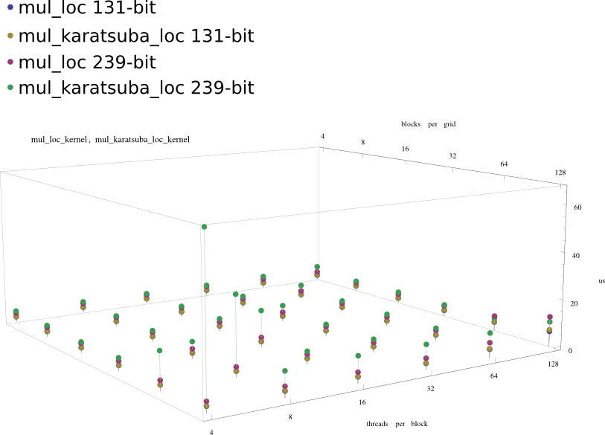
Karatsuba vs. Classical Multiplication and Warp Occupancy

Slide 18
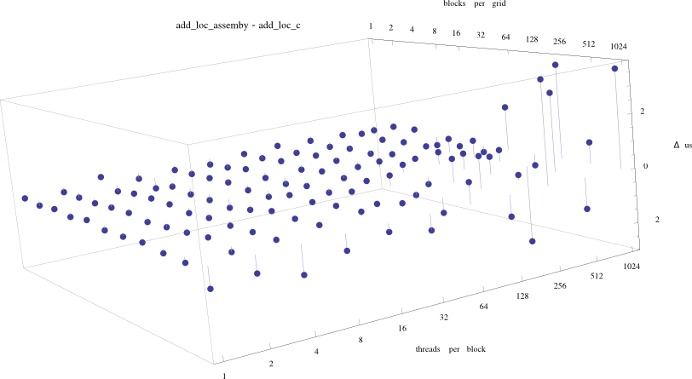
Assembly vs. C

Slide 19
Operator verification
Like benchmark infrastructure
Operation results recovered from server
Checked for errors with GMP on host

Slide 20
Conclusion
Project was tedious to start
Hard time debugging
First hands-on experience
Great fun learning

Slide 21
… it was only the beginning
Montgomery multiplication
Modular exponentiation
Modular inversion
Use arithmetic to implement some algorithms (RSA, Pollard’s Rho, …)

Slide 22
Questions?

Slide 23
Thanks

