Slide 1
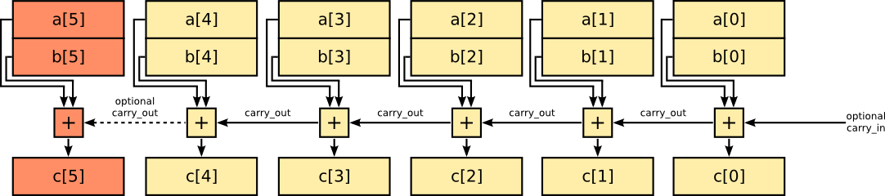
Addition / Subtraction

Slide 2
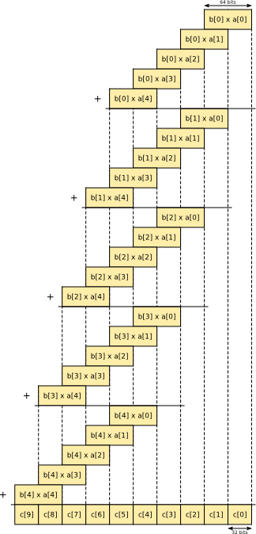
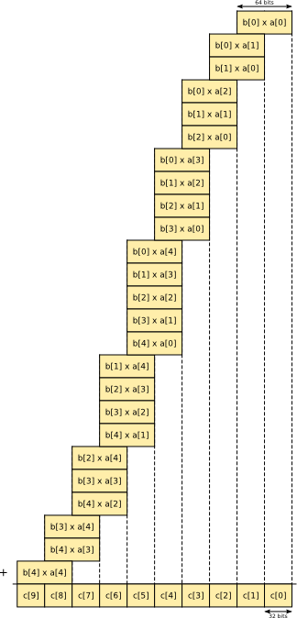
Multiplication

Slide 3
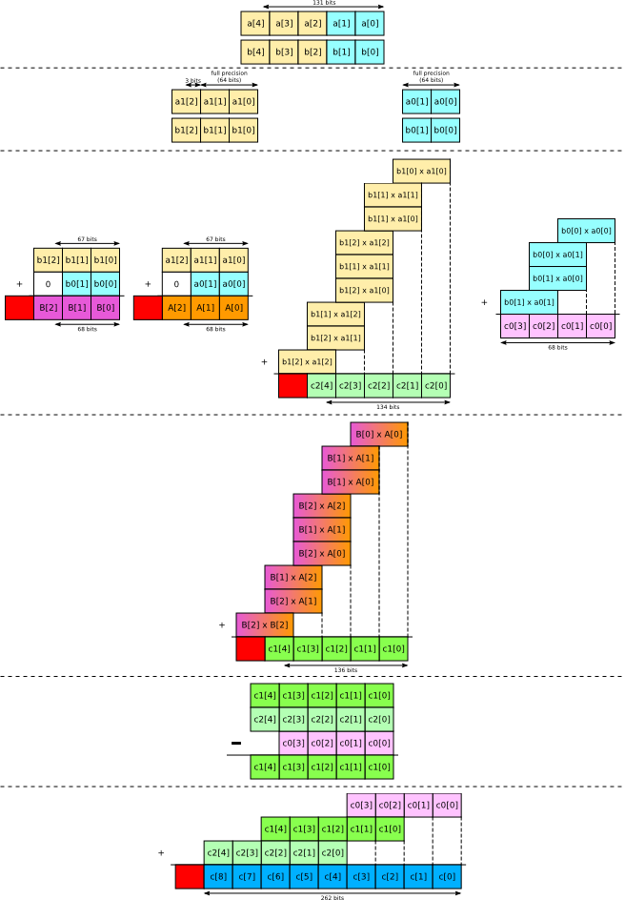
Karatsuba Multiplication

Slide 4
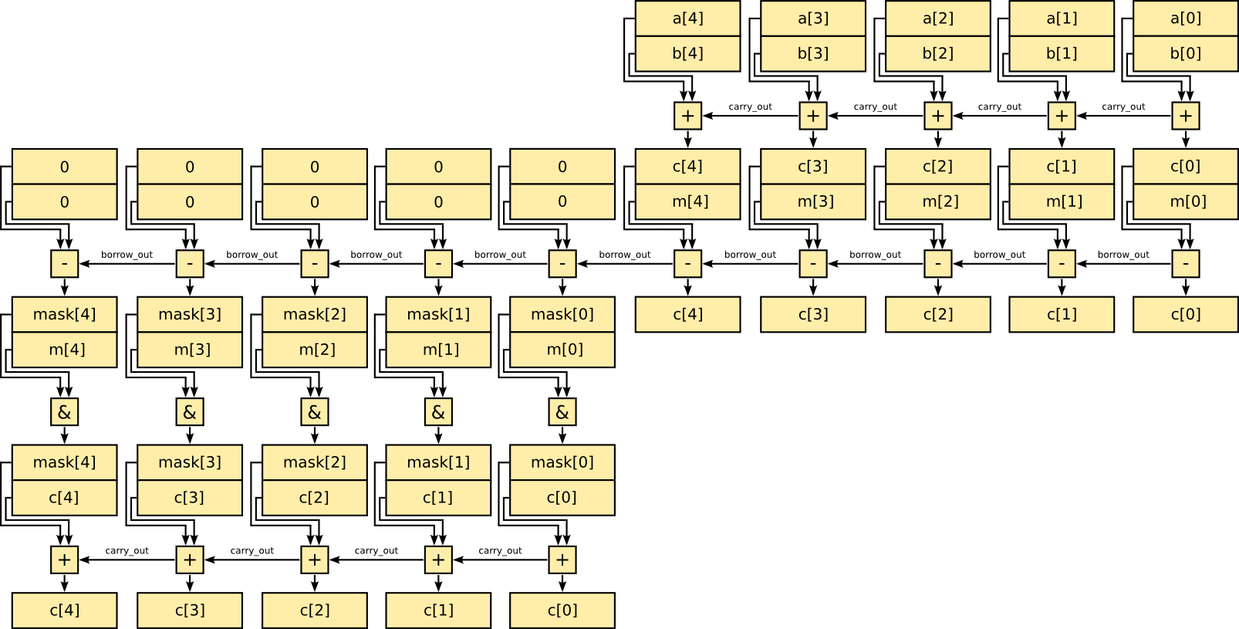
Modular Addition
Hypothesis: a, b < m
c = a + b
c = c – m
mask = 0 – borrow mask = mask & m
c = c + mask

Slide 5
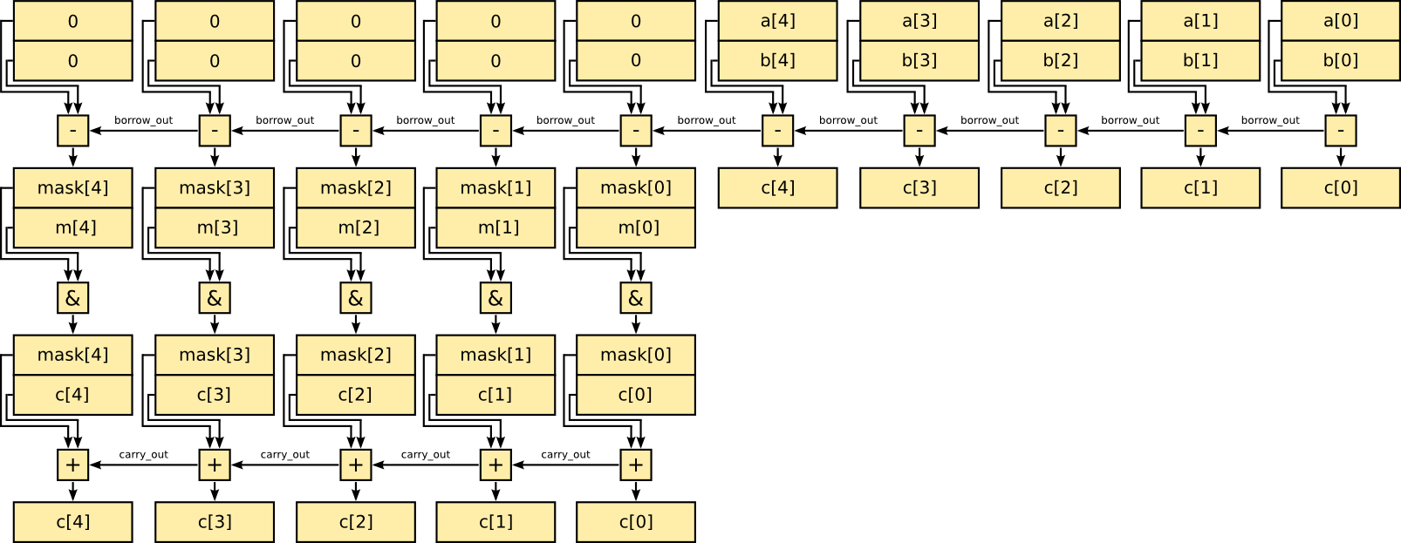
Modular Subtraction
Similar to modular addition
Hypothesis: a, b < m
c = a – b
mask = 0 – borrow mask = mask & m
c = c + mask

