Slide 1
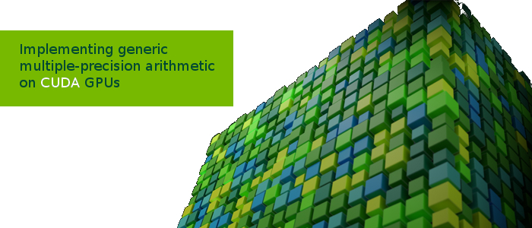
Semester Project Presentation
Alexandre Carlessi
Sahand Kashani-Akhavan

Slide 2
Why GPU?
Traditionally used for graphics
Specialized in parallel processing of independent data
Computational throughput has increased rapidly
Scientists are now starting to use them for high performance computations (simulations, research, …)

Slide 3
What is CUDA?
Framework made by NVIDIA to promote use of GPUs for computations
C++ extension
Allows programmer to access GPU memory
Can create custom computational kernels

Slide 4
Our Project
Learning GPU programming through experimentation to see what works best
Experiment: multiple-precision arithmetic

Slide 5
Goals
Wanted implementation to be
Re-usable
Have configurable precision
Efficient
No need of user knowledge about internals (like a library)

Slide 6
First steps
Started implementing everything in C
Advantages:
Pre-processor can make custom code
Downside:
Not enough low-level control (e.g. cannot access carry bits easily)
Hard to avoid thread divergence and optimize simultaneously
Pre-processor can only create one version of the optimized code

Slide 7
Initial Solution
Assembly
Advantages
Good low-level control
Not hidden behind a compiler: we know exactly what's going on
Downsides
Hard to debug
Like C, not configurable either

Slide 8
Chosen Solution
Meta-programming using scripts.
Use scripts to generate precision-specific optimized assembly code (handles corner cases)
Advantages?
Power of assembly
Configurable output
Straight-line unrolled assembly
Multiple versions of optimized code

Slide 10
Our Framework

Slide 11
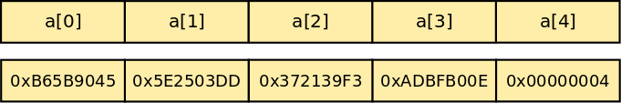
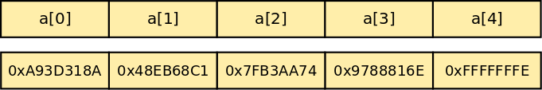
Implementation
Number representation
Unsigned integer array
Uses primary data type of device for efficiency
Two’s complement representation

Slide 12
Operation Memory Access
2 versions of each operator
Differ in operand addressing
“global” operator: expects data to be in global coalesced memory
“local” operator: expects data to be in local non-coalesced memory

Slide 13
Implemented Operations
Addition
Subtraction
Multiplication
Karatsuba Multiplication (1-level)
Modular Addition
Modular Subtraction
Montgomery Reduction*

Slide 14
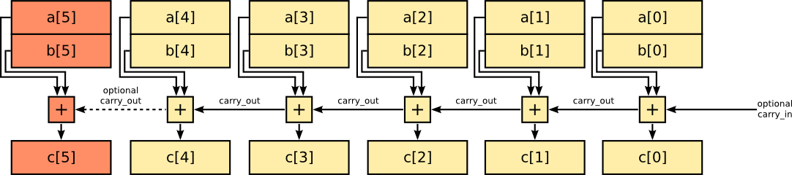
Addition / Subtraction

Slide 15
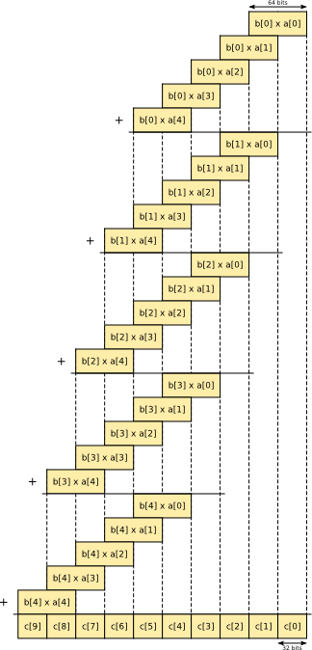
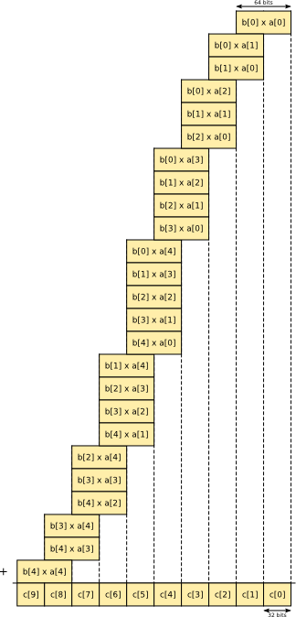
Multiplication

Slide 16
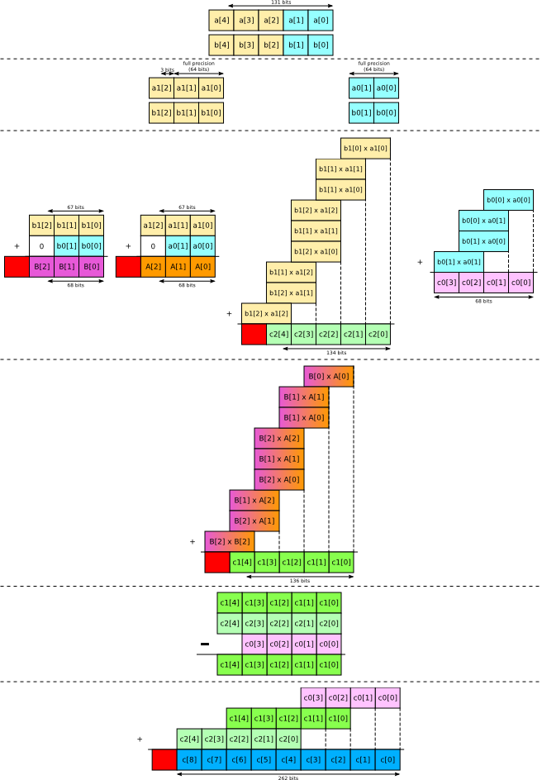
Karatsuba Multiplication

Slide 17
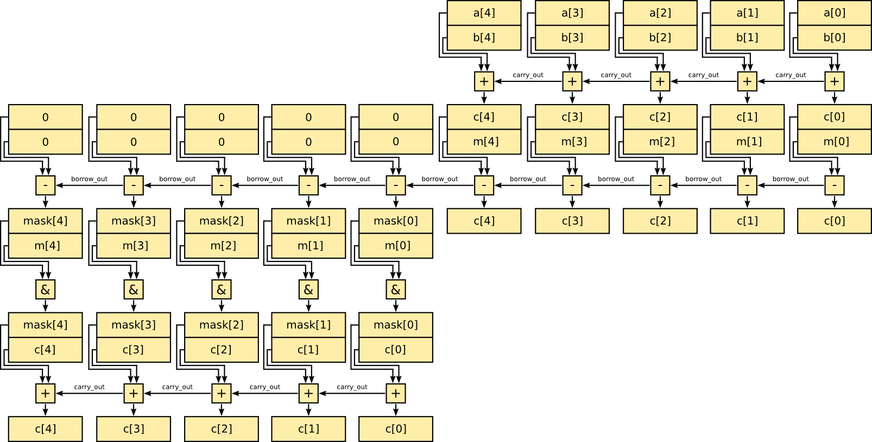
Modular Addition
Hypothesis: a, b < m
c = a + b
c = c – m
mask = 0 – borrow mask = mask & m
c = c + mask

Slide 18
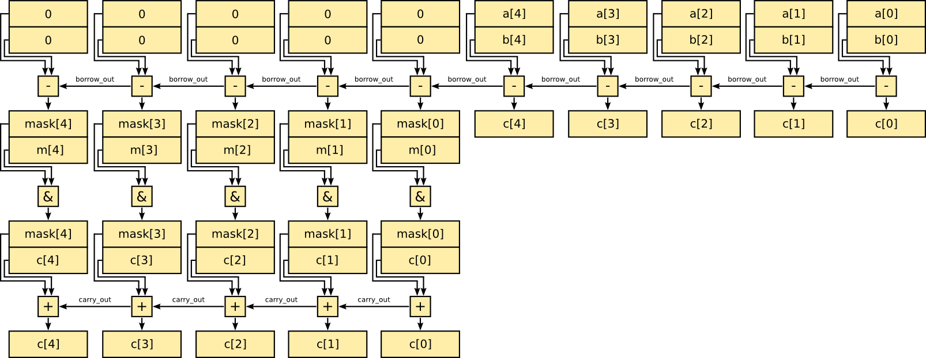
Modular Subtraction
Similar to modular addition
Hypothesis: a, b < m
c = a – b
mask = 0 – borrow mask = mask & m
c = c + mask

Slide 19
Benchmark Infrastructure

Slide 20
Benchmarks
Involve 10 consecutive executions of an operation.
Types of benchmarks
Local vs. global memory access
Importance of operand layout in memory
Classical vs. Karatsuba multiplication
Kepler vs. Fermi
Warp occupation

Slide 21
Warp Occupation Results
Better to have less blocks, where more threads are used.
Must keep warp occupation full, at least 32 threads.
If not, then resources are wasted.

Slide 22
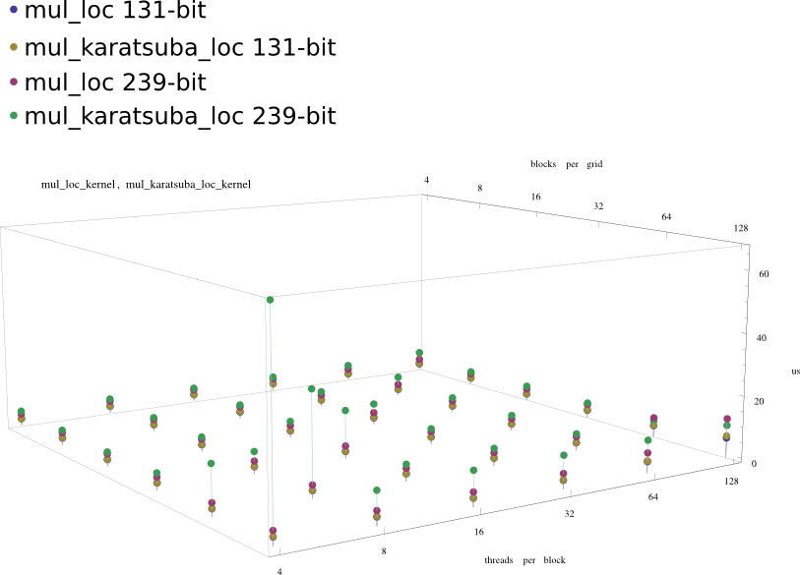
Karatsuba vs. Classical Multiplication and Warp Occupancy

Slide 23
Operator verification
Like benchmark infrastructure
Operation results recovered from server
Checked for errors with GMP on host

Slide 24
Conclusion
Project was tedious to start
Hard time debugging
First hands-on experience
Great fun learning

Slide 25
Questions?

Slide 26
Thanks

